Slide 1
Monitoring UHC

Slide 2
Proposed Common Framework

Slide 3
What it recommends
Focus on service coverage and financial risk protection
  National level and disaggregated (equity)
    Financial risk protection
    Impoverishing and catastrophic OOPE
    Service coverage
    Preventive and curative

Slide 4
Catastrophic expenditures
measures the incidence of financial hardship caused by health payments—ie, the number of households with health spending that is large relative to their ability to pay
Some subtract food spending from consumption – Capture that poorer HH have less resources for non-food needs. E.g. 40%
  Overlooks other non-discretionary spending—eg. clothing, shelter, and heating—maybe more important than food expenditure
  Use total consumption as ability-to-pay measure. E.g. 10% and 25%

Slide 5
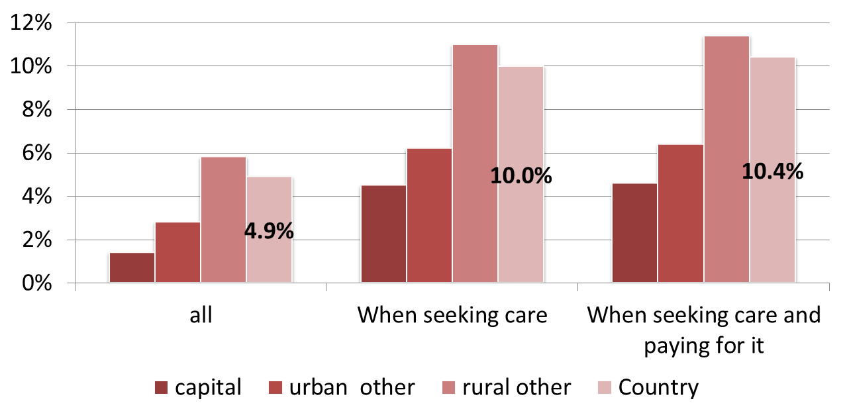
Incidence catastrophic OOPE
–care or not

Slide 6
Impoverishment
health spending that causes extreme hardship by pushing families below the poverty line
depth of poverty, - extent to which out-of-pocket health payments worsen a household’s pre-existing level of poverty,

Slide 7
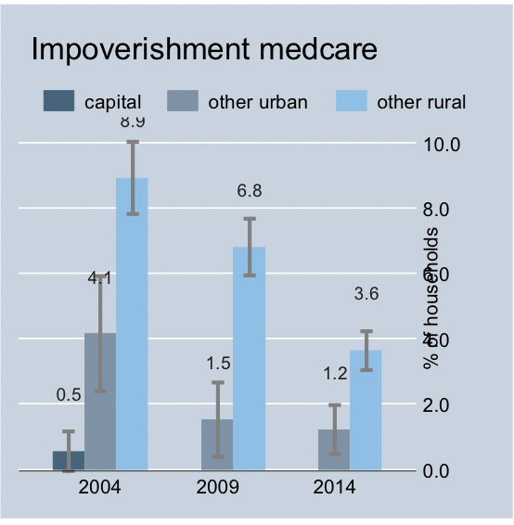
Impoverishment
-place of residence

Slide 8
Coverage of essential health services –
Indicators
Health interventions:
Relevance: condition is a priority, the intervention is cost-effective, and the health condition potentially imposes major health expenses.
Quality: information is available about the quality of the services.
Availability: information used to measure the indicators is reliable, regular and available using existing instruments.

Slide 9
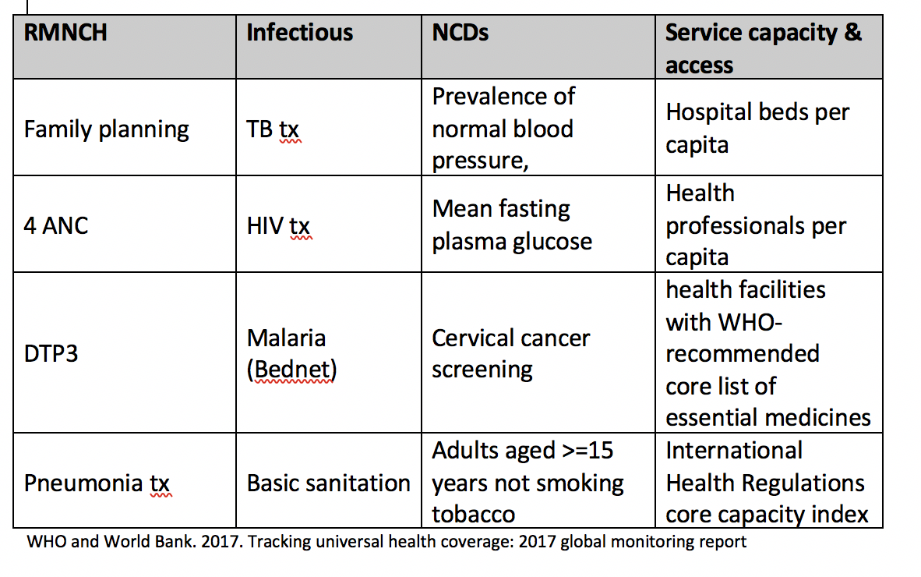
Selected health services

Slide 10
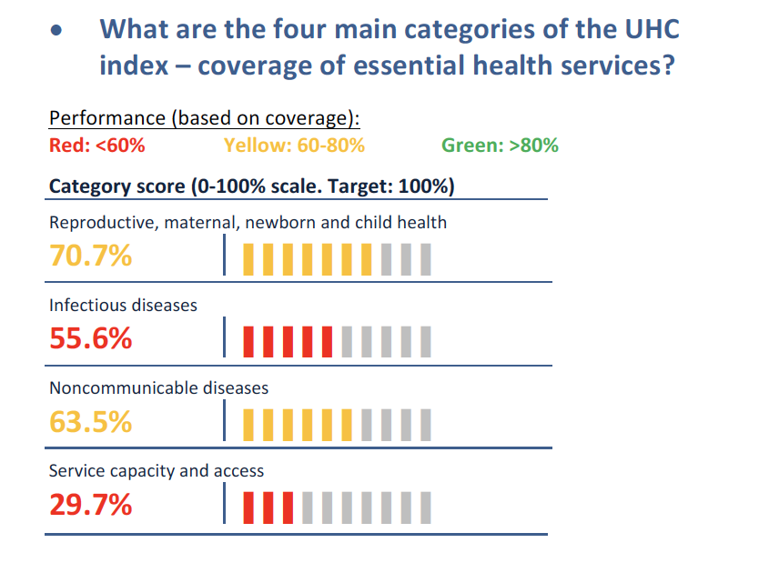
Cambodia’s performance
-services

Slide 11
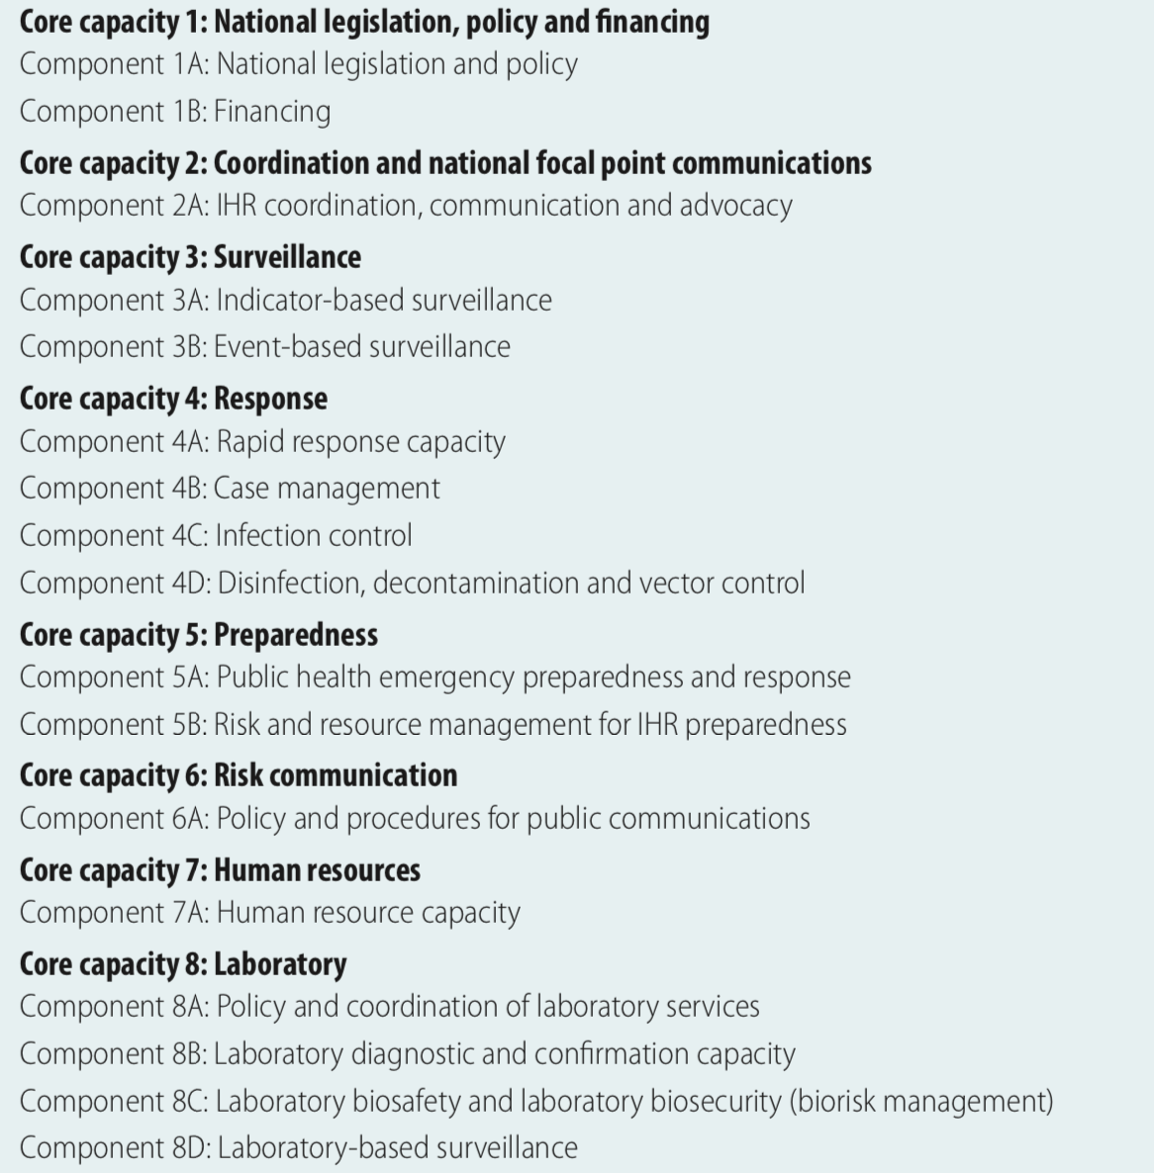
Core capacities and components of the International Health Regulations

Slide 12
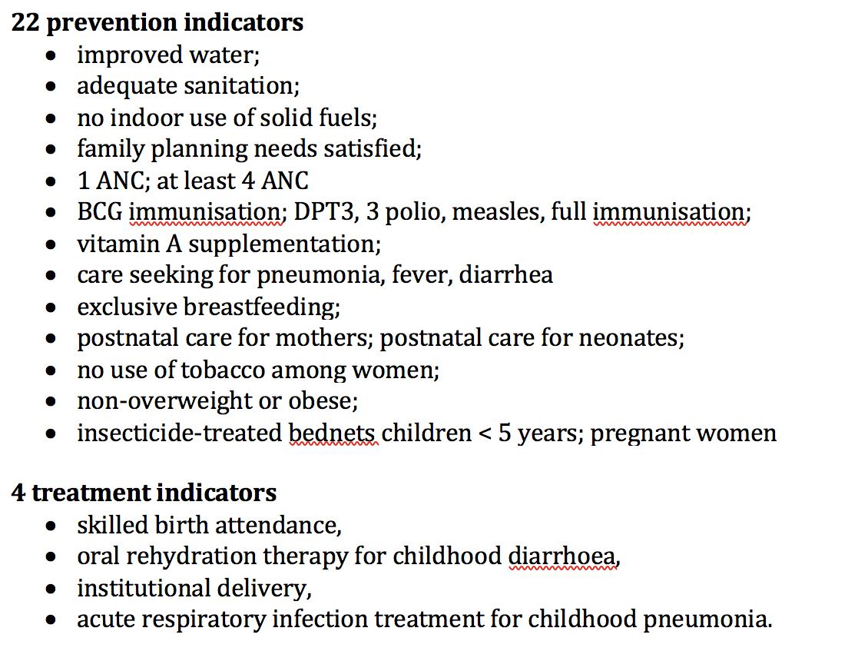
Myanmar’s approach
Su Myat Han, Md Mizanur Rahman, Md Shafiur Rahman, et al. Progress towards universal health coverage in Myanmar: a national and subnational assessment. Lancet Glob Health 2018; 6: e989–97

Slide 13
What is planned
Training NIPH and GS NSPC in calculating financial risk protection
Handling secondary data set, esp. CSES
Calculating financial risk protection
Equity analysis

Slide 14
Outstanding issues and proposed
Adjusting CSES
Poverty line
Indicators for service coverage
WHO
Somil?
JLN?

