Slide 1

Delivering health services benefits under single national health insurance system
Krzysztof Landa, M.D.

Slide 2
FIELD A
Funds from the primary contribution (health premium), tax
BASIC BENEFIT PACKAGE
FIELD B
cheap
expensive
A + B = ACTUAL NEGATIVE BP

Slide 3
Pricing – the most important regulatory mechanism of HI
„Partially guaranteed”
= partially covered BP
(theoretically 1-99% co-payment or a HI
trully 20-80% copayment or aHI)
100% out of pocket payments or aHI
( „not guaranteed”)
>120%
BBP
regulation by pricing

Slide 4
Basic Benefits Package / BBP
A defined or undefined set of health technologies (health care services, drugs, medical devices or medical procedures in specified indications) to which patients are entitled within basic health insurance (for the basic premiums)

Slide 5
Benefits Package
A set of health care services or medical procedures:
which may be performed within health insurance of a specific type (regardless of the way the services are financed) or
which are excluded from the scope of specific health insurance.

Slide 6
Every country with health insurance has BBP
Modified example from the study of Pia Schneider Economist (Health), in 2001 the Director of Europe and Central Asia Region of The World Bank
7 USD premium per person per year in Rwanda
      1 visit at primary care physician a year
      Transportation to a hospital in health urgency
      3 basic antibiotics
____________________________________________________________________________
30 USD premium in Cambodia

Slide 7
Poland
Serbia
Drugs - Reimbursement List
Drugs - Reimbursement List – A, B, C, D
Ambulatory Care
Secondary and Tertiary Care
Drug
Programms
Higly Specialized Procedures
Higly Specialized Procedures
Chemotherapy regimens catalogue
Hospital catalogue
Dentistry care
Dentistry catalouge
Prevention Programms
Primary Care
Primary Care
Prevention Programms
Vaccination catalouge

Slide 8
Present distribution of the various types of interventions
Do more harm than good
Za J.A. Muir Gray, Director of Research and Development, NHS Executive, Anglia and Oxford Region.
„Evidence-Based Healthcare”
Do more good than harm
Of unknown effect

Slide 9
What does a decision-maker want to know?
Is this technology of proven efficacy and what is its safety profile?
What is the strength of intervention in comparison to optional ones? (which is the most efficacious option and what are the differences)
Which is the most cost-effective option and what are the differences?
Is coverage of the intervention possible in respect to available resources? What changes should we expect if the technology gets a privileged market position?

Slide 10
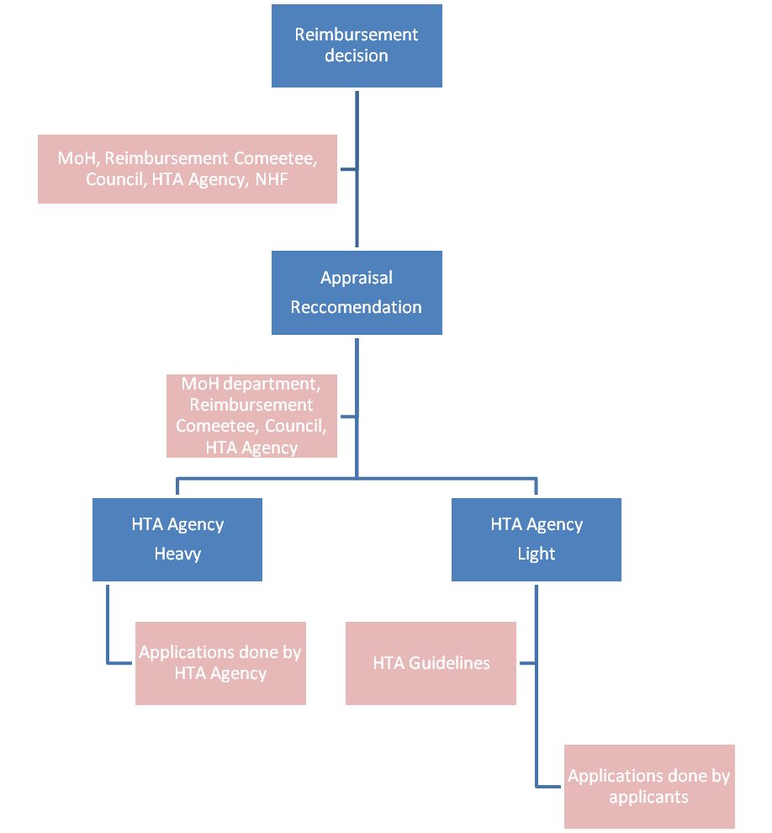
Evidence based coverage decision-making
– general proces with examples

Slide 11
The need for HTA
    In the long run no country can afford anything else than cost-effective technology
    Modified after: Prof. Egon Jonsson
    The former Director of SBU
    (SBU is the Swedish HTA Agency)

Slide 12
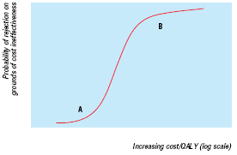
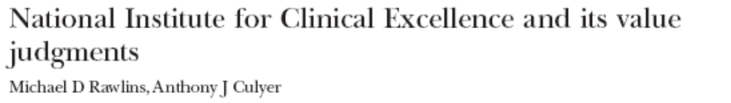
BMJ publication on cost-effectiveness thresholds by Prof. Sir Michael Rawlins

Slide 13
B
1/ willingness to cover
C
A
Switzerland
Cost per QUALY / cost per LYG
Rwanda
UK
Hungary
Cambodia
Serbia

Slide 14
Decision Options of the ELK (source: the Swiss Federal Office for Social Security SFOSS):
Coverage granted Decisions
Yes Reimbursement without restrictions
Yes R. for specific indications
Yes In medical centers which have to fulfil certain requirements
Yes In centers + evaluation registers
Yes In evaluation (by ELK)
No In evaluation (by applicant)
No Refusal

Slide 15
Types of co-payment
„Trifles”:
3 pln to a visit
10 pln to hospital addmission
HIGH POLITICAL RISK BUT NO CURE FOR THE SYSTEM
Deductibles
(Udział własny)
High amount
co-payments

Slide 16
The inclusions to BPs based on – TRANSPARENT CRITERIA!
50-70% unanimous opinion of specialists in respect to well established health services (lack of disagreement)
20-30% comparative analyses of efficacy and safety based on systematic reviews
10-20% comparative economic evaluations and budget impact analyses

Slide 17
RMED
Reimbuserment Mode for Economic Development

Slide 18
Defining problems - main concerns
How to attract pharma industry to invest in Polish economy?
What is of the greatest importance to Polish economy in pharma? Which pharma companies can be named „friendly” (the most valuable) to Polish economy?
How to use already available resources in a better way - with no extra money?
How to make it in a transparent & simple way (KISS) but also as a very strong enhancement factor?
How to use resources on drug reimbursement in a way to enhance investments of pharmaceutical industry and production of drugs in a given country?

Slide 19
RTR / RMD – criteria of partnership to Polish economy
Cost on R&D (preclinical >> clinical)
Export
Employment (wages, numbers)
Taxes
Any other?
High certainty of data provided to the Ministry of Economy under criminal liability

Slide 20
REIMBURSEMENT MODE FOR DEVELOPMENT (RMED) APPLICATION
RMED APPLICATION
as pricing and reimbursement criterion
for setting mark-ups
for development of official practice guidelines, standards and algorithms
as a obligatory criterion for central public tenders

Slide 21
Generics & biosimilars
Recognition of pharmacological (better compliance) and technological innovations

Slide 22
RTR / RMD – categories and coefficient
RMD criteria / Total points (example – not decided yet) | RMD categories | RMD coefficient (example scale)
0-100 | A | 1.0
100-200 | B | 0.8
200-300 | C | 0.5
300-500 | D | 0.3
>500 | E (empty box) | 0.1

Slide 23
RTR (refundacyjny tryb rozwojowy)
RMED (reimbursement mode for economic development)
C_{new} x RMD – C_{comparator}
ICUR =
U_{new} – U_{comparator}
Participants of the HTAi Policy Forum in Barcelona 2017: „simple & elegant idea”

Slide 24
Thank you for your attention
Thank you for attention
Krzysztof Landa, M.D.
Landa@meritumla.com
+48 501162763

