Slide 1

Ministry of Healthcare of the Republic of Kazakhstan
Concerning measures to improve
the list of the state guaranteed benefit package
Astana, June 2018

Slide 2
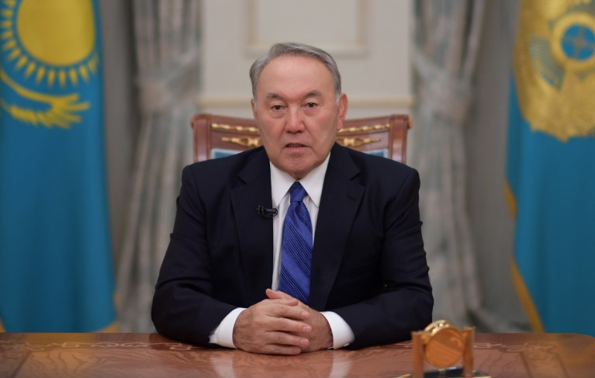

Global trend: to provide universal health coverage and manage chronical non-infectious diseases
State of the Nation Address by the President of the Republic of Kazakhstan Nursultan Nazarbayev, January 10, 2018
Modern health care should focus more on disease prevention rather than on expensive hospital treatment.
It is necessary to develop a new model of the guaranteed scope of free medical care by defining clear boundaries of state obligations.
People will be able to receive services not guaranteed by the state by becoming a member of the system of compulsory social health insurance or through voluntary medical insurance as well as co-payment.
Generally accepted international standard: universal heath coverage
Access to quality health services;
Access to safe, efficient and financially affordable drugs and vaccines, and financial risk protection

Slide 3
Demographic trends: increased live expectancy, changing age-sex composition, high impact of chronic non-infectious diseases
Expected life expectancy – 72,4 years (in 2016. 6,3 years increase since 2006), forecasted increase of this indicator
Population increase of the most intense recipients of medical services: children (23% increase by 2025, from 5,6M to 6,9M people), elderly (41% increase by 2025, form 1,9M to 2,8M people)
Chronic noninfectious diseases are the major causes of death and disability among population (cardio-vascular diseases, cancer, respiratory diseases, diabetes, etc.). 5,8M patients with chronic diseases are registered for dispensary care in Kazakhstan (2017)
Major causes of life-years loss due to diseases and disabilities in Kazakhstan between 1990-2010 (Lancet, World Bank, 2011)
Top 5 population mortality causes’ distribution in Kazakhstan 2016
(74% of total mortality cases)
Other chronic noninfectious diseases
Cardiovascular diseases
DIabetes
Traumas
Infectious diseases and nutrition malfunctions
Maternity and child

Slide 4
Due to insufficient funding of state guaranteed benefit package, citizens are forced to bear significant health expenditures that can lead to poverty
State guaranteed benefit package deficit dynamics and population’s out-of-pocket health expenditures
Total health expenditures in Kazakhstan (3,7% of GDP) are significantly lower than in countries with same level of development (6% GDP).
The share of private expenditures on health is 41% that is twice higher than maximum threshold recommended by WHO (20%)
More than 30% of private expenditures are spent on procurement of self-paid health services declared within SGBP framework.
(National health accounts for 2017, preliminary report)
SGBP deficit
Out-of-pocket private expenditures
SGBP expenditures
RECOMMENDED HEALTH EXPENDITURES (6% OF GDP)
3,1T KZT
Medical services payed out-of pocket by population (G KZT) |  |  | State-paid medical care deficit (G KZT)
Medical services |  | 236,4 | 308,7
 | Inpatient care | 58,4 | 126,1
 | Outpatient care | 146,7 | 164,3
 | Rehabilitation | 11,3 | 18,3
 | Dental services | 19,6
Drugs and medical equipment |  | 404,3 | 41,9
 | Drugs | 299,2 | 41,9
 | Medical equipment | 105,1
Other services |  | 37,3 | 11,9
Total |  | 678 | 362,5
STATE GUARANTEED BENEFIT PACKAGE DEFICIT 362,5G KZT
PRIVATE EXPENDITURES
678,0G KZT
STATE GUARANTEED BENEFIT PACKAGE
940,1G KZT

Slide 5
Consumption of primary care and clinical diagnostics
Registered consumption of primary healthcare services in 2017: 47,8M visits
17,3M
visits
15,9M
visits
4,6M
visits
7,5M
visits
7,1M
visits
prophylactical
Due to disease
At home
Dispensary patients
Dispensary observation of 5,8M patients with chronic diseases doesn’t meet quality standards:
  Annual visits frequency of primary care facility - 1,2 visits per patient instead of 2 visits per patient required.
  Demand of diagnostic services (≈96G KZT) is not factually backed up by budgeted financing.

Slide 6
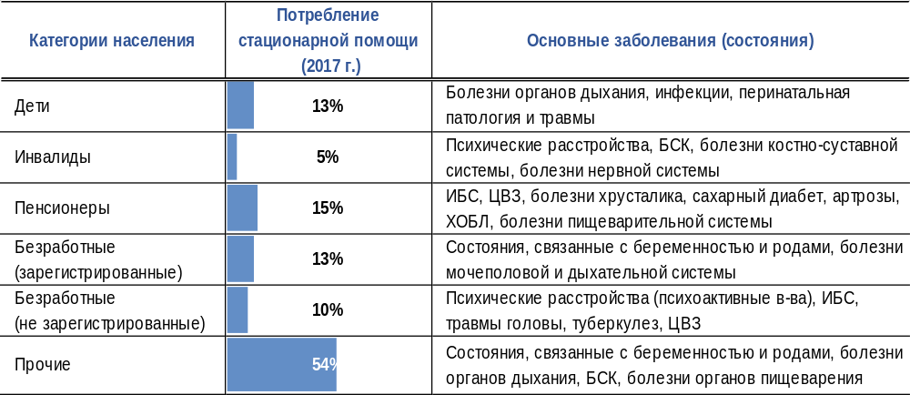
Consumption of inpatient care and daycare: the main consumer of hospital care is economically inactive population
Population categories
Inpatient care consumption
(2017)
Major diseases and conditions
Children
Respiratory diseases, infections, perinatal pathology and traumas
People with disabilities
Psychological disorders, cardiovascular diseases, osteoarticular diseases, diseases of nervous system
46%
Elderly
CAD, cerebrovascular disease, diseases of eye lens, diabetes, arthroses, Chronic obstructive lung disease and diseases of digestive system.
Unemployed (registered)
Conditions related to pregnancy and labor, diseases of genitourinal and respiratory system
Unemployed
(not registered)
Psychological disorders (psychotropic substances), cardiovascular diseases, head injuries, TB, Cerebrovascular diseases
Others
44%
Conditions related to pregnancy and labor, diseases of cardiovascular, respiratory and digestive systems
Among patients who has received inpatient hospital treatment (≈ 2,9M treated cases):
  By hospitalization types 68% of all cases– emergency hospitalization
  By social status 46% of patients are preferential social groups of population (in compliance with Law «About Mandatory Social-Medical Insurance”) who receive 47% of allocated budget on inpatient care
  By disease types 24% (698,9k cases) – chronical noninfectious diseases
  Approximately 20% of treated cases – could be successfully treated in daycare facility
Among patients received the day care (≈ 1,12M cases):
  By consumer categories – 61% of population are welfare beneficiaries (in compliance with the law “About MSHI”)
  By disease categories – 42% (471,4K people) patients with chronic diseases registered for dispensary care

Slide 7
Consumption of rehabilitation and palliative care
Structure of patients who did not receive necessary 2nd and 3rd stage rehabilitation
(180,5K patients, 2017)
After severe nervous system injury
Primary pulmonary hypertension
Welfare beneficiaries : 53%
Not registered unemployed: 13%
Bone-marrow injury
After keyhole surgeries
Rheumatic valvular heart disease
Post-surgery treatment of deformations and fractures of vertebra
Cardiomyopathy
Brain injuries
Post-operation after joint replacement
Myocardial infraction
After limb bone fracture
Post-surgery
Angina (angina pectoris)
Planned budget (under current tariffs) doesn’t consider factual demand on rehabilitation and palliative care, covering only:
  20% of rehabilitation cases (cardiology, cardiosurgery, neurology, orthopedics)
  34% cases for palliative care (cancer, TB, terminal stage of organ failure, etc.)

Slide 8
Solutions: establishment of a three-level healthcare delivery system, based on staged introduction of new SGBP model
Optimization of SGBP
Comprehensive list of dynamically observed and socially significant diseases
Exclusion of outdated methods
Comprehensive list of diagnostic services
  NEW MODEL OF SGBP
  (basic services)
ADDITIONAL SERVICES:
paid services,
voluntary health insurance,
co-payment
MSHI
(atop SGBP and new services)
Regular updates of SGHP and MSHI
MSHI PACKAGE:
atop SGBP and new services
I STAGE
II STAGE
III STAGE
  Draft of Government resolution
  Draft of the law “About MSHI”
NEW SGBP MODEL:
basic health services
Introduction
of MSHI
* SGBP will associate with minimal social standard (The law of the RK «About minimal social standards and their guarantees

Slide 9
I STAGE: Major optimization directions of SGBP
Primary care
Diagnostics
Inpatient care
Dispensary disease list was optimized
from 259 to 29 diseases
959 outdated and inefficient services
were excluded
769 diagnostics and 529 surgeries and manipulations to be treated in daycare facilities
Increase access of population with demographically harming diseases to primary care units
Decrease burden of medical workers
Increase access and quality of diagnostics of demographically harming diseases
Decrease inpatient care expenditures
Increase access to cost-effective daycare treatment
Dynamical observation does NOT include:
Osteochondrosis
Iron-deficit anemia
Deforming osteoarthrosis
Nonincarcerated hernia
Hydrocephalus
Alzheimer disease
Nonrheumatic arthritis and others
Excluded:
Consultations: transplantologist, anesthesiologist, Immunologist, clinical pharmacologist, reflexologist, dietarian and others
Services: Manual biochemistry, microbiology on analyzation, EIA, STD, CLIA and others
Excluded:
Iron-deficit anemia, conjunctiva, Chronic bronchitis, gastritis, dermatitis, arthritis and othersхронический
Eye surgery, tonsillectomy, excision of varicose veins, arthroscopy, laparoscopically excision of hernia, incision and drainage of an abscess, and others
9

Slide 10
Healthcare services distribution of SGBP and MSHI
NEW MODEL OF SGBP
Healthcare for EVERY PERSON with emergency or acute condition
    Control over SOCIALLY SIGNIFICANT diseases.
MSHI PACKAGE (FOR INSURED CITIZENS)
Healthcare to improve quality of life of EVERY PERSON,
Foundation for the future generations’ health
For all citizens
  Emergency care and air medical services
  Primary care
  Emergency day care and inpatient hospital treatment
  Palliative care
For people with socially significant and
major chronic diseases
  Diagnostics
  Outpatient drug provision
  Planned day care and inpatient hospital treatment
  Rehabilitation for patients with TB
Diagnostics
  Periodic screening of adult population
  Specialized screening of children
  Expensive lab and diagnostic services
Outpatient drug provision atop SGBP
Day care for diseases on top of SGBP
Planned inpatient care for diseases on top of SGBP
Rehabilitation for adults and children by following categories: cardiology. cardiosurgery, neurology, neurosurgery, traumatology, orthopedics.

