Slide 1
Health financing policies and strategies for UHC in Europe –
some experiences and thoughts from a diverse continent
Professor Konrad Obermann MD PhD
Mannheim Institute of Public Health
Heidelberg University
Astana, 19th of June 2018

Slide 2
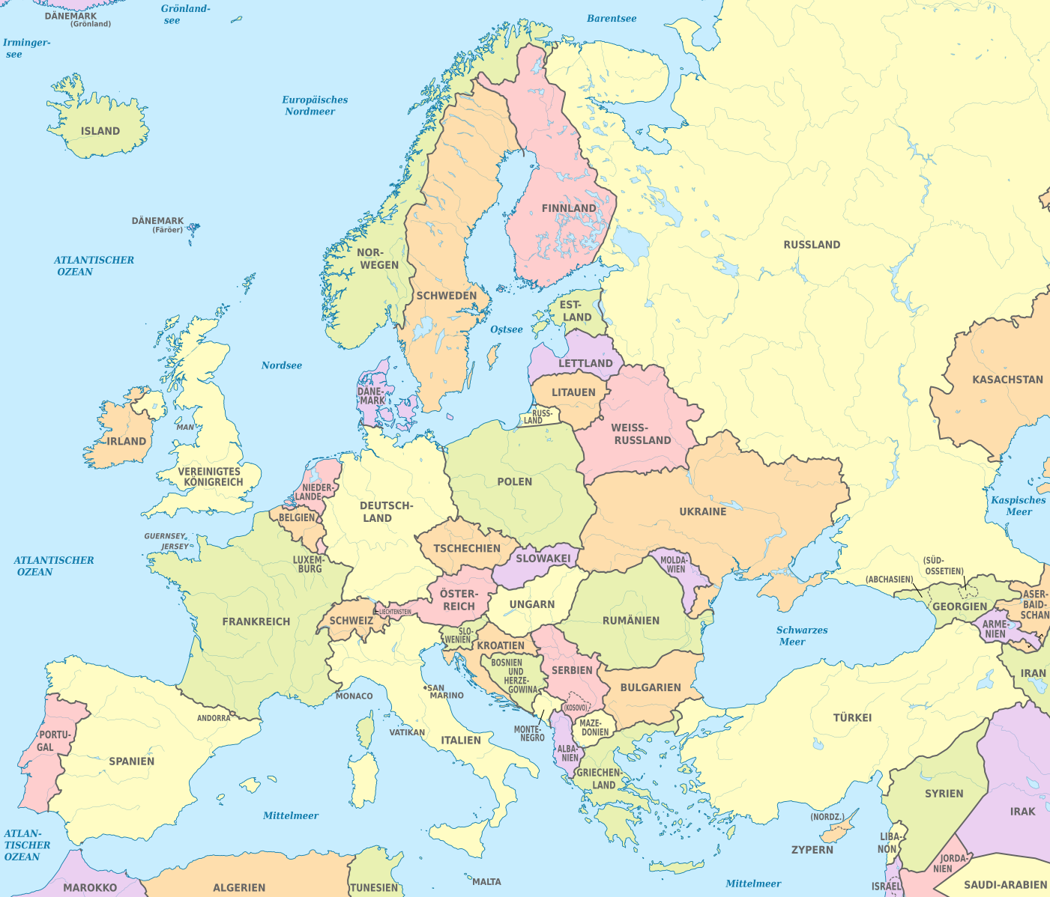
What is Europe?
Ural
Mountains
Geography
(Philip Johan von
Strahlenberg, 1730)
“Europe is an idea”
(Bernard-Henri Lévy)
Area: 10.1m km²
(Russia: 17m km²
Kazakhstan: 2.7m km²)
Population: 742m
Caucasus
Mountains
Dardanelles

Slide 3
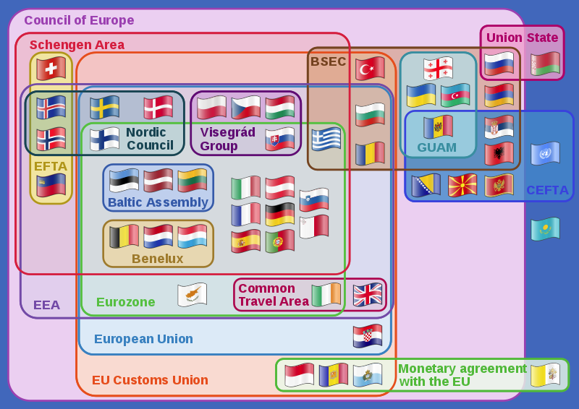
Europe is diverse
Number of countries:
Ranging from 48 - 52
Isle of Man
Holy See
Kosovo
GDP per capita
(USD, 2016)
Luxembourg: 106,000
... Moldova: 1,800
Size (’000 sq km)
Germany 348
... Monaco 0.01
Population (m)
Germany 82,5
... Monaco 0.03
24 official EU languages
ca. 130 languages spoken

Slide 4
So what is Europe when it comes to health care?
Europe has a long history of enlightenment and fighting for individual liberty
and citizen rights ...
... but is also somewhat quaint (11 of the 29 worldwide ruling monarchs
are from Europe)
Health systems often build up on local responses to needs
and local collaboration / unions
Governments control the financing and delivery of health care
Mostly a single payer system, be it state-funded or via social health insurance,
which could be either a single institution or a multitude of (competing) insurers
What works and doesn't work in practice?
Where to look for useful and applicable solutions?
Differentiate between political, technical and administrative questions

Slide 5
Co-payments
Key functions
Reimbursement
Human Resources
Pay for performance
Admin structure
Purchasing
eHealth
Health Tech. Assess.
Key processes
Service delivery
IT
Quality of care
Pharmaceuticals
Marketing
...
Fraud and corruption
Pooling
Mostly a one-off structural decision
...
Revenue generation
Whom to include in mandatory coverage
Identification of poor
Subsidies
Political
Technical
Administrative
Enrolment
Unified database
...

Slide 6
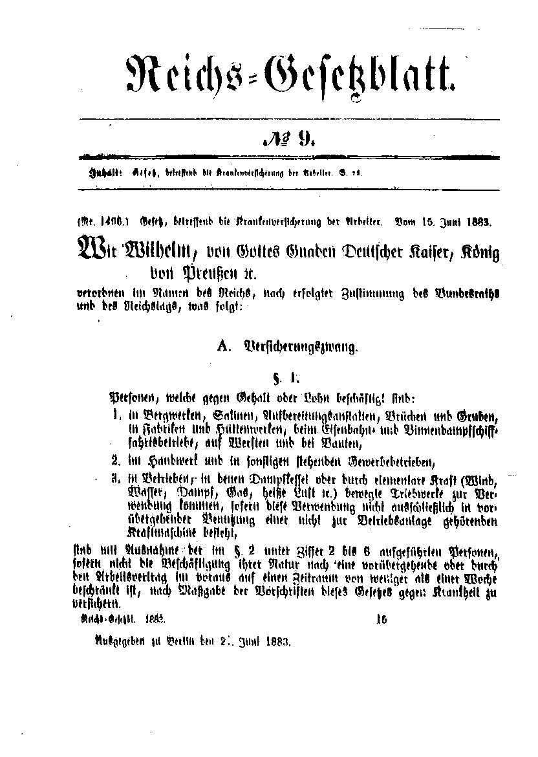
Political: It started with an Imperial Message laying the ethical foundation of SHI ...
Message of Kaiser Wilhelm I to the Reichstag November 1881
“Already in February of this year We voiced our conviction that the healing of the social damage cannot only be sought through the repression of social riots, but equally on the positive promotion of the welfare of the workers. We consider it our Imperial obligation to again recommend warmly this task to the Reichstag, and we would look back with much greater satisfaction to all the success with which God has obviously blessed Our government, if we were to raise awareness on this issue and bring the fatherland new and permanent guarantees of its internal peace and to help those in need with greater security and efficiency of the assistance to which they are entitled.
...
For such assistance it is a difficult task to find the right ways and means, but also one of the highest responsibilities of any community, based on the moral foundations of the Christianity. The close connection to real life forces of this nation and the merging of the latter in the form of corporate co-operatives under state protection and state support will, as we hope, make the solution of tasks possible that the state alone to the same extent could not provide .
Source: Obermann et al., 2016

Slide 7
Higher earner can choose between SHI and PHI leading to adverse selection
... leading to a fundamental financing flaw
Who
How
Where
Employees with annual income < 50.800€ (Versicherungspflichtgrenze)
includes dependents (non-working wife, children)
Students
Unemployed
mandatory insurance
statutory
health insur.
Employees with annual income > 50.800 €
Self employed
most civil servants
Choice
private
health insur.
0.7 dependents
per member
voluntary insurance
0.3 dependents
per member

Slide 8

Political: Balanced Systems
Policy
Self Administration
Independant Surveillance
Federal Ministry of Health
Policy, Laws, Guidelines, Monitoring
Joint Federal Committee
Self-Admin Doctors/Hosp/Ins
Expert Advisory Board
Review Development in H/S
H/C quality &
efficieny (IQWiG)
Supreme Fed. Authorities
PHI
SHI
Med. Service
(cases review)
Plan / Supervision
Disease Prevention+Control
(Robert-Koch-Institut)
Assoc. Statut.
H/Insurance
Physicians (KV)
State Ministries Health
Hospital Plan, Environmental Health, Securing H/C
Drugs/Vaccines Quality-Safety
(Paul-Ehrlich-Institut)
Drugs/Med. Devices License
(BfArM)
Federal
Chamber
of
Physicians
(BÄK)
District / City Health Departments
Public Health, Infectious Control
Privately
insured Pt‘s
Socially
insured Pt‘s
Health Promotion+Education
(BZgA)
Med. Documentation & Info
(DIMDI)
PHC: Private Practices
145,000 physicians
Publicly & privately owned Hospitals
18.8m Inpt‘s, 500,000 beds, 175,000 physicians
Risk Assessment
a.o. Food Safety, Poisoning (BfR)
PHI Private Health Insurance SHI Social Health Insurance HC Health Care

Slide 9
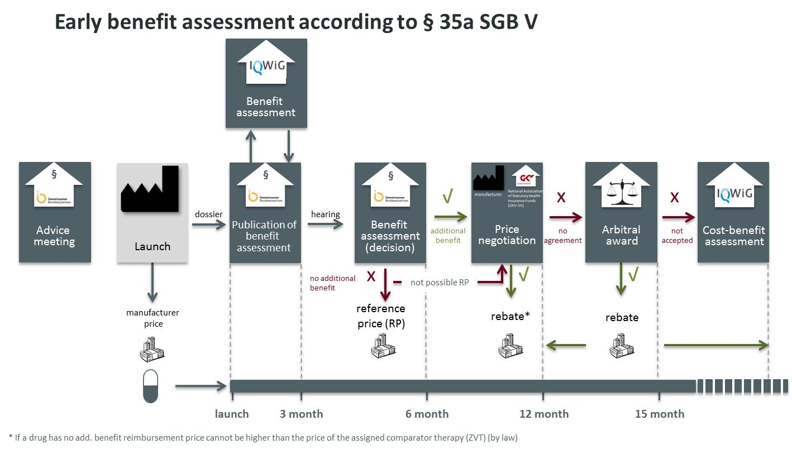
Technical: Managing drug prices without the QALY
Source: Smartstep-consulting.de

Slide 10
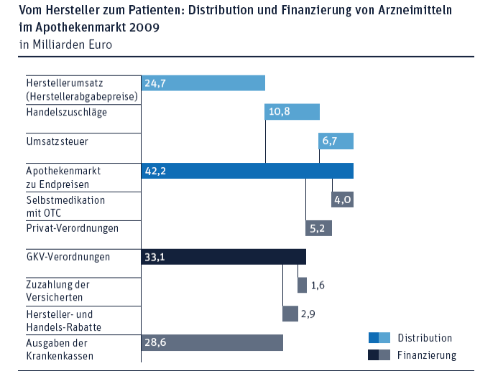
Technical: Very high distribution cost for pharmaceuticals
21.000 privately
owned pharmacies
Total distribution cost:
EUR 10.8bn

Slide 11
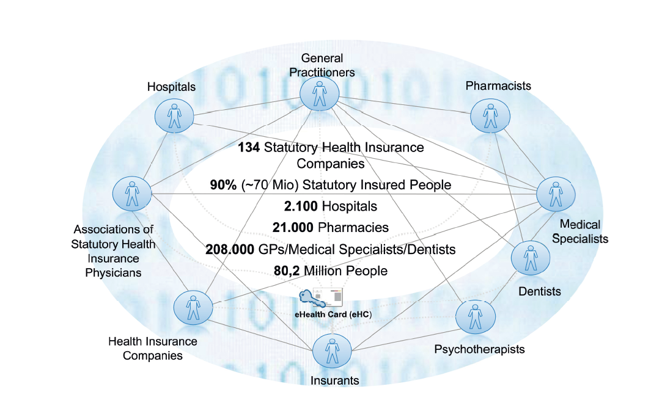

Administrative: The e-Insurance Card did not move forward when left to the self-administration
Joint venture of
the self-administration
partners
Source: Obermann et al., 2016

Slide 12
Administrative: Members and employers own the SHIs, can in principle elect the oversight Board
CEO of the
fund
Administration
elect
Board of directors
50 / 50
elect
Insured
members
Employers

Slide 13


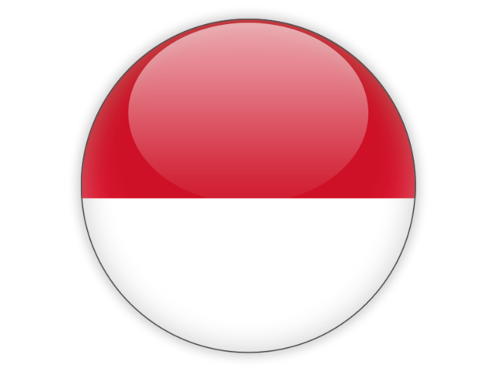





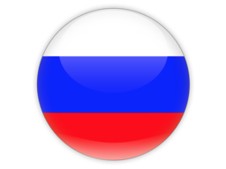
...
Co-payments
Detailed analysis required
Reimbursement
Pay for performance
eHealth
✗
Health Tech. Assess.
✓
Service delivery
Quality of care
Pharmaceuticals
✗
Identification of poor
Subsidies
Enrolment
Unified database
Human Resources
Admin structure
✓
Key processes
IT
Marketing
Fraud and corruption

Slide 14

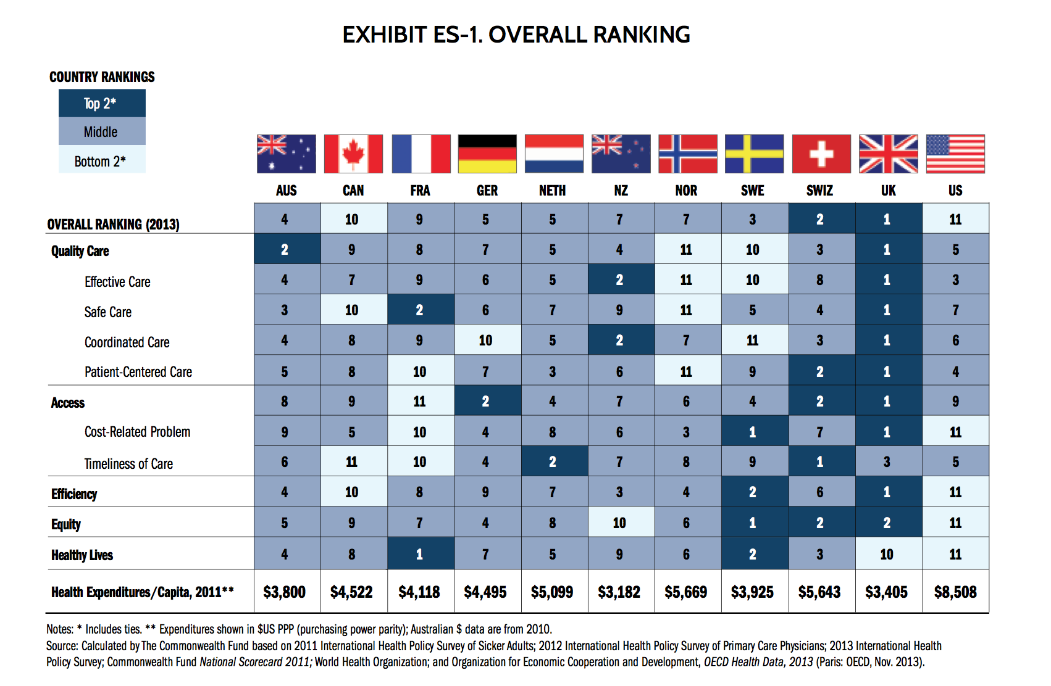
Some final thoughts (I): Be wary of rankings
“Better be vaguely right than precisely wrong” (JM Keynes)

Slide 15
Some final thoughts (II): Misperceptions of UHC
UHC (100% coverage, 100% necessary quality care, 100% financial protection) is essentially an unattainable goal (ask any country with an advanced health system) – “UHC as a permanent political struggle rather than a point-in-time technical goal” (Richard Horton, Lancet, April 7, 2018)
The quest for UHC needs to be complemented with strong (vertical) public health program in order to achieve significant health improvements for a population

Slide 16
Some final thoughts (III): Finding a national way
“The 1990s reforms demonstrate, however, how an emphasis on internationally developed health economics theories to design a health system can lead to major problems, especially where local context, values, costs of change, and political factors are not adequately considered. These reforms cost New Zealand significant sums of money, distracted the sector’s attention away from key issues, and have been shown to be detrimental to health outcomes. The reforms have left a legacy of a major aversion to significant organisational reform in the New Zealand health sector that is still evident today.”
Cumming J: Health Economics and Health Policy: Experiences from New Zealand
Appl Health Econ Health Policy 2015

Slide 17
Thank you! info@konrad-obermann.de

