Slide 1

Major Health Financing/Protection Issues in Asia
Eduardo Banzon
Principal Health Specialist
Asian Development Bank

Slide 2
The GOOD news

Slide 3
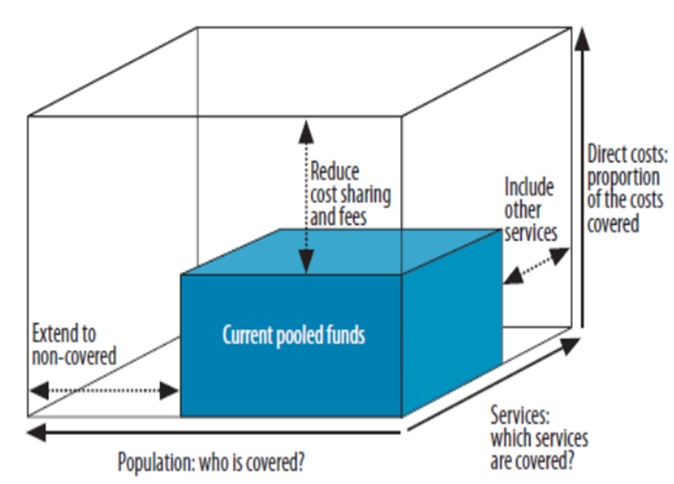
Asia and the Pacific countries are pursuing
Universal Health Coverage (UHC)

Slide 4
Countries of Asia and the Pacific are investing more on health, in real terms
Source: authors

Slide 5
Source of inefficiency
Type of inefficiency
Addressing inefficiencies
Lack of organizational incentives
Soft budget constraint
Single purchaser
Financial autonomy and active purchasing
Training & additional capacity
Personnel restrictions
Skills & capacity gap
Contracting out
Limited competition & higher prices
Centralization of procurement
Procurement restrictions
E-Procurement
Notes:
Summary table

Slide 6
Source of inefficiency
Type of inefficiency
Addressing inefficiencies
Underfunding & misallocations
Minimum funding threshold
Budget restrictions
Budgetary autonomy
Individual inefficiencies
Less competition & agency problem
Personnel incentives
Outsourcing
Process reforms
Bureaucratic behavior and risk aversion
Red tape
Autonomy
Notes:
Summary table

Slide 7

BREAKING NEWS : Investing in National Health Insurance (NHI) Systems
From Korea and Thailand to…
Philippines
Indonesia
Viet Nam
Laos
Mongolia
India
Pakistan
others

Slide 8
NHI
Common features in Asia:
  A national agency or body serves with more or less autonomy from the state, sometimes even as a legal entity apart from the government
  This organization operationalizes health financing functions by ensuring citizens’ financial protection, and purchasing health services and goods on behalf of a population.
  Potential to carry a stewardship function for the whole health system, and provide an opportunity for efficiency gains in each sub-function that is beyond operations by the public sector.
Often referred to national health insurance, national health service, national hybrid health insurance, national health fund, national social security fund …

Slide 9
BUT…

Slide 10
NHI may aggravate Fragmentation

Slide 11
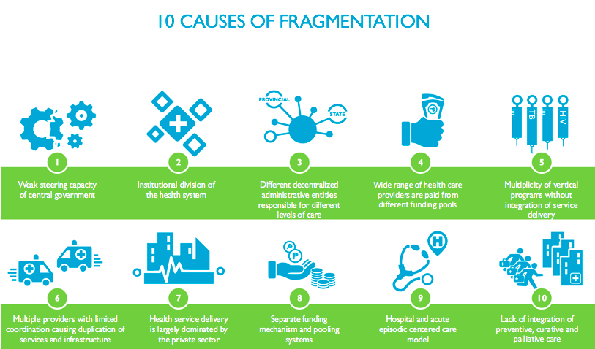

Slide 12
NHI is not automatically equivalent to Strategic purchasing

Slide 13
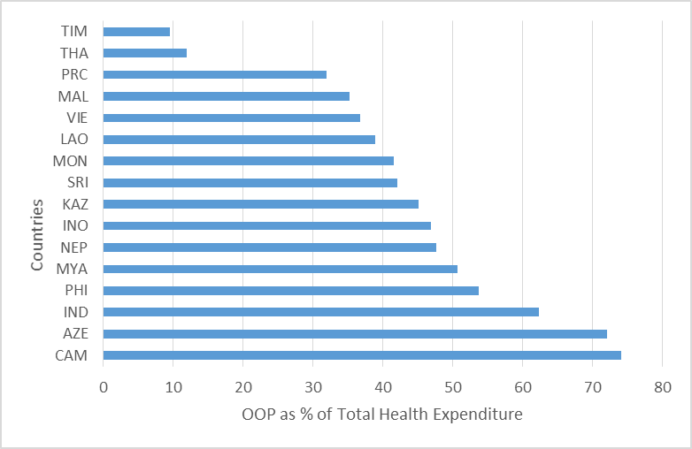
High Out of Pocket (OOP) spending continue to persist in a number of countries in Asia and the Pacific
Source: WHO Global Health Observatory, 2014

Slide 14
Not your usual skills and capacities
Contracting/ Managing health care providers and sub-national
Costing/ financial management
Digital health
Determining and measuring quantity an quality of care
Managing capitation, case rate, pay for performance and other payment systems which is not line-item budget, salary and unregulated fee for services
Making financial autonomy work in hospitals and health care providers
Management/governance of a separate health fund

Slide 15
money for UHC/nHI is not enough

Slide 16
Great stories
Incremental revenues from increased sin taxes funding NHI
Expansion of employers/employees contributing to NHI
Central government funding pulling in sub-national counterpart funding
Part of VAT paying for NHI
Increased allocation from national/sub-national budgets for NHI
Moving away from voluntary payments/contributions from NHI

Slide 17
But spending for health is not enough
Source: WHO Global Health Observatory, 2014

Slide 18
SUPPLY-SIdE readiness to NHI and a changing world

Slide 19
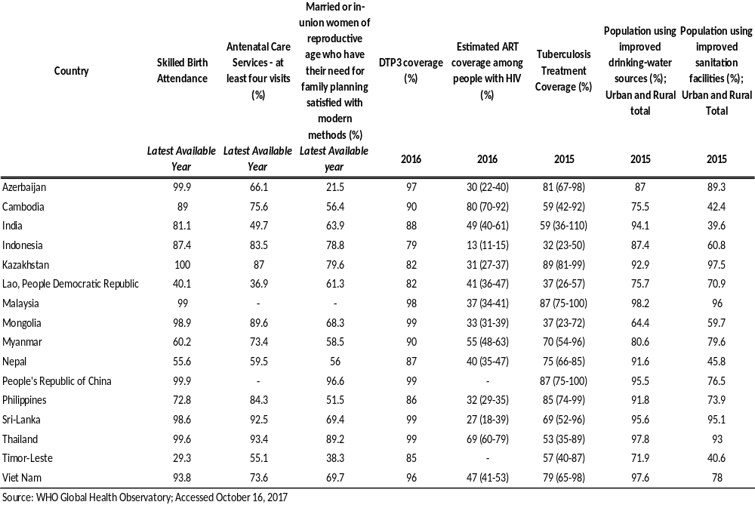
Gaps in Health Service Coverage

Slide 20
Forward-looking hospitals and health service delivery
Hospitals are still designed for acute care, young population and a mostly communicable disease burden
Need to transform hospitals to be be inclusive, resilient and safe, and green and climate-smart which can provide chronic care, address the needs of aging population, a NCD-mostly disease burden, and the effects of climate change

Slide 21
WHICH Health Services to cover?

Slide 22
Continuing debate
Lack of focus and emphasis on primary care
Not just hospitalization benefits
Use of evidence/system approach in determining what will be covered

Slide 23

Overseas Care in the Pacific
Taiwan
Hawaii
Guam
Philippines
Singapore
Australia
New Zealand

Slide 24
Informal sector POPULATION are getting COVERED BUT…

Slide 25
Migrant movement
Middle East
1971: Male construction workers from Asia to UAE (Kafala Sponsorship System)
1973: Large scale migration from Asia after oil price rises
Mid 1980s: Less demand for migrant labor after decline in oil prices, Gulf war and the completion of many construction projects
Within
Asia
1980s: Growing labor migration within Asia, feminization and skilled workers
2000s: Intra Asian Migration, especially SEA

Slide 26
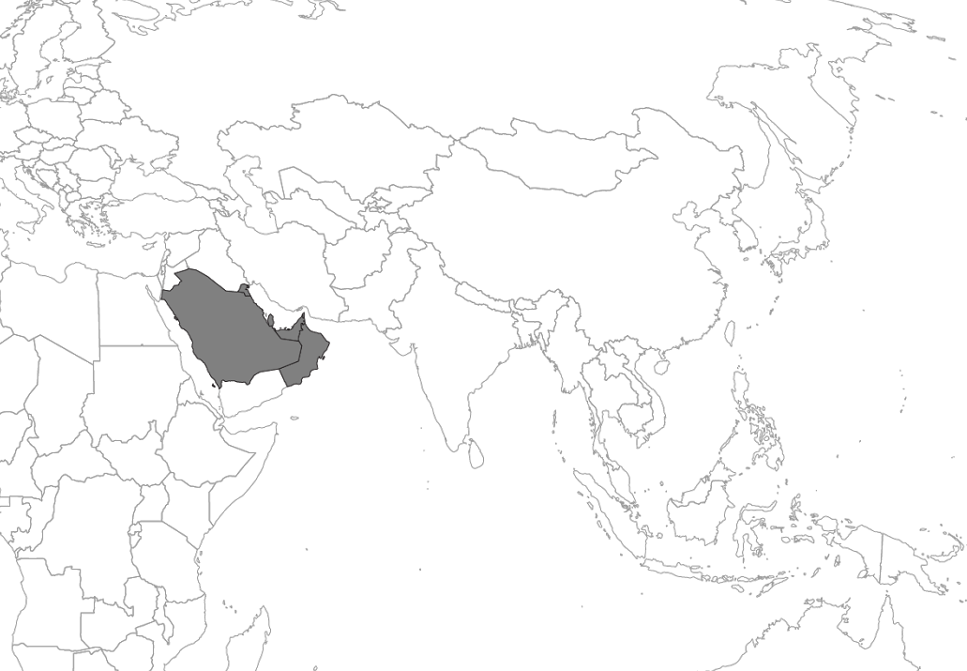

Receiving
Bahrain
Kuwait
Oman
Qatar
Saudi Arabia
UAE
Sending
Bangladesh
PRC
Indonesia
Nepal
Philippines
Sri Lanka
Viet Nam
Sending&
Receiving
India
Malaysia
Pakistan
Thailand
Receiving
Taipei, China
Japan
Republic of Korea
Hong Kong, China
Singapore
GCC
10 mil
20 mil
1990
Migrant stock
in GCC countries
2000
in Southeast Asia
in South Asia
2010
2015
Source: UN (2015)

Slide 27
Can we properly Measure impact of nhi?

Slide 28
THANK YOU

