Slide 1
Some issues to consider when introducing Social health insurance
Jean-Olivier Schmidt
Programme Director Perinatal Health Programme Kyrgyzstan
GIZ
P4H Conference, Astana 19-20 June 2018

Slide 2

What is GIZ?
A German federal enterprise
  A company owned by the Federal Republic of Germany
  Advisory services and project management
Operations in Germany and over 120 countries around the world
Business volume of over EUR 2.6 billion in 2017
Main commissioning party: the German Federal Ministry for Economic Cooperation and Development (BMZ)
Commissioned by well over 200 public and private-sector bodies in Germany and abroad
Staff of around 19,000 people
Notes:
But first let me start by saying some works on myself and GIZ. In Kazakhstan GIZ supports projects in the area of sustainable economic development and vocational educational trainings through regional programmes

Slide 3


Notes:
This is an overview of the countries where GIZ has either supported the introduction or the further development of the Social health insurance. Each case shows some elements from the original one but each one was also adapted and developed further according to the specificities of the country

Slide 4
Preconditions for functioning of SHI
Some issues when introducing SHI
Social acceptance
Capacities
Impact on quality
  Societal preparedness and support
  Adequate Capacities (institutional, organisational, people, skills)
  Quality services for all
Notes:
We have seen some issues when introducing and also maintaining the legitimacy of SHI in countries. This also concerns

Slide 5
Preconditions for functioning I
The German Social Model and System
A (rights-based) system based on deep – rooted (Kantian) Humanism , solidarity and subsidiarity, that successfully fosters social justice
Notes:
5
Societal preparedness and readiness to support each other

Slide 6
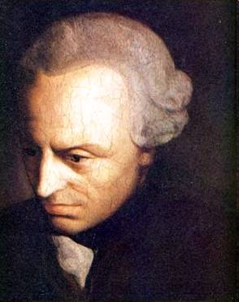
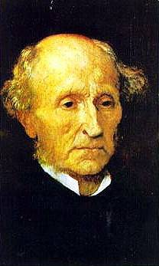
John Stuart Mill and Immanuel Kant
Notes:
Our system in our own country but also the way how we approach development cooperation has deep historic roots in philosophy – without the influence of Kant our human rights based approach can not be properly understood as it is firmly rooted in our constitution. Article one of our constitution says that the dignity of a human being is inalienable.

Slide 7
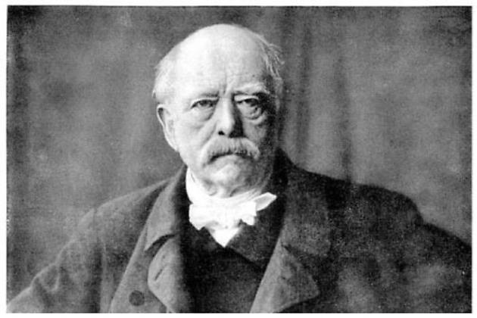
Preconditions for functioning I
Social Health Insurance
Design principles of social health insurance:
  Societal solidarity
  Legally mandatory coverage
  Contributory based system
  Subsidiarity
  → strong sustainability despite wars,
  financial crises and marked regime changes
Notes:
Besides the general rationale why social protection per se is useful in a developing country, we believe that our design principles are also of interest for developing countries but of course these need to be customized according to the specific context:
Solidarity Principle
Cross-subsidization of risks – solidarity between different groups of people (young and elderly, families and singles, healthy and sick, different socio-economic profiles of risk groups)
Principle of insurance coverage
Everybody needs to be covered by health insurance
Contributory system
Financed mainly through contributions by employer and employee as percentage of income, increase of tax contributions
Subsidiarity principle
Health insurance bodies are not for profit organisations and are mandated by the State to run their business autonomously. Their are independent organisationally and financially. Members elect steering committee of their insurance

Slide 8
Preconditions for functioning II
Social Health Insurance
Develop the adequate capacities
  Regulatory and legal framework
  Organisational setup
  Human ressources for SHI

Slide 9
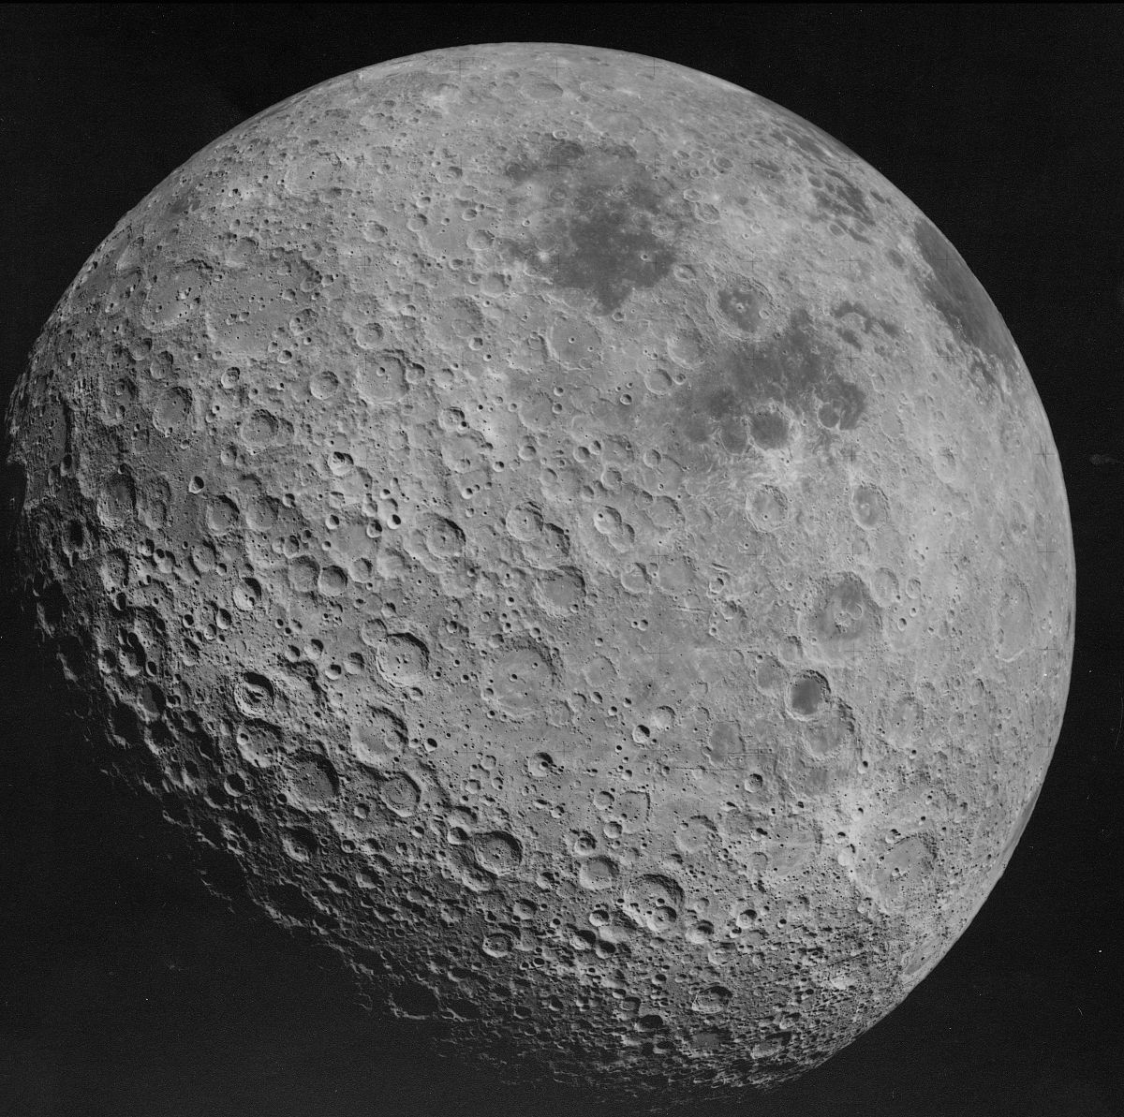
Preconditions for functioning II
Social Health Insurance
HR for SHI - a neglected field of attention
Specific skill set for managerial and administrative HRH
Universality of management/administrative functions?
Health care as extremely regulated field with many actors and functions
Huge variations in administrative costs between countries (with sometimes extremely low costs for SHI as compared to PHI)

Slide 10
Preconditions for functioning II
Social Health Insurance
Country | Schemes | Admin Costs
Germany | 126 schemes, 70 million insured, 100,000 FTE staff | 5-6% revenues
Netherlands | 15 Mio, 7300 FTE | 4.4%
Czechoslovakia | 8 schemes, 10 Mio, 8500 FTE | 2.9-3.5%
Philippines | 70 million, 6000 FTE | 8%
Tanzania | 2.5 Mio, 325 FTE
Notes:
Lack of international benchmarks, to compare effectiveness of schemes vis – a – vis internal procedures, such as number of staff per 1000 insured, time needed to get approval for services requiring peer-approval, time required to respond to a complaint, effectiveness of grievance process

Slide 11
One specific skills (social insurance clerks)
Social Health Insurance
Social insurance clerks | Some features
Training length | 3 years training (dual training)
Core function | Taking care of all members of SHI – calculating premiums and taking care of their claims, including advice
Content of training | Applying legal regulations
 | Advising employers and employees on legal regulations
 | Keeping to regulations on occupational safety
Other staff | 15% of staff in SHI other background (lawyers, medical doctors, IT, controller)
Notes:
Lack of international benchmarks, to compare effectiveness of schemes vis – a – vis internal procedures, such as number of staff per 1000 insured, time needed to get approval for services requiring peer-approval, time required to respond to a complaint, effectiveness of grievance process

Slide 12
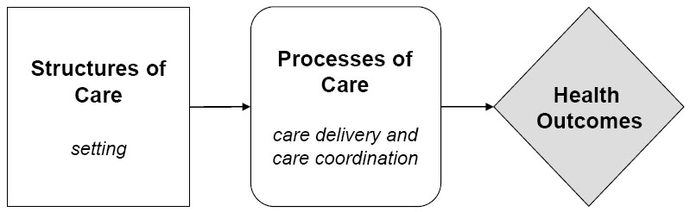
Preconditions for functioning III – Providing services of adequate quality
Social Health Insurance
Notes:
This is the most difficult task – quality has different dimensions and you need different interventions to address those.
Structural, process and outcome quality
Health insurance defines in Germany. The structures of care

Slide 13
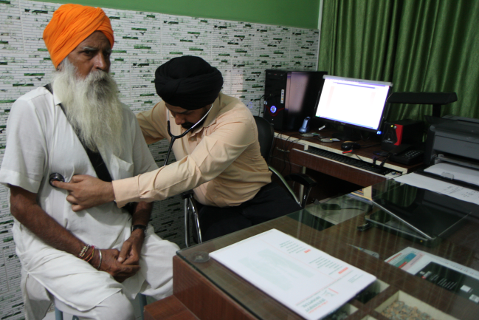
Example from the field I: India
Indo-German Social Security Programme:
Germany supports the Indian Ministries of Employment and Health on the implementation of the national health insurance RSBY (Rashtriya Swasthya Bima Yojana).
Achievements:
Covers currently around 150 mio. people;
Use of sophisticated technology: households are issued a biometric smart card;
Significantly improved access of women to medical treatment.
Notes:
Some examples of our country work, both from Asia and Africa
In India we supported for the past 10 years the Government in setting up a health insurance scheme for the poor. This was succesful in covering so far around 150 million people for stationary care and reducing OOPs. Next phase the GoI is envisioning is to go beyond the poor population and include also the non-formal economy of the country.

Slide 14
Example from the field 2
Nepal: Social health insurance including hospital management
Advice and capacity development of the national and district health insurance offices
Support in implementing health insurance in three pilot districts
Advice on the development of a strategy / policy on a systematic quality management approach and a plan for quality assurance and quality improvement
Supporting selected hospitals in quality improvement measures
          Implementation of the Ministry of Health Minimum Service Standards
          Development of business plan
          Strengthening of facility management
          Infection prevention
          Waste management

