Slide 1
Lessons from mandatory health insurance development and governance in Estonia
Triin Habicht
Health financing reforms for Universal Health Coverage
19-20 June 2018
Astana, Kazakhstan

Slide 2
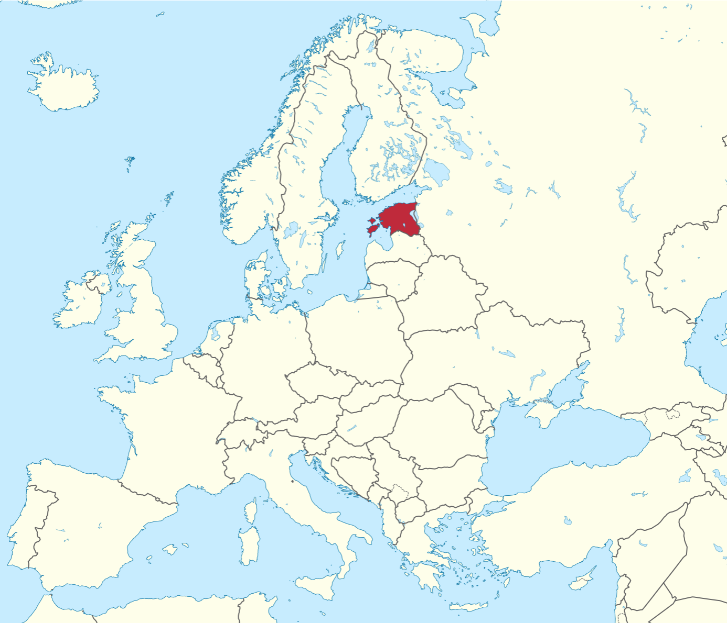
Estonia in brief
Population 1.3 million
High-income country
  European Union (since 2004)
  GNI per capita 17 750 USD* (2016)
Health expenditures (2016)
  6.7% of GDP
  Per person 1 340 USD
  Public expenditure 75.7% of THE
  Health insurance 65.0% of THE
  OOP 22.7% of THE
Estonian Health Insurance Fund (EHIF) is a single payer
  Social health insurance system since 1992
*1USD=0.8EUR

Slide 3
National Institute for Health
Development
Public agencies in health sector
Ministry of Social Affairs
EHIF
Health
Board
State Agency
of Medicines
Contracts
Health care providers,
private law, public or private
ownership

Slide 4
Evolution of the organization of health insurance
First sickness funds in 1913
Re-established regional non-competing sickness funds in 1991/92 (22 in total)
Central sickness fund to coordinate regional funds in 1994
Estonian Health Insurance Fund in 2001,
Currently with 4 regional departments

Slide 5
Key facts about EHIF
Estonian Health Insurance Fund (EHIF) is a single payer
  Social health insurance system since 1992
  EHIF pools most of public funds
  Coverage with health insurance 94-96% of population
  EHIF operates as public independent legal entity
  Founded in the public interest by separate act
  General public service regulation does not apply to EHIF, e.g. applies private sector labor codes
  Governed by Supervisory Board (15 members) chaired by Minister of Health and Labor
  The main source of revenues 13% payroll tax paid by employers

Slide 6
Moving away solely contribution based health insurance
  Gradual increase of state budget contributions on the behalf of pensioners from 7% in 2018 up to 13% in 2022
  On behalf on non-working pensioners
  Contribution is calculated as a share of average state guaranteed pension
  By 2022 new revenue source forms about 11% of the EHIF’s budget
  In parallel, other public expenditure streams will be consolidated under the EHIF
  Aims to reduce fragmentation
  Was necessary to find a compromise in the Government
  As a result, the net growth of public spending is expected to be 0.2% of GDP by 2022

Slide 7
“Health insurance is based on the solidarity of and limited cost-sharing by insured persons and on the principle that services are provided according to the needs of insured persons, that treatment is equally available in all regions and that health insurance funds are used for their intended purpose” (Health Insurance Act, issued 2002)
“… to ensure the payment of health insurance benefits pursuant to the Health Insurance Act, other legislation and health insurance expenditures prescribed in the budget of the health insurance fund” (Estonian Health Insurance Fund Act, issued 2001)

Slide 8
Tripartite supervisory board
15 members (might be reduced to 7 by end of 2018)
5 state representatives
  Minister of Social Affairs, Minister of Finance and Chairman of the Parliamentary Committee of Social Affairs (ex officio)
  1 member or parliament (nominated by the Parliament)
  1 public servant from ministry of Social Affairs (nominated by the Government)
5 employer and 5 beneficiaries representatives
  List of representing organizations is designated by Government
  Nominated by Government according to the proposal made by representing organizations
Supervisory Board design is expected to prevent conflict of interest
  No formal procedure to manage conflict of interest by so far (available in EHIF but not applied at Supervisory Board level)
  Supervisory Board decisions are public

Slide 9
Supervisory board
Governing body of the EHIF
The Minister of Health and Labour is the Chairman of the Board
Main functions are:
  approve the development plan of the EHIF
  on the proposal from the Management Board, approve the structure of the EHIF
  designate and remove the Chairman of the Management Board
  approve the annual action plan of the Health Insurance Fund
Notes:
https://www.haigekassa.ee/en/supervisory-board

Slide 10
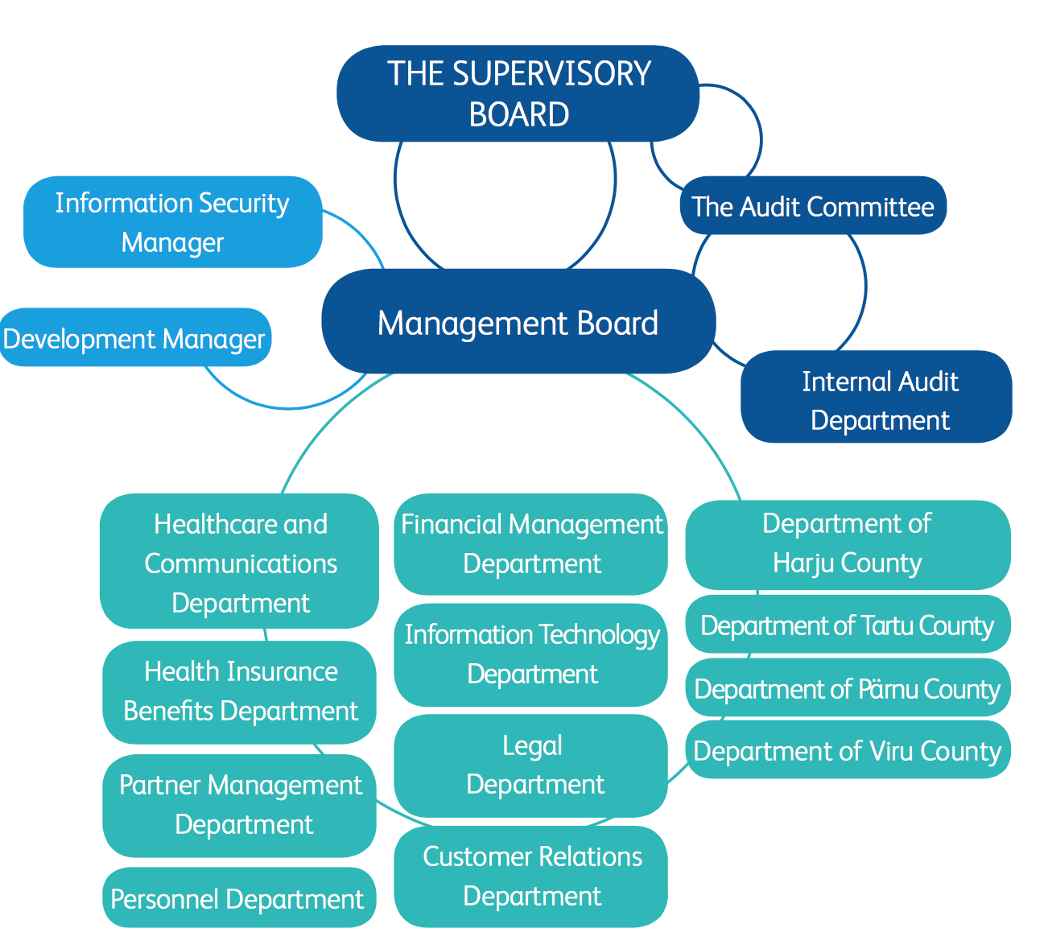
Organogram of the EHIF

Slide 11
Management Board
3 members (allowed up to 7 members)
Runs daily operations
Main functions are:
  draw up the development plan and the annual action plan and submit these to the Supervisory Board for approval
  prepare the draft budget and the draft of the supplementary budget and submit these to the Supervisory Board for approval
  approve the budgets of regional departments on the basis of the budget of the EHIF
  approve the plan for entering into contracts with the providers of health services
Notes:
https://www.haigekassa.ee/en/management-board

Slide 12
Scope of decision rights
EHIF has broad autonomy to contract with service providers but Government supervisory and participatory role has been maintained
Establishment of system (objectives and principles) – Parliament
Contributions definition and coverage (eligibility) – Parliament
Co-payments –general regulation by Parliament; actual co-payments by providers
Benefit package – general regulation by Parliament; actual benefit package by Government
Provider payment methods and Prices –Government; price calculation methodology by Ministry of Social Affairs
Contracting – basic principles by Parliament; specific principles by Supervisory Board of EHIF
Waiting time limits –Supervisory Board; for primary care by Ministry of Social Affairs
Budget – forecast by MoF; budget position by Parliament as part of State Budget; the line-items in detail by Supervisory Board

Slide 13
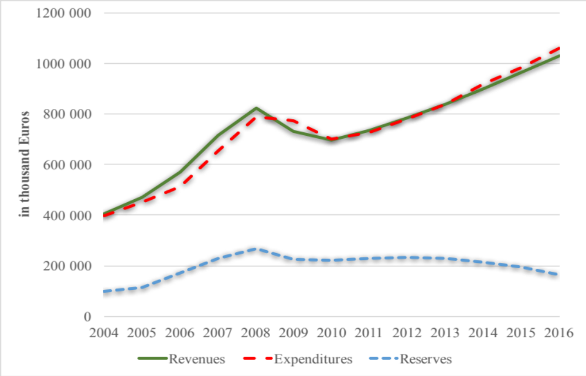
EHIF revenues, expenditures and reserves
Financial crisis
Deficit
Source: EHIF

Slide 14
EHIF’s reserves policy
  Solvency reserve: 5,4% of total budget since 2018 (8% in 2001-2004, 6% 2005-2017)
    To balance macroeconomic risks
    Needs government approval
  Risk reserve: 2% of health insurance spending (introduced in 2002)
    To balance the risks of health insurance obligations
    Needs EHIF’s supervisory board approval
  Accumulated surplus: non-mandatory reserve as difference between revenues and expenditures
    Accumulated before financial crises
    Needs EHIF’s supervisory board approval (<30% of total surplus, <7% of previous period’s health care services budget)

Slide 15
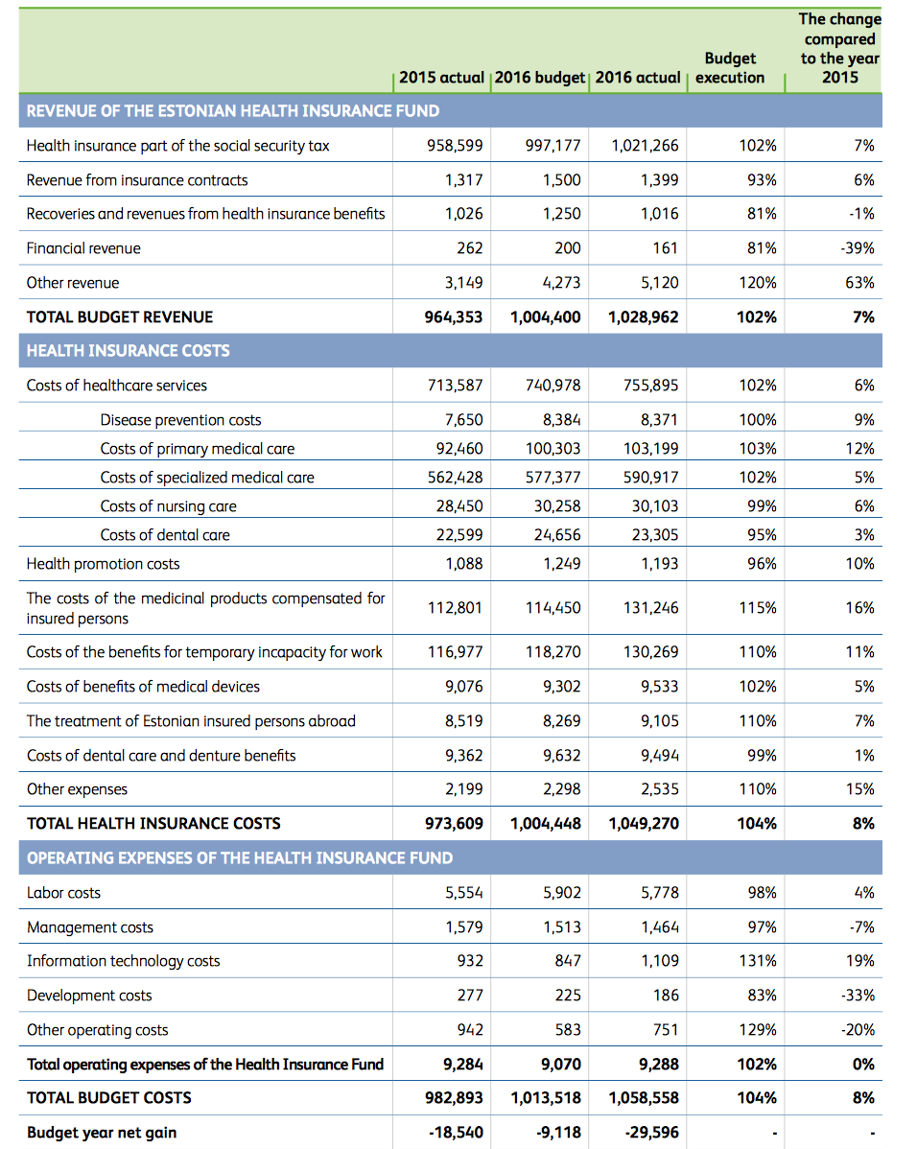
Outline of the EHIF’s budget (2016)

Slide 16


Accountability mechanisms
Management Board shall present quarterly overview of the activities and economic situation to the Supervisory Board
  All reports made public
  Annual reports available in English https://www.haigekassa.ee/en/annual-reports
  Annual reports available in Russian https://www.haigekassa.ee/ru/bolnicnaa-kassa/otcety
4-year corporate strategy with action plan and score card
  Reporting is part of the quarterly reporting
  Revised annually
  Available in English https://www.haigekassa.ee/sites/default/files/uuringud_aruanded/hk_arengukava_a4_eng_veeb.pdf
Regular public and partners satisfaction surveys

