Slide 1
Kyrgyz Republic experience in introducing compulsory health insurance
Compulsory Health Insurance Fund (MHIF) of the Kyrgyz Republic
Kaliyev Marat
Compulsory Health Insurance Fund (MHIF) of the Kyrgyz Republic

Slide 2
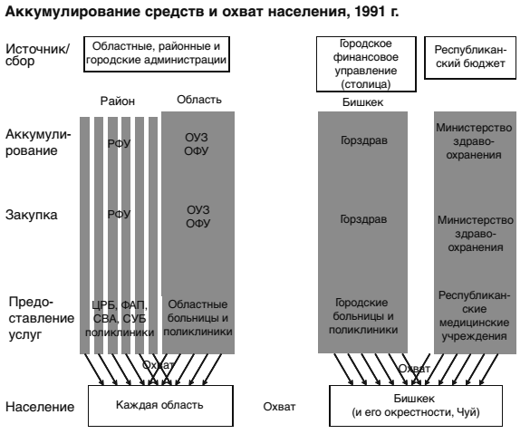
accumulation of funds and population coverage, 1991
city finance department
republican budget
regional, district and city administrations
Source/
collecting
District
Region
Bishkek
RHA
accumulation
Ministry of Health
city health department
DFD
RFD
Purchase
RHA
RFD
Ministry of
Health
DFD
regional hospitals and polyclinics
city hospitals and polyclinics
provision of services
republican medical institutions
Bishkek and its environs, Chui
Population
Each region
Coverage

Slide 3
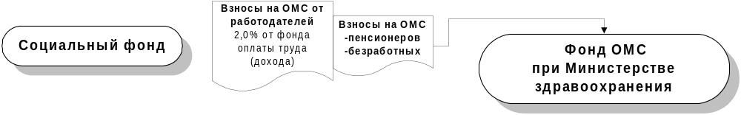
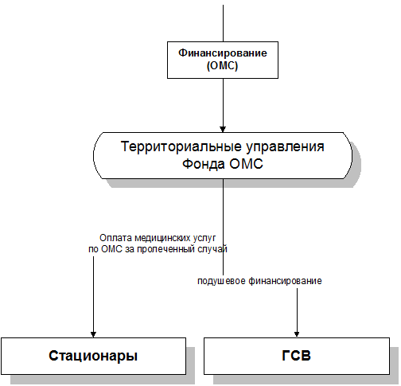
The creation stages of the Single-Payer health care System (1997-1999гг.)
republican level
Republican level
CMI fund under the Ministry of Health
social fund
contributions to CMI from pensioners and unemployed population
Employers
contributions to the CMI (2.0 percent of the wage fund (income))
Financing (CMI)
Regional level
Regional level
territorial CMI Fund
offices
Payment for medical services of CMI for the treated case
District level
Per capita financing
Stationeries
GFP

Slide 4
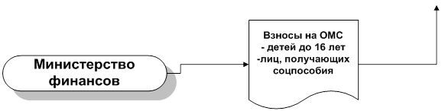
The creation stages of the Single-Payer health care System (2000г.)
Employers
contributions to the CMI
(2.0 percent of the wage fund (income))
contributions to CMI from pensioners and unemployed population
Republican level
CMI fund
under the Ministry of Health
social fund
contributions to CMI from children under 16 years receiving social benefits
Financing (CMI)
Ministry of Finance
Regional level
territorial CMI Fund
offices
Payment for medical services of CHI for the treated case
Районный уровень
Per capita financing
Stationeries
GFP

Slide 5
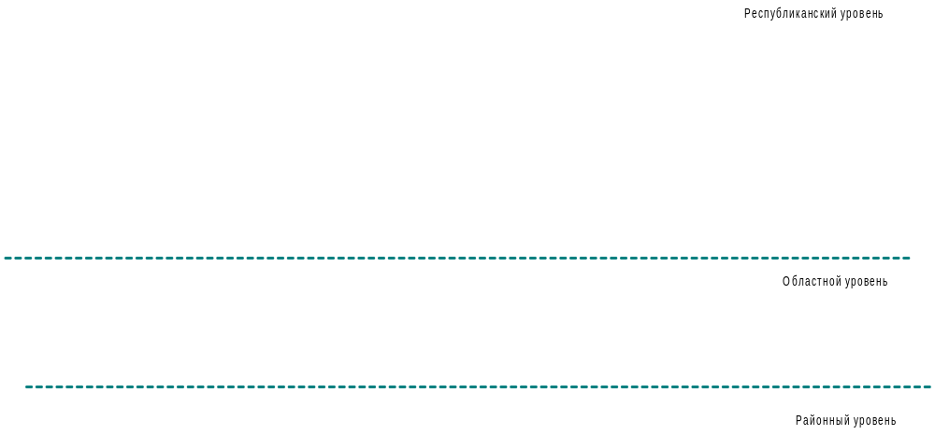
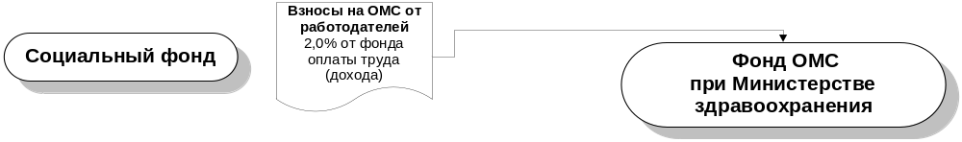
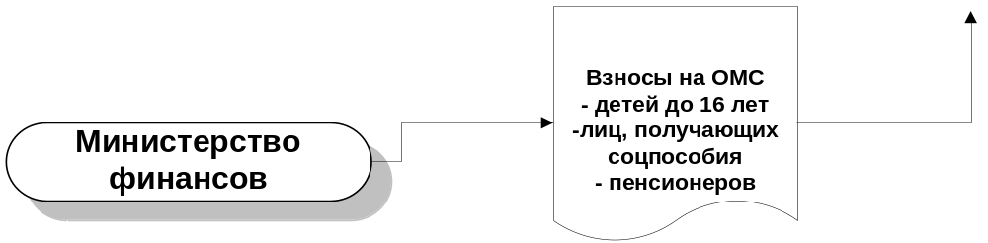
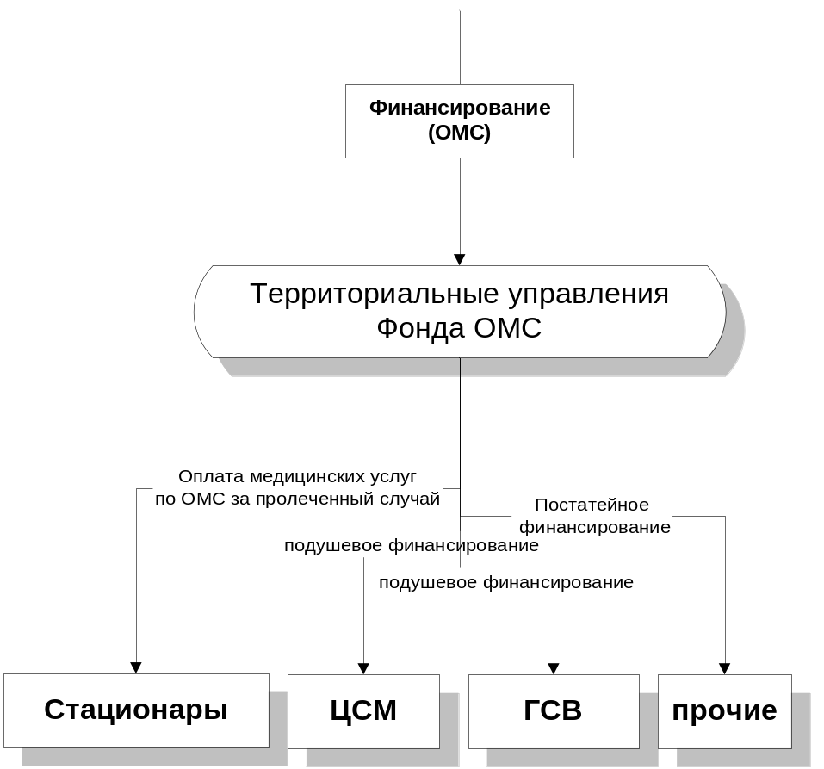
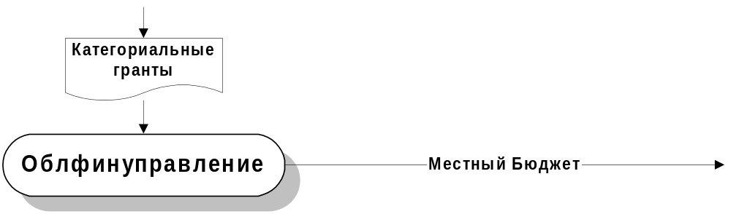
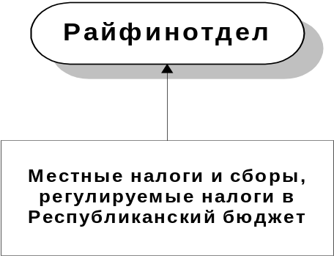
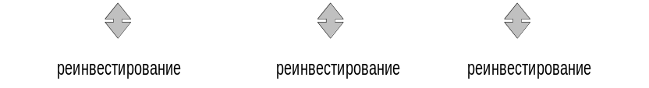

The creation stages of the Single-Payer health care System(2001-2005гг.)
Employers
contributions to the CMI (2.0 percent of the wage fund (income))
CMI fund
under the Ministry of Health
social fund
contributions to CMI from children under 16 years receiving social benefits
Ministry of Finance
Financing (CMI)
categorical grants
Regional level
territorial CMI Fund
offices
regional financial department
district finance department
Payment for medical services of CHI for the treated case
District level
Местный Бюджет
line item financing
local budget
Per capita financing
Stationeries
Local taxes and duties, regulated taxes to the Republican budget

Slide 6

The creation stages of the Single-Payer health care System (2006-2014гг.)
SF КR
(CMI)
CMI Fund under the Government of KR
Employers
contributions to the CMI (
2.0 percent of the
wage fund (income))
Bank
МF КR
(BCA)
Insurance premiums on CMI
children under 16 years old
receiving social assistance and
pensioners under 70 years old and over
(2711)
Treasury of the Ministry of Finance of the Kyrgyz Republic
Financing
(BCA)
Financing (CMI)
Financing of healthcare organizations in the Single Payer System
(2216)
Bishkek city Administration
(BCA)
Территориальные управления Фонда ОМС
territorial CMI Fund
offices
Financing of health organizations in Bishkek through the local budget
(2216)
Regional Treasury of the city of Bishkek
Through the regional Treasury
offices
Payment for medical services
of CHI for the treated case
Per capita financing
Per capita financing
Payment by the number of brigades
Stationeries
CFM/GFP
Stompolyclinics
AS
Со-payment Special funds (Treasury)
Со-payment Special funds (Treasury)
Special funds (Treasury)
Special funds (Treasury)

Slide 7

The creation stages of the Single-Payer health care System (2015-2016гг.)
SF KR
(CМI)
Employers
contributions to the CMI (
2.0 percent of the
wage fund (income))
Bank
CMI Fund
Insurance premiums on CMI
children under 16 years old
receiving social assistance and
pensioners under 70 years old and over
(2711)
Treasury of the Ministry of Finance of the Kyrgyz Republic
МF КR
(РБ)
Financing (РБ)
Financing (CMI)
Financing of healthcare organizations in the Single Payer System
(2216)
territorial CMI Fund
offices
Со-payment Special funds
Through DTD
Payment for medical
services for the treated case
Per capita financing
Per capita financing
Payment by the number of brigades
Hospitals
CFM/GFP
Stompolyclinics
AS
Со-payment Special funds (Treasury)
Со-payment Special funds (Treasury)
Special funds (Treasury)
Special funds (Treasury)

Slide 8


Social Fund
(CMI)
Ministry of finance
(RB)
law on Fund' s budget CMI
Treasury МF КR
Payment for medical
services for the treated case
Per capita financing
Per capita financing
Payment by the number of brigades
Hospitals
CFM GFP
Stompolyclinics
AS
Со-payment Special funds (Treasury
Со-payment Special funds (Treasury
Со-payment Special funds
Special funds (Treasury

Slide 9
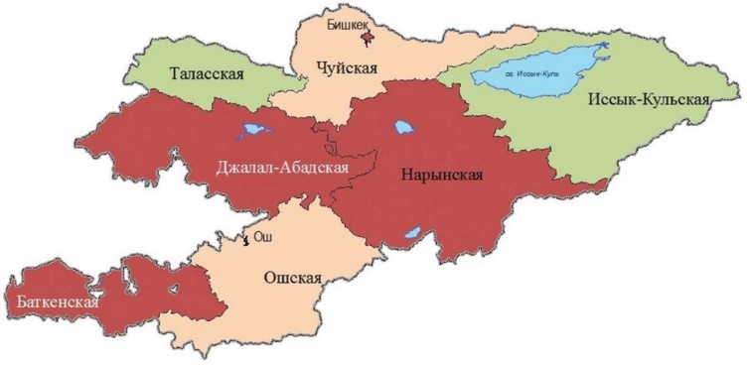

Per capita financing on GFP (group of physicians) from
2005-2016 budget., sом
Bishkek (local HD)
Chu region (city of Osh)
Districts of Osh region
Batken region
Dzhalal-abad region
Issyk kul region
Naryn region
Talas region

Slide 10


The base rate for the treated case in hospitals according to the 2005-2016budget , сом
Bishkek
Chu region (city of Osh)
Districts of Osh region
Batken region
Dzhalal-abad region
Issyk kul region
Naryn region
Talas region

Slide 11
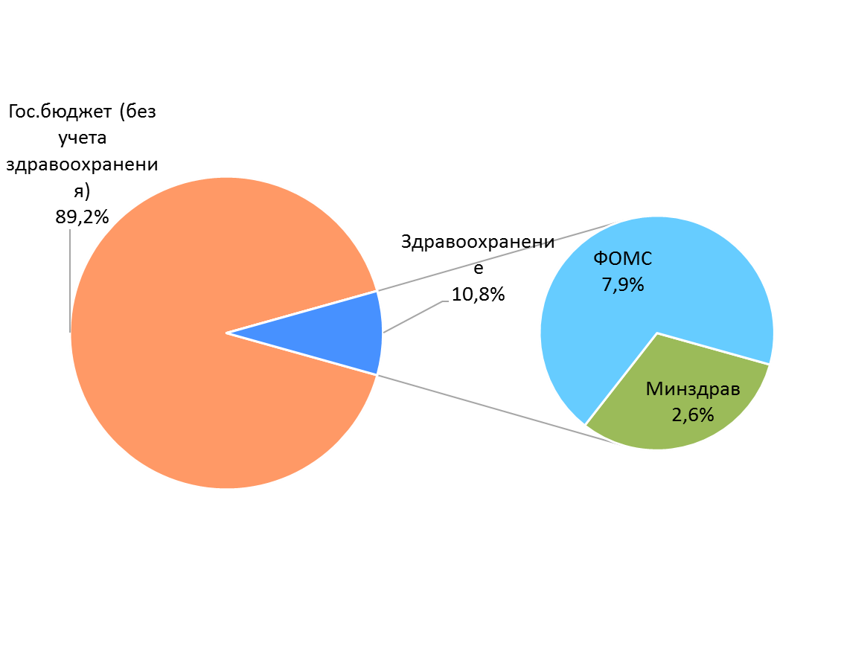
The share of health expenditures per capita in the Kyrgyz Republic in 2018.
Public health
expenditure
state budget without healthcare expenditures – 89.2%
Health care – 10.8%
CMIF 7.9%
Ministry of health – 2.6%

Slide 12





Dynamics of the consolidated budget of the Single Payer system
206 mln.$
2018
2016
181,6 mln.$
+9,2 times
2010
73,6 mln.$
+3,7 times
2005
34,7 mln.$
+76% times
2000
19,7 mln.$

Slide 13

Levels of medical services in the health care system of the KR
Special funds.
CMI 13,4%
Со-payment
RB
74,5%
Hospitals (third level)
Hospital (second level)
ПМСП (first level)
18%
49%
33%

Slide 14

Single-payer health care
259 health organizations operate in the Single Payer system
Family Medicine Centers – 64
Legally independent GFP – 17
Hospitals– 67
CMI Fund
Centers of General Practice – 29
Emergency medical stations – 2
Specialized health organizations operating on the Basic Compulsory Health Insurance Program – 10
Anti-tuberculosis organizations – 23
Health organizations operating under the Basic Compulsory Health Insurance Program– 2
Private health organizations operating under the Basic Compulsory Health Insurance Program– 3
Dental Clinics– 34
Hemodialysis centers – 8

Slide 15
Single-payer health care financing
Consolidated budget of the Single Payer health care system in 2018
- 14 230.3 million soms
Stationeries
7559,1 mln. som(53,1%)
ЦСМ/GFP
3323,0 mln. som (23,4%)
ПТБ
867,7 mln. som (6,1%)
ЭМП
448,3 mln. som (3,2%)
Dental care
417,4 mln. som (2,9%)
drug supply
319,4 mln. sоm (2,2%)
Specialized HD (БГМС)
695,4 mln. som (4,9%)
Hemodialysis
286,0 mln. som (2%)
Administrative expenses
132,0 mln. som (0,9%)
Information support costs
12,0 mln. som (0,1%)
Insurance stock
170,0 mln. som (1,2%)

Slide 16
Categories of citizens who make co-payments according to levels
The minimum level
Persons awarded with the "Veteran of Labor"medal;
The medium level
Insured workers
Self-employed (PE)
The maximum level
The remaining citizens which are not listed above, but have a referral from the doctor GFP
Retired people under 70;
Children from 5 to 16-18 years old
Farmers
Students
Persons who have CMI policy
citizens who have the right to receive medical assistance free of charge (except for children under the age of 5) arriving at planned inpatient treatment for a third or more times a year
Military with CMI policy;
Persons receiving social welfare;;

Slide 17
The level of co-payment for medical services for inpatient treatment in health care organizations operating in the SP health care system (in soms)
Тherapy
Minimal - 330
Maximum - 2650
Surgery
Мinimal - 430
Medium - 840
Medium - 1090
Maximum - 3440

Slide 18
Structure of payment to hospitals for the treated case in 2016

Slide 19



PRIVILEGED SERVICES OF HEMODIALYSIS
Medical centers providing hemodialysis services on preferential terms
URPA (Bishkek city)
Uniclinic
Diamed
URPA (Osh city)
Vita Med LTD
Nefro Center
Baman
Clinic №1
Free choice of medical center irrespective of place of residence
Improving access to hemodialysis services
Hemodialysis
Reduction of cost of compensation for 1 session up to 69 dollars.
+
The cost of patient's co-payment of hemodialysis was no more than $ 8..
Introduction of an electronic medical record of the patient
Payment by electronic register according to the "Hemodialysis"
Database

Slide 20
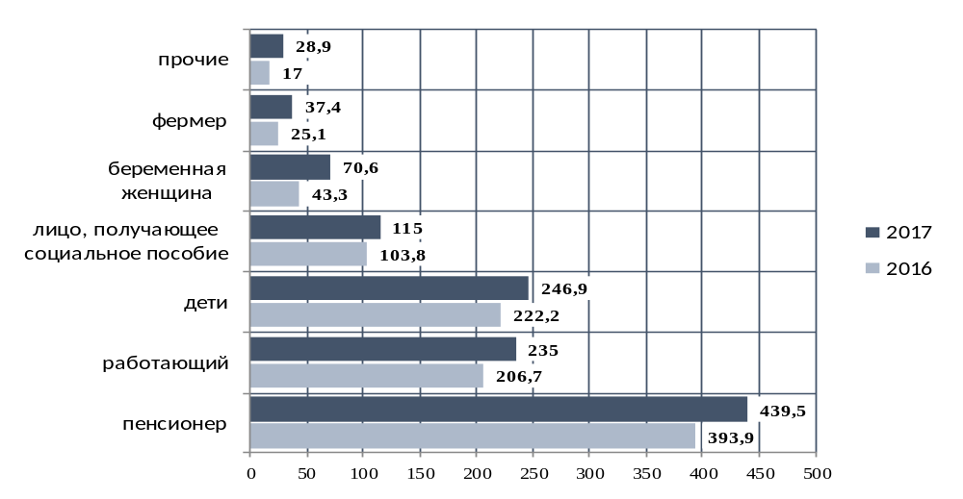
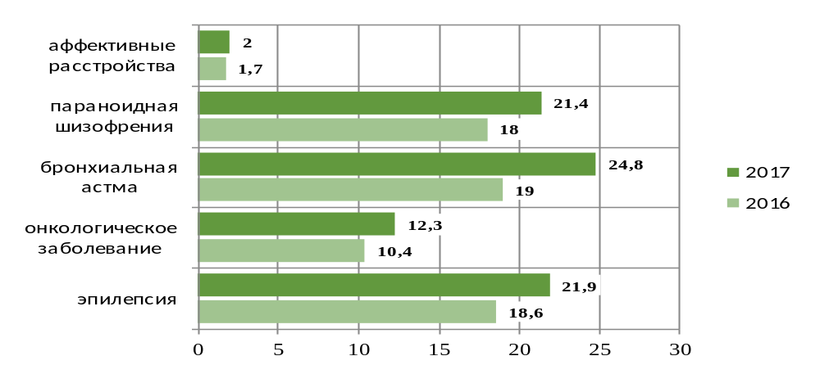
PRIVILEGED MEDICINAL SUPPORT
The number of prescribed prescriptions for CMI and SGP in 2017 (thousands of units).
other
farmers
Pregnant woman
Medicinal products according to the prescriptions of CMI of the insured population category -
discount up to 50%
person receiving
social benefits
children
worker
pensioner
affective disorders
Medicinal products according to the prescriptions of SGP of a privileged category of patients -
discount up to 90%
paranoid schizophrenia
bronchial asthma
oncological disease
epilepsy

Slide 21
HOSPITALIZATION IN STATIONARY
The dynamics of stationary hospitalizations

Slide 22
QUALITY OF MEDICAL SERVICES
Short-stay offices / cots SSO
Since 2015
a mechanism has been introduced to finance short-term hospitalization of children
The results of monitoring the quality of medical care provided to children under 5 years of age in the SSO*
timely medical assistance
effective use of budgetary funds
*Monitoring data of 18 hospitals for the assessment tool for children of 5 years, July-August 2017.

Slide 23
Economic efficiency of the SSO
QUALITY OF MEDICAL SERVICES
The number of treated cases in the SSO in 2016 is 9,245
The number of treated cases in the SSO in 2017 is 28,398

Slide 24
Expertise of the quality of medical services, 2004-2015.
Structure of detected defects at the PHC level,%
Structure of detected defects in stationeries ,%
Notes:
Для улучшения качества предоставляемых медицинских услуг и оптимизации деятельности системы обязательного медицинского страхования, Фондом ОМС осуществляется деятельность по проведению экспертизы качества медицинских услуг на основании разработанных клинических протоколов, основанных на методах доказательной медицины, правил и действующих нормативных документов.
Экспертиза качества направлена на определение соблюдения прав пациентов при получении медицинских услуг, соответствия медицинских услуг установленным стандартам наблюдения, обследования и лечения.
Нормативными документами определены следующие объемы экспертиз: 3% от количества пролеченных случаев на стационарном уровне, 0,5% от количества поликлинического обслуживания на первичном уровне и 1% от количества вызовов экстренной медицинской помощи.
Ежегодно на постоянной основе врачами-экспертами территориальных управлений Фонда ОМС проводится более 90 тысяч экспертиз качества в организациях здравоохранения, работающих в системе Единого плательщика. Проводимая экспертиза приводит к снижению дефектов в обследовании, лечении и диспансеризации больных на первичном уровне, в обследовании и лечении на стационарном уровне.

Slide 25
Auditing
The findings revealed in the audit of health organizations in 2017

Slide 26





INFORMATION SYSTEMS OF THE CMI FUND
Health Ministry
- HO handbook
- medical staff
- attributed population
- deductions for CMI
- persons receiving social benefits
Database on cases treated
Database on preferential recipes
Social Fund
Database on examination of medical services
Receiving data
Database on indicators of contracts
Ministry of labor and social development
Database on hemodialysis
Database on the questionnaire
Database on the helpline
Calls to the helpline via the web site, mail or visit
Database on CMI policies
Пациент
Stationeries
Family Medicine Centers
Pharmacies
Notes:
26

Slide 27

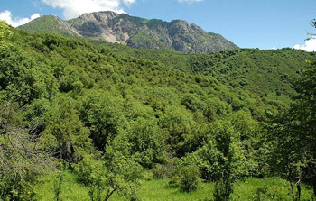
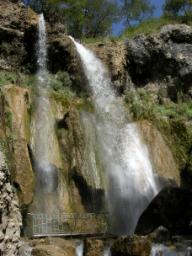
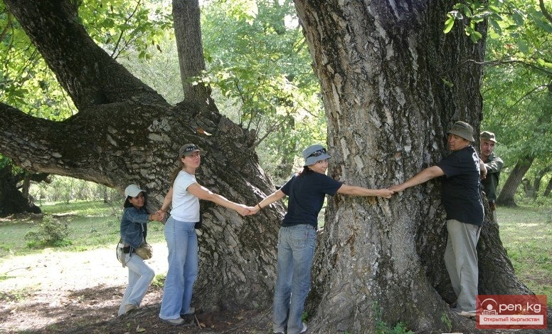
One of the most unique creations of nature, the tract Arslanbob - a magnificent blooming oasis
At an altitude of more than 1600 m above sea level, in the rare climatic conditions of neighboring air masses, there are magnificent
walnut forests,
With total area of more than 700 thousand hectares.
Age of forests, according to scientists, can exceed 50 million years and their origin is likely to relate to the Paleolithic era.
Thank you for attention!
Only here there are specimens up to 30 meters high, whose age can exceed 1000 years

