Slide 1
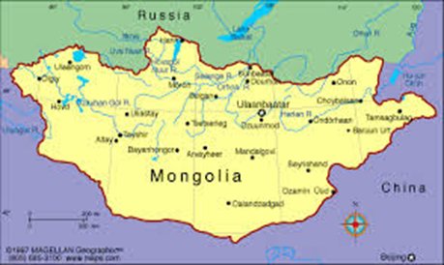
Health insurance coverage for self-employed nomads in Mongolia
Sonin Sodov, MD., PhD
Mongolia
19-20 June 2018,
Astana, Kazakhstan

Slide 2
Country profile of Mongolia
Mongolia, a land-locked country with a territory of 1 566 460 sq.kms.
The 19th largest country and the 2nd largest landlocked country in the world.
Bordered by Russia to the north and China to the south.
Population - 3.2 mln, population density - 1.9 per sq.km.
Life expectancy - ♀ 75.10 years ♂ 65.58 years.

Slide 3
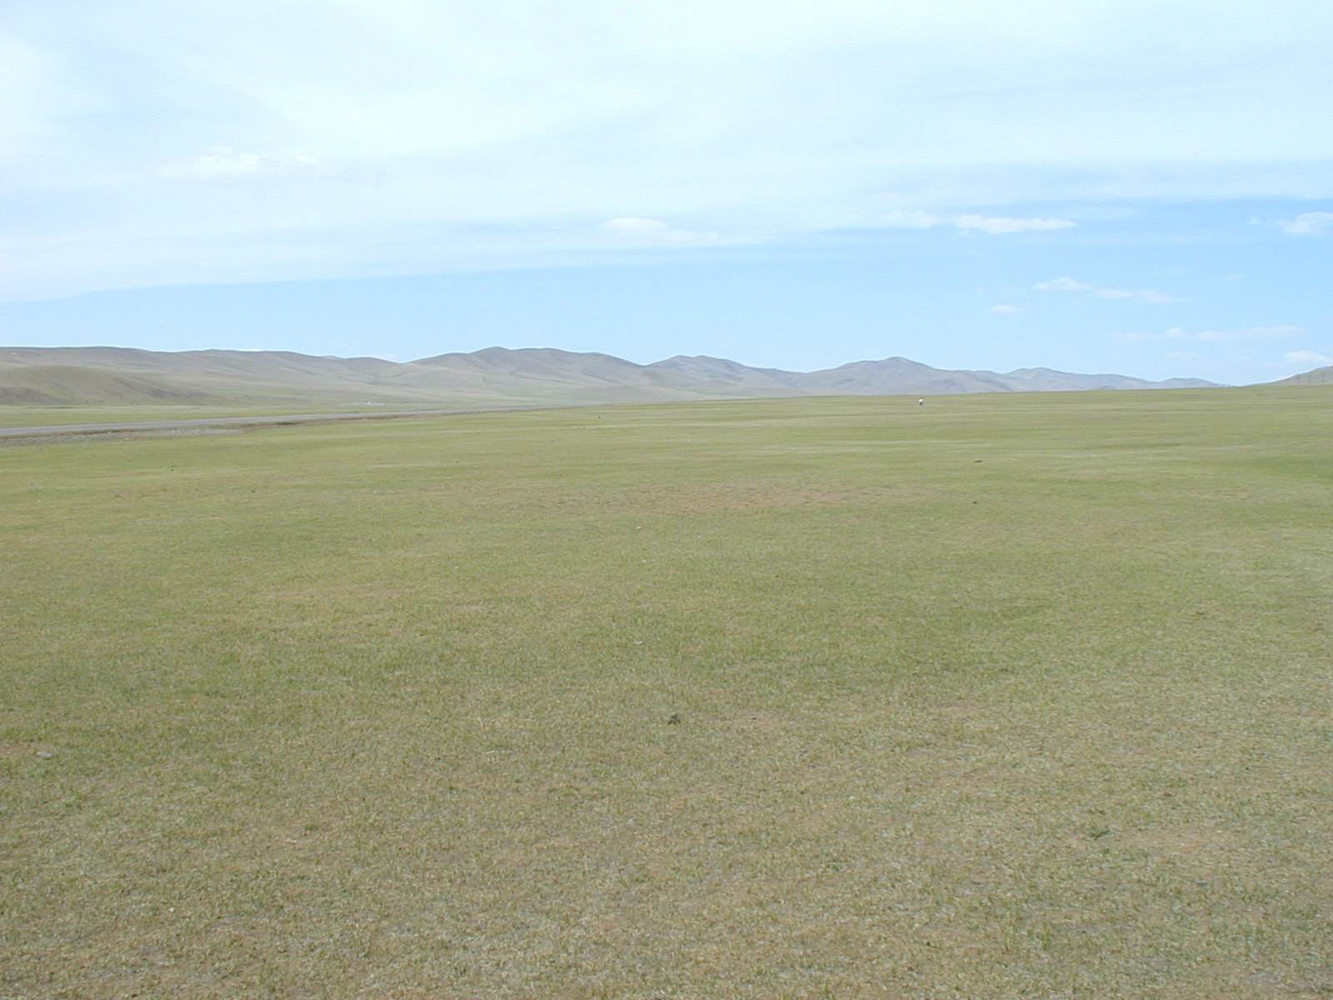
- a sparsely populated (1.9 inhabitants per sq. km.)
- population 3.2 mln, but 66.2 mln animals/30 mln sheep

Slide 4
Country profile of Mongolia
Administratively, Mongolia is divided into 21 aimags (provinces) and the Capital City - Ulaanbaatar.
68.9% of the total population live in cities.
31.1% reside in the rural areas.
More than 20 – ethnic groups and subgroups:
  82.4% of the population – Khalkha,
  3.9% – Kazakhs, 2.8% - Durbets, 2.2% - Bayads and 1.7% - Buriads.

Slide 5
Health System
The main aims of health services in Mongolia - the provision of accessible, equitable and quality health services to everyone.
The priority of Mongolian health sector - to provide quality primary health care services based on family medicine to all citizens.

Slide 6
Health System
The health system of Mongolia provides health services at primary and secondary/tertiary levels:
  Primary health care:
    Family health centers in urban areas - 220
    Rural health centers in remote areas - 331
  Secondary health care:
    District General Hospitals - 8
    Provincial General Hospitals - 21
  Tertiary health care in the Ulaanbaatar City:
    Multispecialty central hospitals - 8
    Specialized Centers - 5

Slide 7
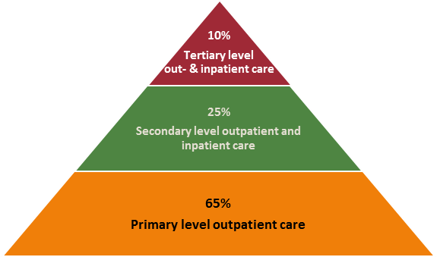
Levels of care

Slide 8
Current expenditure levels
Secondary
45%
Tertiary
33.4%
Primary
21.6%

Slide 9
Purchasers of Health Care by Level
Types of health services | Local budget (Capitation) | State budget (Line item) | Health Insurance (DRG) | Fee for services
Primary Health care | +
Secondary Health care |  | + | + | +
Tertiary Health care |  | + | + | +

Slide 10
Health Financing
Mongolia’s health care financing system is fragmented across all levels of care and includes:
    Government budgets provided by the MOF through the MOH based on a capitation payment (for PHC services) and a line item budget (for secondary and tertiary level services)
    Reimbursement of services by the Health Insurance (based on 117 DRGs)
    Hospital own revenues including copayments from patients and user-fees etc.

Slide 11
Health Financing
Government Budget – Semashko model in socialist era before 1990 – a strong centrally-planned hierarchical healthcare system fully financed by general government revenues. Health care was free of charge at the point of delivery but the system, mostly reliant on curative services.
Health Insurance – implemented from 1994.
Out of pocket payment(OOP) – as a share of the THE - a sharp increase from 14.5% in 1995 to 42% in 2014.

Slide 12
Health Sector Budget Plan, 2017

Slide 13
Health Insurance System
In 1994, the Mongolian Government introduced the Health Insurance in order to address the drastic decline in the government health budget due to the socioeconomic transition of 1990s. Budget tightening has resulted in a significant reduction of government spending on health.
The Citizens Health Insurance Law was a political commitment to maintain equity in accessing health services and protect the population from financial hardship during the economic transition from a centralized to a market-oriented economic system.

Slide 14
Health Insurance System
1994 – Health Insurance was launched in collaboration with a state owned commercial national insurance company.
1996 – Health Insurance Organization was transferred to the Social Insurance General Office (SIGO), under the supervision of the MPDSP.
2018 – Health Insurance Organization reorganized as an independent government agency under MoH.

Slide 15
Income of HIF by type of insured, 2017
  65% - employer, employee
  16% - state subsidized group
  6% - informal sector group 13% - other income

Slide 16
Who is covered?
Categories of insured |  | Contribution payment, 2018
1 | Employees of business entities and organizations, Formal salaried sector | 4% of salary or income, equally shared by employer and employee by 2%
2 | Child aged 0-18, State subsidized | 1% of minimum wage - 2400 MNT monthly and 28 800 MNT or 12$ per year
3 | Students, Informal sector
4 | Self-employed, unemployed, Informal sector
5 | Nomads, Informal sector
6 | A citizen-member of the family who is in need of social welfare support, State subsidized | 2% of minimum wage - 4800 MNT monthly and 57 600 MNT or 24$ per year
7 | The mother / father / who cares a child till 2 years old(till 3 years old if twins), State subsidized
8 | Military servant, State subsidized
9 | The convicted person, State subsidized
10 | Citizens with no fixed income other than pensions, State subsidized
11 | Foreign nationals and stateless persons | 6% of minimum wage

Slide 17
Coverage rate

Slide 18
Coverage, income and expenditure of HIF

Slide 19
Nomads
Livestock production accounted for 84.2% of total agricultural production.
66.2 mln livestock in 2017.
149,800 nomads registered. (0.5% of population)
114,300 nomads covered by health insurance.
Coverage rate - 76.5%.
In order to have Health Insurance entitlement, nomads should pay insurance contributions for not less than 12 consecutive months.

Slide 20
Nomads contribution rate
1996 – 1997 | 200 MNT monthly, flat rate
1998 – 2002 | 300 MNT monthly, flat rate
2003 – 2010 | 500 MNT monthly, flat rate
2011 – 2015 | 670 MNT monthly, flat rate
2016 | 3840 MNT, 2% of minimum wage monthly and 46 080 MNT (minimum wage – 192 200 MNT).
2017 | 4800 MNT, 2% of minimum wage monthly and 57 600 MNT or 24$ per year ( minimum wage – 240 000 MNT).
2018 | 2400 MNT, 1% of minimum wage monthly and 28 800 MNT or 12$ per year, reduced by 50 % due to the country’s socioeconomic difficulties.

Slide 21
Nomads
Difficulties in attracting nomads for health insurance:
  inadequate information on the number of nomads to be covered by health insurance.
  young people are less likely to be interested in health insurance.
  features of the geographical location of livestock, herders live along pasturelands in a vast rural area.
  shortage of cash money, no fixed salary

Slide 22
What is covered?
The government budget and SHI - two separate benefit packages of services
  The government budget:
    preventive
    public health services
    maternal and child care
    treatment of chronic and infectious diseases such as diabetes and HIV/AIDS.
  The health insurance benefit package:
    individual clinical care such as outpatient and inpatient care of reimbursement based on 117 DRGs

Slide 23
Technical efficiency
The value of health insurance for the insured remains low due to:
  high out-of-pocket payments
  poor quality of care.
High out-of-pocket expenses are:
  a consequence of health insurance reimbursement ceilings, (2 000 000 MNT)
  exclusion of costly procedures and diagnostic services from the reimbursement process,
  limited reimbursement for medicines,
  enforcement of various forms of co-payments, existence of informal payments,
  the need to seek better quality care abroad.

Slide 24
The revised Health
Insurance Law, 2015
The revised Health Insurance Law adopted in January 2015 introduced several positive features.
  The introduction of a personal insurance card for all insured persons to strengthen the functioning of the health insurance database as well as improve transparency in financial transactions among the insured, insurer and health care providers.
  The minimum wage as the base to define the contribution level for certain categories of citizens, including those receiving the government subsidy, which will increase the revenue of the fund.
  The increased income from contribution collection will not be used as grounds to decrease the government health budget.

Slide 25
Declaration of Alma-Ata
  The global health community will mark the 40th anniversary of the Alma-Ata Declaration at the Global Conference on Primary Health Care on 25-26 October 2018, Astana, Kazakhstan to recommit to strengthening Primary Health Care to achieve Universal Health Coverage (UHC) and the Sustainable Development Goals(SDG).
  CONGRATULATIONS!

Slide 26
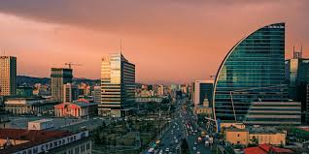
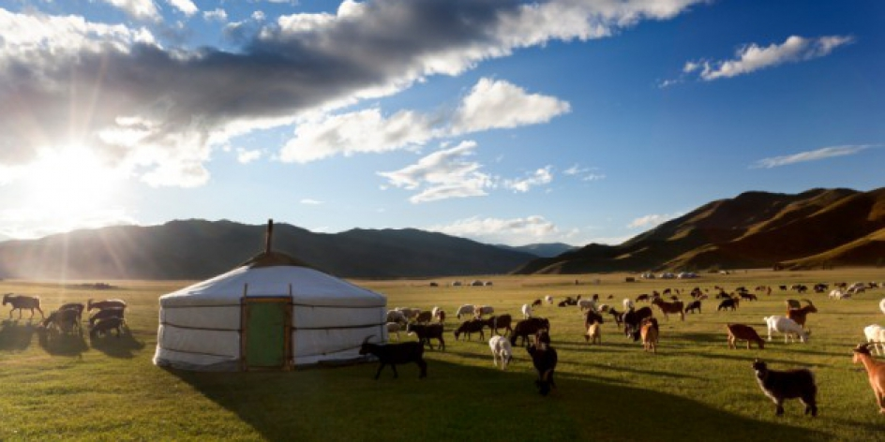
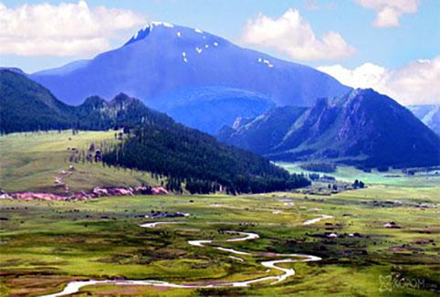
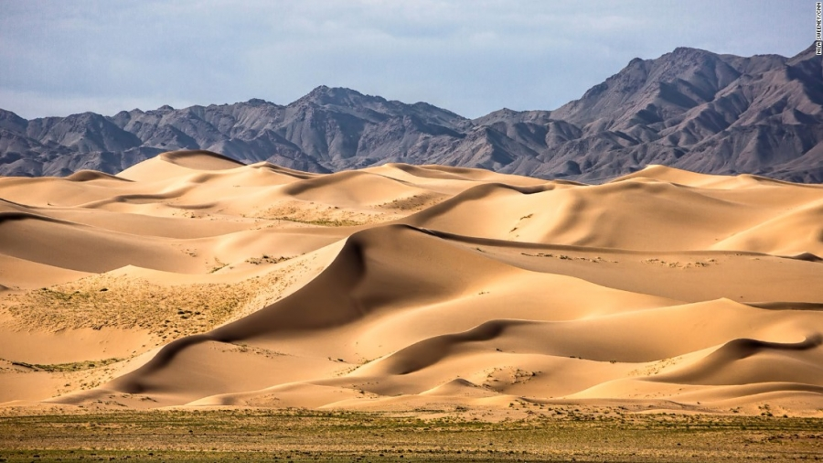
Thank you

