Slide 1

DIGITALIZATION OF HEALTHCARE IN KAZAKHSTAN
Ministry of health of the Republic of Kazakhstan
Astana
2018

Slide 2


Global trend: rising health care costs due to increased burden of chronic diseases, population aging and rising costs of technology
2
January 31, 2017: "... .. introduce a system of compulsory social health insurance, based on the joint responsibility of the state, employers and citizens. The effectiveness of this system is proved by world practice. The government needs to provide the necessary informatization of health care. “
January 10, 2018: "We should pass from ineffective and costly for the state medical examination to manage the main chronic diseases with the use of remote diagnostics, as well as outpatient treatment ...
Messages to the people of Kazakhstan
By the Head of state N.Nazarbayev
"Over the past decade, EH has played a key role in such processes as improving access to diagnostic services, improving the quality of care, increasing the level of coordination between service providers, improving case management, overcoming geographic factors of dissociating patients and service providers, and involving patients in the care of their own health and well-being ". The WHO Regional Office for Europe, "From innovation to implementation»
WHO Regional Office for Europe, "From innovation to implementation. EHealth in the WHO European Region 2016 .
Digital technologies quickly spread in most countries of the world. But digital dividends - wider benefits for development from the use of these technologies - are lagging behind. In many cases, digital technologies have stimulated economic growth, created opportunities and increased the effectiveness of service delivery. However, the combined effect of their use proved to be weaker than expected and distributed unevenly. The World Bank Group, "World Development Report. Digital dividends, 2016
.

Slide 3
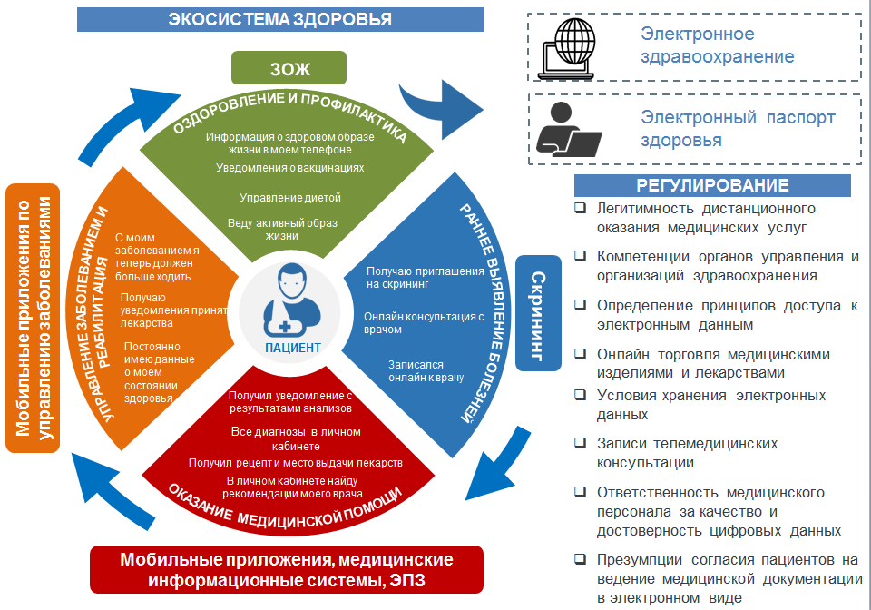
3

Slide 4


HEALTH AND PREVENTION (IMPROVEMENT OF QUALITY OF LIFE)
FROM MANAGING DISEASES TO HEALTH MANAGEMENT
HEALTH AND PREVENTION
Online monitoring of health indicators
Getting information about physical activity
Getting information about food consumed
Individual nutrition programs
Individual exercise programs
Individual HLS programs
The system of "smart" services for the implementation of a healthy lifestyle
Screening
How to lead a healthy lifestyle?
What and when should I get vaccinated?
Why engage in physical culture?
How to eat right?
3) Implementation in mobile applications of communication with portable medical devices for an organized group of the population and provision of access to medical workers through DPP.
Deadline: December 2018.
1) Explanatory work with the population on the use of infocommunication technologies in medical organizations.
Term: monthly
МЕРОПРИЯТИЯ
2) Notifications on nutrition, a healthy lifestyle, physical activity for a particular organized group of people.
Deadline: December 2018.

Slide 5




EARLY DETECTION OF DISEASES
«AS IT IS»
Inspection, referral and entry to narrow specialists, booking of tests
Extract and appointment of rehabilitation course
Emergency hospitalization
Costly treatment
Tests passing, treatment appoinment
EARLY DETECTION OF DISEASES
Appeal
examination
1
2
3
4
5
6
7
When to undergo a physical examination?
Ambulance
Hospital
Therapist
Narrowt specialist
Hospitalization
How to undergo primary diagnosis avoiding visit to the doctor?
PATIENT
Low effectiveness of prevention, emergency hospitalization
Invitation
for screening (SMS alerts, phone calls)
«AS IT WILL BE»
Automatic list generation through MIS
Inspection, referral and entry to narrow specialists, booking of tests
How to get to the doctor?
Statement on D-accounting
1
2
3
4
5
Therapist,
Narrow specialist
Tests passing
Тherapist
PATIENT
Effective targeted prevention
surveillance, including remotely
3) Teleconsultations of general practitioner with specialized special. on diabetes mellitus in the Karaganda region.
Deadline: December 2018.
5) Analysis of the accumulated data for the predictive diagnosis of art. hypertension in all regions
Deadline: April 2019.
1 SMS alerts and push notifications of screenings for a specific population in all regions
Duration: June 2018.
Events
2) Online appoinment to the doctor via mobile application in 4 pilot regions (Akmola, West Kazakhstan, Kostanay, Karaganda regions)
Duration: June 2018.
4) The competence centers "Virtual offices" (Telediagnostics) of functional diagnostics (cardiology) in the Karaganda region
Deadline: January 2019.

Slide 6

RENDERING OF MEDICAL CARE
«AS IT IS»
5.1
Tests passing
Осмотр, направление к узким специалистам
Direction for diagnostic tests
Appoinment
Inspection of narrow specialist
Appeal
5.2
analysis, patient notification
1
2
3
4
5
RENDERING OF MEDICAL CARE
Мед.сестра
Терапевт
Профильный специалист
Мед. сестра
5.3
appointment, treatment, re-admission of the patient
PATIENT
How to get test results?
examination of the therapist by results of analyzes
re-appointment
by results of analyzes
Where to look at your diagnoses?
«AS IT WILL BE»
Mobile application (egov, medical information systems)
Where to get the prescribed medicine?
Inspection, direction and appointment to prof. special, booking test passing
Tests passing
Where to find out the doctor's prescriptions and recommendations?
Examination
3.1
Appeal
1
2
3
appointment, treatment, following the results of the treatment, the patient's repeated admission (if necessary)
Тherapist
3.2
Narrow specialist
PATIENT
Single call canter
1) Step-by-step introduction of medical information systems
Deadline: December 2018.
3) Implementation of optimized medical services (reduction of visits), taking into account digitalization
Deadline: November 2018.
5) Voice input of data in the MIS
Deadline: January 2019.
2) Launch of the electronic health passport
Deadline: August 2018.
EVENTS
4) Conducting medical records in digital format
Deadline: January 2019.

Slide 7


MANAGEMENT OF CHRONIC DISEASES AND REHABILITATION
«AS IT IS»
Prescription of medicine for the next month
Updating the information about the dispensary patient
registered with a chronic disease (diabetes, arterial hypertension, oncology)
Prescription for medicine
Periodic inspection of the patient to monitor condition
Tests passing, the reception of prof. specialist.
Appeal
1
2
3
4
5
6
DISEASE MANAGEMENT AND
REHABILITATION
Nurse
Doctor
Narrow specialist
Nurse
Nurse
PATIENT
How to live with my diagnosis?
Mobile application (egov, medical
What medicine to take?
«AS IT WILL BE»
registered with a chronic disease (diabetes, arterial hypertension, oncology)
One-time prescription for medicine
Patient examination only in critical conditions
How to constantly monitor your health?
Appeal
1
2
3
Nurse
Doctor
PATIENT
Without visits - online renewal of prescriptions, online transmission of data on health conditions, update of information about a dispensary patient
1) Pilot projects for 3 disease management programs. (Diabetes mellitus, arterial hypertension, circulatory system diseases)
Deadline: November 2018.
3) A pilot project to create a virtual health assistant (Bot-med-consultant) on hypertension
Deadline: December 2018.
EVENTS
2) "Virtual schools of health." Address notifications for a certain group of citizens on the prevention of complications and the management of a healthy life style
Deadline: October 2018.

Slide 8
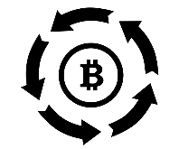





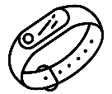


DIGITALIZATION OF THEHEALTH
ECOSYSTEM
ARTIFICIAL INTELLIGENCE
PATIENT AND DOCTOR
ACCESS TO ELECTRONIC HEALTH PASSPORT
Notification of patients about the need for screening and prof. examination
Electronic prescriptions, test results, diagnoses, recommendations)
SINGLE DATA STORAGE
INTEGRATION PLATFORM
FUND
OF THE SOCIAL HEALTH CARE
INSURANCE
MOBILE APPLICATIONS
MEDICAL INFORMATION SYSTEMS
Mobile applications, social networks for informing citizens about health issues
Smart Watches
Fitness Trackers
Online expertise
Online appointment with a doctor
Personalized notifications and recommendations
Online analytics
Forecasting
Clinical decision support systems
Mobile applications for dispensary patients
Dynamic data store
Telediagnostics
Electronic refferal
Remote consultation with a doctor
Wearable medical
devices
Online interpretation services for symptoms

Slide 9


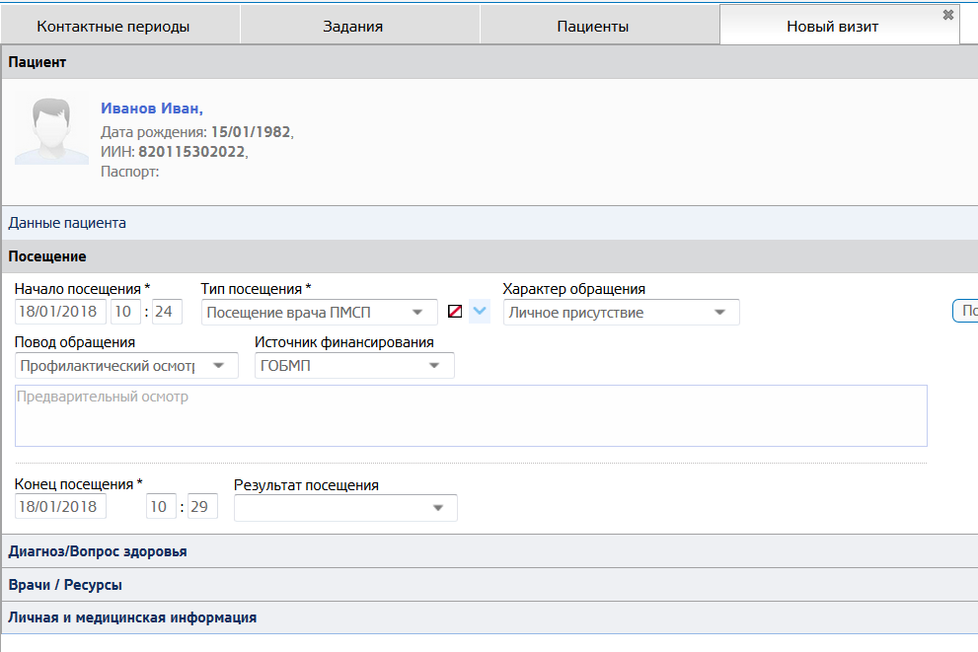
ELECTRONIC HEALTH PASSPORT
Patient Information
Diagnoses given by the attending physician
Quality management system of medical services, payment systems
Analytical systems, medical statistics, large data
ELECTRONIC HEALTH PASSPORT
Rapid access to important patient data for doctors
Electronic case history of each patient
Machine learning and artificial intelligence based on collected data
Complete refusal of paper outpatient cards and case histories
Unified research data warehouse
Collection and storage of data on the patient's health from the moment of birth and throughout his life
Participation of the patient in the collection and reliability of data on his state of health
Constant 24/7 access to data in electronic form
The coverage of 20% of the population in 2018

Slide 10













BIG DATA
11
PERIOD OF KEY DATA ACCUMULATION
2011-2018 YEARS
BIG DATA PROCESSING
2019-2021
Proactive Services for the Population
1000.. TB
Support for decision-making for both the doctor and the patient
1024 ТB
484 ТB
Prediction of genetic diseases (Watson for Oncology)
22 ТB
Predicting outbreaks
2018
2019
2020
2021-…
Planning of medicines volumes
Forecasting the expenditure of medicines
Data Centers
Labeling and tracing of medicines
Protection from the immutability of data based on technology blockade
Portable medical
devices
E-GOV
Government bodies
A roadmap for the implementation of “Big data" technology will be developed
MIS

Slide 11
ANTICIPATED EFFECT
STATE
Increase the patient's activity in managing his own health
BUSINESS
Online sales of services and products in healthcare
Increasing trust in health services (CRM-approach)
Development of the "Health" and "prevention"
industry
Expansion of GFMH by optimizing costly medical services
Savings of around 3,200 tons of paper per year on medical paper records
New workplaces
Optimization of non-productive work of average medical personnel about 6 billion tenge for 2018-2020
Development of the MICT in healthcare, start-ups
Optimization of the effectiveness of medical organizations IN THE COLLECTIVITY 150 BILLION. tenge for the years of 2018-2020
The volume of the market in infocommunication technologies of health care is about 3.5 billion a year
Оoptimization of pharmaceutical expenditures of about 28 billion tenge for 2018-2020

Slide 12



ЗОЖ
PATIENTS SATISFACTION
Anticipated effect
ОЗДОРОВЛЕНИЕ И ПРОФИЛАКТИКА
Raising the level of population satisfaction with the quality of medical care:
2018 - 44%, 2019 - 49%,
2020 - 55%
Информация о здоровом образе жизни в моем телефоне
Уведомления о вакцинациях
Управление диетой
Reduction in reception time
at the doctor's
Веду активный образ жизни
УПРАВЛЕНИЕ ЗАБОЛЕВАНИЕМ И
РЕАБИЛИТАЦИЯ
РАННЕЕ ВЫЯВЛЕНИЕ БОЛЕЗНЕЙ
С моим заболеванием я теперь должен больше ходить
Reduction of the time for obtaining the results of the study
Мобильные приложения по управлению заболеваниями
Получаю приглашения на скрининг
Reduction of "live" queues
Получаю уведомления принять лекарства
Скрининг
100% electronic prescription for free medicines
Онлайн консультация с врачом
ОКАЗАНИЕ МЕДИЦИНСКОЙ ПОМОЩИ
Постоянно имею данные о моем состоянии здоровья
ПАЦИЕНТ
Reduction of visits to the doctor
Записался онлайн к врачу
Получил уведомление с результатами анализов
Managing Your Own Health
Все диагнозы в личном кабинете
Availability and efficiency of medical services
Получил рецепт и место выдачи лекарств
Coverage of digital h-passports among population :
2018 – 10%, 2019 – 40%,
2020 – 50%, 2021 – 70%
В личном кабинете найду рекомендации моего врача
Мобильные приложения, медицинские информационные системы, ЭПЗ
All information about health is available online

Slide 13
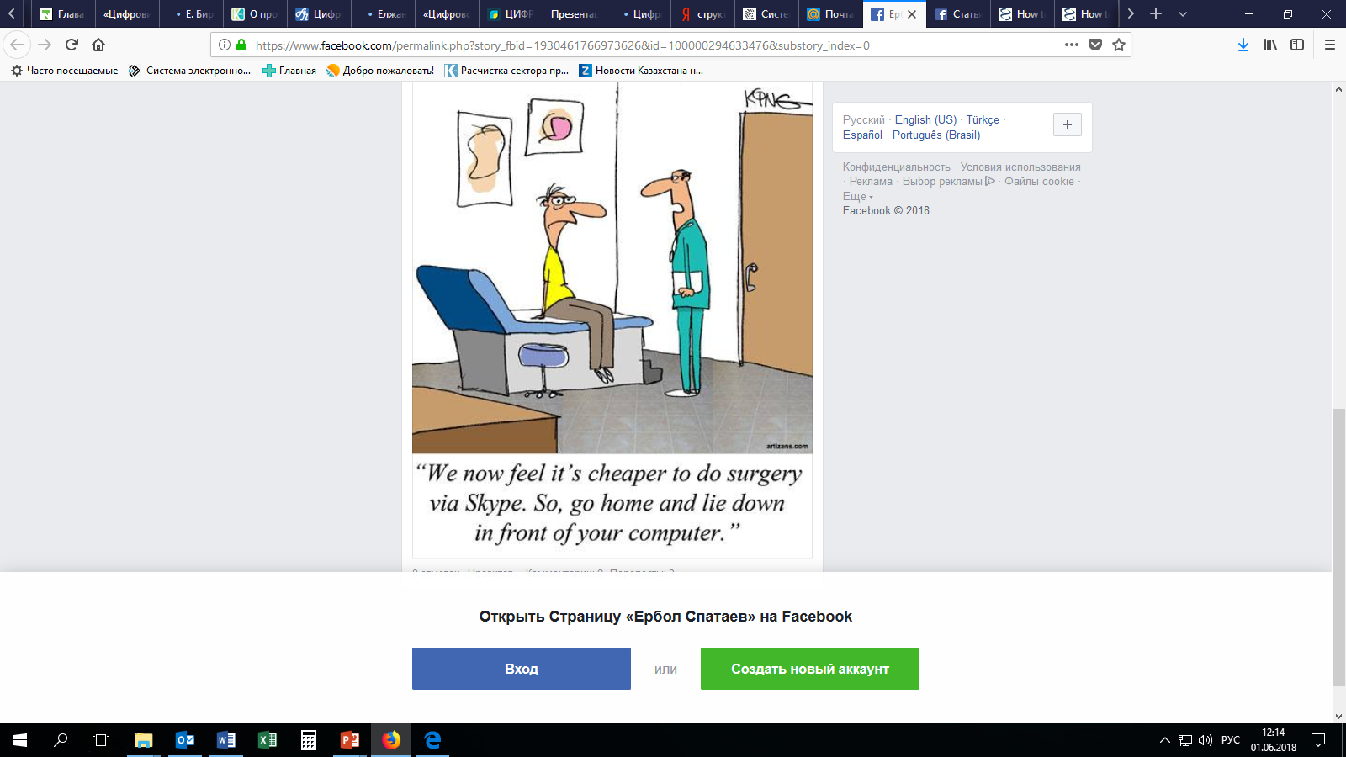
Thanks for attention!

