Slide 1

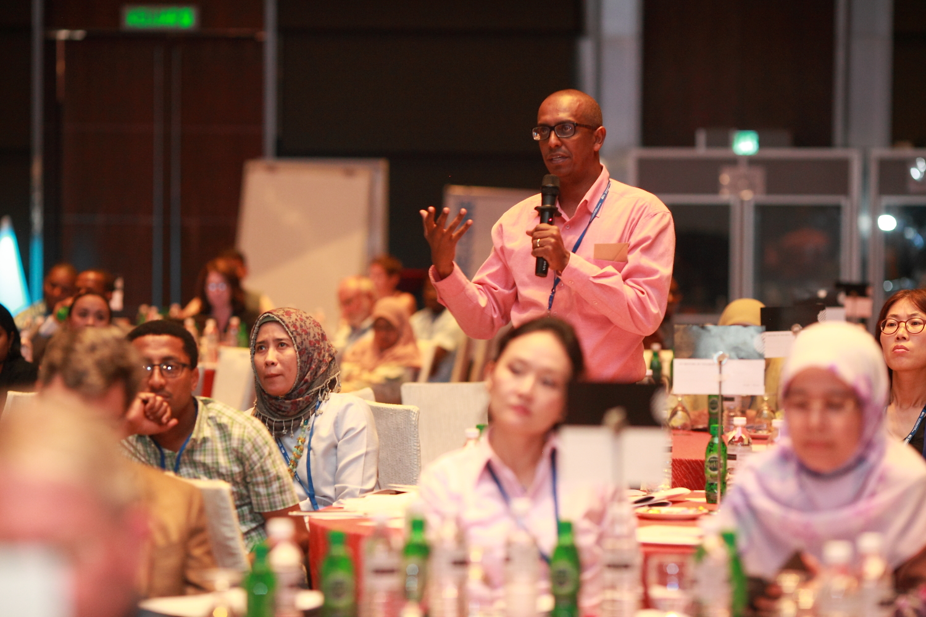



Accelerating Progress toward Universal Health Coverage

Slide 2
The Joint Learning Network: Practitioners and Policymakers Bridging the Gap Between Theory and Practice
Dr. Israel Pargas
Senior Vice President
Health Finance Policy Sector
PhilHealth, Philippines
June 20, 2018

Slide 3



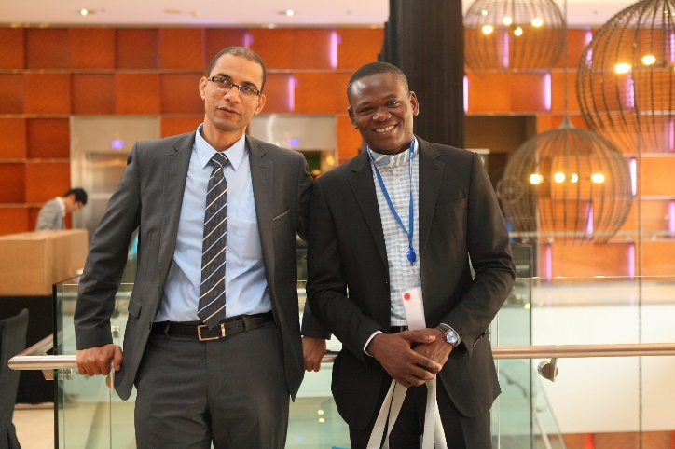
About The Joint Learning Network (JLN)
Our mission is to provide countries with a self-governed collaborative learning environment for harnessing collective expertise and experiences to:
  accelerate progress of individual countries toward UHC and
  contribute pragmatic solutions and tools as global public goods toward achieving UHC.

Slide 4
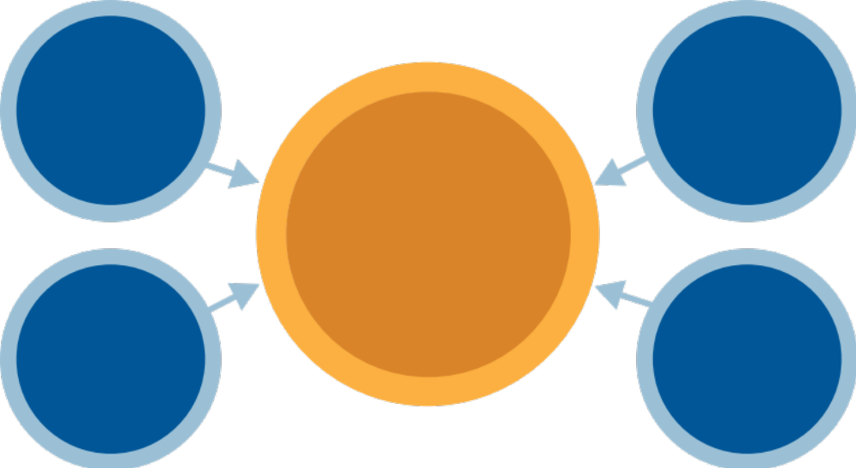
JLN’s Ultimate Goal
Expand health coverage
to reach target populations, especially the poor and informal sector
Promote financial sustainability of UHC systems
UHC for All
Extend health coverage to more than 3 billion people and ensure financial protection
Increase access to and utilization of essential health services, especially primary care
Improve quality of care and patient safety

Slide 5
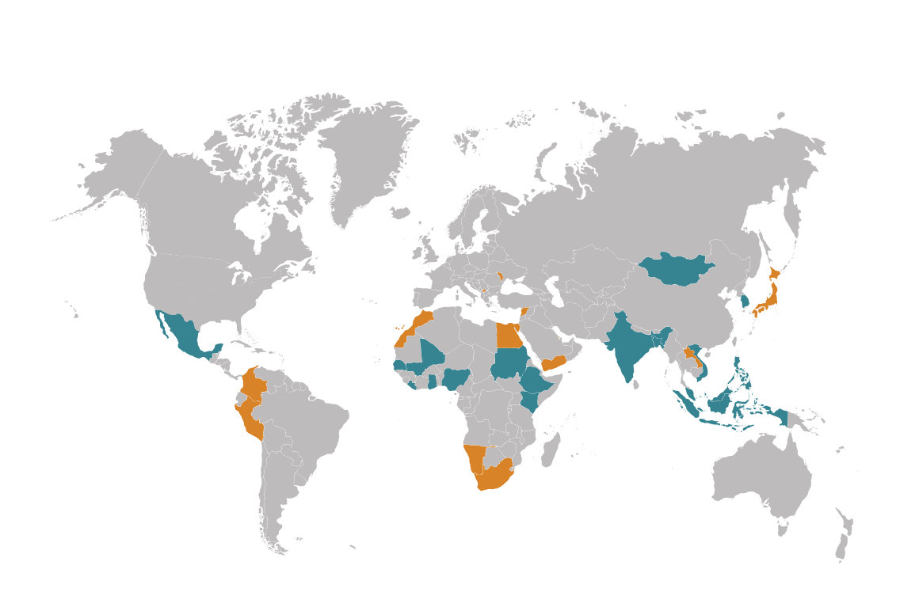
A Growing Network of Policymakers and Practitioners
Full Members
Bangladesh
Ethiopia
Ghana
Indonesia
India
Kenya
Liberia
Philippines
Malaysia
Mali
Mexico
Mongolia
Nigeria
Senegal
South Korea
Sudan
Vietnam
Associate Members
Bahrain
Colombia
Egypt
Japan
Kosovo
Laos
Lebanon
Moldova
Morocco
Namibia
Peru
South Africa
Yemen

Slide 6
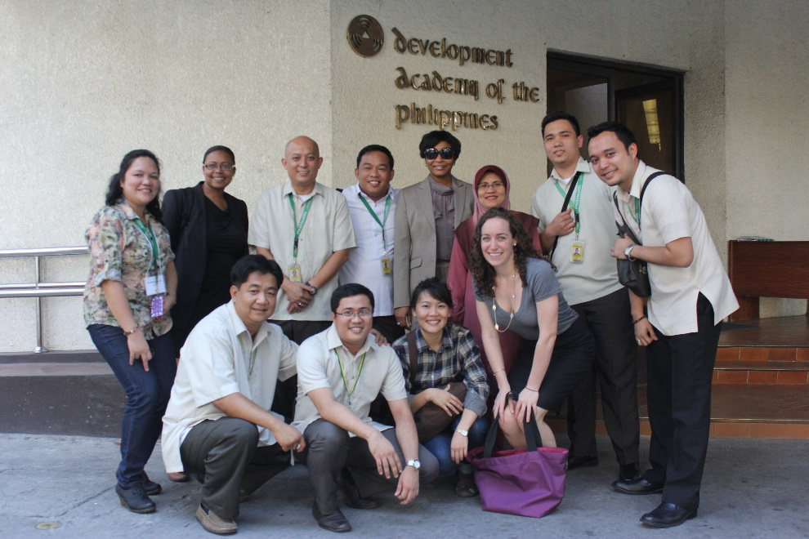
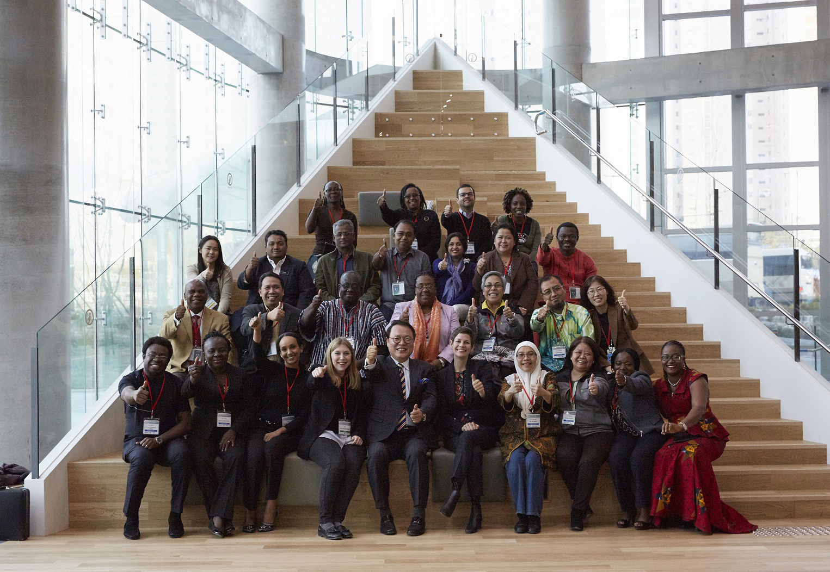
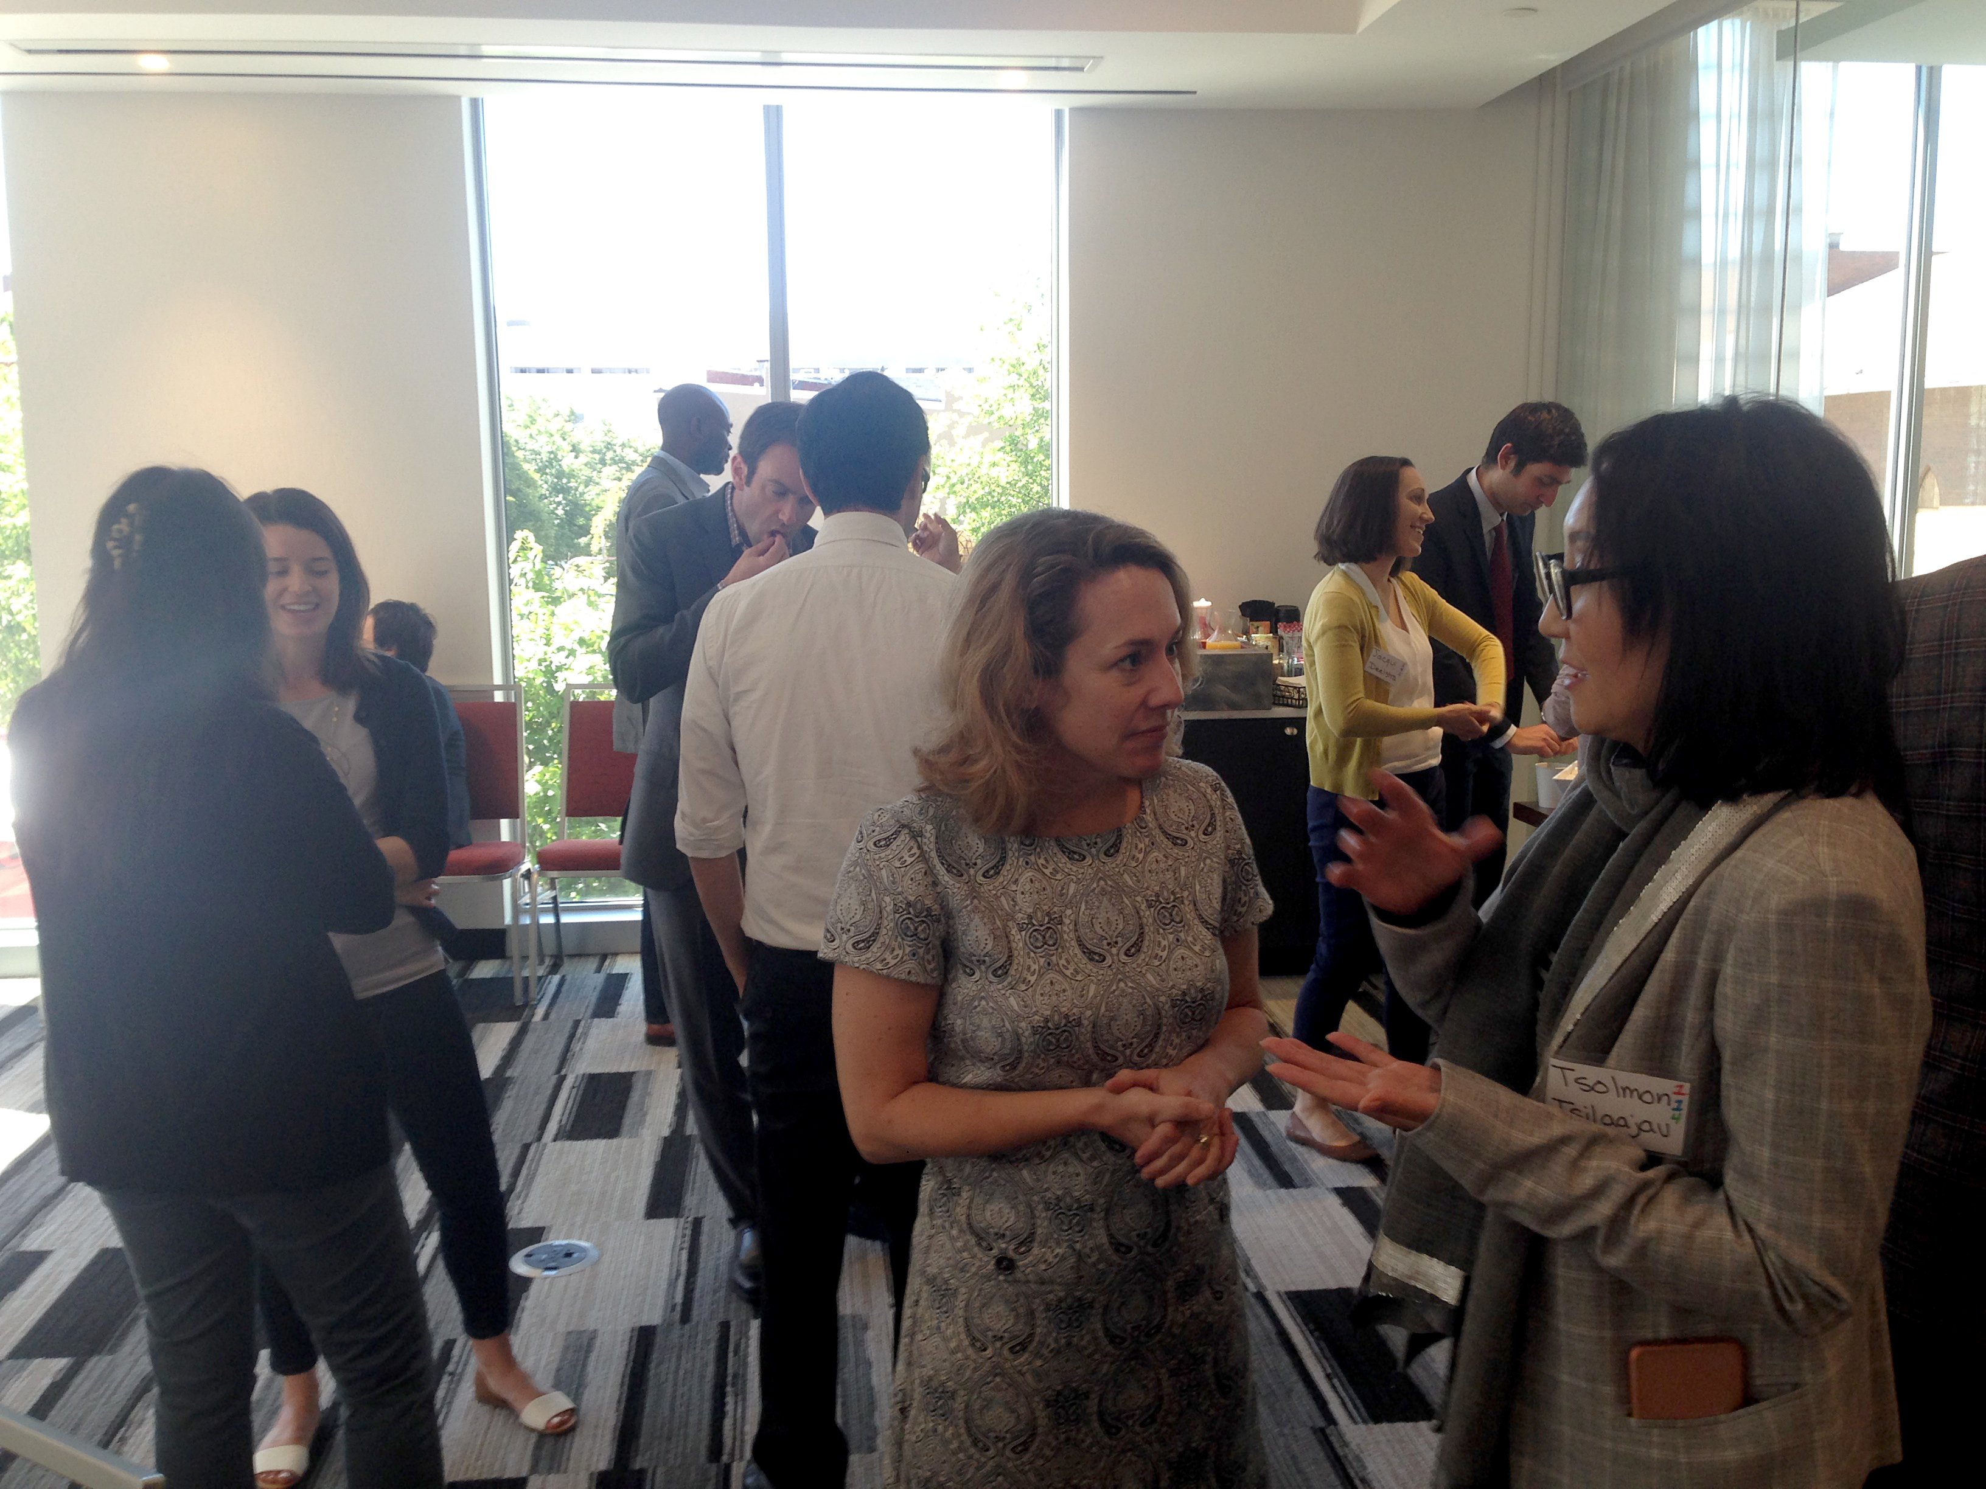
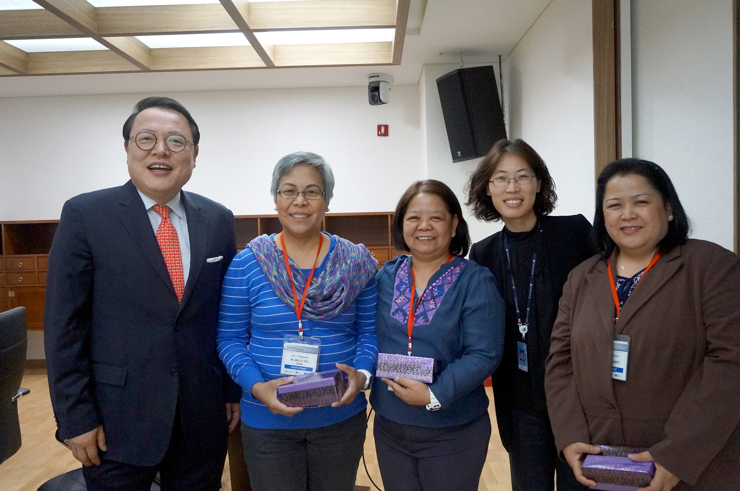
A Vibrant Community
The JLN is a vibrant community of country members deeply engaged in practitioner-to-practitioner learning to jointly problem solve, generate global knowledge, adapt pragmatic tools to a country-specific context and innovate pathways in their countries toward the goal of universal health coverage.
As a country-driven and country-owned network, JLN members work closely together, often developing life-long friendships, while pursuing UHC in their respective countries.

Slide 7







JLN’s Learning Priorities:
Technical Initiatives
Population Coverage
Primary Health Care
Provider
Payment
Information
Technology
Quality
Revisiting Health Financing
Extend equitable health coverage to all, with a focus on the poor and informal sector
Improve service delivery and utilization of preventive care by aligning primary care and health financing
Ensure financial sustainability, efficiency and quality through effective provider payment mechanisms
Enable data interoperability across health systems to support quality health care and responsible financial management
Incentivize health care providers to improve quality of services
Navigate resource needs, availability and utilization of priority health services

Slide 8
JLN Health Financing Collaboratives
Leveraging Resources for Efficiency |  | Domestic Resource Mobilization |  | Fiscal Policy for Public Health
Addresses challenges faced by countries in leveraging existing resources for health. |  | Deliberates the challenges that countries face when mobilizing domestic resources for health. |  | Examines the use of fiscal policy—such as tobacco taxes—to discourage consumption and gain positive health outcomes.

Slide 9
The Joint Learning Approach:
Co-producing Practical Knowledge

Slide 10
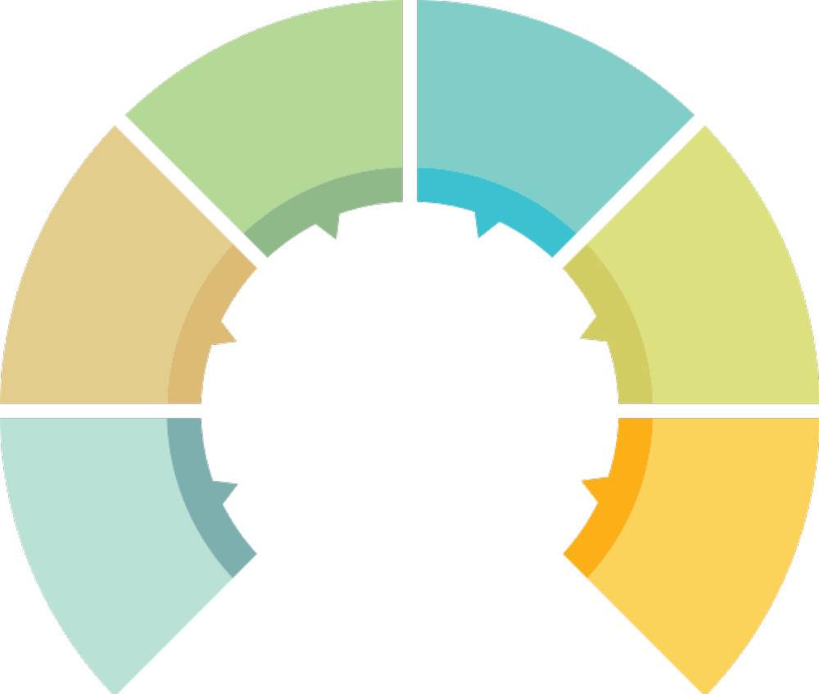
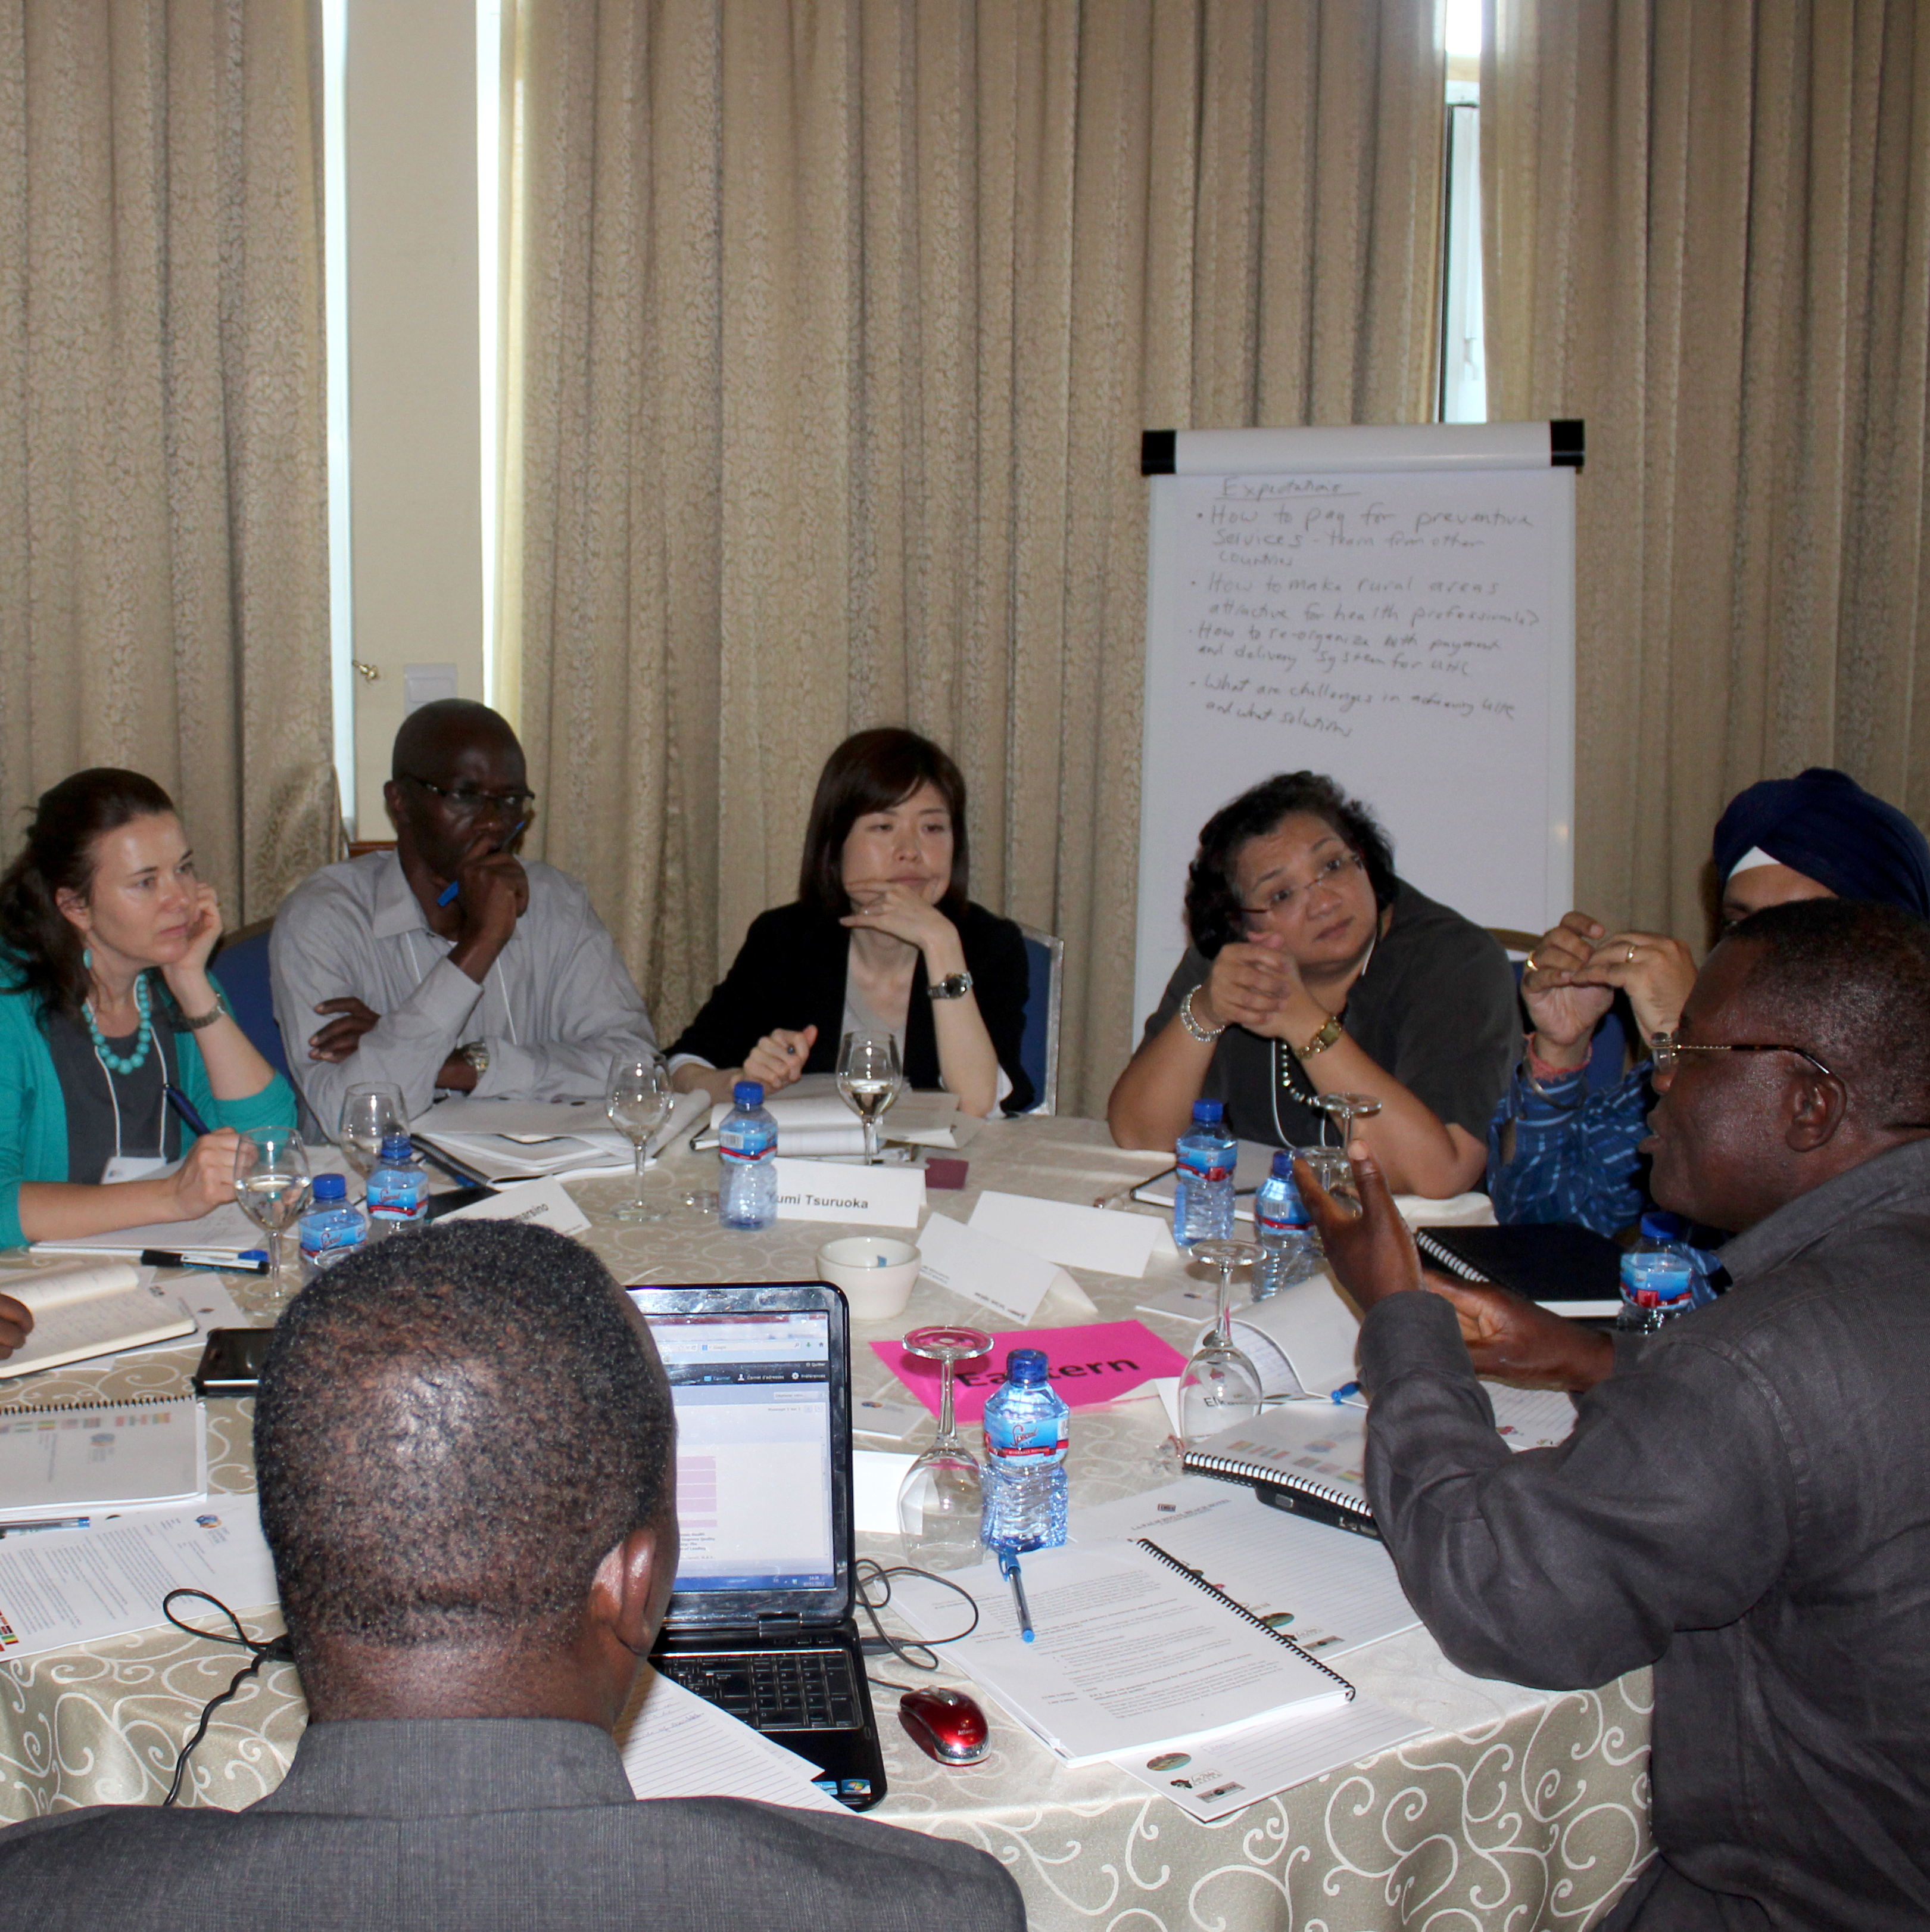
Creates space to analyze root causes of UHC challenges
Builds trust, safe space and community among members
Results in practical tools and knowledge that can be shared and applied
Highly relevant to countries’ reform priorities
Centers on country ownership
Creates opportunities for responsive follow-up by partners
THE VALUE OF COUNTRY-DRIVEN JOINT LEARNING

Slide 11

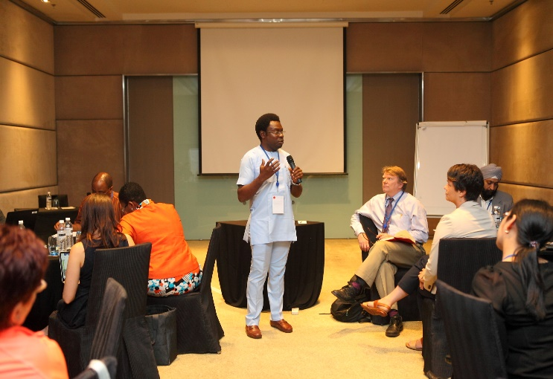
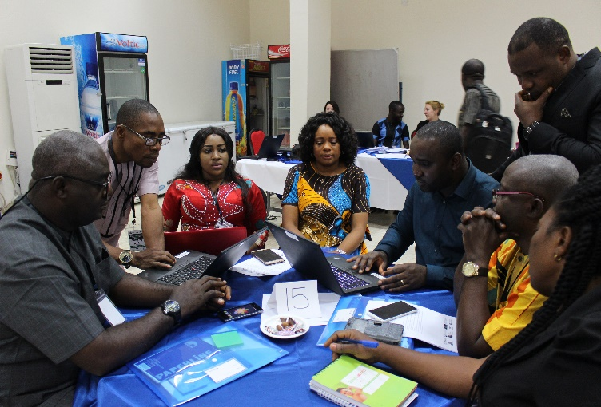
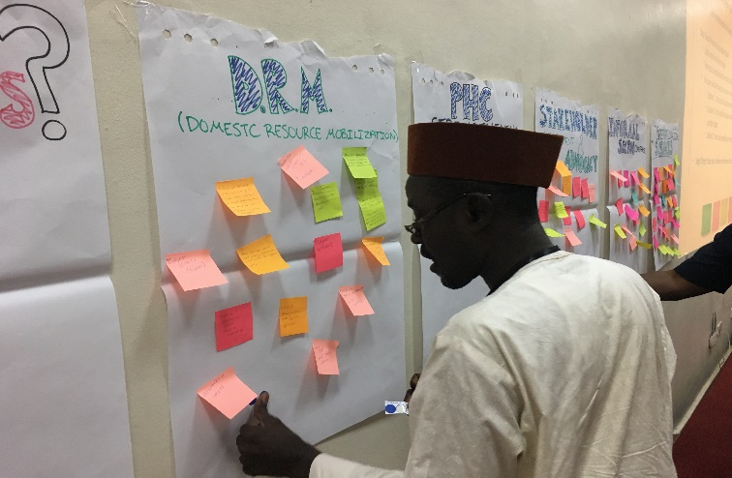
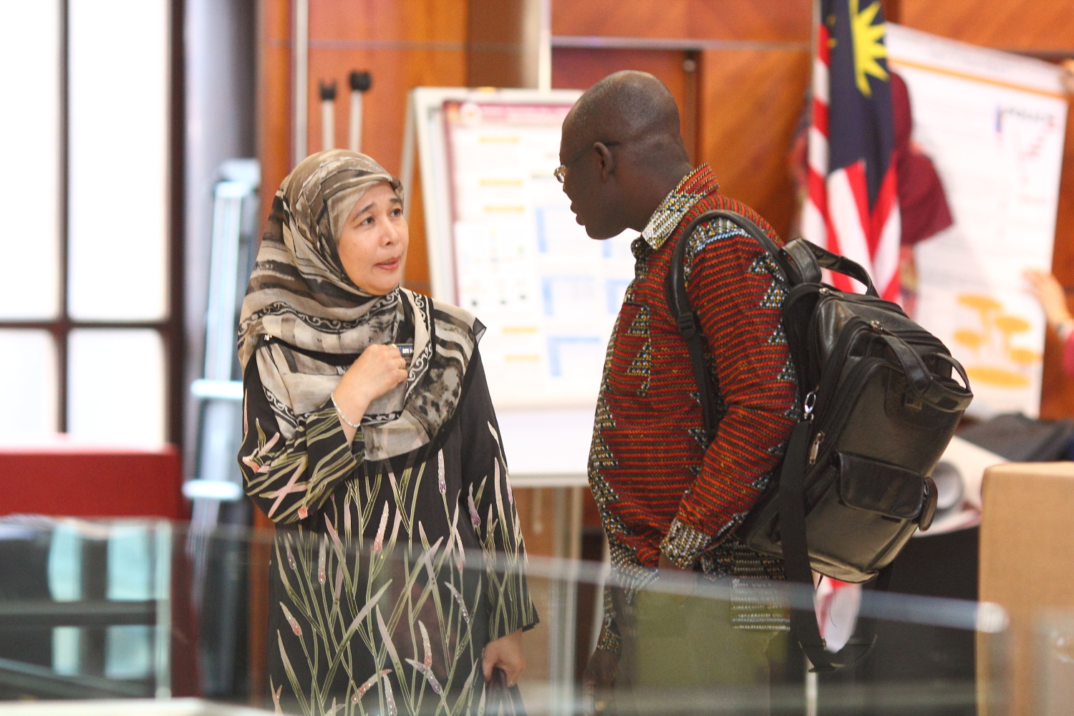
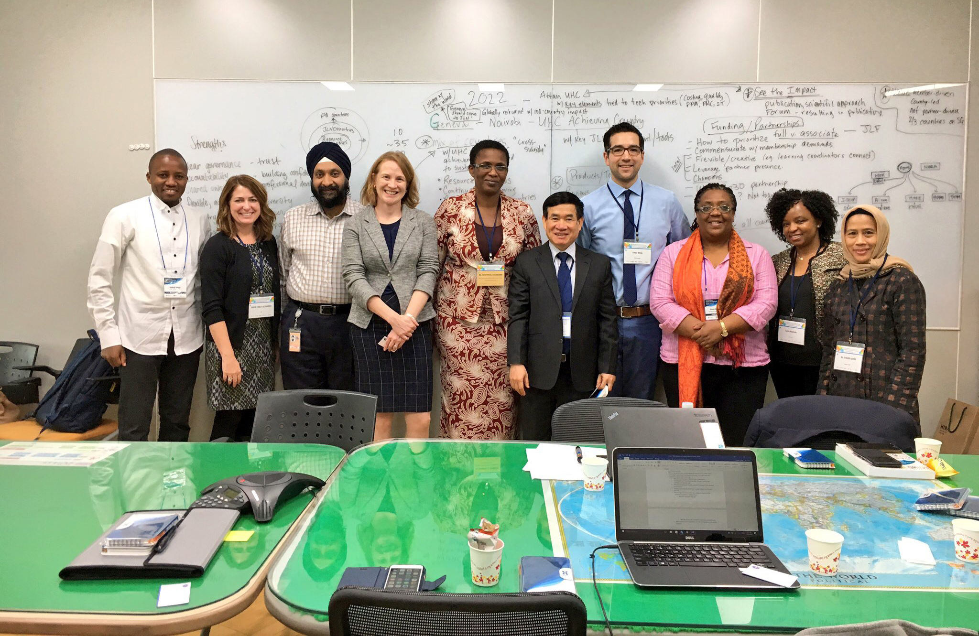
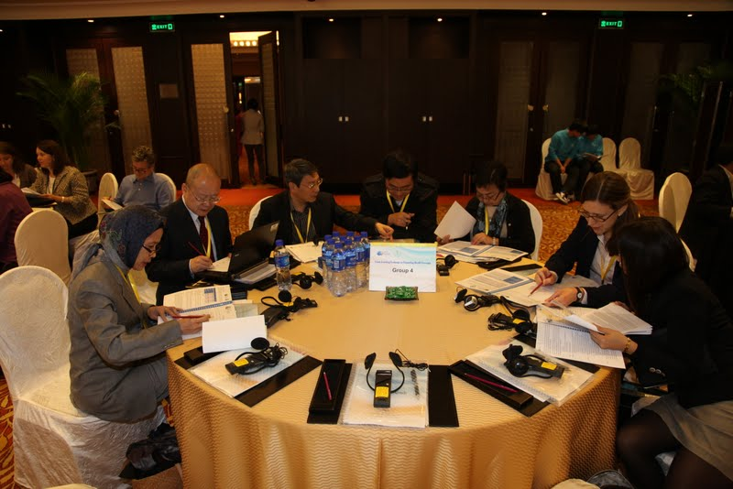
Joint Learning in Practice

Slide 12

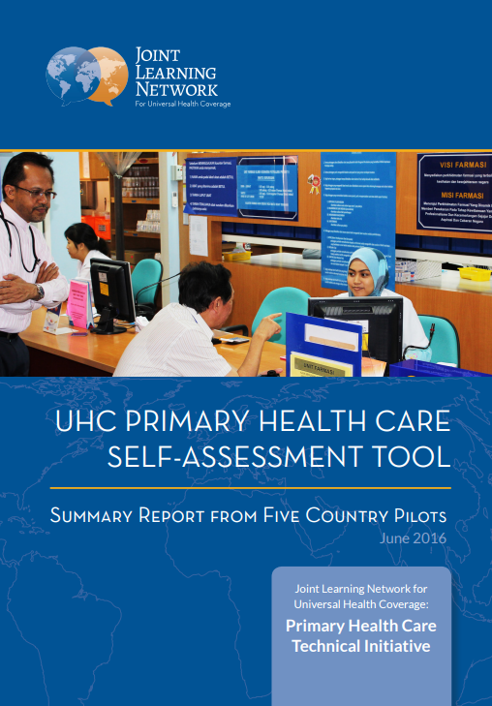


JLN as a Global Source of UHC
Knowledge
The JLN and its member countries have published over 20 knowledge products that address the practical how-to’s of universal health coverage reforms.
Visit jointlearningnetwork.org/resources to explore JLN’s resource library.

Slide 13
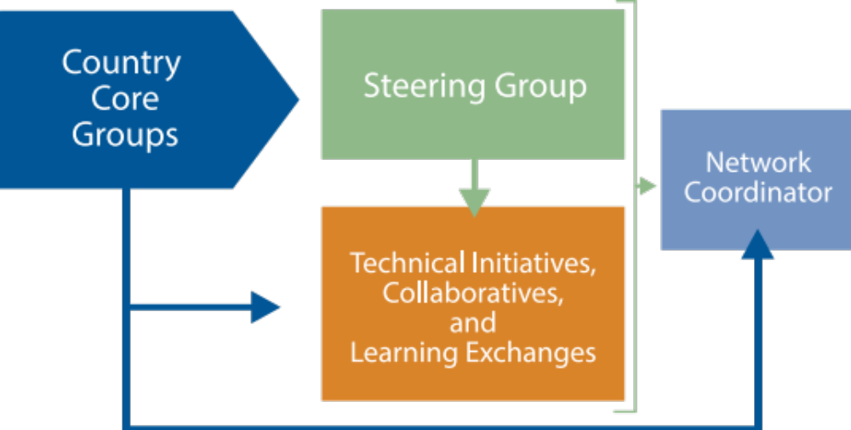
The JLN: A Country-Driven and
Country-Owned Model
The JLN is governed by a global Steering Group comprised of representatives from full member countries and partner organizations.

Slide 14




JLN Development Partners
The JLN receives generous funding from the following partner organizations:

Slide 15






Thank You!
Stay Connected
jointlearningnetwork.org
@JLN4UHC
@jointlearningnetwork

