Slide 1
Intercountry Conference on partnership collaboration: health financing reforms for universal health coverage, 19-20 June 2018, astana, Republic of kazakhstan
“Asia regional networking platform for sharing knowledge and practice”

Slide 2

Some data at global and Asia regional levels
Globally
Every year, 150 mln. people suffer from catastrophic health expenditure and about 100 mln. fall into poverty because of the use of health services.
ILO estimates that in some countries of the world 90 % of their population have to pay for health services from out of pocket without any social and financial protection.
Recent data suggests that more than 800 mln. people (almost 12% of world`s population) spend at least 10 % of their household budgets on health expenses for themselves, a sick child or family member. They bear “catastrophic health expenditure”.
Asia region
About 76.2 mln. of 100 mln. fall into poverty because of the use of health services.
Approximately 500 mln. people (more than 60% of 800 mln.) spend at least 10 % of their household budget on health.
Out of pocket payment (OOP) as % of current health expenditure accounts for 56% in South-East Asian countries and 46% in 5 Central Asian republics.
Share of OOP as % of private health expenditure accounts for 84% in South-East Asian countries and 95% in the same 5 Central Asian republics.
It shows that health system financing is a central issue to improve access to quality health services and social protection thus make progress towards “universal health coverage”.
Sources: -Tracking Universal Coverage, 2017 Global Monitoring Report, WHO and WB.
- Global Health Expenditure Database, WHO 2018.

Slide 3
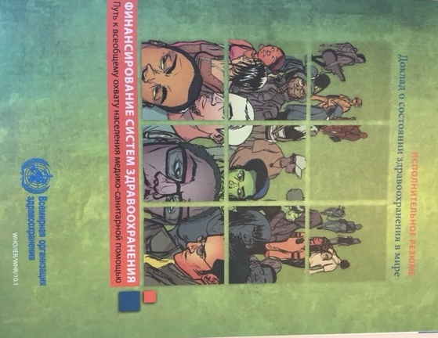
Universal health coverage (UHC)
World Health Report 2010.
Access to comprehensive and quality health services (promotion, prevention, treatment, palliative and rehabilitative care)
No one should be exposed to the risk to become poor due to health payments.
Health financing needs to be designed and organized to ensure that it provides access to all people to use comprehensive and quality health services without financial hardship.

Slide 4
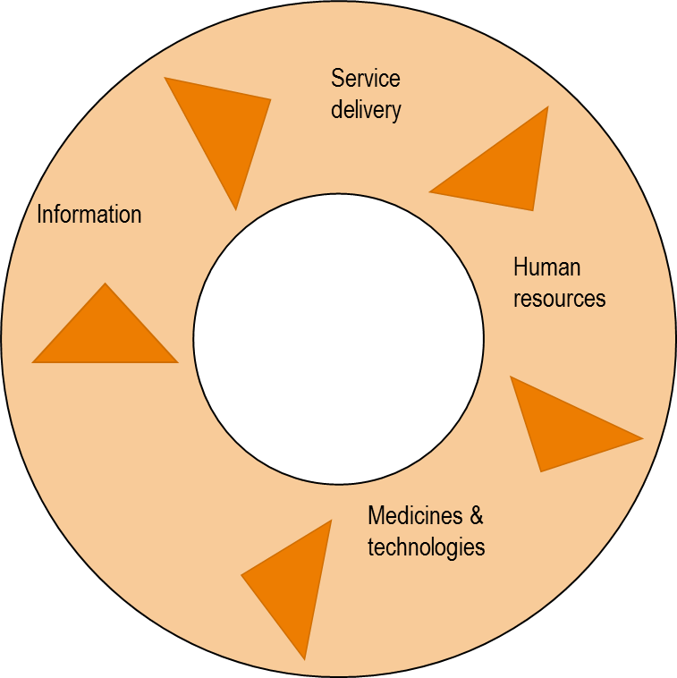
System approach to UHC
Health system strengthening – the main strategy and policy to attain UHC related goals and objectives.
Health financing is one of the core health system components. Practically, it connects all other components.
Мany countries in the world need to mobilize more monies for health and increase the share prepaid and pooled fund and their efficiencies.
There is no single answer for all and no country starts from zero ground.
Предоставление
услуг
Информация
Финансирование
Мед.кадры
Управление
Лекарства и технологии
Every country has own system and there is something to do in order to improve the health system. It is also important to share information, experiences, knowledge and lessons learnt including failures among each other.

Slide 5
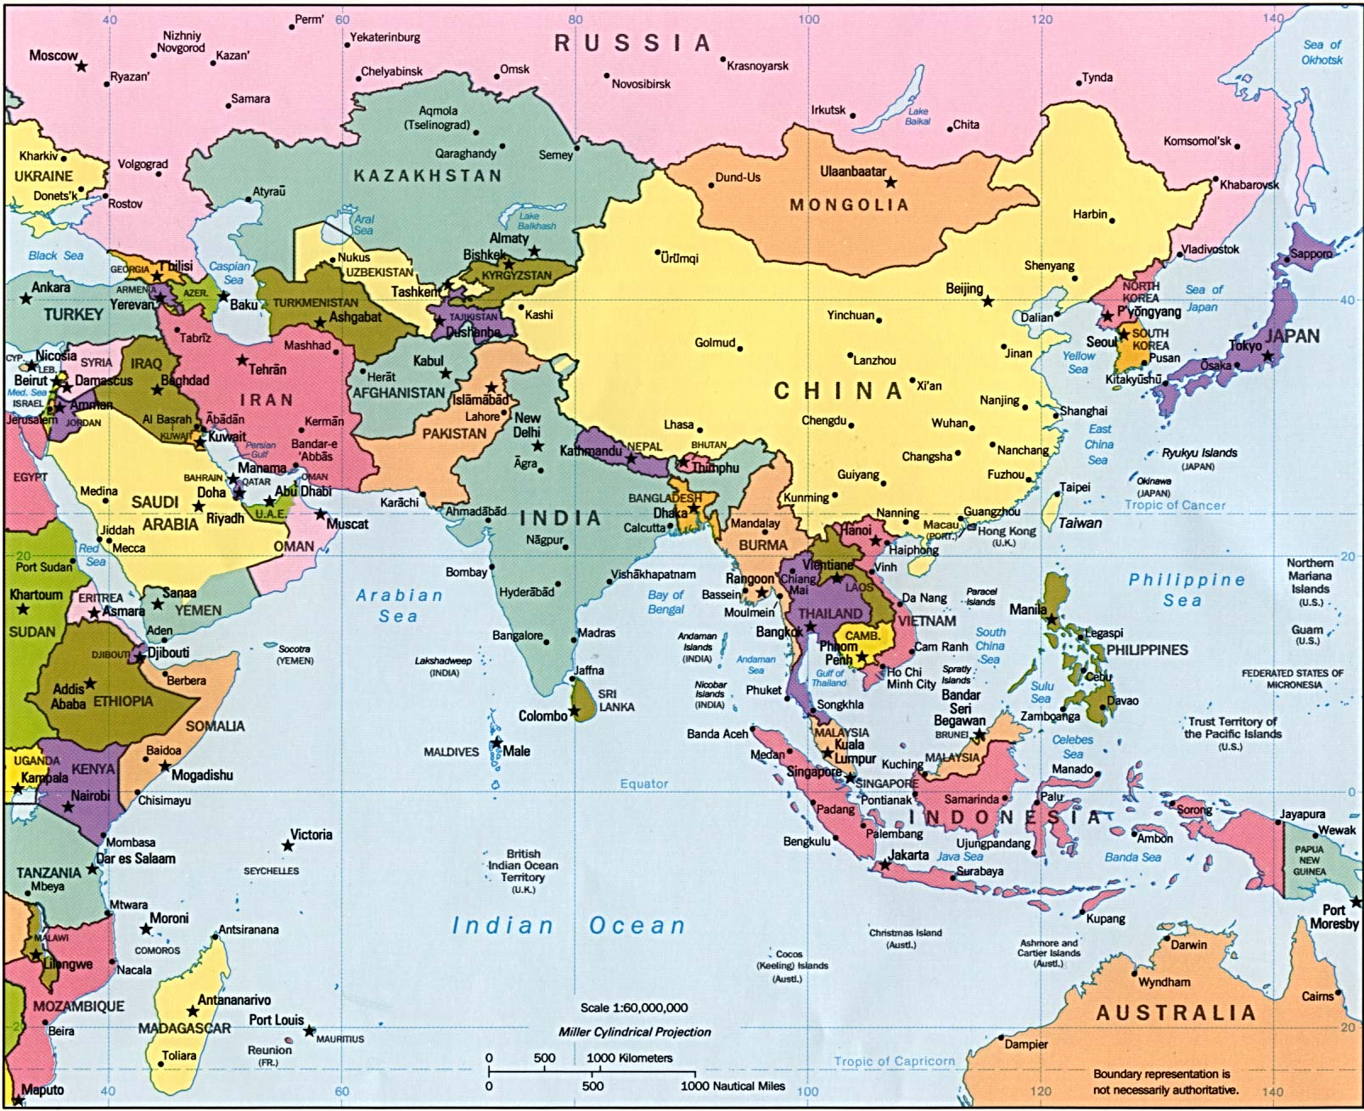
Asian region

Slide 6
Main aims for partnership
Create a particular space for communication and partnership (connect, inform and involve) on issues relating to health, social protection, finance and other related sectors.
Support universal and inclusive partnership open for all interested organizations, institutions, non-governmental and civil society organizations and other potential, non-traditional partners.
Build on existing mutually beneficial and equal partnership relations and activities to heighten potentials and synergies to attain common goals and tasks.
Expand regional pool of experts and use their professional and practical knowledge.
Increase access to relevant analytical work, reports, evidence, best practices and systematic information at regional and country levels.

Slide 7
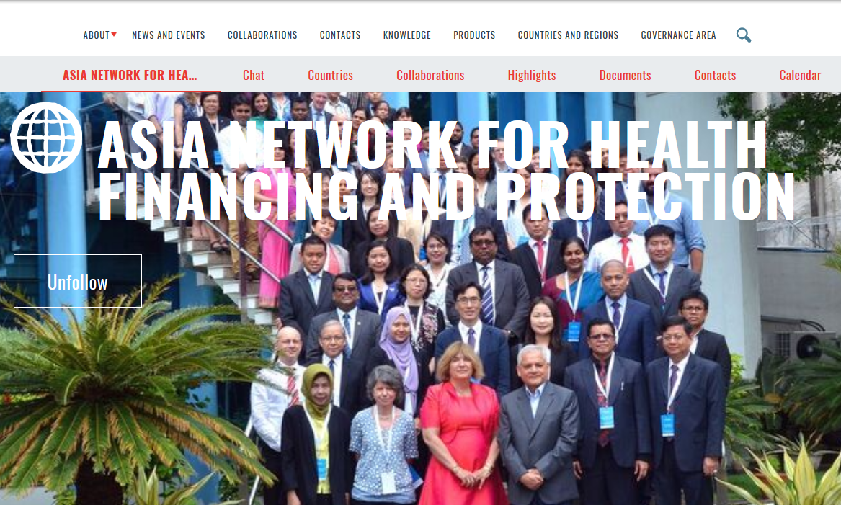
Network initiative
The initiative for Asia regional partnership was started in 2017. Strengthening, expansion, operationalisation are the network activities for Asian in 2018. These include:
Expert meeting to hear innovative and critical thinking and dialogue.
Sub-regional consultation to promote the Network among Asian countries.
Expansion to countries (South Korea, Malaysia, the Philippines, Russian Federation) and other networks such as Joint Learning Network (JLN), Asian Network for Health System Strengthening (ANHSS), Asia-Pacific Network for National Health Accounts (APNHA) and other organizations (ASEAN).

Slide 8
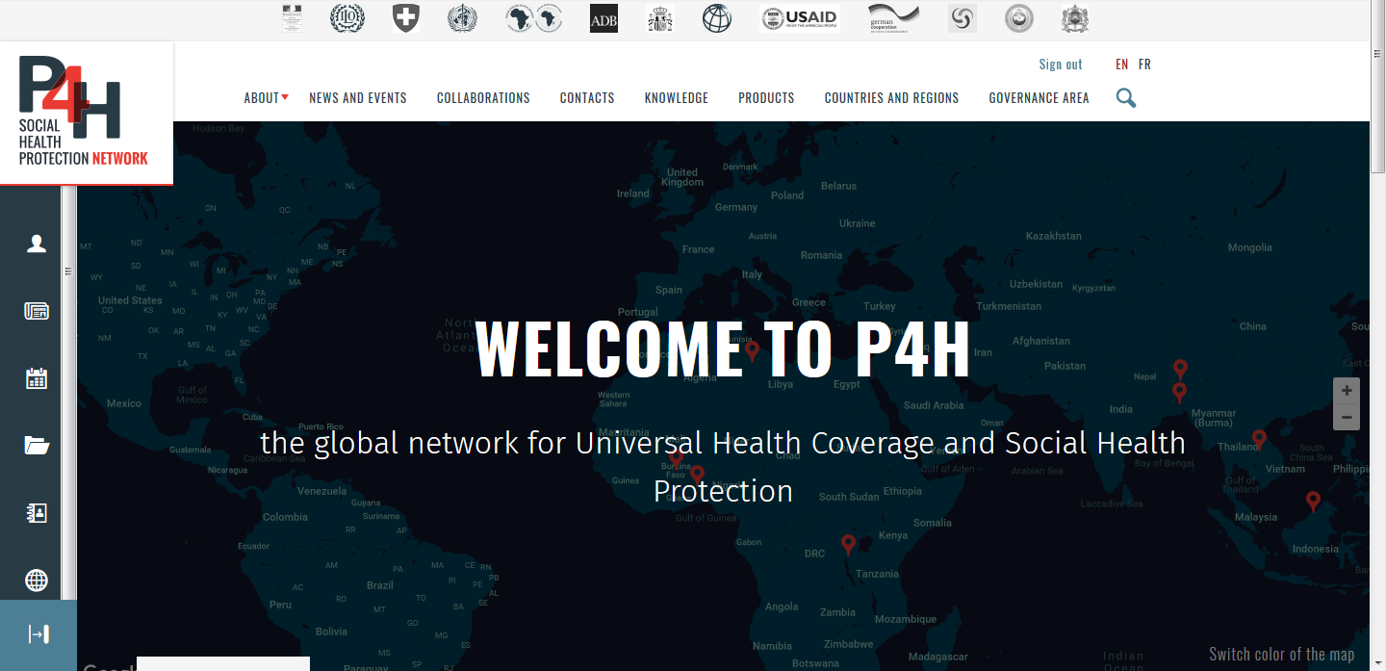
P4H web-platform

Slide 9
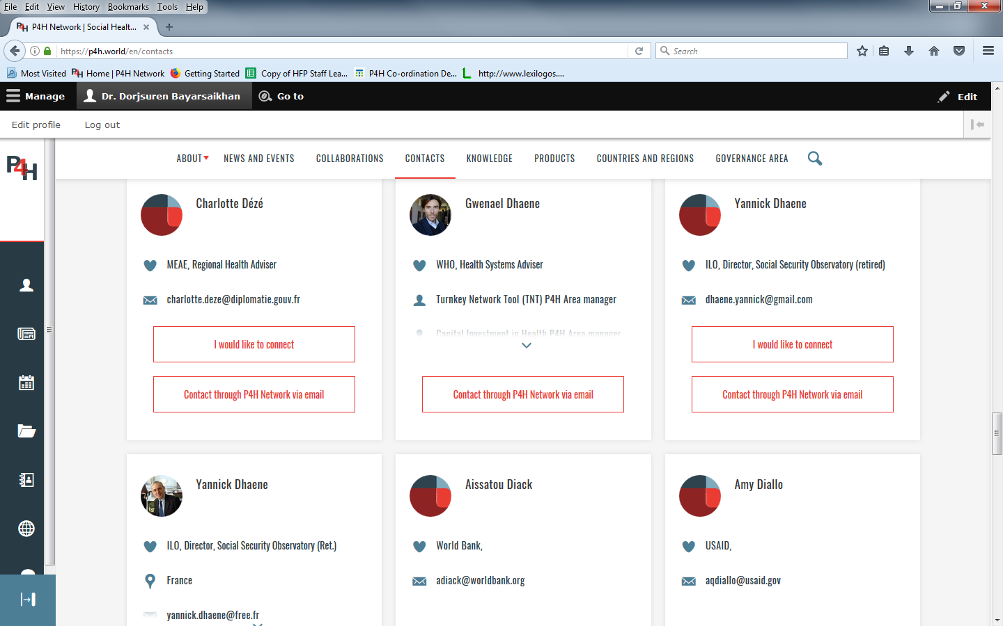
P4H web platform: Contacts

Slide 10
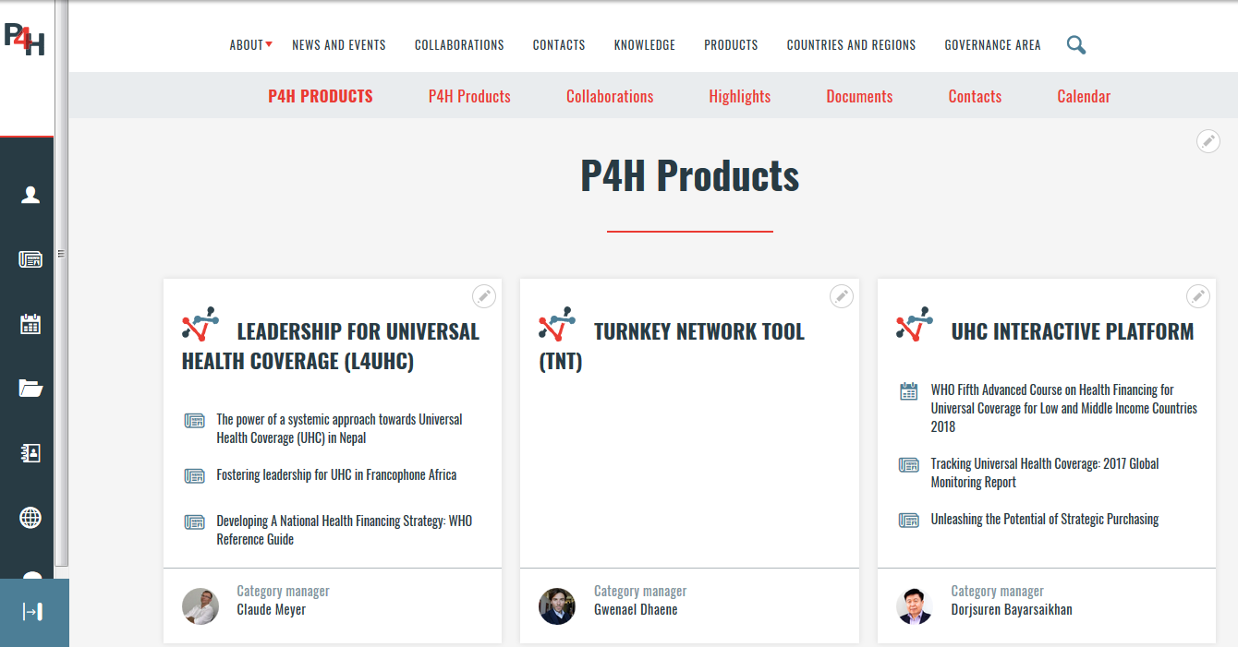
Access to P4H products: UHC interactive platform

Slide 11
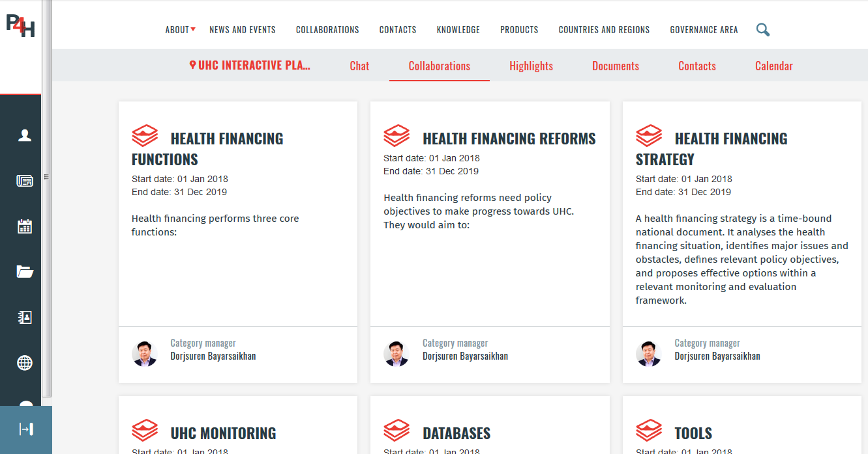
Interactive platform:
Partnership collaborations

Slide 12
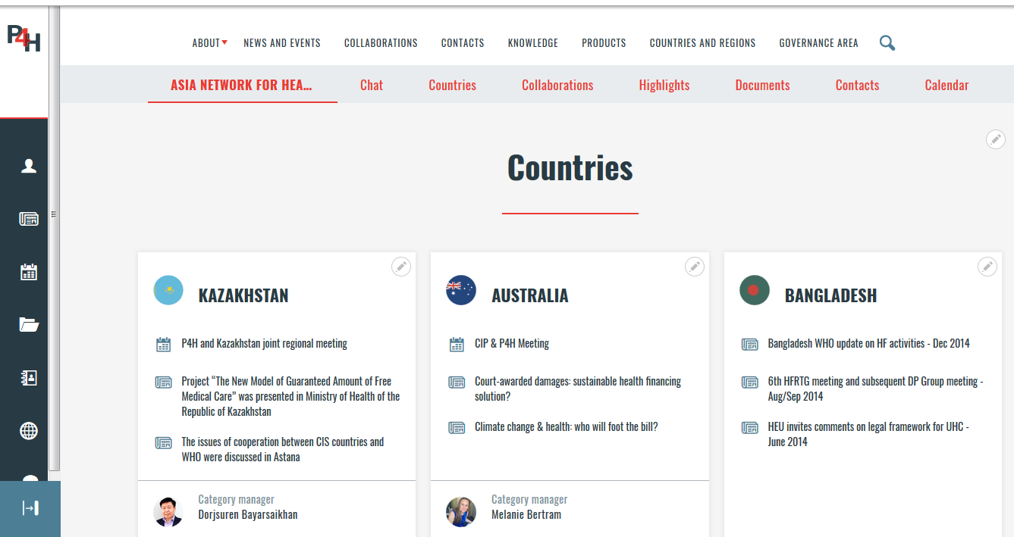
Asia network: Counrties

Slide 13
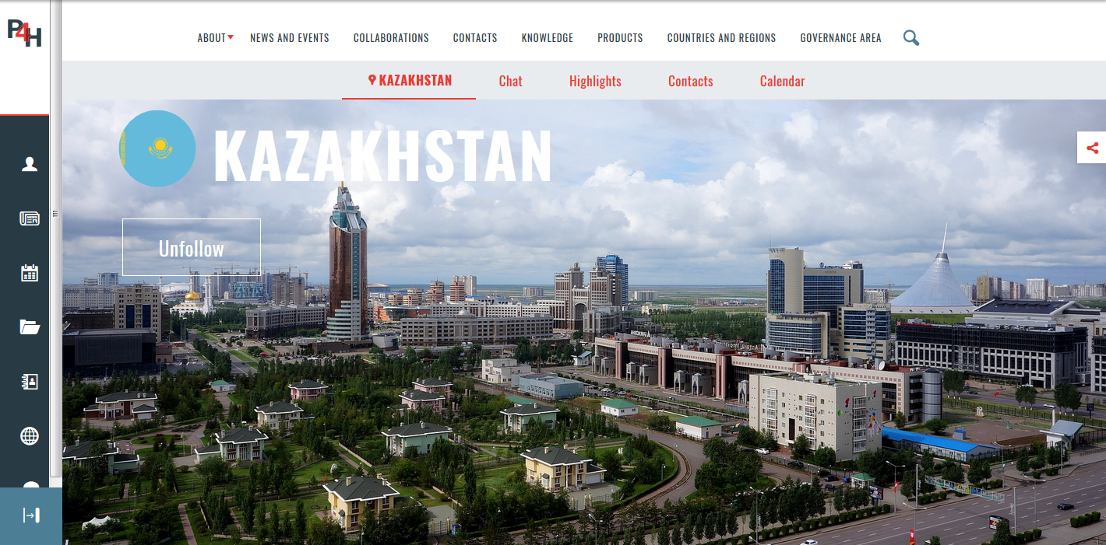
Countries: Republic of Kazakhstan

Slide 14
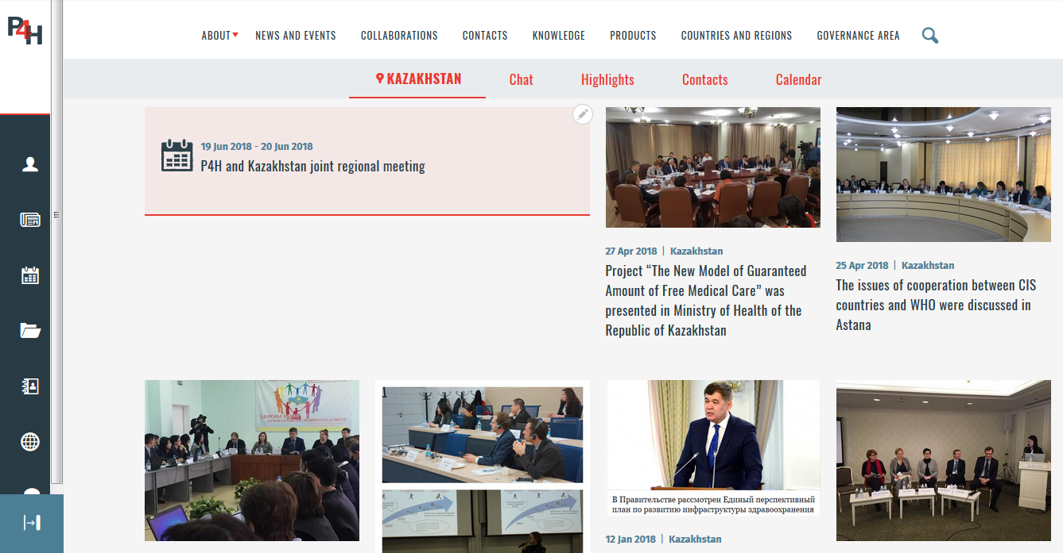
Republic of Kazakhstan: News and events

Slide 15

Thank you for attention
Connect us: www.p4h.world

