Slide 1

Evidence–informed policy making in health financing – lessons from the WHO project EVIPNet in Kazakhstan
Republican Center for Health Development
Ministry of Health of the Republic of Kazakhstan
Head of the Center for the of Education & Science Development
of the RCHD
Vitaliy Koikov
June 2018

Slide 2

Key messages
Worldwide, there is the problem of the effectiveness of spending the budget in the context of limited financial resources allocated to the health system
For the successful implementation of solutions in the field of health, incl. on the financing of health, it is necessary to systematically use the evidence in the development and implementation of policy decisions

Slide 3

Demand for the use of evidence in the development of health policy in the Republic of Kazakhstan
Health 2020
STRATEGY "Kazakhstan-2050“
Creation of modern and effective systems of education and health
Increase of responsibility, efficiency and functionality of the state apparatus.
Health development
Problem-solving
Engagement
Equity focus
Evidence base - policy-making based on evidence
Strategic Thinking
State program
"Densaulyk"
Improving the efficiency of health system management and financing
Increasing the efficiency of resource use and improving the infrastructure of the health system
Notes:
Принятый в 2012 году на 62-й сессии Европейского региональ­ного комитета ВОЗ программный документ «Здоровье-2020: Основы европейской политики в поддержку действий всего государства и общества в интересах здоровья и благополучия» в качестве основы для достижения стратегических целей и задач по улучшению здоровья жителей стран Европейского Региона определил необходимость «использования фактических данных (доказательств) при формировании политики», т.е. при разработке управленческих решений на всех уровнях здравоохранения

Slide 4

Evidence-Informed Policy – EIP
EIP - an approach to policy-making in healthcare, in which the best available evidences and research results are used in the decision making process - systematically and transparently - both at the stage of defining the agenda (problem identification) and at the stages of development and subsequent implementation of the policy decisions

Slide 5

Evidence-Informed Policy Network - EVIPNet
The purpose of EVIPNet:
the creation or strengthening of the knowledge translation mechanisms in support of public health and health service delivery systems, as well as health policy based on scientific research data

Slide 6
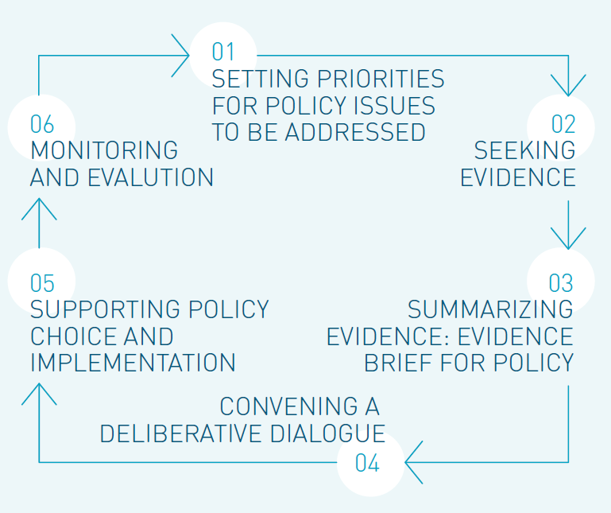
The cycle of work of the EVIPNet country teams
Source: Fourth EVIPNet Europe multicountry meeting, 14-16 June 2018, Chișinău, Moldova

Slide 7


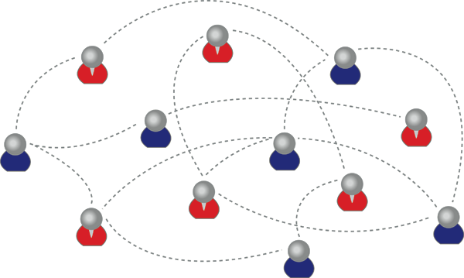


EVIPNet Europe and its 19 member countries
The former Yugoslav Republic of Macedonia
Georgia
Hungary
Albania
Romania
Kyrgyzstan
Serbia
Slovenia
Bulgaria
Poland
Republic of Moldova
Tajikistan
Ukraine
Russian Federation
Kazakhstan
Lithuania
Turkmenistan
Estonia
Slovakia
Source: Fifth EVIPNet Europe multicountry meeting, 14-16 June 2017, Bratislava, Slovakia

Slide 8
The main stages of Kazakhstan's participation in the EVIPNet-Europe Network
2012 year
The launch of the EVIPNet-Europe Network
2014 year
Kazakhstan joined to EVIPNet initiative
2015 year
April - the launch of the EVIPNet initiative in Kazakhstan
2015-2016 years
Conducting situational analysis “Evidence-informed health policy-making in Kazakhstan”
2017-2018 years
discussion of the SA results with the participation of key stakeholders, finalization of SA
2017-2018 years
preparation of the Evidence Policy Brief on AMR
Methodical support
WHO Regional office for Europe
- EVIPNet Secretariat
Izmir, Turkey
Bled, Slovenia
Trakai, Lithuania
Kishinev, Moldova
Bratislava, Slovakia
Multi-country meetings
2012 | 2013 | 2014 | 2015 | 2016 | 2017 | 2018

Slide 9

The situation analysis (SA) “Evidence-informed health policy-making in Kazakhstan”
1. The general situation in the country
2. Health system
3. National system of scientific research in the field of health
4. The process of evidence-informed policy-making
5. KTP Institutionalization
EVIPNet-Europe Situation Analysis Mannual
Dates: 2015-2016
Presentation of the SA draft:
February 14, 2017
Finalization of the SA
Tasks:
To describe and to understand the conditions in the country that can facilitate or hinder the dissemination of knowledge and EIP;
To provide basic information for the organization and to conduct discussion on the establishment of an appropriate and sustainable KTP;
To strengthen cooperation with international partners in support of follow-up work under the KTP
Data sources:
Official publications
The results of the stakeholder survey, (1st group - "policymakers": specialists of the MoH, RCHD, 2th group "generators of new knowledge": specialists from universities, research institutes, NCs, NGOs
Results of interviewing representatives of stakeholders involved in disseminating knowledge and formulating policies

Slide 10
General situation in the country
Opportunities
Challenges
The political support of the EIP at the state level
Implementation of project management in the Ministries
Strengthening the role of civil society, incl. NGOs in policy development.
An influential player in the political arena is the mass media, which can provide substantial support to the EIP
A centralized vertical policy-making system reduces efficiency and transparency of the policy-making process.
High staff turnover in government bodies (MoH etc.) often leads to a change in goals and decisions, a decrease in the effectiveness of the implemented policy.
There is a discrepancy between the declared political support of the EIP and the actual scale of the EIP spread

Slide 11
Health system
Opportunities
Challenges
The introduction of modern management in the work of the MoH of the RK and health organizations contributes to the expansion of the practice of using evidence in the policy-making
Participation of representatives of the medical community and civil society in the development of health policy (Public Council of the MoH and the Joint Commission on Quality of Medical Services)
Regular placement of an order for carrying out analytical research and development within the framework of Budget program 001 allows the policy-makers to receive methodological support and evidence in the development of policy decisions
The introduction of an interoperability platform creates the conditions for access to quality and reliable data
The lack of highly qualified experts in government bodies with sufficient practical experience and scope of competencies limits the opportunities for rapid introduction of the EIP
The inadequate level of expenditure on health may negatively affect the functioning of the future KTP and its financial sustainability.
Insufficient integration of information systems in the health system hinders the continuity of information flow and limits the possibilities of operational analysis.

Slide 12
National Health Research System
Opportunities
Challenges
The development of research and innovation is one of the priorities for health
The state is interested in developing the research potential in the field of the Public Health, as well as in the field of health system research.
Establishing research priorities is systematic and consistent - based on foresight research
International standards have been implemented in the training of health professionals and in research
There is a potential for conducting high-level research in the field of medicine, Public Health and health systems
There is support from international organizations
Insufficient funding for research in the field of health
Insufficient infrastructure development for high-quality research
Absence of a full-text unified database on Kazakh scientific research
Access to global resources is limited due to inadequate knowledge of English among scientists
Insufficient scientific capacity and quality of health research
The results of scientific research are not available to policy-makers, and they are not used in policy development.

Slide 13
The process of evidence-informed policy-making
Opportunities
Challenges
Policy-makers and academics point to the need for immediate implementation of effective mechanisms for the dissemination of knowledge
RCHD contributes significantly to the use of evidence and research results in policy-making
There are organizations in Kazakhstan with the potential for disseminating knowledge
There is a successful experience in conducting policy dialogues on health policy issues;
There are positive examples of the EIP, the implementation of the EBM principles, which can form a culture that is favorable for EIP
Political promises, lack of financial resources and personnel often influence policy choices more than research data;
The level of application of the research data is low due to lack of awareness and experience of participants.
Quite often there is a low level of quality of scientific research results
It is necessary to strengthen the opportunities for the translation of scientific research data in accordance with the conditions of the country;
It is necessary to further develop the practice of regular policy dialogues

Slide 14
EIP Institutionalization
Opportunities
Challenges
In Kazakhstan, there are conditions for the EIP development and the KTP creation
Two final scenarios for the future work of the KTP were developed - the KTP on the basis of the RCHD and the KTP on the basis of the RCRC and MU consortium
The agreement between the MoH, RCHD and MU (in the case of the second scenario) can provide the KTP with EIP authority with sustainable support for the relevant functioning
A wide range of stakeholders can be involved in the KTP formation
The cooperation between the MoH (as a supervisory authority), RCHD (as host organization) and WHO (advisory and mentoring) can play an important role.
The experience of implementing previous initiatives points to the need for strong political support for the institutionalization of EVIPNet through the KTP formation
Additional funding is required for the KTP formation and training events
High turnover of staff in the MoH and the RCHD can lead to loss of the potential and relevance of EIP over time.
It is necessary to raise awareness among stakeholders.
While maintaining the current workload, the KTP team may have difficulty performing its functions

Slide 15



Required Activities
Increasing the awareness of all stakeholders (and researchers and policy-makers) about the importance and necessity of using the best scientific research data:
conducting regular trainings on evidence-based practices
creation of effective motivation and formation of a culture of using the best quality data in professional activity
Improve the practice of the formation, adaptation and application of research data:
increase the competence of researchers,
improvement of the material and technical basis of scientific organizations
improving the methodology of research,
strengthening coordination of research at interdepartmental and interdisciplinary levels;
Introduction of effective mechanisms of communication between all stakeholders:
development of interactive platforms on topical issues in the sphere of organization and management of healthcare with the involvement of leading domestic and foreign scientists;

Slide 16
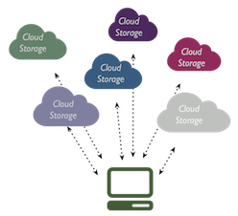

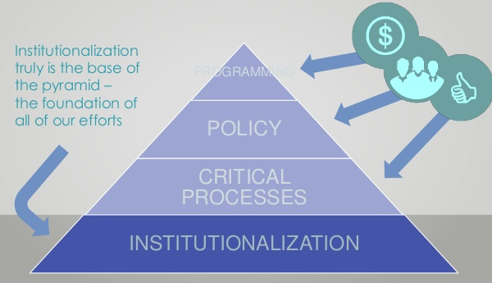
Required Activities
Ensuring access of all stakeholders to actual health data:
development of a national health research portal,
integration of information resources in NHIS and ensuring the quality of their content,
providing access to international databases of scientific and technical information.
Formation of the country team leaders from among:
policy-making
organizers of the health system,
researchers,
representatives of civil society,
who will support and promote all the above-mentioned activities and initiatives, actively integrating Kazakhstan into the global EVIPNet network
The institutionalization of the Knowledge Translation platform can be placed in the Republican Center for Health Development with active participation of all stakeholders

Slide 17
Practical steps to develop the EVIPNet Network in Kazakhstan
Already done
In the work
It is planned
Preparation of situational analysis on EVIPNet in Kazakhstan
Development of the EVIPNet Development Strategy in Kazakhstan
Establishment of the KTP as an institutional framework for the development of the EVIPNet network with the involvement of all stakeholders
The indicator of the Development Plan of the RCHD is the number of developed Policy Briefs.
RCHD specialists were trained
Policy Brief on AMR was prepared with the support of the WHO Regional office for Europe
Step-by-step introduction of tools for the translation of scientific data to the field of policy-making
The specialists of the RCHD took part in a series of training seminars conducted by the WHO Regional office for Europe
A system of educational trainings and webinars for policy-makers and researchers is being developed
Step-by-step capacity building of specialists from government bodies and researchers (on the use of tools for translation of scientific data to the field of policy-making)

Slide 18
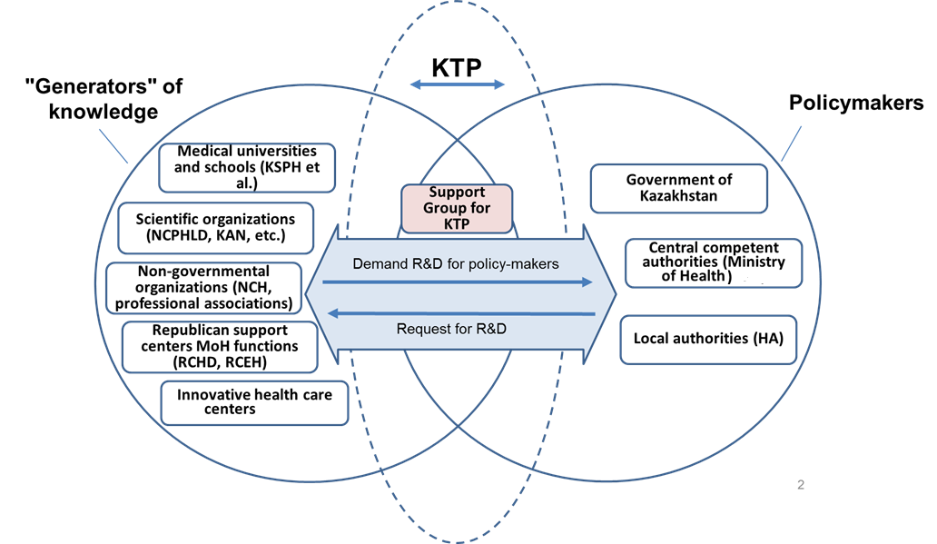
Key stakeholders that may participate in the KTP creation
EIP tools:
Clearing house
Evidence-based policy briefs
Policy dialogue
Rapid response services

Slide 19
EIP Tools
EIP Tools | What it is?
Policy Brief | A short report in which scientific research data is submitted in such a way that they are accessible, relevant, easy to use and applicable at the local level.
Policy dialogue | A meeting of policy-makers and stakeholders is usually in the form of seminar, where organized discussions are held on any issue of high priority
Clearing house | A constantly updated document repository that operates on a "one-stop shop" principle for users who need high-quality and relevant research data on a particular topic
Rapid response services | A group of research analysts who provide for policymakers an easy-to-use synthesis of research data of the highest quality in terms that are set by policy-makers (within a few days or weeks)

Slide 20
Policy Brief:
“Controlling antimicrobial resistance in Kazakhstan through addressing the problem of irrational use of antibiotics”
What is the problem?
Irrational use of antibiotics caused by their prescriptionless intake and excessive prescription contribute to the growth of antimicrobial resistance (AMR) in Kazakhstan
The lack of a national strategy to contain AMR reduces the effectiveness of prevention of infectious diseases.
Despite the existing ban, in practice antibiotics can be bought without a doctor's prescription. More than 90% of pharmacists recommend buying two or more antibiotics at the same time.
There is a lack of commitment by doctors to adhere to clinical protocols.

Slide 21
Policy Brief: policy options
Option 1. Raising awareness on the threat of the AMR through multisectoral collaboration to reduce the irrational use of antibiotics:
the adoption at the national level of a policy (strategy, plan) to contain AMR, which ensures control and joint responsibility of all parties for the use of antibiotics in the field of human, animal and food safety;
systematic measures to raise awareness and understanding of the proper use of antibiotics by the general public and specialists in health, agriculture and veterinary medicine
coverage of the use of antibacterial drugs and resistance in school curricula;
the inclusion of AMR's theme as an integral part of training, certification, continuing professional development programs in the health, veterinary and agricultural sectors.

Slide 22
Policy Brief: policy options
Option 2. Improving the system of microbiological monitoring on all levels of public health, agriculture, and veterinary healthcare:
Timely access to information on the incidence, prevalence, characteristic pathogens and features of the AMR geographical distribution;
Introduction of modern express methods of detection of microorganisms and determination of their sensitivity to antibiotics allows to ensure optimal use of antibiotics in the treatment of humans and animals;
Monitoring the content of antibiotics in food, packaging, cosmetics and hygiene products on the market, strict regulation of the content of antibiotics in them will help to contain AMR

Slide 23
Policy Brief: policy options
Option 3. Strengthening the existent systems of control, prophylaxis, and treatments of infections through support mechanisms such as human and financial resources and good governance:
implementation of the AMR management programs at the national, regional and local levels involving all key stakeholders in health, agriculture and veterinary medicine;
effective system of epidemiological surveillance and prevention, timely detection and treatment of infectious diseases;
introduction of effective mechanisms controlling the prescription sale of antibiotics;
effective surveillance systems for AMR should be cross-sectoral, and surveillance should be conducted using appropriate microbiological and epidemiological data of human, animal, plant and food origin;
it is necessary to expand the scope of research and development to create new treatments and vaccines that are effective against infections with MDR;
effective vaccination of the population, as well as animals in agriculture and veterinary medicine

Slide 24
The ultimate goal of the EIP implementation and the KTP establishment
Creation of a such order in which people who make political and managerial decisions in the field of health care and other stakeholders to determine the directions of health development will use the data of scientific research of the highest quality
Creating a modern and effective health system
(Strategy "Kazakhstan 2050")

Slide 25
Thank you for attention!

