Slide 1
Costing of Health Services in Lao PDR
Proposal 2018-19
Design validation meeting - 06/12/2018

Slide 2
Agenda
Introduction
Costing design (Objective, Methodology, Budget, Funding)
Current progress
Next steps

Slide 3
A. Introduction
Why do we need to do costing for health care service?
In the health system, health needs are unlimited, but public health resources are always limited. So, we could not cover all needs of population on health care services
We must select only the necessary needs on health care services, which one should be covered and should not be covered:
- we must prioritize the needs of health care;
- we must know how much its cost for those needs
- we must know which needs could we fund
Therefore, the costing is a basic need of all health care services.

Slide 4
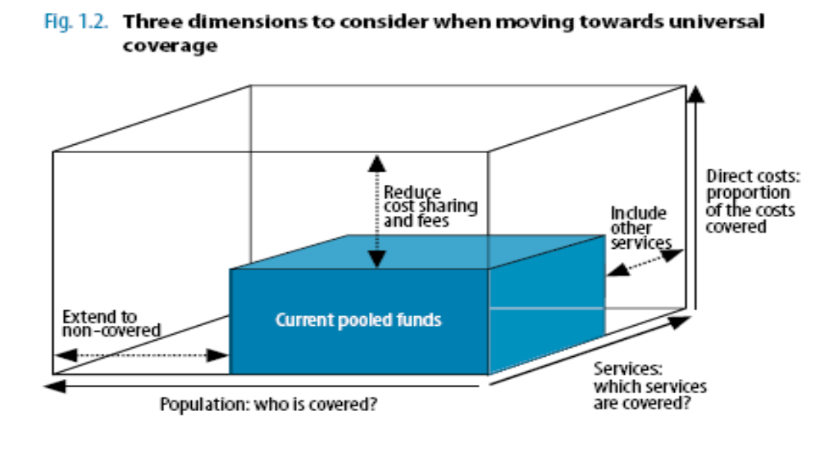
Why do we need to do costing for health care service?
ໃນ ສປປລ:
ການປົກຄຸມດ້ານປະຊາກອນແມ່ນບໍ່ເປັນບັນຫາ ພວກເຮົາຈະບັນລຸ 100% ເວລາໃດພວກເຮົາຂະຫຍາຍໄດ້ນະຄອນຫລວງ; ແຕ່ການປົກຄຸມການບໍລິການ ແລະການໃຊ້ຈ່າຍສາທາລະນະສຸກແມ່ນບັນຫາໃຫຍ່ທີ່ຕ້ອງໄດ້ແກ້ໃຂ, ເພາະດຽວນີ້ ພວກເຮົາປົກຄຸມແຕ່ການບໍລິການປີ່ນປົວ ສ່ວນຄ່າໃຊ້ຈ່າຍກໍ່ປົກຄຸມແຕ່ຄ່າຢາ, ການສຶກສາຕົ້ນທຶນສາທາລະນະສຸກ ຈະຊ່ວຍໃຫ້ພວກເຮົາຈັດລຽງບຸລິມະສິດວ່າຈະປົກຄຸມເອົາການບໍລິການ ການໃຊ້ຈ່າຍໃດຕື່ມອີກ.

Slide 5
B. Costing Design
Objectives & Scope
Methodology
Budget
Funding

Slide 6
1. Objectives & scope of the costing exercises
Objectives:
Provide sound evidence basis to:
Set the providers payment rates for the Health Insurance benefit package for FY2019/20
Prioritize, scale-up of new interventions and ensure minimum funding of the 121 interventions of the Essential Health Service Package
Define the adequate funding channels: what to be funded by the government budget, by the Health Insurance and by facility revenues after FY2020
Define the full health facility cost and revenues information in the decision-making around hospital autonomy
Set up the benchmark user charges & potential HI contributions for health services in public health facilities (outside HIBP) & for private health facilities
+ Advocate for adequate funding with Government/DPs
+ Prepare of the 5y NHSDP 2021-25

Slide 7
Scope of the costing exercises
# | Dimension | Health Insurance Benefit Package (HIBP) / Health Facility (HF) |  | Essential Health Service Package (EHSP)
1 | Perspective | Purchaser (cost incurred to ‘cover’ a service) |  | Provider (cost incurred to ‘deliver’ service)
2 | Provider type | Public health facilities + 2 private hospitals |  | Only public health facilities
3 | Cost object | HIBP Service (for individual service or a package of services) | HF Organization (for each facility level) | Service (for individual service or a package of services provided)
4 | Cost type | Financial cost | Financial cost | Financial cost
5 | Cost measure | Avg cost by service category (Total HIBP cost) | Health facility cost by facility level (total, marginal & fixed costs at zero utilization) | Average cost by intervention Total cost of the EHSP
6 | Cost item | Recurrent cost Personnel (incl incentives needs) Drugs & medical supplies Utilities Other recurrent costs (Depreciation) | Recurrent cost Personnel (incl incentives needs) Drugs & medical supplies Utilities Other recurrent costs Maintenance ( & Depreciation) Capital cost Building Medical equipment Non-medical equipment -> Full cost incurred at facility | Recurrent cost Personnel cost by intervention (hours) or total staff costs by program Non-staff recurrent cost (drugs & medical supplies) Capital cost equipment directly linked Programmatic cost by program (summary total) -> Direct costs + summary full cost

Slide 8
Scope of the costing exercises
# | Costing | Main output | Cost category | Type of cost categories
1 | Health Insurance Benefit package (HIBP) Health Facility Costing (HF) | Average cost by category of service (Total HIBP cost) Cost by facility level (total, marginal and fixed cost at zero utilization) | Full costs Full, marginal & fixed costs | Human resources Pharmaceuticals, supplies Administration & management (Equipment) (Infrastructure)
2 | Essential Health Service package (EHSP) | Average cost by intervention Total cost of the ESP package | Direct costs Full costs summary | Pharmaceuticals, supplies Equipment directly linked Human resources by intervention (hours) or total staff costs by program Programmatic costs by program (summary total)

Slide 9
Key questions
# | Costing package | Questions (direct & indirect)
1 | Health Insurance Benefit package (HIBP) Health Facility Costing (HF) | How much does outpatient department cost (by level)? How much does each intervention/pathology cost? (40 tracers -> ~17-28 categories) How much different to current NHIB per capita and case-based payment rate? How much should the NHIB pay for per capita, and each category? (How much would the total HIBP cost?) (Which categories should be prioritized?) (How much should a patient have to pay for services that are outside HIBP?) How much does public health facility cost (by each level, by cost item)? How should public health facilities be funded? Specifically, which expenditure categories should be funded by what? (by NHIB/NSSF reimbursement, budget allocation, and user fees)?
2 | Essential Health Service package (EHSP) | How much does each intervention cost? (121 interventions) How much would the total EHSP cost? (Which interventions can the government afford?) (Which interventions should be prioritized?)

Slide 10
2. Methodology
2.1. Principles:
Synergies for the three costing exercises
Mix of methodologies:
  Top-down stepdown costing: (HF, HIBP),
  Bottom-up costing: (HIBP admissions, some EHSP interventions),
  Normative costing from International and Lao standards (HIBP, EHSP)
  Activity based costing (part of EHSP interventions)
Uniform services costed:
  Same cost for all patients/users (NSSF members, NHI paying or not, OOP)
By level of health service providers
  CH, Spec. Inst., RH, PH, DHA, DHB, HC, (Outreach, Community)
Various collection sources:
  Specific costing team, Hospital reported to MOH/DOF, national programs, specialists team, international literature

Slide 11
2. Methodology
2.2. Steps:
# | Costing | Average cost by category/intervention |  | Total cost
 |  | Methodology | Tools (e.g.) | Methodology | Tools (e.g.)
1 | Health Insurance Benefit package (HIBP) Health Facility Costing (HF) | Stepdown Bottom-up Normative Stepdown Zero-utilization | Excel (info <OHT) Excel | Utilization from DHIS2, HI, Nat. Prog. Projections utilization | Excel or OHT Excel
2 | Essential Health Service package (EHSP) | Normative (all) Bottom-up (some) | OHT or Excel |  | OHT and/or HSPT or Excel
5y HSD Plan 2020-21

Slide 12
2. Methodology
2.2. Details:
Service Delivery sample:
  HIBP/HF: 3 CH, 5 Spec. Inst, 2 Pvt H, 3 RH, 4 PH, 10 DH (3A-7B), 20 HC => 47 Facilities
  ESP: + Outreach sessions & community events
Service categories/interventions to be costed
  HIBP: current 7 categories (15 pathologies) + 10-22 new categories (25 pathologies) => 40 pathologies/interventions to be costed
  ESP: 16 interventions = HIBP service categories, 15 no direct cost => 90 interventions
  => Total : 130 pathologies/interventions
Stepdown costing in each 47 HF
  CH/RH 12 days, PH/Pvte 10 days, DHA 6 days, DHB 4 days x , HC 2 days
  Costing team: 5 Teams of 7 people (35 people) + facility staff

Slide 13
2. Methodology
  Bottom-up costing
  HIBP: 30 patient files for 40 tracers pathologies/interventions
  ESP: 17 additional interventions
  Compare with data collected from hospitals by DOF
Normative costing
  For all 40 HIBP service categories & all 106 EHSP interventions (~15 no cost, 15 same)
  Int’l standards: from OHT and other standard estimates
  Lao standards: defined by a team of 3-4 specialists from CH/PH for each pathologies/intervention
  EHSP interventions to be costing by national programs
Activity-based costing
  EHSP: very limited (2-5 interventions)
Zero-utilization health facility costing
  HF: normatively estimate health facility zero-utilization cost by each level per day / year

Slide 14
Data source
Approach
Intervention
Package (output)
Health Facility
Total health facility cost
45 health facilities
CH / Spec. inst.
RH, PH, DH, HC
Outreach
Top-down
24
24: bottom-up
24: normative
Bottom-up
HIBP
Average cost by pathology/intervention
(Total cost of HIBP)
16
16: bottom-up
16: normative
DOF report
Activity-based
National programs
90
7: bottom-up
2-5: Activity-based
90: normative
EHSP
Average cost by pathology/intervention
Total ESP cost
Normative
(clinical pathway)
Clinical specialists
Among 90 EHSP interventions,
Around 52 are still covered by HIBP (as part of the NHI payment)

Slide 15
2. Methodology
2.3. Costing Team:
Core costing team:
  LTPHI, DOF, NHIB, NSSF (25-30 people) assisted by students for central level
Providers of information:
  National MOH programs/dep’ts: DHC, FDD, DPIC, DHP, MCHC, HIV, TB,… (1-2p/prog)
  Technical teams of specialists from hospitals (3-4p for each speciality)
Technical support:
  External consultant team to accompany the process during the whole process:
    For HIBP & HF: ~138 days => Firm/Institute with 1 senior & 3 junior for field data monitoring
    For ESP specific: ~65 days (Intl) + 40 days (Lao) => Indiv. consultants to accompany the process
  Technical assistance at various stages of the costing: SRC, ILO, WHO, FHF, WB

Slide 16
2.3. Costing Team
Team | Organization | Support to
Joint costing exercise committee | 7~10 people MOH/NHIB, LTPHI, NSSF, MOH/DOF, MOH/DHC, MOH/MCHC, MOH/MPSC, | Entire costing process
Top-down / Bottom-up Costing Team | 28 people (4 teams of 7 people) assisted by students for data collection at central level + facility staffs LTPHI, NHIB, NSFF, MOH/DOF, MOH/MCHC | Top-down (HIBP/HF) Bottom-up (HIBP/HF)
MOH Departments / National Programs | ~14 persons (1-2 person per program) MOH/DHC, MOH/DFD,MOH/DPIC, MOH/MCHC, MOH National Programs (HIV/STI, TB, Malaria, etc..) | Normative (EHSP) Activity-based Costing (EHSP)
Clinical specialists | ~26 persons (2-4 persons for each specialty) Obstetrics and gynecology, Pediatrics, Internal medicine, Ear, Nose and Throat (ENT), Dentistry, Ophthalmology, General surgery, Cardiology, Oncology, Others | Normative (EHSP)
External consultants | International consultant/s For HIBP/HF: A team of at least 1 senior & 3 junior consultants or an institute to focus on overall design, monitoring, and reporting including (~138 days) For ESP: 1 or several individual consultants (~65 days) / Lao consultant (~40 days) | Assist some parts of the costing process
Development partners | Financial and relevant TA supports from: Financial: ILO, WHO, SRC, WB, FHF, UNFPA, JICA, LUXDEV Technical: ILO, WHO, SRC, WB, FHF | Assist the whole costing process

Slide 17
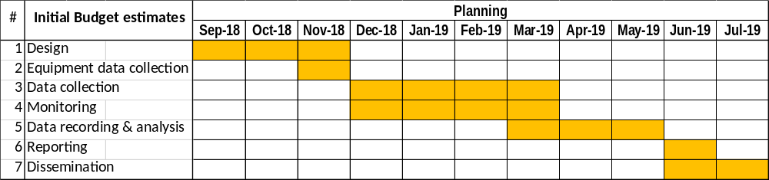
2. Methodology
2.4. Timing:
Process: around 10 months
Period: 10/2018-07/2019

Slide 18
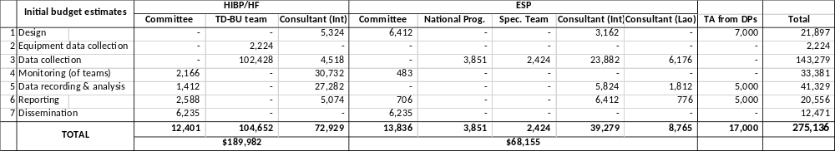
3. Budget estimates

Slide 19
4. Funding for the costing
From Government: 35,000$
  Regular budget chap. 63: MOH DOF, involved Dep’ts
  Budget from NSSF and NHIB
  DLIs 2018/19
From DPs: 230,000$ + TA ~22,500$
  ILO: Consultants HIBP-HF (excl HC), operations HIBP-HF, TA 55,000$ + TA Marielle mission + Nat.
  WB: Consultants EHSP + HIBP-HF (HC), TA 50,000$ + TA Emi
  FHF: Operations HIBP-HF, TA 50,000$ + TA Debbie mission & remote
  WHO: Operations mainly EHSP, TA 30,000$ + TA Christopher & Khek
  SRC: Operations HIBP-HF/EHSP, TA, Coordination 6,000$ + TA JMT, Daniel & data coll.
  UNFPA: Operations HIBP-HF/EHSP (preparation meeting) 14,000$ (before 12/2018!)
  JICA: Operations HIBP-HF (transport) 5,000$ (before end 02/2019!)
  LuxDev: Consultants HF, Operations HF + EHSP 20,000$

Slide 20
C. Progress to date
Costing proposal / roadmap drafted
Proposal presented, revised and technically agreed (8 meetings)
Main funding arrangements agreed by MOH/NHIB and DPs
MOH nomination of the costing team (Decree)
Recruitment process for consultants started
Costing HF data collection with Xaymongkhon private hospital done

Slide 21
D. Next steps
 | Stage | Activities | Who? | When?
 | Design | Disseminate the list of costing members
 |  | Finalize the recruitment of consultants
 |  | Finalize the detailed methodology
 |  | Contract arrangements
 |  | Draft the questionnaire for stepdown/bottom-up costing
 |  | Choice of tool and questionnaire for the normative costing
 |  | Approval by the Costing Steering Committee
 |  | Training of data collectors
 | Data collection | Test in health facility
 |  | Revise the questionnaires
 |  | Data collection in facilities
 |  | Data collection normative costing with specialists and programs
 |  | Monitoring of data collection
 |  | Data recording (Excel for HIBP/HF; Excel/OHT? for EHSP
 | Analysis | Cleaning & analysis
 |  | Integration of other data (DOF list of fees charges, Nat. Prog data,..)
 | Reporting | Reporting for each of the 3 costing exercises
 |  | Compilation (links between data, policy analysis, recommendations)
 | Dissemination | Dissemination
 | Utilization | Utilization of findings EHSP, HF, HIBP

