Slide 1


Global Network for Health Economics, Financing and Social Health Protection
Health economics, financing and social health protection for UHC: the P4H Network approach
Introduction to P4HC+
Himawari hotel, Phnom Penh - Cambodia
6th February 2018
Claude Meyer, P4H Coordinator (WHO-HQ)

Slide 2
1. P4H evolution over 10 years

Slide 3

June 2007: The first P4H discussion, at a time when UHC was an unknown concept in global development policy dialogue

Slide 4
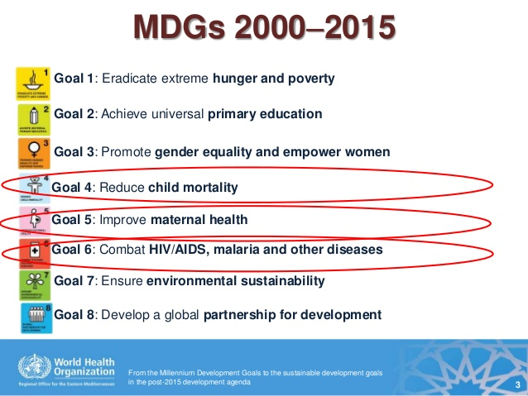
June 2007: mid term of the MDG area…

Slide 5

September 2015: The new SDG context.
Universalism and deep interdependence across sectors

Slide 6
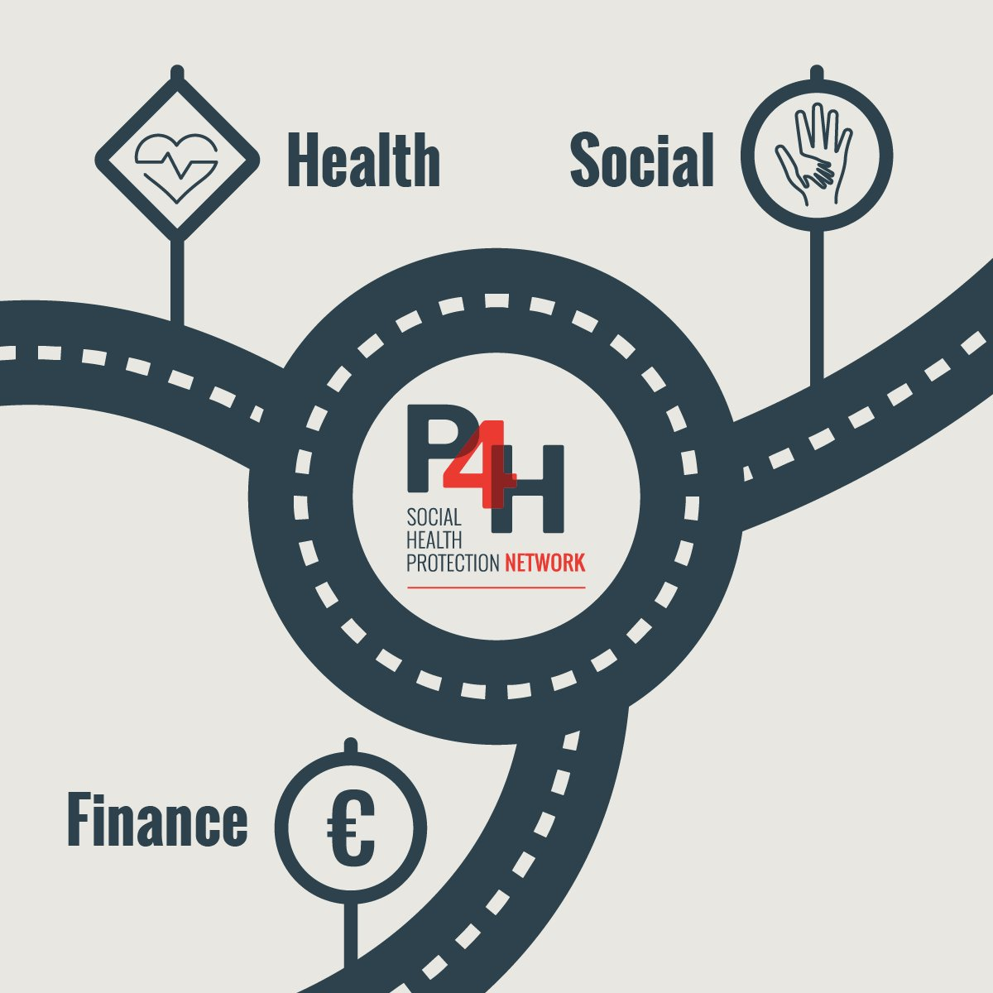
The P4H framework for inclusiveness: placing health financing at the intersection of health, social, finance (and other relevant) sectors

Slide 7

















A rapidly expanding Network
Growth in number of partners is steady.
School of Public Health of Seoul (South Korea) and Council of Europe Development Bank (CEB) will probably join in 2018 and talks are progressing with a broad range of other stakeholders.

Slide 8
September 2017: adoption of updated P4H Network ToR by the P4H Steering Group
Recommendation 1: Reference to the values of the P4H network to be taken from the 2014 TORs : “The principle avenue of P4H to overcome access deficits and the risk associated with catastrophic health expenditure is the creation and extension of sustainable systems of social health protection, based on values of universality, equity and solidarity, and efficiency.” In addition, reference should be made to relevant UN and WHA resolutions as well as ILO Recommendation 202. The recommendation is adopted with no objection.
Recommendation 2: Principles of engagement: Add universalism (all categories of countries and stakeholders) as well as cross-sectoral action, in relation to the 2030 Agenda. The recommendation is adopted with no objection.
Recommendation 3: P4H’s value proposition : P4H enhances partners’ contributions to UHC, and gives them leverage and creates synergies by connecting stakeholders across sectors and levels; incentivizing and facilitating coherent collaboration; promoting the values of the network; and developing products and services for capacity building, coordination and inclusive dialogue on UHC financing and social health protection. The recommendation is adopted with no objection.

Slide 9
2. P4H products and services for networking and collaboration

Slide 10

1) The P4H country/regional focal points: connecting a broad range of stakeholders + info circulation + local operational collaboration

Slide 11

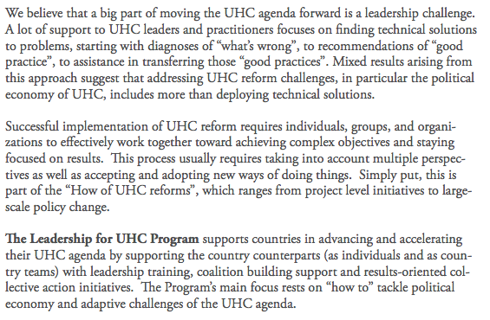
2) The P4H leadership for UHC program: capacity development through reflection on the self as an intervener, building trust in multi-sectoral teams and ability to influence the wider UHC system

Slide 12


Slide 13
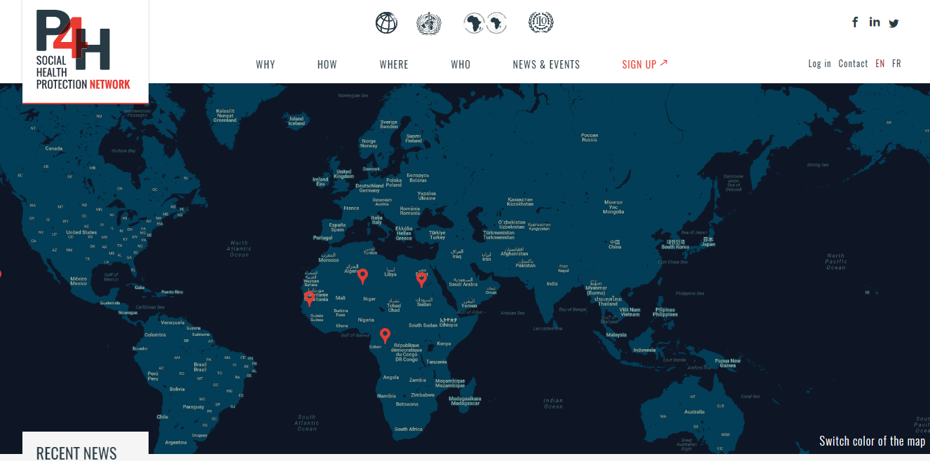
3) Since 6th November 2017, a new users’ experience in our digital platform: use your own dashboard to connect with your health financing / SHP ecosystem and work on your subject matters.
Join 1000+ registered experts!

Slide 14

Connect with us: www.p4H.world

