Slide 1
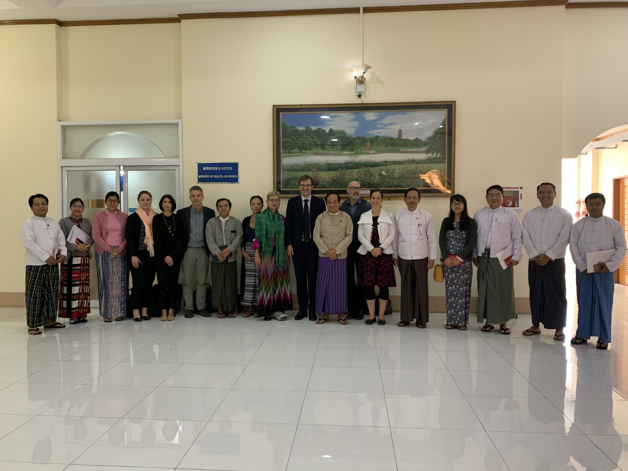
P4h Joint mission in myanmar – 9 to 13 december 2019
Debriefing session, 13th December in Swiss Embassy, Yangon
WHO: Ann Lin
WB: Nang MO KHAM & Kent Ranson
ILO: Thein Than Htay & Marielle Goursat
SDC: Thin Myat Khine, Rea Bonzi
& Viviane Hasselman
USAID: Karen Cavanaugh
GIZ: Htet Lay Lin Oo & Bart Jacobs
P4H Coordination Desk: Claude Meyer

Slide 2
P4H NETWORK’s MANDATE
(Final ToR – SEPT 2018)
2.1 Value proposition
P4H enhances its members' contributions to UHC, gives them leverage and creates synergies by:
Connecting stakeholders across health, finance, social and other relevant sectors and with all other levels
Incentivizing and facilitating collaboration and joint programming
Developing products and services to support capacity building for national coordination and inclusive dialogue on UHC financing and social health protection
Practically linking accountability, ownership and evidence based and result oriented approach.
2.3 Role, vision, goal and mission of the P4H Network
The role of the P4H Network is to act as an honest broker among all involved stakeholders to build coherent frameworks for country, regional and global action.
The vision of P4H is to accelerate progress towards UHC.
The goal of P4H is to support the development of sustainable and equitable health financing systems towards UHC.
The mission of P4H is to promote, develop and strengthen exchange and collaboration for health financing and social health protection towards UHC.

Slide 3

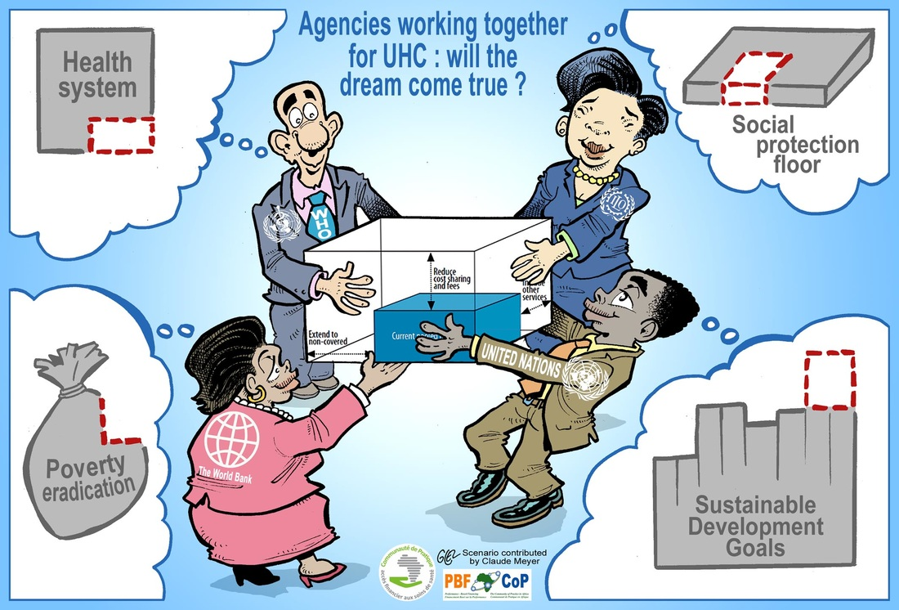
THE P4H Unique MULTI-SECTORAL FRAMEWORK to improve collaboration on health financing

Slide 4
Specific objectives of the mission
1) To take stock of where the health financing reform agenda is, lessons learned, future directions and where external support is needed
2) To strengthen the government’s ability to coordinate external support by formally introducing the P4H Focal Person to national and international stakeholders
3) To strengthen the country based health financing coordination system taking into account the existing structures in Myanmar
4) To identify areas of collaboration and efficient distribution of activities among the various stakeholders

Slide 5
1) HF REFORM AND EXTERNAL SUPPORT NEEDS
Strategic Directions for financing UHC in Myanmar (MoHS/NIMU May 2019) gives a good overview of the situation but doesn’t choose among several key policy options.
Some intersectoral and multi-stakeholder dialogue has been initiated around the Strategic Directions document but the level, intensity and quality of the health financing dialogue could be significantly improved.
The health financing space in Myanmar has numerous national stakeholders (MoHS, MoLIP, MoFP, States and Regions, EHO, CSOs, private providers) and is also crowded with international organizations (INGOs, Multilaterals, Global health funds, bilateral donors).
Support needs are huge in a very complex national context, there is enough to do for everybody but two recurrent themes in most of the meetings were high level advocacy and documentation / research / utilization of recent experimentations in PFM and strategic purchasing.

Slide 6
2) Formal introduction of P4H Focal Person
Htet formally introduced to Access to Health Fund donors and staff (Monday), to two INGOs (PSI and CPI, Tuesday), to SSB, Minister of Health and senior management of MoHS (Wednesday). MoFP was initially targeted on Thursday but had to be droped.
Minister of Health himself provided an authorizing environment for the P4H FP to interact with various working groups within and beyond MoHS.
DG of SSB expressed deep satisfaction to interact with several international partners beyond the traditional relationship with ILO.
Excellent working atmosphere from all stakeholders, very constructive from all development partners: a perfect basis to gradually build and strenghen trust around the health financing theme.

Slide 7
3) Health financing coordination system
The health sector is currently coordinated by the MHSCC, with WHO secretariat. Below, there is a HSS core group with WHO/WB secretariat and a health financing sub group coordinated by WHO. A new WHO Senior Health Policy Adviser will be deployed in January 2020 and it is proposed for the P4H FP to technically report to him and the WHO Representative. Some office space in WHO office would be ideal.
Beyond the Myanmar Government, the mission could identify three layers of stakeholders: 1) The 4 members of the Access to Health Fund + Canada, Japan and France
2) The INGOs working on specific health financing subjects
3) The CSO lead by BGK
Collaboration needs to be strengthened among them, rules of interaction have to be defined to build trust and the three layers should be linked.
A lot of information gathering needs to be done: who is doing what (by health financing functions)? How is it used? Where are the flows?

Slide 8
4) Areas of collaboration
The needs are huge, we need to be realistic, to identify priorities and quick wins for the P4H Focal Person (ideas for the next 6-12 months):
Building consensus among development partners on key health financing messages in relation to the requests for high level advocacy
Organizing a Myanmar side session during PMAC 2020 as a facilited conversation on the links between access to health and the national peace process
Contributing to information sharing and improved dialogue among national stakeholders and developing a research agenda on PFM in health based on previous experiences
Organization of open thematic brown bag lunches (involving remote connection of TGF, GAVI, GFF in the context of the Sustainable Financing Accelerator)
Continuing the health financing capacity development efforts with L4UHC follow up, adjusted flagship sessions, ILO training centre and Mahidol program on social health protection
Working with donors (UK) on finding incentives for the government to invest more in PHC and ways to expand the Access to Health Fund platform to include other sources like TGF, GAVI and GFF

Slide 9
THE P4H COORDINATION TEAM combining global, regional and country levels
P4H Regional or Country Focal Persons:
Burkina Faso – Alexis Bigeard, WHO
Cambodia – Bart Jacobs, GIZ
Cameroon – Josselin Guillebert, GIZ
Chad – Saibou Seynou, GIZ
India – Nina Siegert, ILO
Haiti – Ludovic Queuille, WHO
Kazakhstan – Arystan Moldazhanov, RCHD-KAZ
Madagascar – Virgile Pace, Expertise-FRA
Malawi – Siri Snow, GIZ
Mozambique – Cristina Manzanares, GIZ
Myanmar – Htet Nay Lin Oo, GIZ
Niger – Bouchaib Mourjane, Expertise-FRA
Senegal – Mame Abdoulaye Gueye, WB
Tanzania – Christian Pfleiderer, GIZ
Vietnam – Marielle Goursat, ILO
P4H Coordination Desk:
WHO/HQ – Bayarsaikhan Dorjsuren
WHO/HQ – Claude Meyer
WHO/HQ – Gwenael Dhaene
WHO/HQ – Marie-Pierre Alliod
WHO/HQ – “Recruitment ongoing” (MoFA-FRA)
WB/HNP – Jean-Olivier Schmidt
ILO/HQ – 50% of P3 funding available for 2 years (EC DEVCO funding source)
With support from GIZ/HQ – Helga Mahler
https://p4h.world/ct

Slide 10
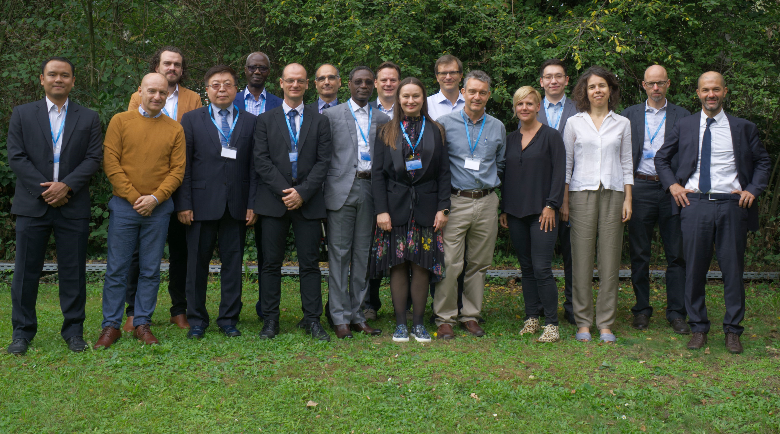

Slide 11

Thank you for your attention !
Connect with us: www.P4H.world
Twitter: @P4hNetwork

