Slide 1

Strategic Healthcare Purchasing in Thailand with a Focus on Paying for Performance
Jiruth Sriratanaban, M.D., Ph.D.
Department of Preventive and Social Medicine,
and Thailand Research Center for Health Services System (TRC-HS)
Faculty of Medicine, Chulalongkorn University
Bangkok, THAILAND

Slide 2


Today’s topics
UHC in Thailand
Strategic purchasing in Thai UCS
  General HC purchasing framework
  Selective purchasing programs
  Pay for performance (P4P)
Value-based purchasing initiative
Essential co-interventions

Slide 3
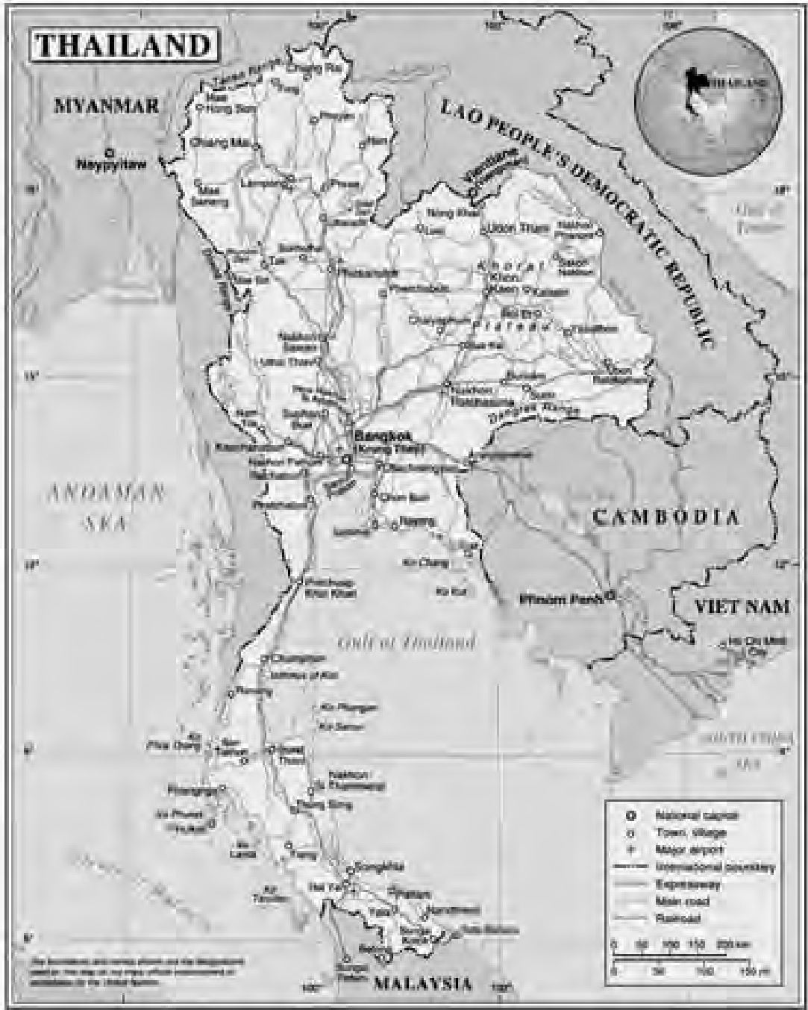
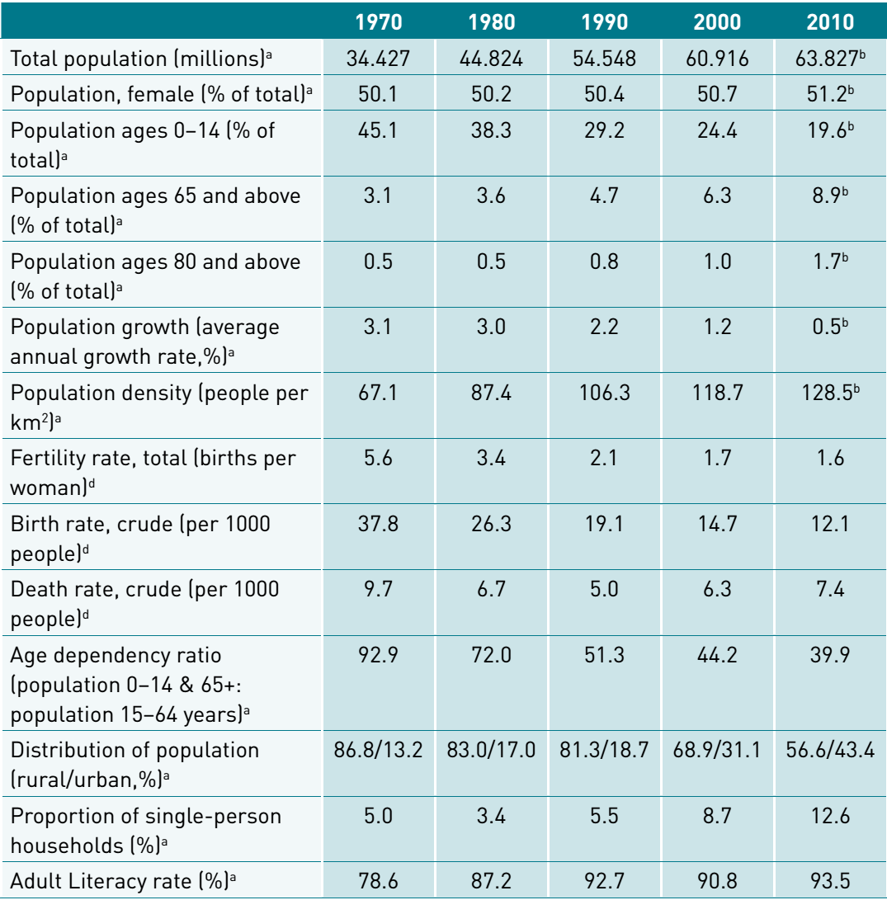
Basic profile of THAILAND

Slide 4
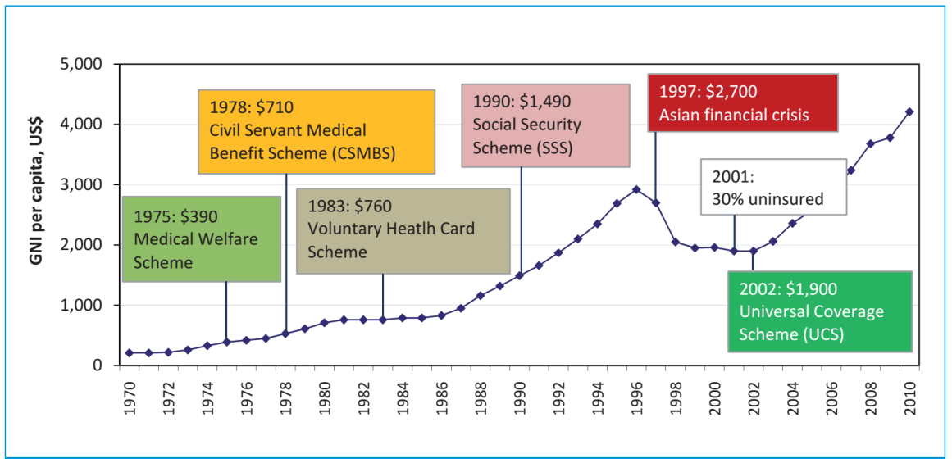
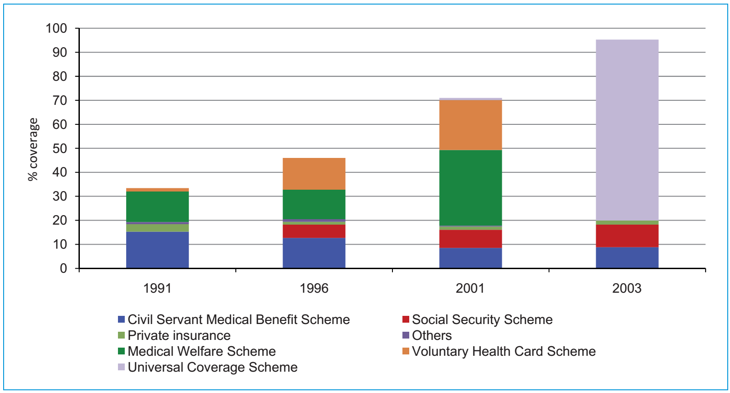
UHC in Thailand: Historical Building blocks
Source: Thailand’s Universal Coverage Scheme: Achievements and Challenges. An independent assessment of the first 10 years (2001-2010). Nonthaburi, Thailand: Health Insurance System Research Office, 2012.

Slide 5
UHC in Thailand: Now
Achieving universal coverage in 2002, through three major compulsory publicly-run health security schemes
Health Schemes | Who? | By whom? | Finance | Provider networks | Annual budget (Approx. PPPY)
CSMBS (1978-) + Local gov. | 4.4 mil. CS +families (+0.6mil. LG) | Min. of Finance | Tax (Semi-open-ended budget) | Any public hosp., Selected private hospitals for elective surgery | 12,676 baht US$ 396
SS (1992-) | 10 mil. private employees | Min. of Labor | Tri-partite contribu-tion | Participating public and private main contractor hospitals and their network | 3,399 baht US$ 106
UCS (2002-) | The rest of pop. 47 mil. | NHSO | Tax (Close-ended fiscal budget) | Primary-care providers, Referral networks of hospitals, Public > Private | 3,197⁺ baht US$ 100⁺

Slide 6


Strategic purchasing in Thai UCS
What to buy:
Inclusive healthcare benefits
Health-need based, e.g. burden of diseases
Healthcare costing and Cost-effectiveness consideration:
  Emphasis on primary care and referral systems
  Health technology assessment (HTA) for high-cost care
How to buy: General vs. Selective contracting
How to pay:
Close-ended payment approaches
Central purchasing for some high-cost drugs and supplies
Selected incentives to promote access and quality

Slide 7
No one-size fits all:
Variation in cost = Variation in care ?
Average outpatient cost per visit (All patient groups)
Baht per visit
Number of visits
Tertiary-care
hospitals
General
hospitals
Yuparach
hospitals
Community hospitals
Community hospitals
in remote areas
Community
hospitals
In very
remote areas
Fixed cost
Variable cost
Number of visits
Source: The Study on Financial statuses and Analyses of financial crisis among hospitals under the Office of Permanent Secretary, Ministry of Public Health (2015)

Slide 8
Combination of payment programs and initiatives
Healthcare | Components | Considerations | Payment methods
Outpatient | Baseline | Different health needs by area | Risk-adj. capitation
 | Performance | Outliers in service load | Pay by service load
 | QOF | + Quality of care | P4P by KPIs
Inpatient | Baseline | Case-mix and volume | DRG w. GB
 | QOF | + Quality of care | P4P by KPIs
Central reimburse-ment | Guideline-based care, High-cost drugs & supplies | + Financial risk protection + Quality of care + Access | Fee schedule by point system w. GB, “Drug” reimburse.
Health promotion and disease prevention | Basic services | + Access | Age & Performance adjusted capitation
 | QOF | + Quality of care | P4P by KPIs
 | Area specific | Policy, Local health needs | Project-based
Rehabilitation services | Performance | + Access | Fee schedule by point system w. GB

Slide 9
Example of central reimbursement to promote access to care:
Guideline-based Payment program by fee schedule for Anti-thrombolytic agent for emergency ST-elevated AMI patients
Rate per 100
Rate per 100,000
2005 2006 2007 2008 2009 2010 2011 2012 2013 2014 2015
Hospital admission (per 100,000)
Anti-thrombolytic agent or Primary PCI (per 100)
Case fatality rate (per 100)
Source: NHSO (2016)

Slide 10
Pay for Performance (P4P)
Quality-Outcome Framework
  Health promotion and Disease Prevention
  Primary care (started in 2014)
  Organization, Network and referral chain, and service development and management
  Quality and responsiveness to local problems
2017: Top-down policies (6 KPIs)
+ Area-based focuses (≤ 5 KPIs)

Slide 11
KPI selection criteria
“Outcomes” over “Process”
High burden, high risk or high cost
Quality of “Integrated care processes”
Data availability in administrative datasets to avoid extra workload on collecting data
Applicability across different areas

Slide 12
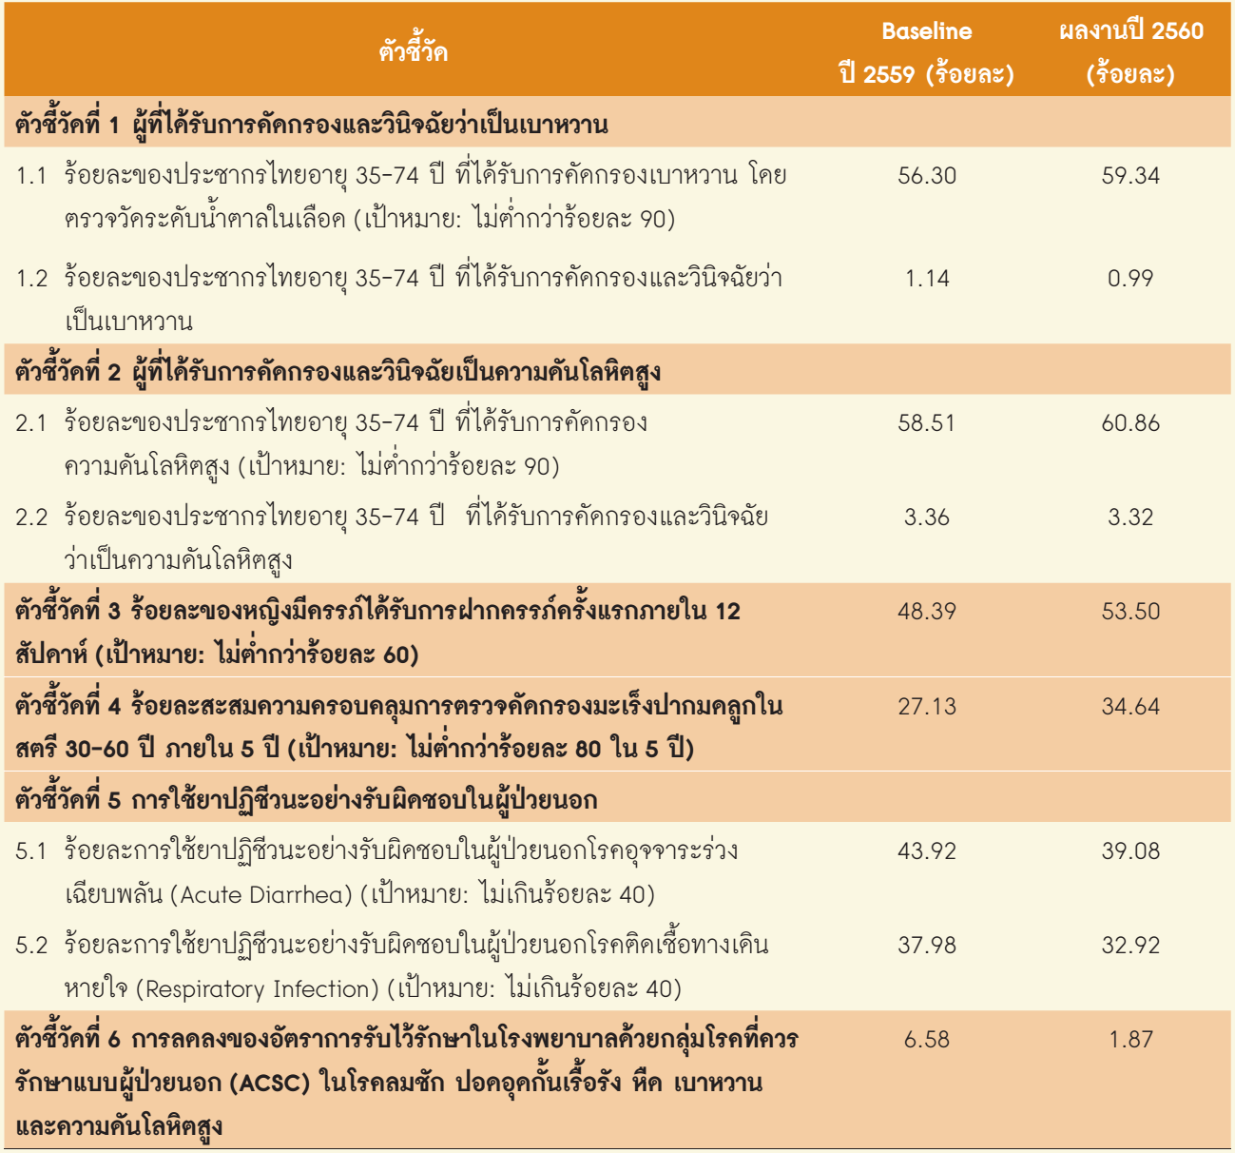
QOF Top-down KPIs for P4P in 2017
2016 Baseline(%) 2017 Result(%)
KPI#1: Screening for Diabetes Mellitus (DM)
1.1. FBS Screening in 35-74 years-old Pop.
(Target ≥90%)
1.2. Screened and diagnosed in 35-74 years-old Pop.
KPI#2: Screening for Hypertension (HT)
2.1: Screening in 35-74 years-old Pop. (Target ≥90%)
2.2: Screened and diagnosed in 35-74 years-old Pop.
KPI#3: Pregnant women got 1st ANC within 12 weeks of gestation (Target >60%)
KPI#4: 5-year cumulative coverage for CA-cervix screening in 30-60 years-old women (Target >80%)
KPI#5: Rational use of antibiotics in outpatient care
4.1. Acute diarrhea (Target <40%)
4.2. Respiratory tract infection (Target <40%)
KPI#6: Reduction in admission of selected ambulatory-care sensitive conditions (Epilepsy, COPD, asthma, DM, HT)

Slide 13
P4P Payments in 2017
Budget for P4P (Total UCS US$97.2 PPPY)
  US$0.31 PPPY from OP budget (≈0.9%)
  US$0.31 PPPY from HP&DP budget (≈2.5%)
Payment methods:
  Point systems for performance bonus
  Rewards, not “Penalty”

Slide 14
Value-Based Purchasing Initiative: Why?
Sustainability
Adequacy
Long-term financial sustainability
for the Government, providers,
And households
All can access health care,
and be protected against bankruptcy
from healthcare expenses.
Providers are sufficiently funded
to provide necessary health services.
SAFE
Fairness
Efficiency
 Increase equity in UHC,
both In terms of cost bearing
and service access
Resource allocation
and investment
 Health service provision

Slide 15
Re-designing payment models
Value-
4.0
3.0
2.0
Diagnosis-
based
payment
based
payment
Capitation-
based
payment
1.0
Activity-
based
payment

Slide 16
Targeted areas for VB healthcare
Rational drug use
Preventable illnesses
(with high financial Burden)
Chronic diseases
Inappropriate health service utilization
Hospital acquired conditions
(Adverse events)
Preventable long-term disabilities
Notes:
Estimated prevalence
of chronic diseases
among Thai elderly:
HT = 31.7%
DM = 13.3%
Heart D = 7.0%
CVD = 4.1%
Cancer = 0.5%

Slide 17
Roadmap of VBP initiative in Thailand
1.
Select disease conditions
Health service guidelines
Care pathways
2. Performance matrix
Outcomes
Costs
3.
Payment modalities
Capitation
P4P
Fee schedule
4.
Integrated info. system
Effective coverage
Disease registry
Cloud
Applica-tions
5.
Delivery
labs
Pilot areas
Monitoring & Evaluation
Improve-ment
P17

Slide 18
Payment design of the future VBP
Value-based
P4P adjustment
Disease-spec.
capitation for IP
CDM-
ambulatory-care,
case-mix-adjusted
capitation
Baseline
capitation
Adjusted for CDM
(-)
+
Incremental cost of
guideline-based care
+
Incentive for better
short-term outcomes
+
Incentive for other
Value-based KPIs,
e.g. focused
guideline-based
performance
No additional pay for CDM-DRG
Need UR for DRG creeping

Slide 19
Co-interventions: Less spoken issues
 Healthcare infrastructure: Primary-health-care structure, Publicly dominated system + semi-autonomous mgt.
 Citizen identification: Clearing house, Budget allocation & claim processing, Performance accountability
 Health systems research: Program evaluation and feedbacks, System development
 Hospital quality improvement and accreditation: Patient-centric attitude, CQI, Safety

Slide 20
Question
&
Answer

