Slide 1
NHA: health expenditures in Kazakhstan
Intercountry Conference on partnership collaboration:
Health financing reforms for Universal Health Coverage
19–20 June 2018, Astana, Kazakhstan
Zarina Temekova
Republican center for health development
Center for Health Economics

Slide 2












Indicators of expenditure on health
Current health expenditure as% of GDP
Public expenditure on health as% of GDP
Per capita expenditure on PPP
OOP as% of GDP
National Health Accounts
System of Health Accounts (SHA 2011)
Financing schemes
Sources of financing
Suppliers
Services

Slide 3
Public expenditures
GDP
Private sector
Government revenue
Health sector financing
CHE of GDP
THE of GDP

Slide 4
Current health expenditures in 2016 were 1,6 trillion tenge or 3,4% of GDP
Health expenditures per capita in 2016 were 280 USD* (90,8 thousand tenge) or 468,5 USD in PPP
In OECD countries minimum = 1088 USD in PPP , Turkey
*Weighted average official exchange rate according to the National Bank of the Republic of Kazakhstan in 2016 - 342.16

Slide 5
Priority to health in public spending: is a political choice!
Share of health spending within government budget
WHO/EUROPE countries with population > 600,000 (2015)
Public health exp.– 899 bln.tg. (10% of state budget).
However, the small size of the state budget (22% of GDP) leads to a low level of state financing of the industry (2.2% of GDP)
Source: WHO, GBDD, April 2018.

Slide 6
Relative to size of their economies,
EU governments spend a lot on health
Source: WHO, GBDD, April 2018..

Slide 7
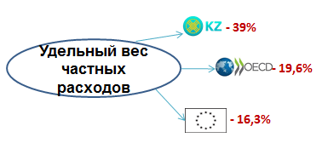
In 2016 health expenditure structure: public expenditure –59%, private expenditure – 40%.
40%
Share of private expenditure
27,5%
Private expenditures
Ratio of private and public expenditure on health in 2010-2016.
low-skilled labor or unemployment
low income of households
low level of healthcare services
difficulties in access to healthcare services
Public expenditures
Private expenditures
Ratio of private spending to public

Slide 8
Strong correlation between OOPs as a share of total health spending and financial protection
Where OOPs are <~15%
of total health spending, a small share of households have catastrophic OOPs
MDA
GEO
ALB
LV
KGZ
UKR
PT
LT
KZ
PL
EE
HU
TR
SK
CR
AT
CY
FR
DE
NL
UK
SE
SI
CZ
IE

Slide 9
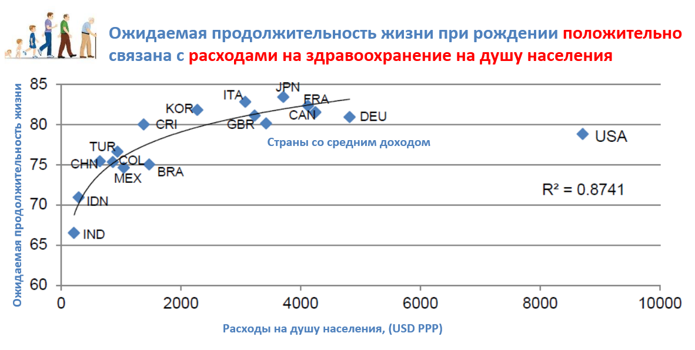
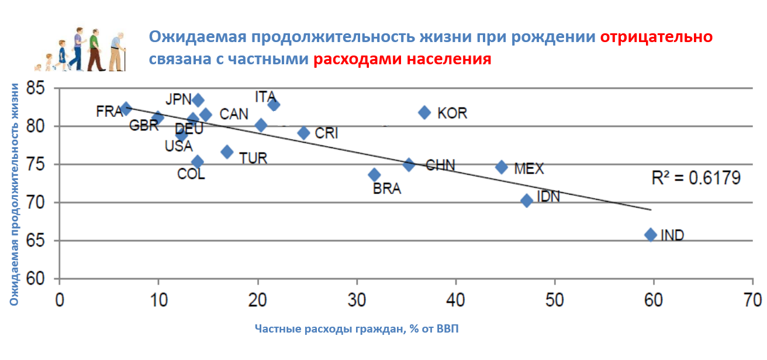
Life expectancy and health expenditures per capita
Life expectancy
Expenditure, per capita (USD PPP)
Life expectancy and OOP
Life expectancy
OOP as a % GDP

Slide 10
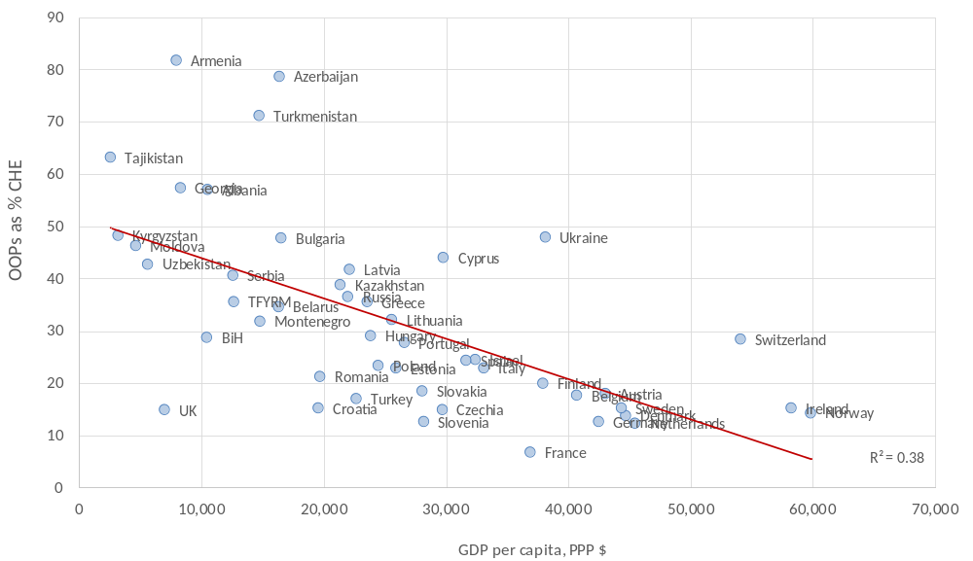
Higher income associated with less out-of-pocket spending (OOPS). Why?
Source: WHO estimates that 2015, selected countries with a population of more than 600,000 people, the BDPD, April 2018.

Slide 11
Reallocate public spending to health?
Health, along with social protection, has already its share increasing, at the expense of other services … and now is more than 18% of government spending on average in OECD countries.

