Slide 1
Provision of Medical Information: the British National Formulary case
Karen Baxter, BNF Director
19-20 June 2018, Astana, Kazakhstan

Slide 2
Introduction
Healthcare in Great Britain
What having a National Formulary can achieve
The British National Formulary (BNF) and information provision
  Content, systems, processes and partnerships necessary for success
International application

Slide 3

Healthcare in Great Britain
Mostly provided by the NHS, which is funded centrally through taxation, although private healthcare is available (less than 10%)
Devolved authority across the countries and regionally - risks of inequalities in provision
Regulation, governance and advice provided by several bodies (Department of Health, Medicines and Healthcare Regulatory Authority, National Institute of Health and Social Care Excellence, Professional Societies)
Collation and accessibility of information driven by a National Formulary

Slide 4

What does the BNF achieve?
BNF Publications improve the health and care of people by being the independent authority in the selection and use of medicines
reduce errors from incorrect use of medicines and cut wasteful prescribing
make it easy for clinicians to make the right decisions, quickly and effectively
support the best possible treatment outcomes for patients of all ages
have a positive effect on every prescribing or dispensing instance in all environments where the BNF is used
are the first port of call for support on the use of medicines
demonstrate the authority of decisions made in any audit trail

Slide 5
Impacts of the BNF?
Influences practice
  changed practice 40%
  influential in prescribing decisions 60%
  saves time 79%
Saves money: worth between £500m and £900m a year to the UK Departments of Health
Provides consistency
  BNF is quoted in law and UK parliament as the definitive word on medicine
  Consulted by 100% of professionals working with medicines

Slide 6
The BNF and Information Provision

Slide 7
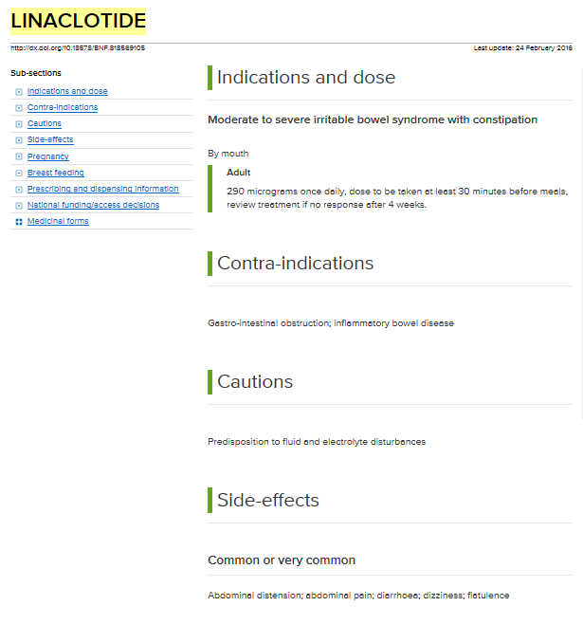
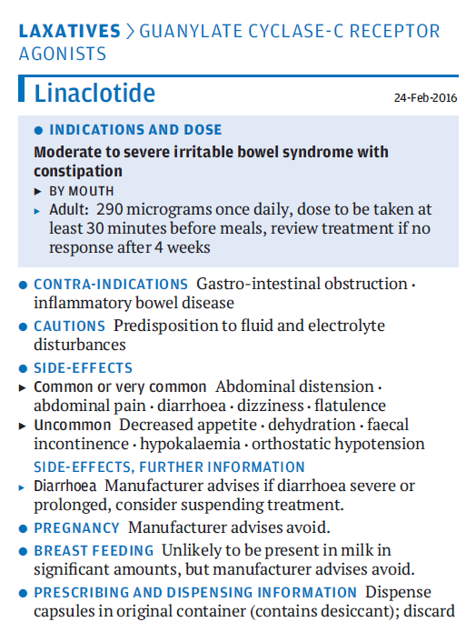
The BNF and Information Provision - Drugs

Slide 8
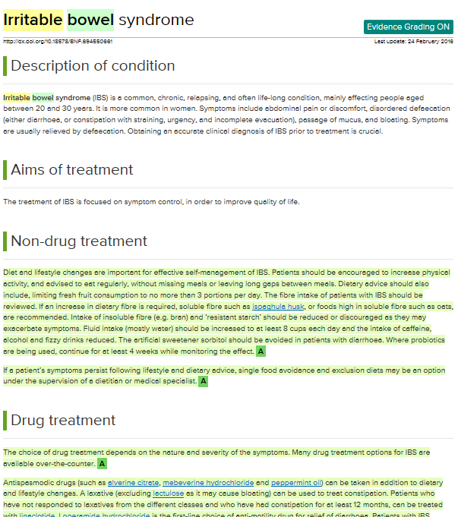
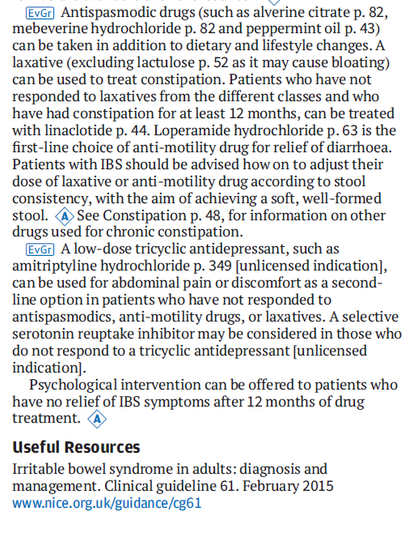
The BNF and Information Provision – Place in therapy

Slide 9

Systems and Processes
Manufacturer’s content independently validated and challenged – primary literature and multiple secondary sources used in this process
Each source is assessed for its own quality standards before being included
  e.g. quality of study design, quality of content creation process for guidelines and secondary sources, quality standards for patient leaflets
  Guidelines similarly assessed
  Gaps in evidence filled by expert advice – complex process involving
    Identification of best available evidence
    Consultation with practice experts across the professions
    Three step internal writing and approval process
    Approval by Formulary Committees
    Independent peer review

Slide 10

Partnerships
BNF team: health professionals, predominantly with practice experience and trained in critical analysis
Guideline producers (e.g. Clinical Knowledge Summaries; NICE)
Regulatory authorities (e.g. MHRA and safety alerting)
Departments of Health (e.g. NHS Improvement)
Clinicians in practice
Royal Colleges
Advisors
Independent, trusted, validated advice and guidance based on best practice and expert experience
Committees
Peer review

Slide 11


Accessibility of the information
Formats required by the users
  Print, online, mobile (app)
Tools e.g. FormularyComplete, which allows annotation to localise BNF information
Embedded in workflows – information provided to Clinical Decision Support providers for inclusion in systems
Information used to support information provision worldwide

Slide 12

International application
BNF Publications are used regularly in over 65 countries to support prescribing decisions, with 415,000 copies produced annually
Parent organisations (RPS, BMA and RCPCH) aim to support and improve healthcare internationally
  This includes support for national formularies and drives licensing arrangements which have been agreed at governmental levels to support localised versions of the BNF Publications
Granular data supports re-use of the content by embedding in other systems and linking with other platforms and products
Re-use of the delivery formats and templates (app, online platforms and print templates) can aid efficient lower cost development of localised products

Slide 13
Summary
Even nationally funded healthcare can result in inequalities without careful management
Good information provision can help standardise care, support quality and safe healthcare provision, and save money
Creating good information is complex but worthwhile and pays for itself in overall system gains
Information needs to be provided in an accessible way (formats clinicians require)
Replication of BNF model can make the route to a National Formulary easier, quicker and cheaper but deliver similar gains locally

