Slide 1


Price Regulation in the Pharmaceutical Market: Turkey’s Experience
Kagan Atikeler
Turkish Medicines and Medical Devices Agency (TITCK)

Slide 2

Health Technology Assessments Unit
June 2018

Slide 3
Reference Pricing System

Slide 4

PRESENTATION PLAN
Legislations
Reference Pricing System
Definitions
Pricing Rules
Price Evaluation Commission
Profit Rates
Reimbursement System and Reimbursement Process
Pharmaceutical Market
Health Financing and Medicines
Türkiye İlaç ve Tıbbi Cihaz Kurumu

Slide 5
Legislations
Decision On The Pricing Of Medicinal Products For Human Use (24.02.2017)
Notification On The Pricing Of Medicinal Products For Human Use (29.09.2017)
Türkiye İlaç ve Tıbbi Cihaz Kurumu

Slide 6
Reference Pricing System
Reference pricing system-since 2004.
Lowest ex-factory price of reference countries
Reference countries; France, Italy, Spain, Portugal and Greece
Import original products: Lowest ex-factory price of reference countries, countries of batch release/import
Import generic products: Lowest ex-factory price of reference countries, countries of batch release/import and where it takes its pharmaceutical form
Türkiye İlaç ve Tıbbi Cihaz Kurumu

Slide 7
Definitions
Cost card: Presents the product cost and the other expense amounts
Price protected product : The products in which any pharmaceutical form of their active substance(s) is (are) placed on the market for the first time worldwide before 01/08/1987 and are accepted as Price protected products as of 2007
Türkiye İlaç ve Tıbbi Cihaz Kurumu

Slide 8
Definitions
Reference Price; The lowest price of the product available on the market;
Reference countries and the countries of batch release/import
EU countries
In any country across the World
Products not subjected to a reference follow-up: Products at an ex-factory price of 9.30 TL and below for Price protected products and at an ex-factory price of 4.87 TL and below for products which are not price protected products,
Türkiye İlaç ve Tıbbi Cihaz Kurumu

Slide 9
Pricing Rules
Original / import
5 Reference Countries
and
Countries of batch release/import
Originals w/o generic : 100%
Originals with generic : 60%
Price protected product: 80%
Generic / import
5 Reference Countries and
Countries of batch release/import and where the pharmaceutical form is taken
Generics with original in Turkey:
  a) Price protected product : 80% of original in Turkey or 100% of import generic product (Lower one)
  b) If not Price protected product : 60% of RF
2) Generic w/o original in Turkey;
5 reference countries search for original product.
  a) Price protected product : 80% of original or 100% of import generic product (Lower one)
  b) If not Price protected product ; 60% of RF
Original / Local manufactured
5 Reference Countries
Originals w/o generic : 100%
Originals with generic : 60%
Price protected product : 80%
Generic/ Local manufactured
Generic with original in Turkey: 60% of RF
Price protected product with original in Turkey: 80% of RF
Generic w/o originals: 5 Reference Countries, if not; nearest generic product based on article 5/2, if not similar pharm. form, if not cost card
Türkiye İlaç ve Tıbbi Cihaz Kurumu

Slide 10
Price Evaluation Commission
Established under the coordination of the Ministry and representatives from;
  Ministry of Finance,
  Ministry of Development,
  Undersecretariat of Treasury
  Social Security Institution for the purpose of evaluating the prices of medicine.
Increase or decrease may be applied on medicine prices at defined rates by the Commission.
Türkiye İlaç ve Tıbbi Cihaz Kurumu

Slide 11
Products subjected to special conditions
Products not subjected to a reference follow-up
Non-prescription products
Blood products,
Infant formulae for medical use, enteral nutrition products
Radiopharmaceutical products,
Allergen products,
Orphan products,
Traditional herbal medicinal products,
Biosimilar products,
Hospital products and serums,
Non-reimbursed products,
Vaccines and products of critical importance in terms of public health
Türkiye İlaç ve Tıbbi Cihaz Kurumu

Slide 12
Products subjected to special conditions
All these products get 100% of lowest reference price except non-reimbursed and traditional herbal medicinal products.
The products manufactured in Turkey may be issued a price also on the basis of the cost card.
The price requested in the cost card would be higher with different rates up to 25% of the reference price for each product group.
The requests higher than 25% of reference price shall be evaluated by the Price Evaluation Commission.
Commission may define price for plasma derived blood products and recombinant blood products based on current foreign exchange rate once every 2 weeks.
In terms of ensuring the market availability of these products
Human albumins and immunoglobulins, Anti-D products.
Türkiye İlaç ve Tıbbi Cihaz Kurumu

Slide 13
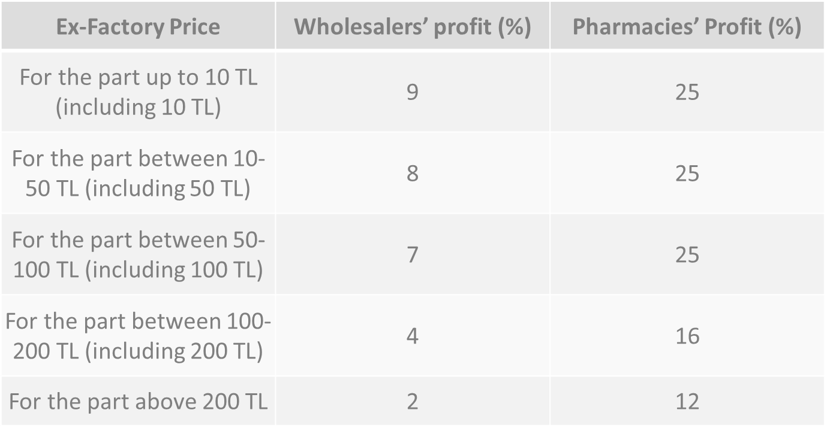
Profit Rates
Türkiye İlaç ve Tıbbi Cihaz Kurumu

Slide 14
Summary
Original pharmaceuticals that do not have generic competition
100% of the Reference Price
+
Wholesaler and Pharmacist Profit Margin
+
%8 VAT
Original pharmaceuticals that have generic competition
(over 4.86 TL)
60% of the Reference Price
+
Wholesaler and Pharmacist Profit Margin
+
%8 VAT
Price protected product
(over 9,30 TL)
80% of the Reference Price
+
Wholesaler and Pharmacist Profit Margin
+
%8 VAT
Türkiye İlaç ve Tıbbi Cihaz Kurumu

Slide 15
Decision Taking Commissions
Medical and Economical Evaluation Commission
(TEDK)
14 members
Medicines Reimbursement Commission
(İGÖK)
10 members
Medical and Economical Evaluation Commission for Medicines Bringing from Abroad (Yİ-TEDK) – 6 members
6 members
Alternative Reimbursement Commission
(AGÖK)
6 members
Türkiye İlaç ve Tıbbi Cihaz Kurumu

Slide 16
Committees Duties
  First molecules
  Original medicines
  Different pharmaceutical form / dose generics of the products on the list
  Passivation of medicines from the Pharmacy Provision system
  Medicines exemption from medicines contribution share
  Terms of reimbursement for all submissions
  Declaration of principle decisions to be taken as basis in the decision process
  Requests regarding reimbursement terms in the Health Implementation Communiqué
  To take a decision about the medicines to be removed from the reimbursement list.
Türkiye İlaç ve Tıbbi Cihaz Kurumu

Slide 17
Committees Decision Process
Presence / absence of alternative treatments used in the same disease
Other pharmaceutical forms of the same or equivalent medicines included in the reimbursement list
Financial burden the new treatment, importance the care, the number of patients targeted for the therapy
Market share distributions of alternative therapies
Current sitiutation in diagnosis and treatment guidelines
Other country practices
Opinions of physicians
Determination of public discount rates
Türkiye İlaç ve Tıbbi Cihaz Kurumu

Slide 18
Reimbursement Process
Process for Medicines
Process for Medicines Bringing from Abroad
Alternative Reimbursement Process
Reimbursement Submission by Turkish Pharmacist Association (TPA)
Alternative Reimbursement Submission by Company
Marketin Authorisation from MoH
30+210 Days (Regular)
30+180 Days (Prioritize)
30+150 Days (High Prioritize)
Alternative Reimbursement Commission
YİTEDK
Medical and Economical Evaluation Commission
Health Services Pricing Commission
Health Implementation Communique
Medicines Reimbursement Commission
Decisions Published in Official Gazette
Medicines listed in Appendix 4/A or 4/C
Decisions Published in Official Gazette
List of Reimbursed Medicines Bringing from Abroad (Appendix 4/C)
Medicines Supply from SSI, TPA or Hospitals
List of Reimbursed Medicines (Appendix 4/A)
Medicines Supply from Pharmacies and Hospitals
Medicines Supply from SSI, TPA or Citizens
Türkiye İlaç ve Tıbbi Cihaz Kurumu

Slide 19
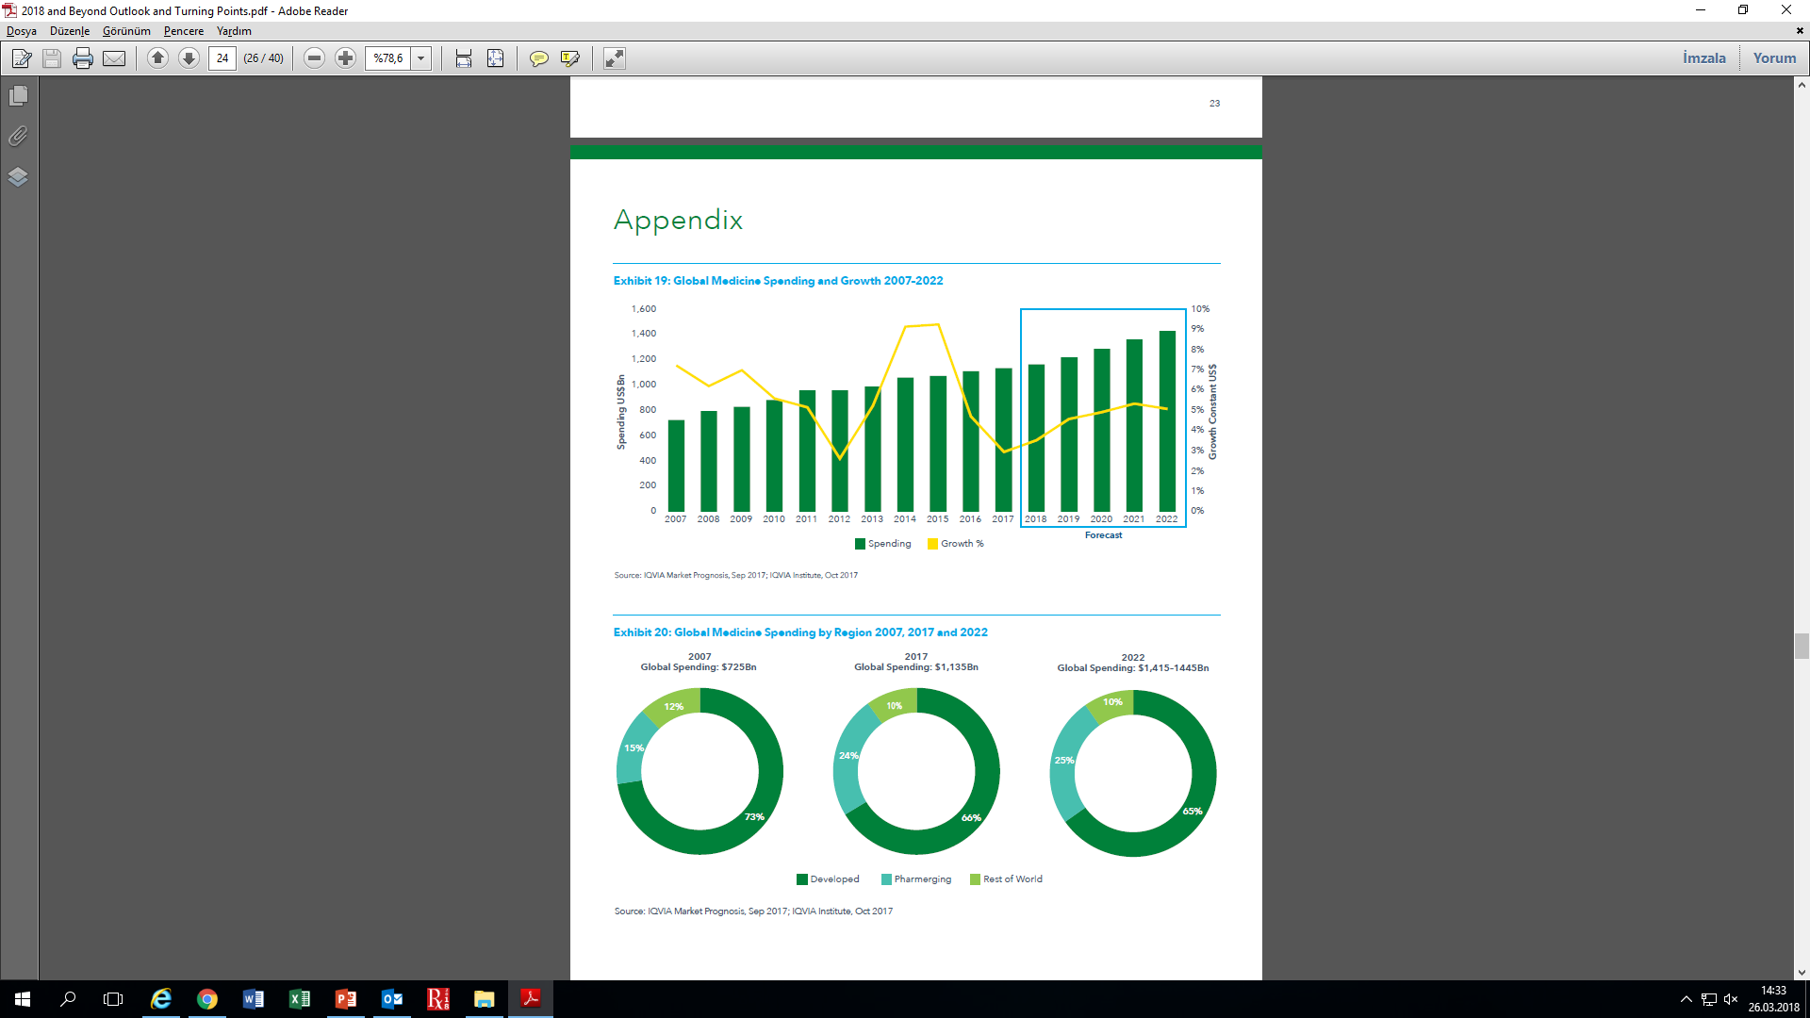
Global Pharmaceutical Market 2007-2022
Kaynak: IQVIA, 2018 and Beyond Outlook and Turning Points
Turkish Medicines and Medical Devices Agency

Slide 20
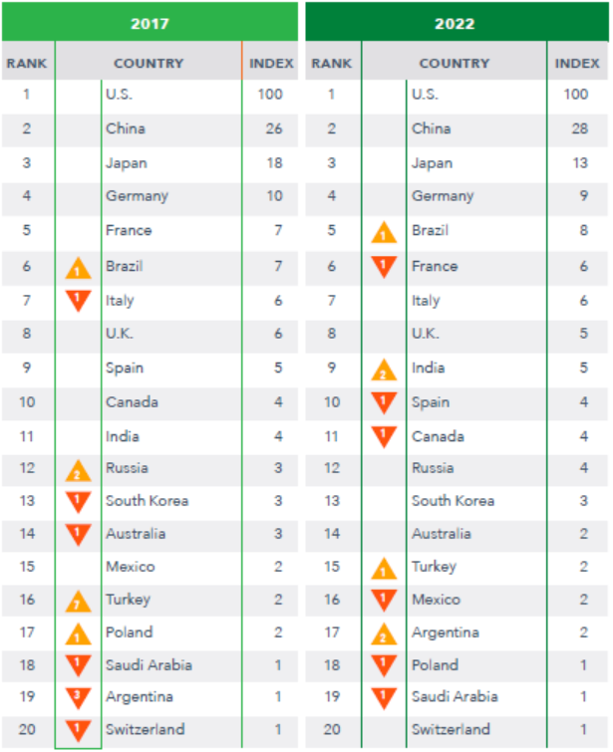
Global Pharmaceutical Market 2017-2022
Turkish Medicines and Medical Devices Agency
Notes:
Gelişen pazarlarda büyüme ortalaması yüzde 10’un altına düşmüştür.
Gelecek 5 yılda büyüme %6-9 arasında beklenmektedir.
Büyüme beklentisi Hindistan için %9-12, Rusya %7-10, Meksika için ise %1’in altındadır.
Aynı dönemde Türkiye için büyüme beklentisi yıllık ortalama %10’un üzerindedir.
Tüm pazarda büyüme beklentisi %3-6 arasındadır. Çin’de yerel üretimi artırarak önümüzdeki 5 yıl içinde patent süresi dolmuş referans ürünler kaynaklı harcamaların %50-85 arasında değişmesi öngörülmektedir. Çin, Brezilya, Hindistan ve Rusya’da ekonomik büyümenin yavaşlaması nedeniyle hastaların cepten harcamalarının artacağı öngörülmektedir.

Slide 21
Turkish Pharmaceutical Market 2002- 2017
Turkish Medicines and Medical Devices Agency
Notes:
Gelişen pazarlarda büyüme ortalaması yüzde 10’un altına düşmüştür.
Gelecek 5 yılda büyüme %6-9 arasında beklenmektedir.
Büyüme beklentisi Hindistan için %9-12, Rusya %7-10, Meksika için ise %1’in altındadır.
Aynı dönemde Türkiye için büyüme beklentisi yıllık ortalama %10’un üzerindedir.
Tüm pazarda büyüme beklentisi %3-6 arasındadır. Çin’de yerel üretimi artırarak önümüzdeki 5 yıl içinde patent süresi dolmuş referans ürünler kaynaklı harcamaların %50-85 arasında değişmesi öngörülmektedir. Çin, Brezilya, Hindistan ve Rusya’da ekonomik büyümenin yavaşlaması nedeniyle hastaların cepten harcamalarının artacağı öngörülmektedir.

Slide 22
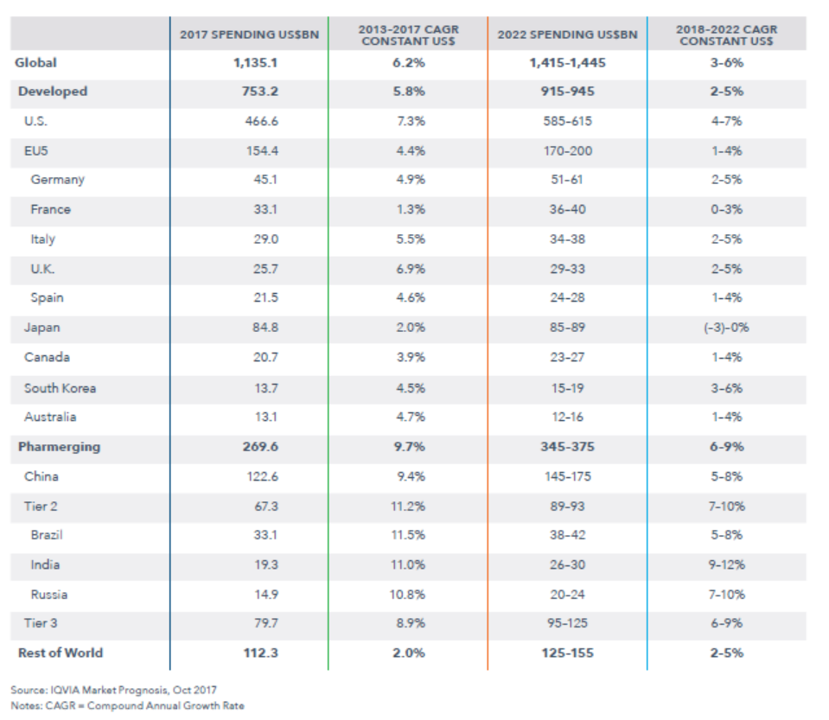
Global Pharmaceutical Market Growth Rates
Turkish Medicines and Medical Devices Agency
Notes:
Gelişen pazarlarda büyüme ortalaması yüzde 10’un altına düşmüştür.
Gelecek 5 yılda büyüme %6-9 arasında beklenmektedir.
Büyüme beklentisi Hindistan için %9-12, Rusya %7-10, Meksika için ise %1’in altındadır.
Aynı dönemde Türkiye için büyüme beklentisi yıllık ortalama %10’un üzerindedir.
Tüm pazarda büyüme beklentisi %3-6 arasındadır. Çin’de yerel üretimi artırarak önümüzdeki 5 yıl içinde patent süresi dolmuş referans ürünler kaynaklı harcamaların %50-85 arasında değişmesi öngörülmektedir. Çin, Brezilya, Hindistan ve Rusya’da ekonomik büyümenin yavaşlaması nedeniyle hastaların cepten harcamalarının artacağı öngörülmektedir.

Slide 23
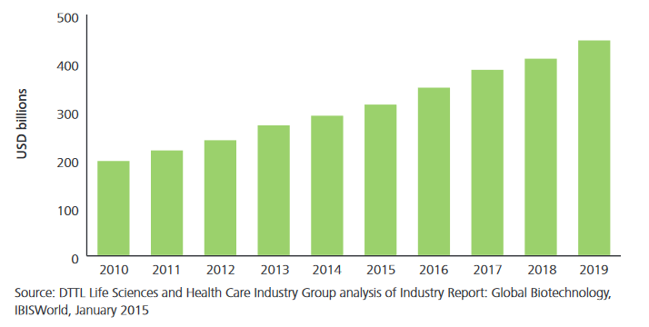
Global Biotechnology Market
Turkish Medicines and Medical Devices Agency

Slide 24
Health Financing and Medicines
Turkey has a social security-based health care system under a single payer: the Social Security Institution. This pools funds from contributory health insurance (with premiums based on employer and employee contributions).
In 2015, 98.7% of Turkish citizens were covered by the universal health insurance (general health insurance) scheme, compared to 67% in 2002
out-of-pocket spending per capita has steadily decreased from 22.8% in 2005 to 16.6% in 2015
External price referencing in introduced in 2004 had a significant impact in limiting co-payments and decreasing prices.
Co-payment rate 10% for pensioners and 20% for active workers.
Prescription fee applies as 3 TL.
SSI reimburse cheapest product in equivalent group.
Generic competition decrease prices.
Main challange : high-cost products
Turkish Medicines and Medical Devices Agency
Notes:
Akılcı antibiyotik kullanımı ile büyük ilerleme kaydedilmiştir.

Slide 25
Health Financing and Medicines
Health Transformation Programme
OECD—30 Years
Turkey— 8 Years
  Aging population,
  Increased antibiotic resistance
  Burden of non-communicable diseases
  Increased burden of chronic diseases
  Burden of innovative medicines
Solution is rational approach on resource management
Turkish Medicines and Medical Devices Agency
Notes:
Akılcı antibiyotik kullanımı ile büyük ilerleme kaydedilmiştir.

Slide 26
Sustainable Health System
Public Pharmaceutical Budget in 2017; 25,4 Billion TL
Universal Social Health Insurance covers 98,4% population
Predictability
Sustainability
The financing of health services should be more predictable and sustainable
Turkish Medicines and Medical Devices Agency

Slide 27
Reimbursement Process
Reimbursement Submissions
All Stakeholders (Industry, Public bodies, NGO’s)
Evaluation of Submissions
Social Security Institution (SSI)
Evaluation by sub-commission
Medical evaluation by sub-committees
Medical and Economical Evaluation Commission
Evaluation of the products
Pharmaceutical Reimbursement Commission
Alternative Reimbursement Commission
Turkish Medicines and Medical Devices Agency
Notes:
All requests for medicines reimbursement are sent by stakeholders
Evaluation of the requests received by SSI Department of Pharmaceuticals and Pharmacy
Appraisal and acceptance of the ones deemed appropriate in the Technical Committees with medical perspective, opinions deliver to the MEEC
Evaluation of the products in the TEDK and taking decisions about those within the scope of Article 9.1 of the Medicines Reimbursement Commission Regulation
For other products, decisions on recommendation of TEDK are sent to Medicines Reimbursement Commission (MRC), decision is taken by MRC, approval of SSI President and after that publication to Official Gazette.

Slide 28
TMMDA HTA Studies
TMMDA
HTA
Macro HTA
5 HTA Reports
Micro HTA Reimbursement Decisions (SSI Commissions)
Turkish Medicines and Medical Devices Agency

Slide 29
TMMDA HTA Studies - Published HTA Reports
Reports are prepared on macro level
By end of 2017, 5 reports have been published.
Analysis of the Effects of Public Interventions on the First 100 Medicines on Value Basis in 2008-2013 Period
Assessment of ghe First 100 Medicines on Value Basis in 2014 and Comparison with the Years 2012-2013
Financial Assessment and Budget Impact Analysis on Fixed Dose Combined Medicines Used in Chronic Diseases
Pharmacoeconomic Evaluation of High-Selling Medicines on Value Based in Turkey Pharmaceutical Market: 2006-2015 Period
Financial Assessment of Inhaler Treatments Used in Respiratory Tract Disease: 1998-2015 Period
One HTA report is planned to be published in 2018.
Turkish Medicines and Medical Devices Agency

Slide 30

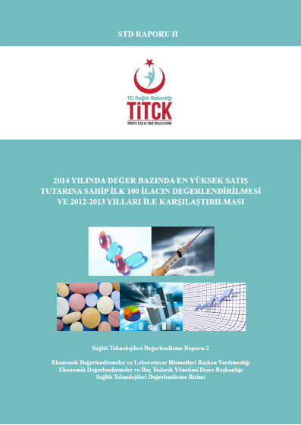

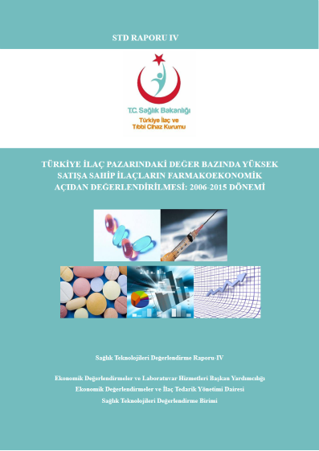
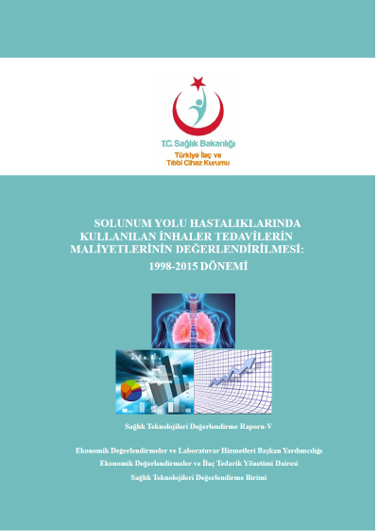
TMMDA HTA Studies - Published HTA Reports
Turkish Medicines and Medical Devices Agency
Notes:
Analysis of the Effects of Public Interventions on the First 100 Medicines on Value Basis in 2008-2013 Period
Assessment of ghe First 100 Medicines on Value Basis in 2014 and Comparison with the Years 2012-2013
Financial Assessment and Budget Impact Analysis on Fixed Dose Combined Medicines Used in Chronic Diseases
Pharmacoeconomic Evaluation of High-Selling Medicines on Value Based in Turkey Pharmaceutical Market: 2006-2015 Period
Financial Assessment of Inhaler Treatments Used in Respiratory Tract Disease: 1998-2015 Period

Slide 31


Thank You for Your Attention
Department of Economic Assessments and Medicines Supply Management

