Slide 1


Healthcare Efficiency Gains
Utilizing data to increase impact
December 19th, 2017 Policy Meeting

Slide 2
Executive Summary
As a part of increasing efficiency and smart resource allocation, the MoH has developed the Routine Efficiency Monitoring System (REMS), an innovative expenditure analysis and efficiency monitoring system:
REMS brings together data on financial resource inputs and corresponding health outputs, enabling routine efficiency monitoring at the point of care
Leverages data from existing health information systems into an integrated user-friendly dashboard
REMS provides evidence-based decision-making expenditure analysis and efficiency analytics

Slide 3


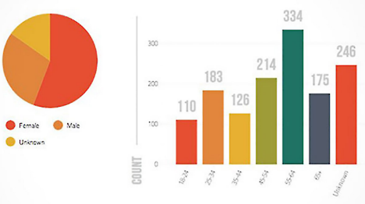
Ministry Led Innovation:
Routine Efficiency Monitoring System (REMS) enables:
New data-driven decision making capabilities
New tool for planning and public health expenditure analysis
Increases in efficiency
Improved resource mobilization and allocation
Identifies underlying costs to guide social health insurance pricing
Routine Monitoring System
IFMIS*
Health Service Financial Data
DHIS2
Health Service Delivery Data
Routinely generated information on performance and efficiency of facilities
*IFMIS – Integrated Financial Management Information System

Slide 4
REMS increases efficiency
REMS gives users the opportunity to do comparative checks and help identify outliers across provinces, districts and facilities which builds a basis for intervention.
Having these analytical capabilities through REMS informs the design of technical support programs to address inefficiencies and strengthen best practices.

Slide 5
REMS helps MoH better allocate resources
REMS provides total and unit costs for HIV health services
Provide a basis for resource allocation and prevent wastage
Enables routine workload estimates per facility which support resource allocation for hospitals
Generating benefits package costs for national health insurance

Slide 6
Demonstration of System

Slide 7
What’s Next?
Expand REMS from the current 326 facilities, 17 districts and two provinces; to all ten (10) provinces and all districts
Include partner resources in system so we have full estimate of the true cost of care and to identify activities which compliment or duplicate efforts
Expand beyond HIV/AIDS services
Link to other eHealth systems
Notes:
I think we need to be explicit about what in not in REMS 1.0 that should be added before we talk about scale-up.

Slide 8
Funding for Two-Year Efficiency Scale-up (in US$ million)
Components | Cost
Component 1: Expanding of program to RMNCH, Malaria, TB, other priority services across ten provinces and integrate across partners / systems | 5.5
1.1 Expand REMS to national-priority services and geographies | 3.5
1.2 Integration of routine partner resources | 0.5
1.3 Integration of eHealth systems (ie supply chain and aggregated electronic medical records) | 1.5
Component 2: Strengthening utilization of integrated health and expenditure data for decision making and health delivery | 2.0
2.1 Training and enhanced data driven decision capacity for district, provincial, national and facility-level staff , deployment and institutionalization of REMS at functional levels (Provincial Planning, Program Planning, Results Based Finance and Results Based Reporting) | 2.0
Total Funding Required | $7.5m USD
Notes:
These number seem high and a bit arbitrary.
1.1 sounds like meetings to reach consensus, (so $2 million seems way too high) 1.2 is additional programming to accommodate additional data inputs. No idea what 1.3 is, 1.4 is building out the facility assessment tools and getting the data. $1.0 seems too low for this at the National level unless MoH is going to put the labor on the CHMTs.
For Component 2, 2.1 is a whole lot of training but what is 2.2?

Slide 9

We want to share.
For more information contact Andrew Kashoka at andrew.kashoka@MOH.gov.zm or Dr. Anita Kaluba at dranitakaluba17@gmail.com

