Slide 1
Health Insurance Benefit Package / Health Facility Costing
(Part 2)
Cost Analysis of Interventions / Pathologies
using bottom-up costed and NHI reported data
Dr Manithong Vonglokham
Lao Tropical and Public Health Institute

Slide 2
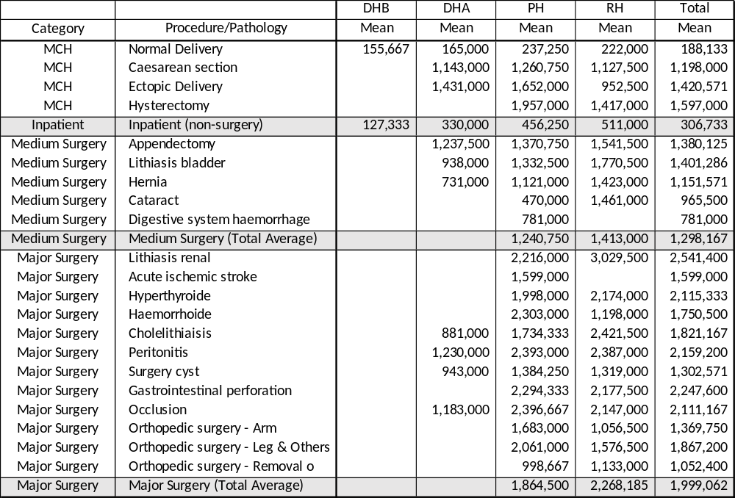
Cost analysis of intervention/pathology
NHI aggregated reported cost of services from 15 costing hospitals
Approx. 8,000 MCH, 35,000 inpatient (non-surgery) and 4,000 medium and major surgery cases categorized by diagnosis/pathology
Covering 1-year period between 2018-2019

Slide 3
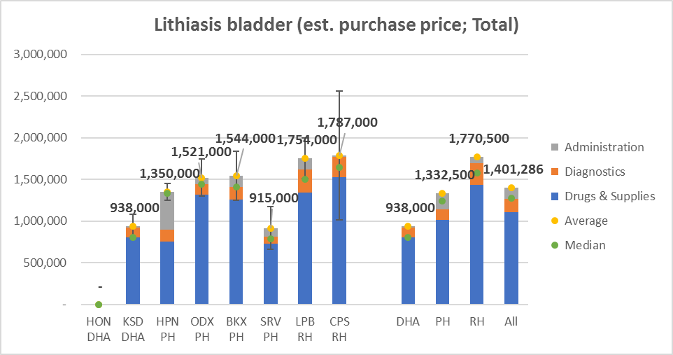
Average estimated unit cost of intervention/pathology
Completed for 22 selected interventions using NHI data

Slide 4
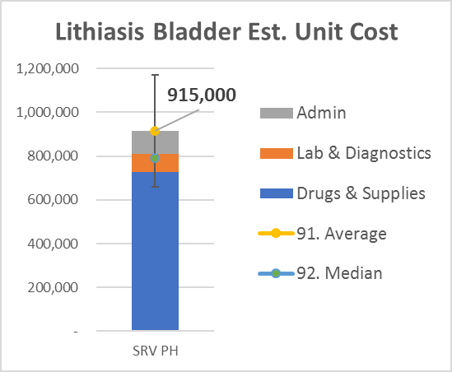
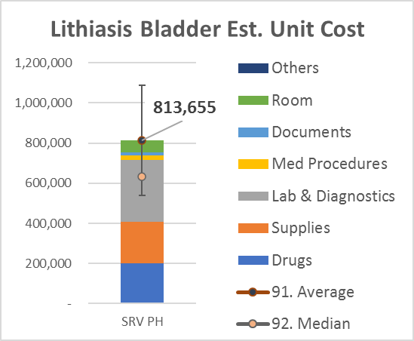
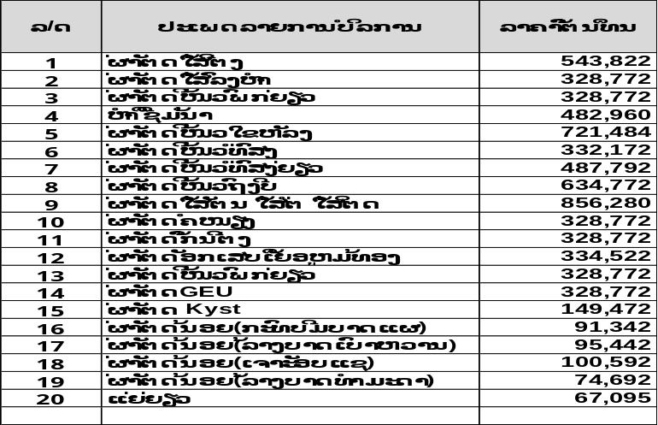
Analysis of category / pathology (from NHI report)
Bottom-up costing data (from LaoTPHI)
Triangulation of cost data from different sources (+ Top-down, EHSP)
Aggregated cost data from NHI claim reports over 1-year period (Drugs, Diagnostics, Admin)
Sales price converted into purchase price
Detailed cost data from selected samples of patient files from the costing hospitals (purchase price)
Data include materials + admin + health personnel
Hospital reported costs of service procedures / diagnostics (mainly supplies, lab tests, etc)
DOF Costing

Slide 5
Progress on Bottom-up costing data entry
 | Transcribing | Total
Completed | ODX PH, SVK RH SRV PH, BKX PH HPN PH, Mahosot | 6
Cleaning | Mittaphab, Setthathirath, MCH | 3
Data Entry | Children H, Dermatology, CPS RH, LPG RH | 4
Transcribing | 2 Private Hs, 4 District Hs (A), 6 District H (B) and 20 health centers | 32
Bottom-up was collected from 45 hospitals
Approx. 7,800 inpatient (5,250 non-surgery and 2,550 surgery cases)
Will be finished data entry in July

Slide 6

Next step on HIBP/HF costing to update PPM
 | Health Facility Costing Top-down (Dr Arthorn) | HIBP Costing (Intervention/Pathology) |  | Dept. Finance Hospital User Fees | Essential Service Package Costing
 |  | Bottom-up (LaoTPHI) | NHI Reported Cost
Type of costs | Direct & Indirect costs Drugs & Supplies Diagnostics Administration Human resource Capital cost | Direct costs Drugs & Supplies Diagnostics Administration Human resource | Direct costs Drugs & Supplies Diagnostics Administration | Direct costs Supplies (+drugs) Diagnostics | Direct & Indirect Drugs & Supplies Diagnostics Administration Human resource Equip. + program cost
Type of interventions | Curative OPD / IPD Dept. (+ Sub-Depts: ER, OB, ICU, others) | Curative NHI service catg. OPD, IPD no surg, Min-Med-Maj Surg Vag. Delivery-C/S | Curative List of all procedures (No general OPD, IPD) | Curative List of procedures / diagnostics tests | Curative + Prevnt. 121 interventions CD NCD RMNCH
Basis | Current practice by depart. / unit | Current practice Tracers by category | Current practice Self-reported | Current practice Self-reported | “Theoretic” costs Based on STG
Hospitals buy-in
More exhaustive
Standard protocols ”what should be”
Chronic diseases specificities
Potential new category of services
NHI Benefit Package
Payment Rate 20/21
NHI Cost Projection / Budgeting
Revise NHI policy and payment methods

Slide 7
Thank you

