Slide 1

Financing Health Promotion and Public Health Service Delivery: Innovations to address non-communicable disease challenges in Cambodia
May 11th 2018

Slide 2
Background
Part of multi-country report on "Financing Health Promotion for NCD prevention” by International Health Policy Program and Thailand Health Foundation, for 8 countries (Bhutan, Cambodia, Indonesia, Philippines, Sri lanka, Thailand, and Vietnam)
The objectives are to produce (1) country report on Financing Health Promotion of the 8 countries and (2) a synthesis of cross country paper

Slide 3
Brief of the country report
Background of Cambodia, health status of the population, disease burden
Health Financing: overall health financing , financing of health promotion and public health services (spending on prevention and public health services was 6.8% of THE in 2014)
  Innovative health financing interventions: internal and external contracting, PBF, vouchers, midwifery incentive scheme, CBHI, HEFs, SDG

Slide 4
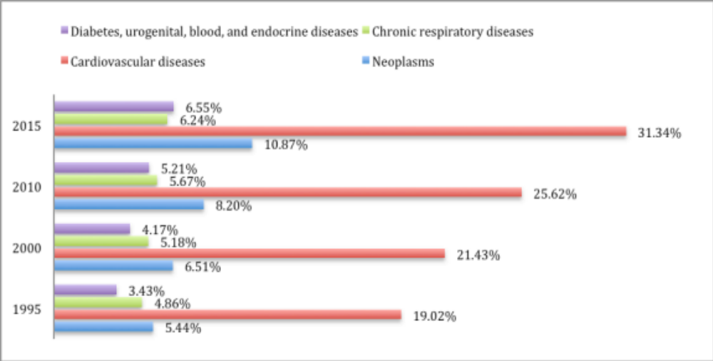
Burden of NCD

Slide 5
Catastrophic expenditure -NCD
Notes:
Catastrophic heath expenditure occurs when a household’s total out-of-pocket health payments equal or exceed 40% of household’s capacity to pay or non-subsistence spending.

Slide 6
Number of medical visits last month
(2014)

Slide 7
OOP as % of monthly income
(2014)

Slide 8
Brief of the country report
Insufficient attention for NCDs
The National Centre for Health Promotion (NCHP) has US$150,000/year (excluding donor support)
The Bureau for NCD received only US$15,000 in 2017
National strategic plan for NCD: addresses all best buy interventions by WHO but mainly on primary prevention
Way forward: Apart from some support for tobacco control, peer education networks, integrated NCDs clinics and screening for cervical cancer, the RGC and Development Partners should consider reallocating existing funds in line with the prevailing burden of disease.
Suggestions: [1] estimate the cost of health system for not addressing NCDs;[2] awareness amongst high-level policymakers about the economic and social implications of NCDs; [3] global funding mechanisms for NCDs; [4] allocation of money from tobacco & alcohol taxation for health promotion activities and introduce tax for sugary beverages

Slide 9


