Slide 1
GFF Country Implementation Guidelines
Draft for consultation – GFF Investors Group
July 16, 2018

Slide 2
Why implementation guidelines now?
The first 16 countries have reached implementation stage; countries have been requesting guidance
Opportunity to apply early lessons from implementation:
  Inconsistent approaches to the investment case poses challenges for results monitoring (e.g., boundaries)
  Reduction of momentum in GFF in-country partnership after IC is developed
  Unclear roles of members of the country platform during implementation
  Inconsistent approach to use of data for decision making
  Need clear theory of change for domestic resource mobilization
  Insufficient participation of some stakeholders (financiers with no in-country-presence, private sector, civil society)
  Ad-hoc approach to implementation research
  Fragmented technical assistance
  Insufficient attention given to advocacy and political processes
  Insufficient communications on the GFF at country level

Slide 3
Purpose of the guidelines
Provide guidance to national governments and other stakeholders
Focus on the implementation stage of the GFF process
  Complement the investment case guidelines
Some adaptation to country context expected
Build on existing experience of GFF implementation and feedback from stakeholders
Will be updated regularly, as more implementation experience is gained
Will be accompanied by a source book with country and global resources

Slide 4
Outline of the guidelines
Vision, mission
Scope of in-country engagement
GFF country platform
Health financing
Data for decision-making
Resource mapping and tracking
Implementation research
Technical assistance
Advocacy
Communication

Slide 5
1. GFF in-country engagement: its vision and mission
Vision of the GFF: to end preventable maternal, newborn, child deaths and improve the health and quality of life of women, adolescents and children.
  This vision is universal. It is at the heart of the “Every Woman, Every Child” movement and is shared by all partners.
Mission of the GFF: to build a new model for development financing for the SDG era, catalyzing multiple sources of financing in support of a country-led investment case that closes the gap in funding for reproductive, maternal, newborn, child, and adolescent health and nutrition by 2030.
  This mission is unique. It is at the heart of the GFF partnership.

Slide 6
2. Scope of GFF in-country engagement – current approach
When a country joins the GFF, it commits to:
  Develop and implement a GFF investment case
    Identifies a set of priorities and the financing to implement them
  Mobilize and lead a country platform at least at the national level and ensure that it meets regularly
  As part of the investment case, develop a common results framework and show commitment to share data and to strengthen monitoring systems
  Increase the level and improve the efficient use of four types of resources:
    domestic financing
    linked IDA/IBRD resources
    aligned financing from bilateral and multilateral agencies as well as CSOs
    private sector resources
  Achieve equity of outcomes and provide financial protection against impoverishment due to ill health or malnutrition

Slide 7
2. Scope of GFF in-country engagement – current approach
GFF investment case and the health financing work program define the scope of the GFF engagement in a country
  Set out a long term vision, and define an initial 5-year set of priority actions
Initial 16 GFF countries have adopted varying approaches to the investment case and health financing work program
GFF investment case is a living document, to be modified during implementation
Various modalities can be used by financiers to align their financing for the implementation of the investment case:
  Pooling (e.g., government account, World Bank trust fund)
  Virtual pooling (e.g., through common plans, results frameworks, instruments such as audits)
  Other co-financing, parallel financing for specific objectives in support of the implementation of the investment case

Slide 8
2. Scope of GFF in-country engagement – proposed modifications
*More similarity in approaches to the investment case anticipated in future
  Possible retro-fitting in initial 16 countries (e.g., during annual reviews)
  Most likely scenario: GFF investment case becomes the “prioritized” operational plan for the national health plan
*Memorandum of Understanding (MoU) to be signed with government upfront when a partner joins the GFF in-country
  Outlines the scope of the contribution
  Includes a data sharing agreement
  Reviewed on annual basis, during annual review
  Note: All new actions in the guidelines are denoted by * in this presentation

Slide 9
3. GFF country platform
Coordination of the GFF engagement is led by the government, through a country platform
Countries encouraged to use existing platforms
Requires effective participation from:
  Relevant ministries (national and sub-national)
  Bilateral and multilateral partners
  *Civil society
  *Private sector
*GFF nodal Ministry to notify in writing, to all national stakeholders, what constitutes the GFF platform
  *Reviewed and reconfirmed annually during the annual review
*GFF country platform will likely need sub-committees
  Data, health financing, etc.

Slide 10
3. GFF country platform
The following key roles will be represented in the platform, at a minimum:
  Government Focal Person
  *Representative from Ministry of Finance
  *GFF Liaison Officer
  Representatives from each aligned financier
  World Bank representative
  *Representative from civil society
  *Representatives from the private sector
  GFF Secretariat Focal Person
*Transparent system for selecting representatives from civil society and private sector, rotation every 2 years
  Resources required to enable civil society to engage at country level
  Opportunity to structure private sector

Slide 11
3. GFF country platform
*Membership on the country platform re-confirmed, and adjusted when necessary, on an annual basis.
Platform meets at least once every quarter
  *Quorum from each type of stakeholder
  Focus on resources and results (at a national and subnational level, using multiple data sources, including financial data)
  * Implementation plan to assign specific roles and responsibilities
  *Meeting minutes to be disseminated, to enable partners with no country presence to remain engaged
  *Try to connect partners with no country presence whenever feasible
  *Review the need for implementation research based on gaps in the program and need to find efficiencies
*Self-assessment of the platform carried out annually
*GFF Champions: engage prominent opinion leaders, in addition to GFF platform members
  Business leaders, religious leaders, media personalities, Parliamentarians, etc.

Slide 12
4. Health Financing
GFF investment case combines key aspects of health financing, notably the efficiency and equity agendas
GFF contributes to an existing health financing landscape in the country
Same principles of health financing which were used to develop the investment case (e.g. prioritization, equity analysis) will continue to be used during implementation
Some aspects of health financing go beyond the purview of the investment case only (e.g., domestic resource mobilization for health sector).

Slide 13
4. Health Financing
*Health Financing Work Program
  Theory of change to cover short and medium term milestones, with a long term (e.g., 10-15 year) horizon
  More specific work program over the initial 3-5 years
  Tailored approaches: technical assistance, analytical work, pilots, evaluations/implementation research and advocacy
  Mutual accountability: formal link between overall GFF investments in-country and the health financing work program
  Alignment with timing of the national budgetary process
Health financing working group within the country platform
Build on existing health financing work in the country and contribute to harmonization of policy advice

Slide 14
5. Data for decision making
The GFF focuses data on the following areas:
Guiding the planning, coordination, and implementation of the RNMCAH-N response (IC), including efficiency
Assessing the effectiveness of RMNCAH-N program and identifying areas for improvement during implementation
  Real time course correction
  Linked to implementation research
Ensuring accountability to those affected by RMNCAH-N outcomes as well as to those providing resources (governments at all levels, CSO, donors, other stakeholders)
Improving the financial sustainability of the investments (specifically DRM) and progress towards universal health coverage (UHC)

Slide 15
5. Data for decision making
Develop a data informed adaptive investment case with real time corrective action implementation
Results Framework
Data use strategy
Supporting Integrate data systems and architecture
Set baselines and achievable targets
The role of the country platform
Building monitoring capacity at all levels of the health system
DQA translated into data quality improvement and use
M&E assessment of systems
Determine gaps in system architecture and systems
Do objectives align with the IC
Data visuals
Data quality and use improvement strategy

Slide 16

How to measure the impact of the GFF
Every 3-5 years:
Every 1-2 years:
Measure HF reforms to increase the total volume of funds to RMNCAH-N: complementary funds, DRM mobilization, allocative efficiency and private sector
Routine data:
Measure HF reforms to getting more results from existing resources technical efficiency agenda and equity
Impact on RMNCAH-N outcomes
National health accounts / Boost
Mapping financial commitments to the RMNACH-N IC by program and regional priorities
Budget allocation systems
Integrated Financial Management Information System (IFMIS)
Private sector fiscal space / market scoping analysis
Integrated Monitoring Approach
Tracking expenditure/disbursement of funds against the IC
Quality of care/ Service delivery
RMNCAH-N performance data (LMIS, DHIS2 etc)
Improved data governance
Impact on Financial protection
Data quality and use incentives for improved outcomes
Building on existing systems and leveraging partners focused on data systems
Integrated health information system and data architecture
Increased subnational demand for the use of quality data for decision making
Country platform

Slide 17
5. Data for decision making
  The main role of the country platform during implementation is to steer performance through the use of data
  *Country performance dashboards at national and sub-national levels
    *Standardized indicators and some country-specific indicators
      *Based on clear theory of change (global evidence as well as country context), determining baselines and setting annual targets
      Roll-up of dashboards for global GFF reporting
      Combination of routine and survey data
  Linking financing to results
    Incentives at all levels of the system
    *Regularly reallocating financing based on budget executions/ absorption, disbursement and expenditure and performance (results)
  Strengthening national data systems, including CRVS
    Based on findings of monitoring system capacity assessment carried out during investment case preparation
      Improving data quality and use, service delivery focused

Slide 18
5. Data for decision making
  GFF builds on and aims to further harmonize existing in-country initiatives to strengthen data system
  *GFF MOU includes agreement to share data on:
    Allocations and expenditures, process, coverage, impact
  *First agenda item of quarterly country platform meetings is the review of dashboard data and decisions on re-allocations
    *Requires a data-sub group to define and prepare the dashboards ahead of the meetings
    GFF Liaison Officer to help guide the process
  *Annual review: more comprehensive, including self assessment of the platform and of likelihood of reaching objectives of the investment case
    *Possible annual results conference to engage stakeholders and to provide a platform to share results of implementation research and new global evidence

Slide 19
An Iterative Learning Process: developing and implementing the Investment Case and long-term health financing reforms
DRM
Efficiency
Prioritized investments for RMNCAH-N outcomes and health financing reforms
intervention I
intervention II
intervention III
HF
Implementation
Health and nutrition and OUTCOMES and IMPACT
Health financing reforms
HF
Monitoring theory of change
HF
Financed
Investment Case - Living document
Country platform
Notes:
Having a nice, well-prioritized document is a good starting point but is not sufficient on its own, so a key area of emphasis for the GFF is on what we term “complementary financing”
At the moment too often countries have national strategic frameworks that are quite broad and don’t have a clear process for securing financing for the plans, and so individual financiers cherry-pick the parts that they are interested in
This results in considerable inefficiency, as there are both gaps (key interventions that are suboptimally financed) and duplications
With the Investment Case process we want to move past this to have a much clearer division of financing, with everyone clear on which slice they are responsible for supporting

Slide 20
6. Resource mapping and tracking
  Resource Mapping during Investment Case Development
  Resource mapping is a key step in the preparation of the investment case
    Determine available resources
      Domestic and external
    See how resources are spread across interventions, geographically
    Identify under-financed priorities (e.g., family planning, nutrition), leading to further prioritization
    Further advocacy or prioritization when resource mapping reveals insufficient resources
    Need to adjust resource mapping when new financiers join the investment case

Slide 21
6. Resource mapping and tracking
  Resource Tracking during Implementation
  *Annual resource tracking is integral part of GFF implementation
  *Discussed during GFF Annual review
  Create mutual accountability
    Government and external financiers
  Start with government resources and main financiers, gradually expanding to smaller financiers
  *MOU signed at the start of the GFF engagement will define data sharing requirements to enable the resource tracking
  *GFF Secretariat currently developing a resource tracking IT tool to facilitate the process
    Aligned with the National Health Account 2011 methodology

Slide 22
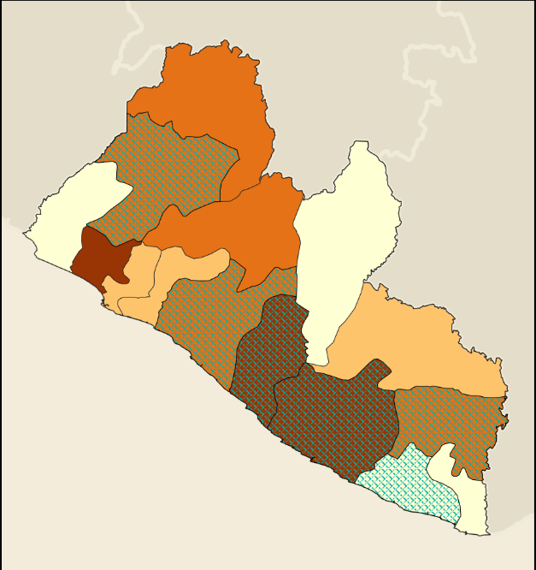
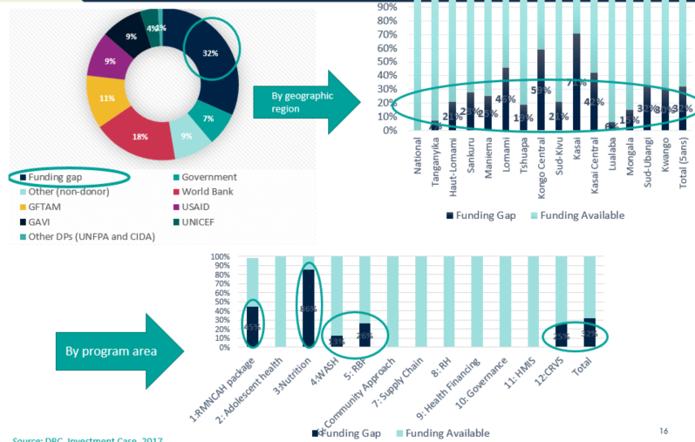
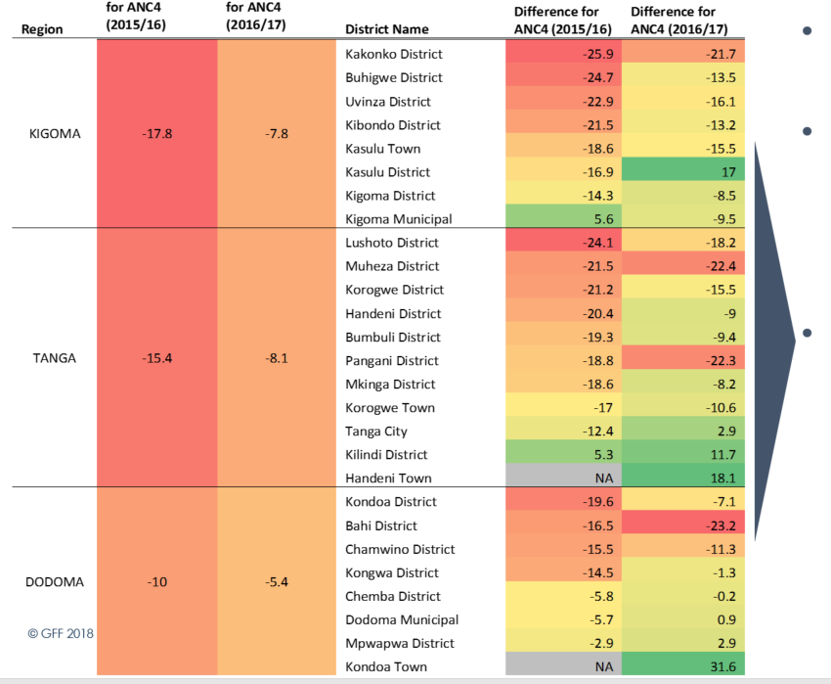
GFF approach – Mapping/ Tracking financial resources to results at subnational levels
Regional differences
& equity agenda
Monitoring geographic priorities (regional disparities, urban versus rural)
Resource mapping
& tracking
Are we in the right places?
Do the result match the available resources?
Do the committed investments match the amounts disbursed?
Are the funds matching the needs?
resource allocation commitments
Health and
nutrition Impact
Performance Results monitoring

Slide 23
7. Implementation research
  Implementation research is critical to understand if, why, how and in what contexts certain interventions supported by the investment case produce results
  Enables adjustments as necessary to the investment case
  Additional information on “real” costs
  Rapid feedback loops for implementers
  *Implementation research plan as part of the overall investment case implementation plan
  *Regular reviews through the GFF country platform
  *Larger results conferences/workshops as appropriate
  *Contribution to the GFF global knowledge and learning agenda

Slide 24
8. Technical assistance
  Objective: to maximize the efficiency of the investment case resources to achieve the intended results
  Includes analytical work as well as implementation support
    Internships, setting up an advisory board to an (insurance) agency, etc.
  *Country-based mechanism to source the TA:
    Identify the needs (e.g., bottleneck analysis)
    Map available TA
    Develop TA matrix and fill gaps
  GFF Secretariat can assist in the preparation of the TA matrix
  *GFF Source Book: first point of reference for countries to access the best available know how and avoid duplication
  *Regular reviews of TA implementation
    *Sub-committee of the country platform
  *Collaboration with national and regional institutions, facilitated through network of GFF Liaison Officers

Slide 25
9. Advocacy
Objective: to accelerate and facilitate the achievement of the results agreed in the investment case
  Especially those results which require government leadership and policy decisions
*Political economy analysis will form the basis of the advocacy strategy
*Advocacy strategy to be developed as part of the IC implementation plan
  Long-term and short-term
  Specific actions linked to key members of the country platform
*Opportunity to engage with national and international CSOs
  Including harmonizing as necessary existing CSO advocacy plans
*Specific “asks” for the group of champions

Slide 26
10. Communication
Objective: to accelerate and facilitate the achievement of the results agreed in the investment case
Generating and sustaining a common understanding of the GFF approach and creating motivation for continued engagement from each stakeholder
*Communications strategy to be developed and implemented by the country platform
  Initial focus on familiarizing with the GFF approach, gradual shift to communicating results
*GFF Secretariat, through the GFF Liaison Officer, will share communications “tool box” to ensure consistency of messaging, while maintaining country flexibility
GFF is a collective endeavor, need to focus on contribution (not attribution) and achieve appropriate level of GFF “branding” in country
*Progress on communications strategy implementation reviewed regularly by the country platform

