Slide 1
Health Insurance Benefit Package / Health Facility Costing
(Part 1)
Preliminary results of health facility costing
using top-down and bottom-up approaches
24 June 2020
Dr Arthorn Riewpaiboon
Consultant

Slide 2
Labor, Material, Capital Costs
Management/supportive cost centers
Medical service
cost centers
Indirect cost allocation:
Simultaneous equation method
Top-down costing;
Hospital
Out-, In-patient cost centers
Average method
Cost per visit, patient day, admission;
- Individual OPD
Overall OPD
- Individual IPD
- Overall IPD

Slide 3
Hospital cost centers;
Oudomxay PH
Management/supportive cost centers
Cost center |  | Code
ໜ່ວຍ​ງານບໍລິຫານ | General admin. | A1
​ໜ່ວຍ​ງານບໍລິຫານ ການ​ແພດ-ສະ​ຖິ​ຕິ | Medical Statistics | A2
​ໜ່ວຍ​ງານການເງີນ-ແຜ​ກ​ານ | Finance & accounting | A3
​ໜ່ວຍ​ງານຈັດຕັ້ງ | Human resource mgnt | A4
ປະກັນສຸຂະພາບ | Health insurance | A5
​ໜ່ວຍ​ງານພະຍາບານ | Nursing admin | A6
​​ໜ່ວຍ​ງານການ​ຢາ/​ສາງ​ຢາ | Drug and medical matcrial supply | A7
​​ໜ່ວຍ​ງານ​ເຕັກ​ນິກ​ | Technology | A8

Slide 4
Medical service cost centers
Cost center |  | Code
ຫ້ອງ​ຈ່າຍຢາ | Pharmacy | B1
ໜ່ວຍ​ງານ ວິເຄາະ | Laboratory | B2
ໜ່ວຍ​ງານ ຮູບ​ພາບລັງສີ | Radiology | B3
ວາງຢາສະຫຼົບ | Anesthesia | B4
ຫ້ອງຜ່າຕັດທົ່ວໄປ ​ | OR_Main | B5
ຫ້ອງຜ່າຕັດປະສູດ-ພະຍາດຍີງ | OR_OB/GYN | B6
ຫ້ອງ​ຜ່າ​ຕັດ​ຫູ ດັງ ຄໍ | OR_ENT | B7
ຫ້ອງ​ຜ່າ​ຕັດ​ຕາ | OR_Ophthalmology | B8

Slide 5
Patient service cost centers
Cost center |  | Code
ໜ່ວຍ​ງານ ທັນ​ຕະ​ແພດ | Dentistry | C1
ກວດສຸກເສີນທົ່ວໄປ | ER_Main | C2
ກວດສຸກເສີນ​ຕາ | ER_Ophthalmology | C3
ກວດເຂດນອກພາຍນອກ | OPD_External Medicine | C4
ກວດເຂດນອກ​ພາຍໃນ | OPD_Internal Medicine | C5
ກວດ​ເຂດນອກ​ເດັກ | OPD_Pediatric | C6
ກວດເຂດນອກ ປະສູດ ພະຍາດຍີງ | OPD_OB & GYN | C7
ກວດເຂດນອກແມ່ ແລະເດັກ | OPD_MCH | C8
ກວດເຂດນອກຫູ-ດັງ-ຄໍ | OPD_ENT | C9
ກວດເຂດນອກຕາ | OPD_Ophthalmology | C10
​ໜ່ວຍ​ງານກາຍຍະ​ບຳບັດ ແລະ ຟື້ນ​ຟູ​ໜ້າ​ທີ່​ການ | OPD_REHAB | C11
ກວດເຂດນອກປອດ-ວັນນະໂລກ | OPD_Pulmonary-TB | C12
ຫ້ອງຄອດ | Delivery room | C13
​ໜ່ວຍ​ງານພື້ນຟູຊີບ | ICU | D1
ໜ່ວຍ​ງານພາຍໃນ | IPD_Internal Meddicine | D2
​ຊືມ​ເຊື້ອ​ - HIV/AIDS | IPD_Infection-HIV/AIDS | D3
​ໜ່ວຍ​ງານ ປອດ-ວັນນະໂລກ | IPD_Pulmonary-TB | D4
​ໜ່ວຍ​ງານ ເດັກ | IPD_Pediatric | D5
​ໜ່ວຍ​ງານປະສູດ - ພະ​ຍາດ​ຍິງ | IPD_OB & GYN | D6
​ໜ່ວຍ​ງານຕາ | IPD_Ophthalmology | D7
​ໜ່ວຍ​ງານພາຍນອກ ​ໜ່ວຍ​ງານຫູ-ດັງ-ຄໍ-ແຂ້ວ | IPD_External med & ENT&Dentistry | D8
ຫ້ອງ​ພິ​ເສດ | VIP | D9
ຕຶກວິ​ລະ​ດາ | VIP_Virada | D10

Slide 6
Costing tool; 20 formats of unit cost
Type of costs
1= | Financial cost
2= | Economic cost
Source of costs
1= | Direct cost only
2= | Direct and indirect costs
Component of costs
1= | Only material cost
2= | Only labor cost
3= | Material and labor costs
4= | Material, labor and equipment/ vehicle costs
5= | Material, labor and capital costs

Slide 7
Financial vs Economic cost
Component | Financial cost | Economic cost
Material cost | Value of material purchased by health facilities -overhead cost (electricity, water) -office material -patrol -drug and medical supplies -chemical reagents -maintenance -hire/ outsource | Financial cost including the value of donated material or supported by the central departments (for instance, MCH drugs, TB drugs, AIDS drug
Labor cost | Actual payment for the staff (both permanent and volunteer) -basic salary (excluding tax) -over time -transportation welfare -spouse welfare | Financial cost of the permanent staff and basic starting salary (opportunity cost) of volunteer (in case the actual payment was more than the starting salary, the actual payment was used in the calculations)
Capital cost | Depreciation cost (purchase price/ useful period) excluding items beyond the useful period | Annual economic cost (current price/ annuity factor) of all items in use including those beyond the useful period with fixed useful year

Slide 8
Indirect cost allocation criteria
Transient cost centers |  | Allocation criteria
ພະແນກບໍລິຫານ ແຜນການ | General admin. | FTE
ພະແນກບໍລິຫານການແພດ | Medical Affair | Visit+patient day
ພະແນກການເງີນ | Finance | Visit+patient day
ພະແນກຈັດຕັ້ງ-ພະນັກງານ | Human resource mgnt | FTE
ການ ບຳ ລຸງຮັກສາ | Maintenance | Space used
ພະແນກປະກັນສຸຂະພາບ | Health insurance | Visit+patient day
ພະແນກພະຍາບານ | Nursing admin | Visit+patient day
ການລົງທະບຽນ | Registration | Visit+patient day
ສາງຢາ | Drug and medical material supply | Supplied value
ຫ້ອງຈ່າຍຢາ | Pharmacy_Dispensing | Visit+patient day
ພະແນກວິເຄາະທົ່ວໄປ | Lab | Service
ພະແນກລັງສີ-ຮູບພາບ | Radiology | Service
ສູນສາຍແສງ | Radiotherapy | Service
ພະແນກວາງຢາສະລົບ | Anesthesiology | Service
ຫ້ອງຜ່າຕັດຜົ້ງທ້ອງ | OR_ABDOMEN | Service
ຫ້ອງຜ່າຕັດສະໝອງ | OR_NEURO SURGERY | Service
ຫ້ອງຜ່າຕັດກະທົບກະດູກ | OR_ORTHOPEDIC | Service
ຫ້ອງຜ່າຕັດກະດູກ ຊືມເຊື້ອ | OR_ORTHOPEDIC | Service
ຫ້ອງຜ່າຕັດກະດູກ ເດັກ | OR_ORTHOPEDIC | Service
ຫ້ອງຜ່າຕັດຫູ-ດັງ-ຄໍ | OR_ENT & MAX FACIAL | Service
ຫ້ອງຜ່າຕັດປະສູດ-ພະຍາດຍີງ | OR_OB/GYN | Service
ຫ້ອງປະສູດ | OR_OB/GYN | Service

Slide 9
Cost format results; preliminary report
Format | Type | Source | Component
123 | Financial | Direct+indirect (Pt service + Med service + Supportive) | M + L
125 | Financial | Direct+indirect (Pt service + Med service + Supportive) | M + L + C
225 | Economic | Direct+indirect (Pt service + Med service + Supportive) | M + L + C

Slide 10
Top-down cost
 |  | Outputs | Unit cost; 123 | Unit cost; 125 | Unit cost; 225
 |  |  | M + L (F) | M + L + C (F) | M + L + C (E)
 |  | Visit | Visit | Visit | Visit
Dentistry | C1 | 1,914 | 216,174 | 227,513 | 276,213
ER_Main | C2 | 18,083 | 99,576 | 105,415 | 131,109
ER_Ophthalmology | C3 | 540 | 277,773 | 279,306 | 292,932
OPD_External Medicine | C4 | 1,716 | 230,745 | 241,744 | 329,723
OPD_Internal Medicine | C5 | 11,945 | 97,600 | 100,342 | 119,767
OPD_Pediatric | C6 | 5,894 | 77,830 | 79,207 | 86,806
OPD_OB & GYN | C7 | 2,641 | 143,808 | 147,340 | 162,943
OPD_MCH | C8 | 7,006 | 93,000 | 97,021 | 113,681
OPD_ENT | C9 | 286 | 309,397 | 311,989 | 368,400
OPD_Ophthalmology | C10 | 2,328 | 99,466 | 103,025 | 110,913
OPD_REHAB | C11 | 788 | 349,425 | 367,444 | 453,583
OPD_Pulmonary-TB | C12 | 11,798 | 51,850 | 52,587 | 55,475
Delivery room | C13 | 4,748 | 94,641 | 97,114 | 111,245
Overall OPD |  | 69,687 | 101,493 | 105,353 | 124,790

Slide 11
Top-down cost
 |  | Outputs |  | Unit cost | 123 | Unit cost | 125 | Unit cost | 225
 |  |  |  | M + L (F) |  | M + L + C (F) |  | M + L + C (E)
 |  | Admission | Pt-day | Admission | Pt-day | Admission | Pt-day | Admission | Pt-day
ICU | D1 | 1,076 | 1,549 | 1,074,494 | 746,388 | 1,181,280 | 820,567 | 1,272,282 | 883,780
IPD_Internal Meddicine | D2 | 1,949 | 6,562 | 675,531 | 200,642 | 714,427 | 212,194 | 786,673 | 233,652
IPD_Infection-HIV/AIDS | D3 | 1,016 | 3,254 | 699,632 | 218,447 | 720,747 | 225,040 | 774,481 | 241,817
IPD_Pulmonary-TB | D4 | 46 | 112 | 3,619,574 | 1,486,611 | 3,828,603 | 1,572,462 | 4,101,435 | 1,684,518
IPD_Pediatric | D5 | 1,398 | 3,830 | 656,605 | 239,669 | 675,661 | 246,625 | 722,674 | 263,786
IPD_OB & GYN | D6 | 3,283 | 5,527 | 252,079 | 149,733 | 262,870 | 156,143 | 317,241 | 188,439
IPD_Ophthalmology | D7 | 221 | 1,225 | 1,551,957 | 279,986 | 1,762,189 | 317,913 | 4,233,210 | 763,706
IPD_External med & ENT&Dentistry | D8 | 1,611 | 5,733 | 695,294 | 195,381 | 708,915 | 199,208 | 1,011,676 | 284,286
VIP | D9 | 208 | 754 | 654,653 | 180,594 | 787,300 | 217,186 | 996,035 | 274,768
VIP_Virada | D10 | 723 | 2,278 | 776,225 | 246,361 | 780,793 | 247,811 | 856,269 | 271,766
Overall IPD |  | 11,531 | 30,824 | 629,267 | 235,404 | 662,495 | 247,834 | 808,356 | 302,399

Slide 12
Cost-recovery
Overall hospital
Data of | Oudomxay PH
Revenue
MoH budget (excluding salary) | 5,176,167,875 | LAK | 40%
Insurance | 4,676,079,250 | LAK | 22%
Patient payment | 4,588,447,690 | LAK | 21%
Others | 145,272,791 | LAK | 1%
Debt to be received | 3,610,890,000 | LAK | 17%
Total | 21,681,220,686 | LAK | 100%
Overall cost recovery
Cost component | 121 | Financial cost covering only material cost from all departments
Full cost | 2,155,833,558
Cost recovery (Revenue-Cost) | 19,525,387,128
Revenue/ Cost | 10.06
 |  |  |  | RCC (Charge/ Cost)
 |  | Full cost | Total charge; 123 | 121 | 123 | 125
Laboratory | B2 | 680,749,669 | 1,682,371,000 | 14.13 | 2.47 | 2.40
Radiology | B3 | 575,357,005 | 501,895,000 | 7.83 | 0.87 | 0.85

Slide 13
Cost-recovery; services
Beneficial for hospital management
Efficiency analysis; control cost and/or increase number of services
Price setting
Cost format
Format | Type | Source | Component
123 | Financial | Direct+indirect (Pt service + Med service + Supportive) | M + L
125 | Financial | Direct+indirect (Pt service + Med service + Supportive) | M + L + C
225 | Economic | Direct+indirect (Pt service + Med service + Supportive) | M + L + C

Slide 14
Cost-recovery; services
Service | Unit price | Unit cost |  |  | Cost recovery (Price-cost)
 |  | 123 | 125 | 225 | 123 | 125 | 225
CBC | 40,000 | 8,815 | 9,034 | 12,849 | 31,185 | 30,966 | 27,151
Group | 10,000 | 6,988 | 7,233 | 10,655 | 3,012 | 2,767 | -655
TS TC | 5,000 | 6,684 | 6,932 | 10,290 | -1,684 | -1,932 | -5,290
Hz(Malaria) | 70,000 | 10,641 | 10,836 | 15,044 | 59,359 | 59,164 | 54,956
WIDAL | 50,000 | 10,699 | 10,950 | 15,503 | 39,301 | 39,050 | 34,497
Deng | 60,000 | 11,308 | 11,551 | 16,234 | 48,692 | 48,449 | 43,766
Rick | 107,000 | 14,169 | 14,374 | 19,672 | 92,831 | 92,626 | 87,328
Lep | 75,000 | 12,221 | 12,452 | 17,331 | 62,779 | 62,548 | 57,669
HBV ag | 30,000 | 9,482 | 9,749 | 14,040 | 20,518 | 20,251 | 15,960
HBV ab | 30,000 | 9,482 | 9,749 | 14,040 | 20,518 | 20,251 | 15,960
HCV | 30,000 | 9,482 | 9,749 | 14,040 | 20,518 | 20,251 | 15,960
HAV | 30,000 | 9,482 | 9,749 | 14,040 | 20,518 | 20,251 | 15,960
HEV | 30,000 | 9,482 | 9,749 | 14,040 | 20,518 | 20,251 | 15,960
HIV | 100,000 | 13,743 | 13,953 | 19,160 | 86,257 | 86,047 | 80,840
Syph | 75,000 | 12,221 | 12,452 | 17,331 | 62,779 | 62,548 | 57,669
Amph | 15,000 | 8,568 | 8,848 | 12,943 | 6,432 | 6,152 | 2,057
HCG | 30,000 | 9,482 | 9,749 | 14,040 | 20,518 | 20,251 | 15,960
Opiate | 30,000 | 9,482 | 9,749 | 14,040 | 20,518 | 20,251 | 15,960
Gonorrhea | 70,000 | 11,917 | 12,151 | 16,965 | 58,083 | 57,849 | 53,035
Chlamydia | 182,000 | 18,735 | 18,878 | 25,157 | 163,265 | 163,122 | 156,843

Slide 15
Service | Unit price | Unit cost |  |  | Cost recovery (Price-cost)
 |  | 123 | 125 | 225 | 123 | 125 | 225
Echographie | 30,000 | 48,917 | 50,556 | 59,584 | -18,917 | -20,556 | -29,584
ECG | 25,000 | 48,055 | 49,709 | 58,767 | -23,055 | -24,709 | -33,767
X-ray-ກະໂຫຼກຫົວ | 70,000 | 49,567 | 50,099 | 55,081 | 20,433 | 19,901 | 14,919
X-ray-ຜົ້ງດັງ | 70,000 | 49,567 | 50,099 | 55,081 | 20,433 | 19,901 | 14,919
X-ray-ຄາງກະໄຕ | 70,000 | 49,567 | 50,099 | 55,081 | 20,433 | 19,901 | 14,919
X-ray-ກະດູກກ້ານຄໍ | 70,000 | 49,567 | 50,099 | 55,081 | 20,433 | 19,901 | 14,919
X-ray-ກະດູກໄມ້ຄ້ານ | 70,000 | 49,567 | 50,099 | 55,081 | 20,433 | 19,901 | 14,919
X-ray-ກະດູກກົກແຂນ | 70,000 | 49,567 | 50,099 | 55,081 | 20,433 | 19,901 | 14,919
X-ray-ກະດູກແຂນ | 70,000 | 49,567 | 50,099 | 55,081 | 20,433 | 19,901 | 14,919
X-ray-ກະດູກປາຍແຂນ | 70,000 | 49,567 | 50,099 | 55,081 | 20,433 | 19,901 | 14,919
X-ray-ກະດູກຄໍ່ມື | 70,000 | 49,567 | 50,099 | 55,081 | 20,433 | 19,901 | 14,919
X-ray-ຜົ້ງເອິກ | 70,000 | 49,567 | 50,099 | 55,081 | 20,433 | 19,901 | 14,919
X-ray-ກະດູກມື | 70,000 | 49,567 | 50,099 | 55,081 | 20,433 | 19,901 | 14,919
X-ray-ປອດ | 70,000 | 49,567 | 50,099 | 55,081 | 20,433 | 19,901 | 14,919
X-ray-ກະດູກສັນຫຼັງ | 70,000 | 49,567 | 50,099 | 55,081 | 20,433 | 19,901 | 14,919
X-ray-ກະດູກແອວ | 70,000 | 49,567 | 50,099 | 55,081 | 20,433 | 19,901 | 14,919
X-ray-ຜົ້ງທ້ອງ | 70,000 | 49,567 | 50,099 | 55,081 | 20,433 | 19,901 | 14,919
X-ray-ກະດູກສະໂພກ | 70,000 | 49,567 | 50,099 | 55,081 | 20,433 | 19,901 | 14,919
X-ray-ກະດູກກົກຂາ | 70,000 | 49,567 | 50,099 | 55,081 | 20,433 | 19,901 | 14,919
X-ray-ພົກຍ່ຽວ | 70,000 | 49,567 | 50,099 | 55,081 | 20,433 | 19,901 | 14,919
X-ray-ກະດູກຂາ | 70,000 | 49,567 | 50,099 | 55,081 | 20,433 | 19,901 | 14,919
X-ray-ກະດູກຫົວເຂົ່າ | 70,000 | 49,567 | 50,099 | 55,081 | 20,433 | 19,901 | 14,919
X-ray-ກະດູກແຄ່ງ | 70,000 | 49,567 | 50,099 | 55,081 | 20,433 | 19,901 | 14,919
X-ray-ກະດູກຄໍ່ຕີນ | 70,000 | 49,567 | 50,099 | 55,081 | 20,433 | 19,901 | 14,919
X-ray-ກະດູກສົ້ນນ່ອງ | 70,000 | 49,567 | 50,099 | 55,081 | 20,433 | 19,901 | 14,919
X-ray-ກະດູກແຂນສອກ | 70,000 | 49,567 | 50,099 | 55,081 | 20,433 | 19,901 | 14,919
X-ray-ກະດູກຕີນ | 70,000 | 49,567 | 50,099 | 55,081 | 20,433 | 19,901 | 14,919
X-ray-UIV | 70,000 | 49,567 | 50,099 | 55,081 | 20,433 | 19,901 | 14,919

Slide 16
Results of all hospitals

Slide 17
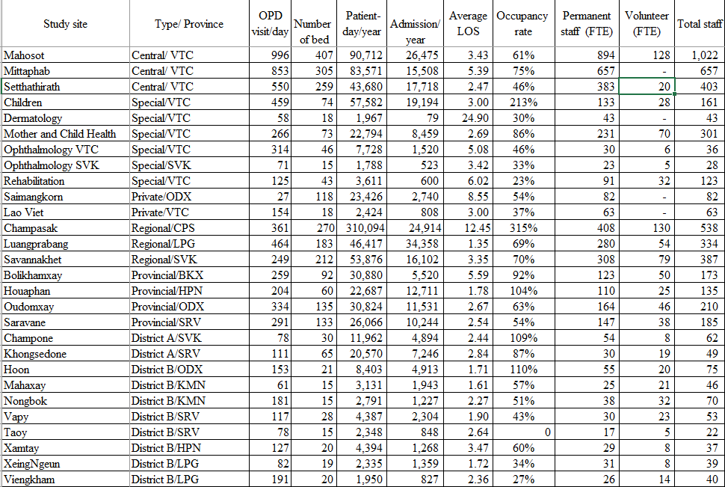
Characteristics and performance of all hospitals

Slide 18
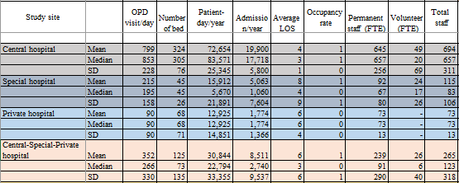

Slide 19
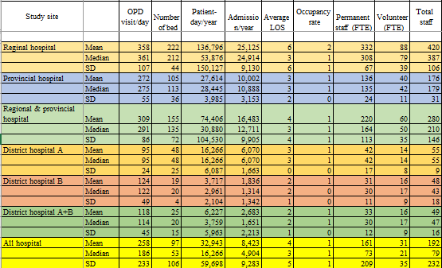

Slide 20
Cost structure of central and private hospitals
 | Material |  |  | Labor |  |  | Total
Study site | Drug/ med supplies | Others | Total | Permanent | Volunteer | Total
Mahosot | 47,294,795,055 | 22,045,203,090 | 69,339,998,145 | 25,778,362,817 | 227,740,290 | 26,006,103,107 | 95,346,101,252
 | 49.6% | 23.1% | 72.7% | 27.0% | 0.2% | 27.3% | 100.0%
Mittaphab | 32,905,902,780 | 25,670,390,622 | 58,576,293,402 | 14,828,461,907 | - | 14,828,461,907 | 73,404,755,309
 | 44.8% | 35.0% | 79.8% | 20.2% | 0.0% | 20.2% | 100.0%
Setthathirath | 36,804,383,296 | 12,730,372,137 | 49,534,755,433 | 12,527,648,255 | 169,400,000 | 12,697,048,255 | 62,231,803,688
 | 59.1% | 20.5% | 79.6% | 20.1% | 0.3% | 20.4% | 100.0%
Children | 5,087,304,694 | 11,104,790,902 | 16,192,095,596 | 4,371,412,760 | - | 4,371,412,760 | 20,563,508,356
 | 24.7% | 54.0% | 78.7% | 21.3% | 0.0% | 21.3% | 100.0%
Dermatology | 1,126,224,798 | 699,413,863 | 1,825,638,661 | 1,332,636,345 | - | 1,332,636,345 | 3,158,275,006
 | 35.7% | 22.1% | 57.8% | 42.2% | 0.0% | 42.2% | 100.0%
Mother and Child Health | 306,935,075 | 9,800,831,225 | 10,107,766,300 | 7,175,826,128 | 1,223,779,400 | 8,399,605,528 | 18,507,371,828
 | 1.7% | 53.0% | 54.6% | 38.8% | 6.6% | 45.4% | 100.0%
Ophthalmology VTC | 1,851,431,974 | 3,550,034,338 | 5,401,466,312 | 1,537,275,322 | 40,370,238 | 1,577,645,560 | 6,979,111,872
 | 26.5% | 50.9% | 77.4% | 22.0% | 0.6% | 22.6% | 100.0%
Ophthalmology SVK | 531,453,000 | 161,760,000 | 693,213,000 | 16,920,000 | 30,615,000 | 47,535,000 | 740,748,000
 | 71.7% | 21.8% | 93.6% | 2.3% | 4.1% | 6.4% | 100.0%
Rehabilitation | 306,935,075 | 2,386,018,319 | 2,692,953,394 | 2,245,789,173 | 219,735,000 | 2,465,524,173 | 5,158,477,567
 | 6.0% | 46.3% | 52.2% | 43.5% | 4.3% | 47.8% | 100.0%
Saimangkorn | 3,526,094,963 | 1,410,635,081 | 4,936,730,044 | 8,479,855,636 | - | 8,479,855,636 | 13,416,585,680
 | 26.3% | 10.5% | 36.8% | 63.2% | 0.0% | 63.2% | 100.0%
Lao Viet | 3,110,106,529 | 3,687,595,848 | 6,797,702,377 | 4,575,928,236 | - | 4,575,928,236 | 11,373,630,613
 | 27.3% | 32.4% | 59.8% | 40.2% | 0.0% | 40.2% | 100.0%

Slide 21
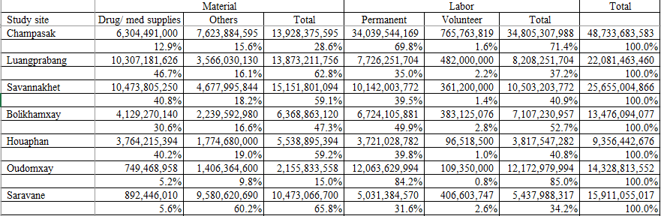
Cost structure of regional and provincial hospitals

Slide 22
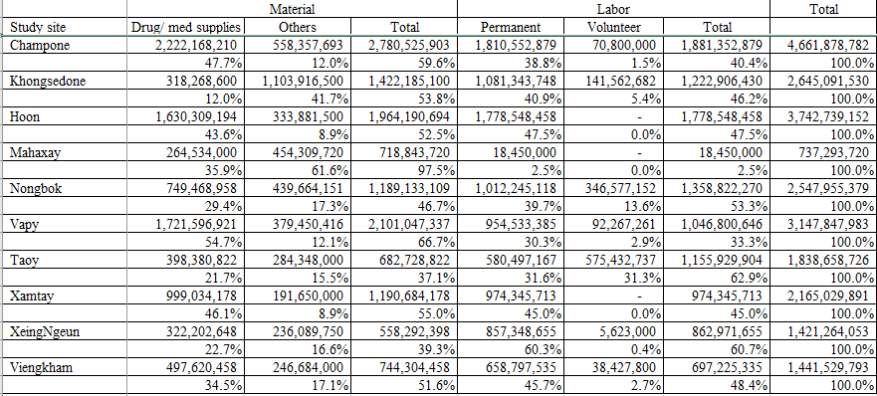
Cost structure of district hospitals

Slide 23
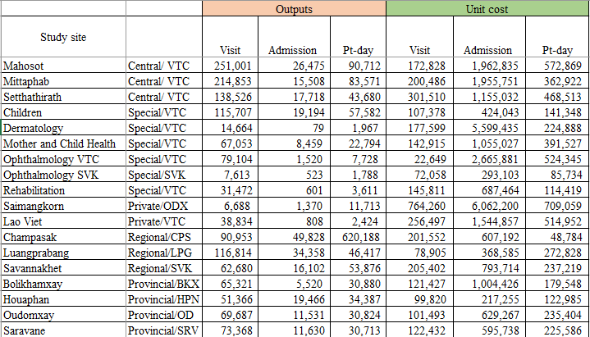
Outputs and top-down unit cost of
central, special, regional, provincial and private hospitals

Slide 24
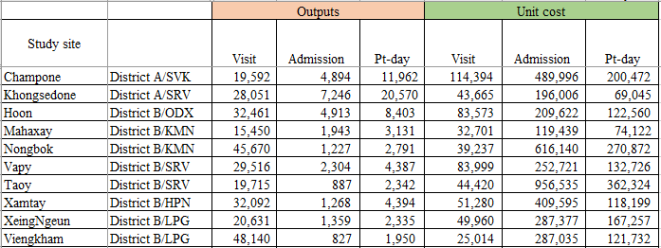
Outputs and top-down unit cost of district hospitals

Slide 25
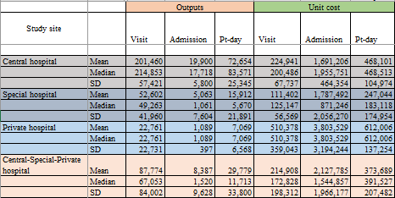

Slide 26
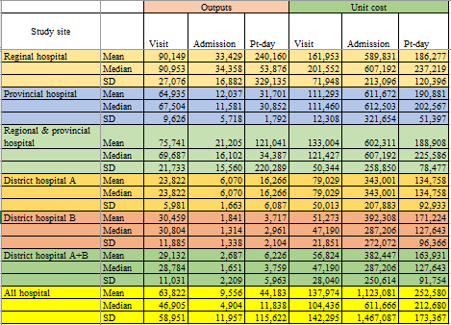

Slide 27
Labor, Material, Capital Costs
General Admin, Finance, Health insurance
Pharmacy, Lab, Delivery room
Indirect cost allocation:
Simultaneous equation method
Top-down costing;
Health center
Outreach service financial support;
Per idem, travel cost, VHV incentive
Outreach Health Promotion & Education
ວຽກງານເຄື່ອນທີ່_ສົ່ງເສີມ
ແລະສຸຂະສຶກສາ
OPD_General/ minor surgery
OPD_Vaccine
OPD_ANC
OPD_PNC
OPD_Family Planning
OPD_Nutrition
IPD
Direct cost
Activity-base costing;
Per idem, travel cost, VHV incentive
Indirect cost
Average method
Cost/village-year
Cost/village-visit
Cost/household-year
Cost/population-year
Cost per visit, patient day, admission;
- Individual OPD
- Overall OPD, Overall IPD

Slide 28
Cost center of health center A (Bantao)
Cost center |  | Code
ບໍລິຫານ ແຜນການ | General admin | A1
ຫ້ອງຈ່າຍຢາ | Pharmacy | B1
ຫ້ອງປະສູດ | Delivery room | B2
ກວດເຂດນອກ_ທົ່ວໄປ / ຜ່າຕັດນ້ອຍ | OPD_General/ minor surgery | C1
ກວດເຂດນອກ_ສັກຢາກັນພະຍາດ | OPD_Vaccine | C2
ກວດເຂດນອກ_ຝາກທ້ອງ | OPD_ANC | C3
ກວດເຂດນອກ_ກວດຫຼັງເກີດ | OPD_PNC | C4
ກວດເຂດນອກ_ວາງແຜນຄອບຄົວ | OPD_Family Planning | C5
ກວດເຂດນອກ_ໂພຊະນາການ (ຕິດຕາມເດັກດີ) | OPD_Nutrition | C6
ຄົນເຈັບນອນ | IPD | D1
ວຽກງານເຄື່ອນທີ່_ສົ່ງເສີມ ແລະສຸຂະສຶກສາ | Outreach_Health Promotion & Education | E1

Slide 29
Cost center of health center B (Laosouliya)
Cost center |  | Code
ບໍລິຫານ ແຜນການ ການເງິນ | General admin Finance | A1
ປະກັນສຸຂະພາບ / ກອງທືນ ກປຊ | Health Insurance | A2
ຫ້ອງຈ່າຍຢາ | Pharmacy | B1
ວິເຄາະ(ກວດເຊື້ອໄຂ້ຍຸງ) | Laboratory | B2
ຫ້ອງເກີດລູກ | Delivery room | B3
ກວດເຂດນອກ_ທົ່ວໄປ / ຜ່າຕັດນ້ອຍ | OPD_General/ minor surgery | C1
ກວດເຂດນອກ_ສັກຢາກັນພະຍາດ | OPD_Vaccine | C2
ກວດເຂດນອກ_ຝາກທ້ອງ | OPD_ANC | C3
ກວດເຂດນອກ_ກວດຫຼັງເກີດ | OPD_PNC | C4
ກວດເຂດນອກ_ວາງແຜນຄອບຄົວ | OPD_Family Planning | C5
ກວດເຂດນອກ_ໂພຊະນາການ (ຕິດຕາມເດັກດີ) | OPD_Nutrition | C6
ຄົນເຈັບນອນ | IPD | D1
ວຽກງານເຄື່ອນທີ່_ສົ່ງເສີມ ແລະສຸຂະສຶກສາ | Outreach_Health Promotion & Education | E1

Slide 30
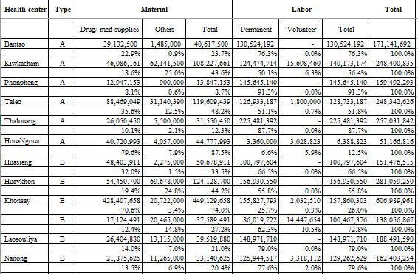
Cost structure of health centers

Slide 31
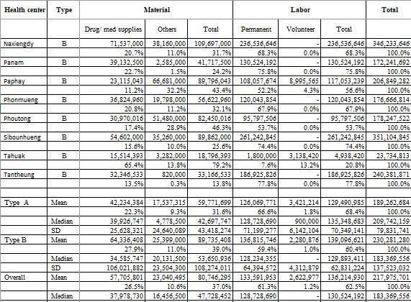

Slide 32
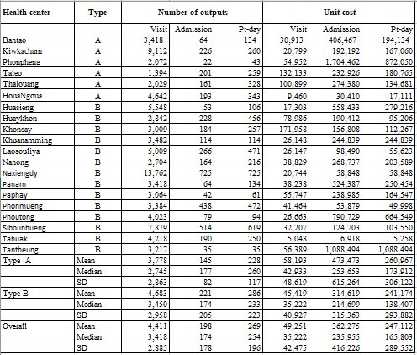
Outputs and unit cost of health centers

Slide 33
งานส่งเสริม 8 อย่าง (ຄິງທິ່ & ເຄື່ອນໄຫວ), Bantao HC
1 | ເຄື່ອນໄຫວ_ສົ່ງເສີມ ແລະສຸຂະສຶກສາ | Outreach_Health Promotion & Education | every 3 months
2 | ເຄື່ອນໄຫວ_ສັກຢາກັນພະຍາດ | Outreach_Vaccination | every month
3 | ເຄື່ອນໄຫວ_ກວດທ້ອງແມ່ມານ | Outreach_ANC | every 3 months
4 | ເຄື່ອນໄຫວ_ກວດຫຼັງເກີດ | Outreach_PNC | every 3 months
5 | ເຄື່ອນໄຫວ_ວາງແຜນຄອບຄົວ | Outreach_Family Planning | every 3 months
6 | ເຄື່ອນໄຫວ_ຕິດຕາມໂພຊະນາການ | Outreach_Nutrition | every 3 months
7 | ເຄື່ອນໄຫວ_ຈ່າຍຢາຂ້າແມ່ທ້ອງ​<5 ປີ | Outreach_Deworming | every 6 months
8 | ເຄື່ອນໄຫວ_ໃຫ້ຢາວິຕາມິນ<5 ປີ | Outreach_Vitamin Supplemenation | every 3 months

Slide 34
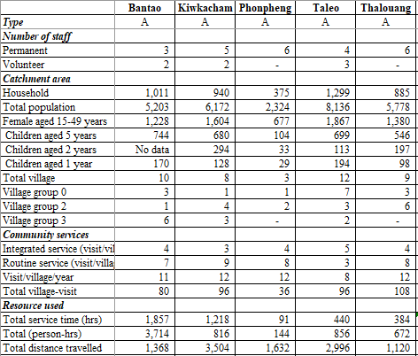
Characteristics and outputs of health center outreach services

Slide 35
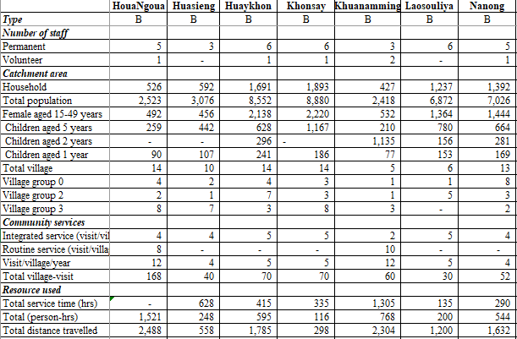

Slide 36
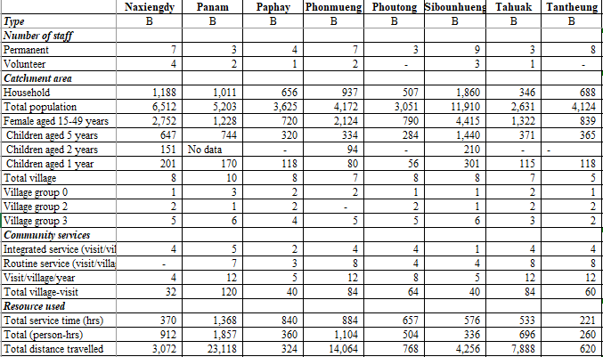

Slide 37
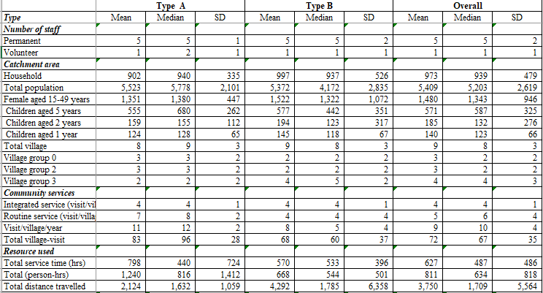
Summary
Characteristics and outputs of
health center outreach services

Slide 38
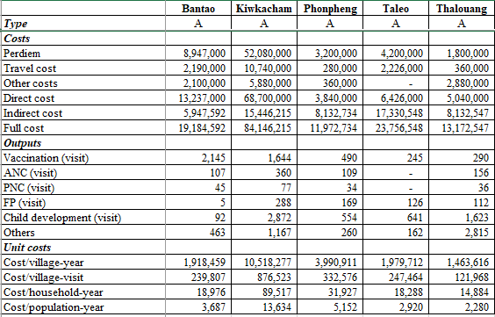
Costs, outputs and unit costs of health center outreach services

Slide 39
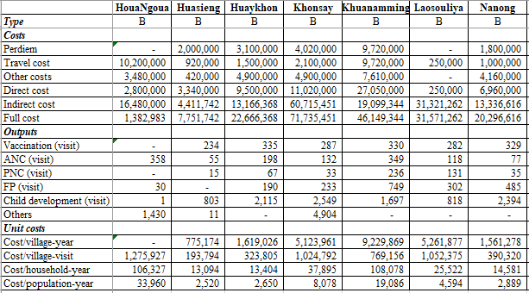

Slide 40
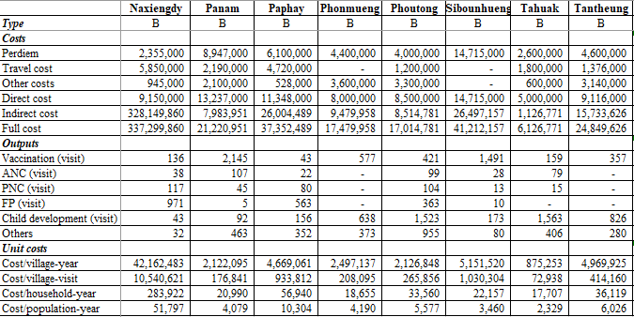

Slide 41
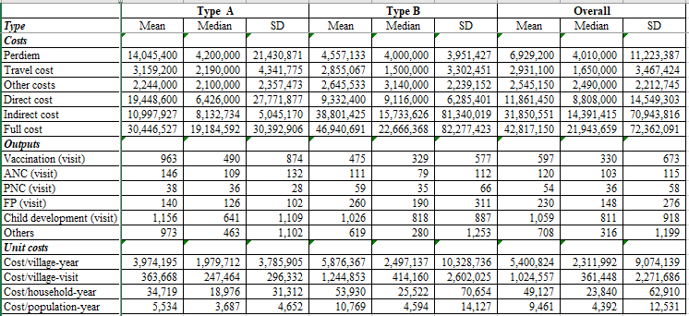
Summary
Costs, outputs and unit costs of health center outreach services

Slide 42
Bottom-up costing or case-based costing

Slide 43
Labor, Material, Capital Costs
Management/supportive cost centers
Bottom-up costing
Indirect cost allocation:
Simultaneous equation method
Out-, In-patient
cost center
Medical service
cost centers
Patient data
Cost per visit, patient day (routine service cost)
Cost per test, procedure, drug, medical material,….
Number of services (visit, pt-day, drug, med supplies, lab, surgery,…)
Cost = Quantity x unit cost
Treatment cost = ER/OPD/IPD routine service cost+
Drug/ med supply cost + Lab cost + Surgery cost
Case-based cost

Slide 44
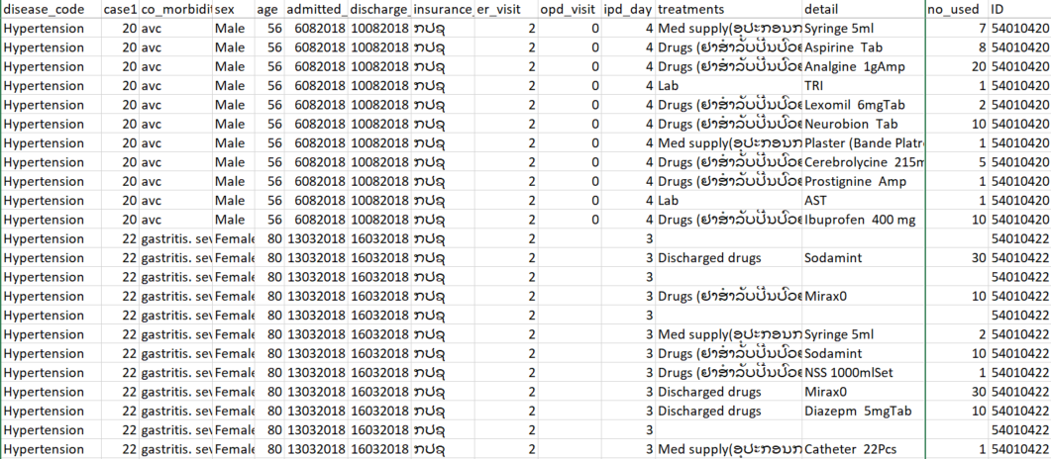
Service utilization;
Data from patient chart

Slide 45
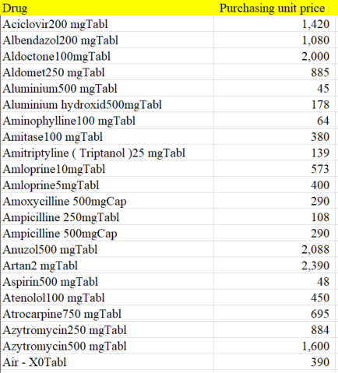

Slide 46
Service | Unit cost | 123
Drug dispensing
CBC
Group
TS TC
Hz(Malaria)
WIDAL
Deng
Rick
Lep
HBV ag
HBV ab
HCV
Echographie
ECG
X-ray-ກະໂຫຼກຫົວ
X-ray-ຜົ້ງດັງ
X-ray-ຄາງກະໄຕ
X-ray-ກະດູກກ້ານຄໍ
X-ray-ກະດູກໄມ້ຄ້ານ
X-ray-ກະດູກກົກແຂນ
X-ray-ກະດູກແຂນ
X-ray-ກະດູກປາຍແຂນ
X-ray-ກະດູກຄໍ່ມື
X-ray-ຜົ້ງເອິກ

Slide 47
Unit cost for Bottom-up cost (Routine operational cost)
 |  | Unit cost; 121
 |  | visit
Dentistry | C1
ER_Main | C2
ER_Ophthalmology | C3
OPD_External Medicine | C4
OPD_Internal Medicine | C5
OPD_Pediatric | C6
OPD_OB & GYN | C7
OPD_MCH | C8
OPD_ENT | C9
OPD_Ophthalmology | C10
OPD_REHAB | C11
OPD_Pulmonary-TB | C12
Delivery room | C13
The figures include minor materials and labor costs (123) and capital costs (125 and 225)
that are linked to routine operation of health facilities (administration, maintenance, etc). They do not include drugs, lab tests and other procedures linked directly to health services.

Slide 48
Unit cost for Bottom-up cost (Routine operational cost)
 |  |  | Unit cost | 121
 |  |  |  | Pt-day
ICU | D1
IPD_Internal Meddicine | D2
IPD_Infection-HIV/AIDS | D3
IPD_Pulmonary-TB | D4
IPD_Pediatric | D5
IPD_OB & GYN | D6
IPD_Ophthalmology | D7
IPD_External med & ENT&Dentistry | D8
VIP | D9

Slide 49
Case-based cost report format
Demographics, clinical characteristics, service utilization
 |  | Hospital |  |  |  | Central hospital |  |  | Special hospital
Pathology |  | Mahosot | Mittaphab | Setthatirat | …… | Mean | Median | SD | Mean | Median | SD
Hypertension | Age (year)
 | Insurance
 | Length of stay
ARI

Slide 50
Case-based cost report format
Cost analysis
financial cost covering material cost (only) of both direct and indirect cost;
the costing format 121.
 |  | Hospital |  |  |  | Central hospital |  |  | Special hospital
Pathology |  | Mahosot | Mittaphab | Setthatirat | …… | Mean | Median | SD | Mean | Median | SD
Hypertension | OPD/IPD routine service
 | Drugs+ dispensing
 | Med supply
 | Lab
 | X-ray
 | Med procedure
 | Others
 | Total
ARI | OPD/IPD routine service
 | …………..

Slide 51
Cost at zero utilization
Cost elements | Formula | Total initial costs | + one-month cost
Land costs | Total market value based on estimated cost per sq. meter |  | n/a
Infrastructure; building, furniture | Current price- (original price-total depriciation cost) |  | n/a
Infrastructure; furniture | Current price- (original price-total depreciation cost) |  | n/a
Equipment (incl vehicle) | Current price- (original price-total depreciation cost) |  | n/a
Maintenance and repairs; building | 2 % of the cost (above) per month | n/a
Maintenance and repairs; furniture | 3 % of the cost (above) per month | n/a
Maintenance and repairs; equipment | 3% of the cost (above) per month | n/a
Utilities and recurrent expenditures | Total cost per month | n/a
Office material | Total cost per month | n/a
Drug/Supplies (min. package) | Min. set of items x unit cost |  | n/a
Human Resources | Total annual cost/ 12 month | n/a
Total
Grand total

Slide 52
Cost at zero utilization; Oudomxay PH
Cost elements | Formula | Cost (LAK in 2018)
 |  | Total initial (T0) | +1 Time unit
Land costs | Total market value based on estimated cost per sq. meter | 0
Infrastructure; building | Current price- (original price-total depreciation cost) | 10,553,109,599
Infrastructure; furniture | Current price- (original price-total depreciation cost) | 186,714,470
Equipment (incl vehicle) | Current price- (original price-total depriciation cost) | 8,031,066,418
Maintenance and repairs; building (%) | 2 |  | 17,588,516
Maintenance and repairs; furniture (%) | 3 |  | 466,786
Maintenance and repairs; equipment (%) | 3 |  | 20,077,666
Utilities (electricity, water…) | Annual cost/ 12 months |  | 30,150,000
Office material | Annual cost/ 12 months |  | 92,233,792
Drug/Supplies (min. package) | Sum of cost 1 package | 102,070,916
Human Resources | Annual cost/ 12 months |  | 1,070,318,500
Total |  | 18,872,961,404 | 1,230,835,259
Grand total |  |  | 20,103,796,663

Slide 53
Points of verification
Building; cost, space use; missing-cost, some cost center has no space used
Equipment/ furniture/ vehicle; completeness of items, price, year
Utilities of DH paid by DHO
Outputs of med services (lab, OR,..); no detail of number by individual service
Number of visit, admission, pt-day; reliability, disaggregation by clinic, ward

Slide 54
Discussion
How to verify the data?
How to make health facilities get benefits from this project? Also to verify the data, then, to sustain the cost analysis.
Limitation to cover all items of building, vehicle, medical equipment, office equipment, furniture, other constructions
The cost including capital cost is underestimated.
Should we include the capital cost in this report?

