Slide 1
HP+ Cambodia
Development of the National Social Protection M&E System
3 May 2019

Slide 2
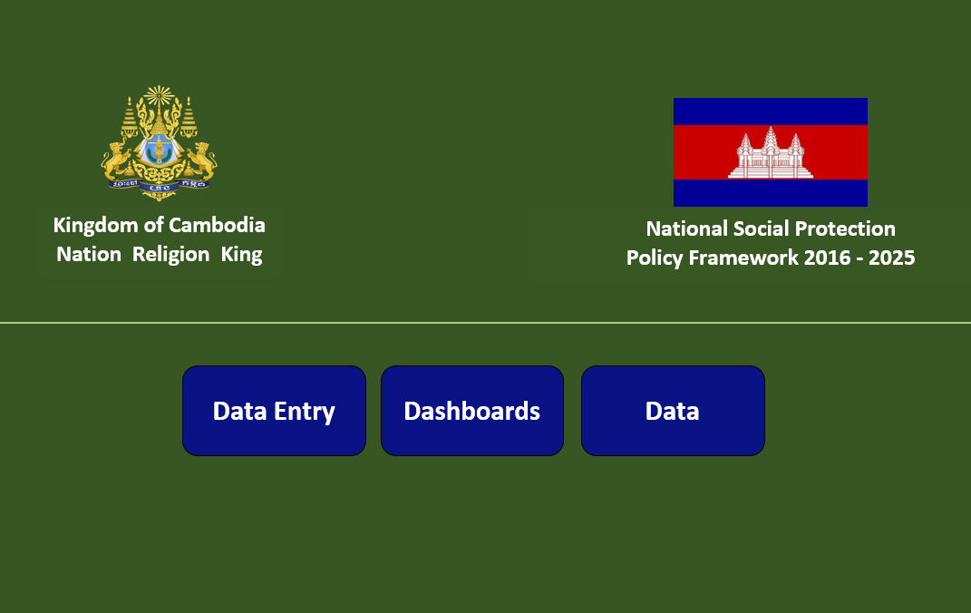

National Social Protection Policy
M&E Framework and system
      Management tool for the Secretariat to effectively fulfill its mandated M&E functions;
      Organizes and integrates key SP indicators to measure progress on reducing poverty, vulnerability, and inequality;
      Automates performance tracking, return on investment modeling, comparative analysis, and customized report generation;
      Designed to inform decision making and future resource prioritization by the ExCom and Ministerial Council.

Slide 3
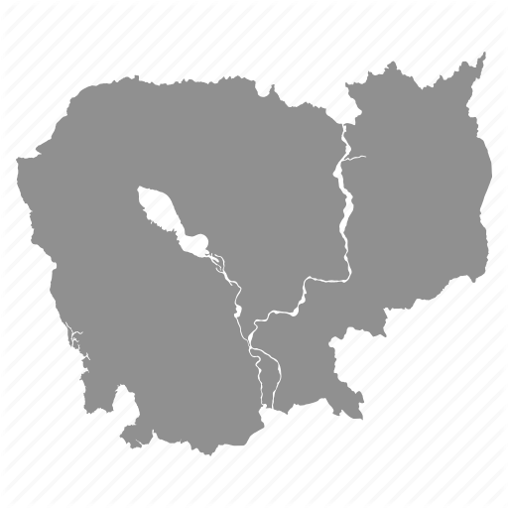
National Social Protection M&E System Progress Timeline
Document review, logical framework, indicator matrix
Social Assistance technical review & integration of SA indicators
Integration of quality perceptions and SP utilization indicators for CSES
Line-Ministry consultations
Operational Manual drafted
Khmer version prepared
Preparation of M&E Prakas
User Interface Demo: data entry, databases, dashboards
Review/alignment with the ILO’s social protection country reporting template
Progress report to NSPC
M&E Introductory training
P4H system preview, comments integrated
Line-Ministry consultations resumed
Results-based M&E Training
Designation of new M&E focal points =>M&E Introductory training
System build and data collection
Deep-dive indicator review by SG leadership
FY2018
FY2019 Q1-2
FY2019 Q3-4
15 months

Slide 4
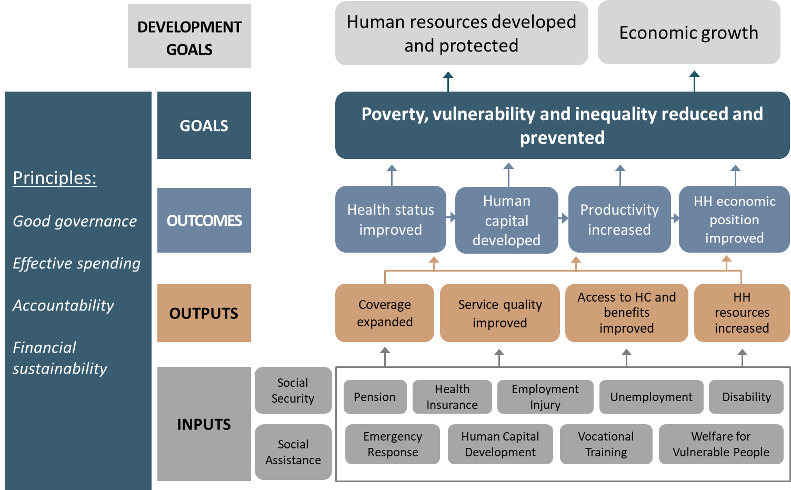
Organized following the
NSPP Logical Framework

Slide 5
M&E Framework / Input Indicators
Level | Group | Number | Indicator | Reporting Unit
Inputs | Planned Investment | IP-1 | Public Social Protection budgeted | MEF, MOL/NSSF
 |  | IP-2 | Public Health budgeted | MEF
 | Actual Investment | IP-3 | Public Social Protection expended | MEF, MOL/NSSF
 |  | IP-4 | Public Health expended | MEF
 | Prioritization | IP-5 | % of total RGC spending on essential services | MEF, MOL/NSSF
 |  | IP-6 | Public spending on social protection, % GDP
 | Investment Gap | IP-7 | Social protection floor index | TBD
 |  | IP-8 | Aggregate Poverty Gap per capita | MOP

Slide 6
M&E Framework / Output Indicators
Level | Group | Number | Indicator | Reporting Unit
Output | Coverage expanded | OP-1 | # of new people registered/ eligible to receive benefits | MOL/NSSF, MOH, MoSVY, MEYS, NCDM
 |  | OP-2 | # of people no longer registered/ eligible to receive benefits
 |  | OP-3 | # of people eligible for coverage
 |  | OP-4 | # of new enterprises, registered and paying | MOL/NSSF
 |  | OP-5 | # of enterprises no longer registered and paying
 |  | OP-6 | # of enterprises eligible for coverage
 | Service effectiveness and quality improved | OP-7 | Duration time of admin processes and delivery of transfers/payments/benefits | MOL/NSSF, MOH, MoSVY, MEYS, NCDM
 |  | OP-8 | Patient satisfaction score | MOH
 |  | OP-9 | Service delivery quality score
 |  | OP-10 | Health Facility Management quality score
 |  | OP-11 | Public quality perception scores | MOP
 | Access to health care and benefits improved | OP-12 | # of new health consultations billed to the scheme # of people receiving benefits (e.g. retirement, disability, emergency relief, school feeding, etc.) | MOL/NSSF, MOH, MoSVY, MEYS, NCDM
 |  | OP-13 | % of population accessing social protection | MOP
 | Household resources increased | OP-14 | Total value of benefits transferred/ provided | MOL/NSSF, MOH, MoSVY, MEYS, NCDM

Slide 7
M&E Framework / Outcome Indicators
Level | Group | Number | Indicator | Reporting Unit
Outcome | Health status improved | OC-1 | % Family planning demand satisfied with modern methods | MOH/NIPH
 |  | OC-2 | Antenatal care, 4+ visits
 |  | OC-3 | % child immunization (DPT3)
 |  | OC-4 | Care-seeking for child pneumonia
 |  | OC-5 | TB detection and treatment
 |  | OC-6 | ART treatment
 | Human capital developed | OC-7 | School enrollment rates | MEYS
 |  | OC-8 | School drop-out rates
 | Productivity increased | OC-9 | Productive days gained | NSPP Secretariat
 | Household economic position improved | OC-10 | Mean/median value of increased productivity Mean/median value of benefit transfer

Slide 8
M&E Framework / Goal Indicators
Level | Group | Number | Indicator | Reporting Unit
Goal | Poverty Reduced | G-1 | Number of poor | MOP/ID Poor
 |  | G-2 | Poverty rate / Poverty head count ratio | MOP
 |  | G-3 | Poverty gap index | MOP
 |  | G-4 | Multi-dimensional child poverty index | MOP
 | Vulnerability Reduced | G-5 | % near poor (e.g. population living below 200% of national poverty line) | MOP
 |  | G-6 | % of HHs with unproductive loans | MOP
 |  | G-7 | HH assets increased | MOP
 |  | G-8 | % of population with OOP health spending >25% of HH income, by residence and quintile | MOH/NIPH
 |  | G-9 | UHC coverage of essential health services (index), overall (%) | MOH/NIPH
 |  | G-10 | % HH with improved, not shared sanitation facility | MOP, MOH/NIPH
 | Inequality Reduced | G-11 | Gini Coefficient | MOP
 |  | G-12 | Palma ratio | MOP
 |  | G-13 | Gender Equity in Enrollment | Secretariat
 |  | G-14 | Gender Equity in Benefits | Secretariat
 |  | G-15 | Residence Equity in Enrollment | Secretariat
 |  | G-16 | Residence Equity in Benefits | Secretariat

Slide 10
M&E Framework / Principle Indicators
Level | Group | Number | Indicator | Reporting Unit
Principles | Good governance | P-1 | % budget execution | Secretariat
 |  | P-2 | # of independent program audits | MEF
 |  | P-3 | # of independent financial audits | MEF
 |  | P-4 | # of major audit findings | MEF
 | Effective spending and efficiency | P-5 | % administrative costs | Secretariat
 |  | P-6 | Cost-per-beneficiary | Secretariat
 |  | P-7 | Benefit-to-cost ratios / return on investment | Secretariat
 |  | P-8 | % of eligible claims processed within 10-days | Secretariat
 | Accountability | P-9 | Public awareness about benefit eligibility | MOP
 |  | P-10 | Publicly accessible investment and performance information | Secretariat
 |  | P-11 | Feedback/monitoring visits completed | Secretariat
 |  | P-12 | Beneficiary satisfaction score | Secretariat
 | Financial sustainability | P-13 | Fund balance | MOL/NSSF
 |  | P-14 | Fund projection | MOL/NSSF
 |  | P-15 | Actuarial valuation | MOH/NSSF

Slide 11
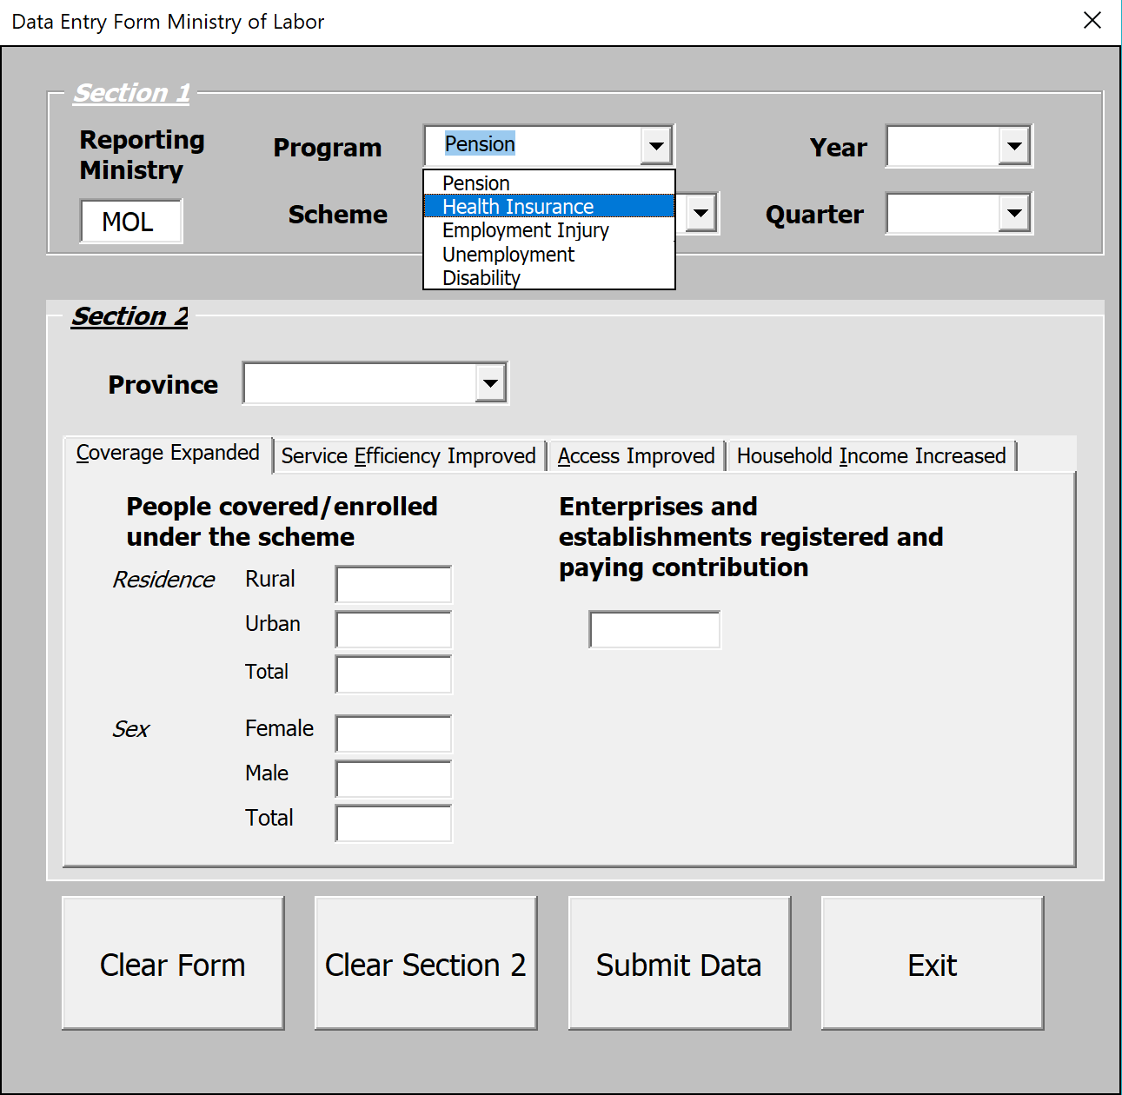
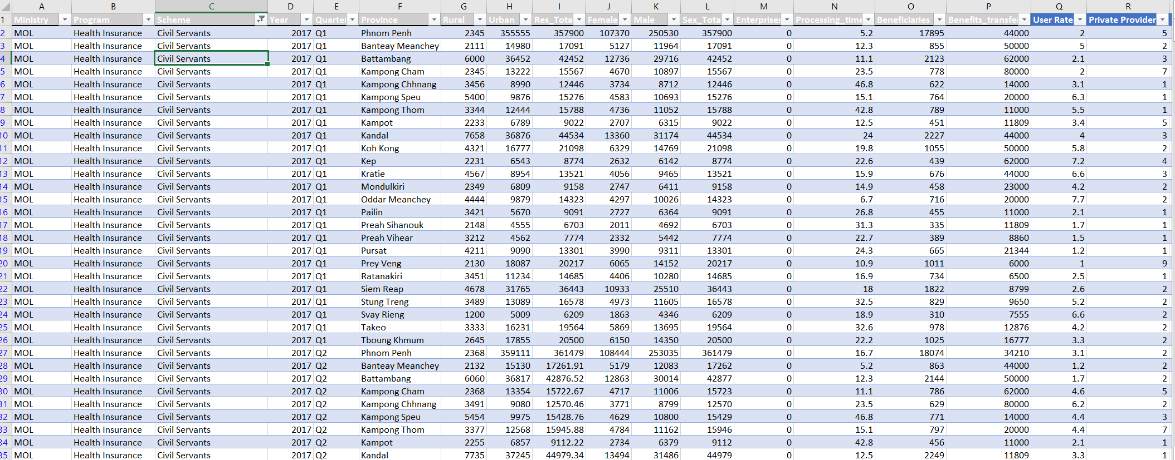
Internet-based Data Entry Forms & automated compilation of data

Slide 12
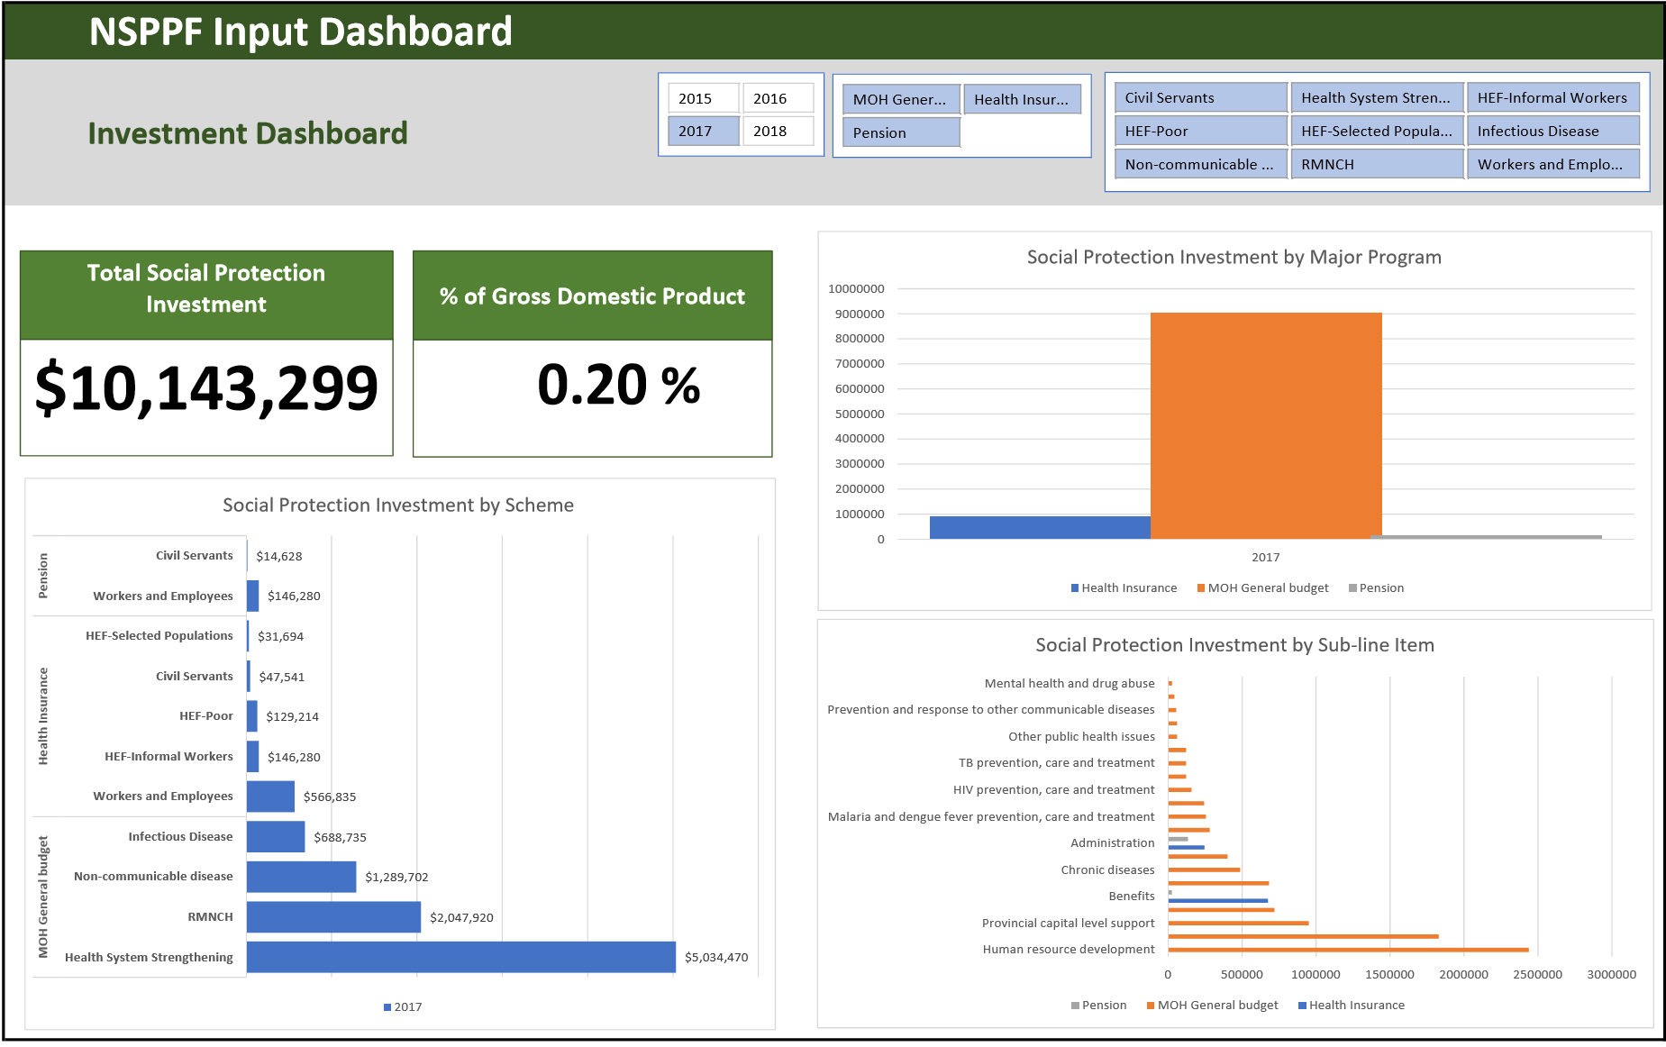
Interactive dashboards to enable user-friendly analysis…

Slide 13
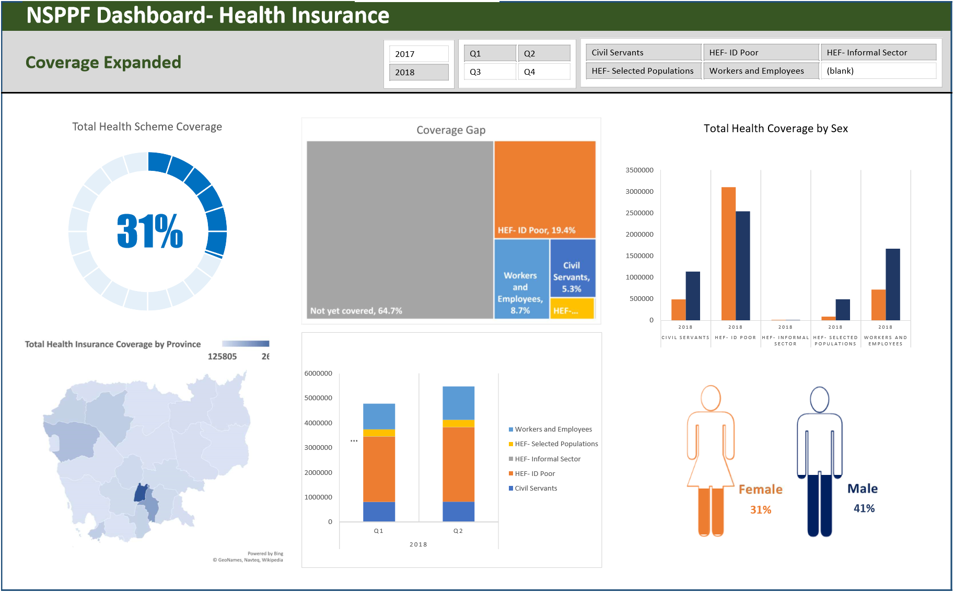
and customized report generation of key social protection indicators and results…

Slide 14
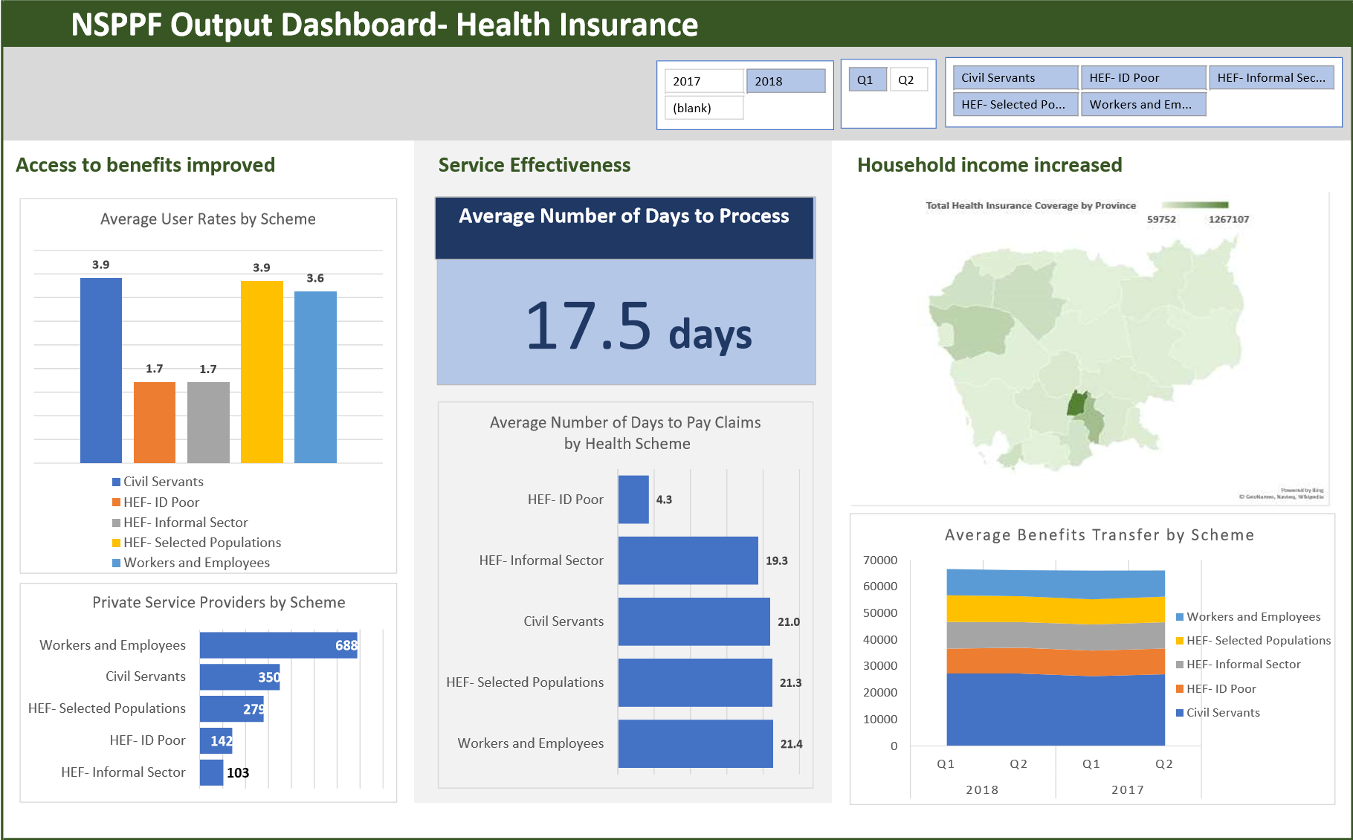
by program component, indicator level and group, reporting period, and scheme.

Slide 15
NSPC M&E Progress Report
1. Worked with experts and consulted, collecting data and information from stakeholders for the drafting of a monitoring and evaluation mechanism within the framework of National Social Protection Framework.
2. Prepared drafting manual on monitoring and evaluation mechanism within national social protection framework and achieved initial draft in Khmer language.
3. Following the drafting of a manual on monitoring and evaluation mechanisms within the National Social Protection Framework, the working group discussed and presented at the relevant institutions such as the NSSF, and the Ministry of Health.
4. Achieve a preliminary draft Prakas on Monitoring and Evaluation Mechanisms within the National Social Protection Framework
Next action
1. Hold the Executive meeting of the Executive Committee and request the National Social Protection Council to discuss and decide on strategic plan and implementation activities.
2. Establish an inter-ministerial working group for implementation.

