Slide 1
Normative Costing of Essential Health Service Package in Laos PDR
Dr. Shankar Prinja
World Bank

Slide 2
Outline
Background
Aims and Objectives
Methodology
Key Results
Limitations
Recommendations

Slide 3
Background
Development and implementation of an Essential Health Service Package (2018- 2020) initiated
Three important questions:
  cost of delivering the services/package
  its feasibility given the fiscal capacity
  whether there is any need or rationality in prioritization within the EHSP
Understanding the costs of delivering health interventions and the major cost drivers is critical to expanding access to health services.

Slide 4
Aims and Objectives
Primary
- Estimate the unit cost of individual core service packages which are part of EHSP
Secondary
- Compare the normative and bottom-up cost estimates
- Undertake Health Technology Assessment for interventions
- Assess the total cost of EHSP implementation in Laos PDR under various scenarios of scale up.

Slide 5
Normative Financial Costing : Steps Involved
Step 1: Identification of core service package by level of service delivery
Step 5: Collect data on the expenditure of program management, at overall program level
Step 2: Identify individual services within the core service package, by level of service delivery
Step 4: Collect data on prices of each of the resource identified as per point no. 3
Step 3: Collect data on the type and quantity of recurrent operational resources per service within the service package, by level of service delivery
Notes:
Text marked in red colour: To highlight that we could not undertake the step due to lack of data

Slide 6
Normative Financial Costing : Steps Involved….
Step 6: Scale up of the normative unit cost identified vide 1-5, for resources not accounted
Step 7: Estimate the unit cost of individual core service packages under EHSP
Step 8: Identify alternative scale up scenarios
Step 9: Assess the cost of implementation of alternative scale up scenarios

Slide 7
Adaptation of ESP for Costing
ESP Document was very comprehensive
However, ESP categories for certain services were:
  Less specific in terms of individual services
  Less specific in terms of target population
Technical consultation with program staff coordinated by the WHO and World Bank
Adaptation of ESP for costing was done
  Stratification within certain ES categories
  Merging of certain categories
  Identification and Suitable allocation of Cross cutting services
Notes:
Cross cutting services: There are few services which belong to a particular disease area, however costs will be added to another. Eg. Referral of TB patients for HIV tests. In ESP this a service for TB patients, however as test is for HIV, cost of this service has been added to HIV costs.

Slide 8
Illustration 1: Merging of ESP categories
Old ESP Categories | New ESP for Costing
ES 16 Routine minimum ANC care | ANC Care Package
ES 22 Provide deworming
ES 23 Daily iron folic acid tablets
ES 24 Td Vaccination
ES 25 Counselling on STI and HIV
Notes:
Categories earlier and how they have been merged.

Slide 9
Illustration 2: Stratification of ES categories
Old ESP Categories | New ESP for Costing
ES 46: Management of newborn with complications | Sepsis management
 | Jaudice management
 | Severe asphyxia management
 | Malformation management
 | Seizure management
 | Preterm birth complication management for newborn
Old ESP Categories | New ESP for Costing
ES 60: IMNCI services | Infantile very severe disease/local bacterial infection management
 | Jaundice management
 | Feeding problem/low weight for age management
 | diarrhea management
 | pneumonia management
 | Fever management
 | Measles management
 | Dengue management
 | Ear problem management
 | sore throat management
 | anemia management
Notes:
ES category which was earlier a lumped category was subsequently stratified

Slide 10
Data collection
Type of Data | Unit of Measurement | Data Sources | Remarks
Human Resource | Type of HR Time per service delivered Wage rate | TWGs STGs Accounts department | Each of these data points were elicited from the TGW members as per their clinical opinion or STG.
Drugs and Consumables | Quantity used per service episode Price | TWGs STGs Procurement department
Diagnostics cost | Number of diagnostic tests per service Price of diagnostic test | TWG and STG Price based on payment rates under national insurance scheme
Program management expenditure cost | Annual Expenditure on program management | Program division Development partner
Overhead Cost | % of total cost represented by overheads at each service delivery level | Bottom up and health facility costing analysis
Scaleup Factor (To be used only when the normative estimates are compared with bottom-up costing estimates) | Proportion of total cost represented by building and space, non-medical & medical equipment and non-clinical HR in health facility | Derived based on analysis of the bottom-up and health facility cost data | To be coordinated with teams undertaking bottom-up and HF costing
Gaps in capital infrastructure | % increase in number of health centres, district hospitals, provincial and central hospitals required | WHO report

Slide 11
Methods Deviation
Program Management & Governance: Scale-up using NHA estimates
Cost of Existing Capital: Not accounted
Cost of Additional Capital Resource Required: Not accounted

Slide 12
Analytical Approach
Step 1: Unit cost estimation
Step 2: Demand estimation
Step 4: Total annual cost estimation for each EHSP
Step 3: Care Utilization Pattern

Slide 13
Unit Cost Estimation
Inputs
Unit cost
Quantity
Human Resource: Type and time per service/procedure (in minutes)
Drugs: Type and quantity of drugs used per episode treated
Price/Wage
Wage per minute
(using monthly salary)
Price per unit
Price per unit
Consumables: Type and quantity of consumables used per episode treated
Price per test
Diagnostic tests: Type and number of tests per episode treated
Cost
Human Resource Cost (X):
Time spent per service*Wage per minute
Drugs Cost (Y):
Quantity of drug (s) used*Price per unit
Consumables Cost (Z):
Quantity of consumable (s) used*Price per unit
Diagnostics Cost (W):
Number of test (s) done*Price per test
Unit cost (U): X+Y+Z+W

Slide 14
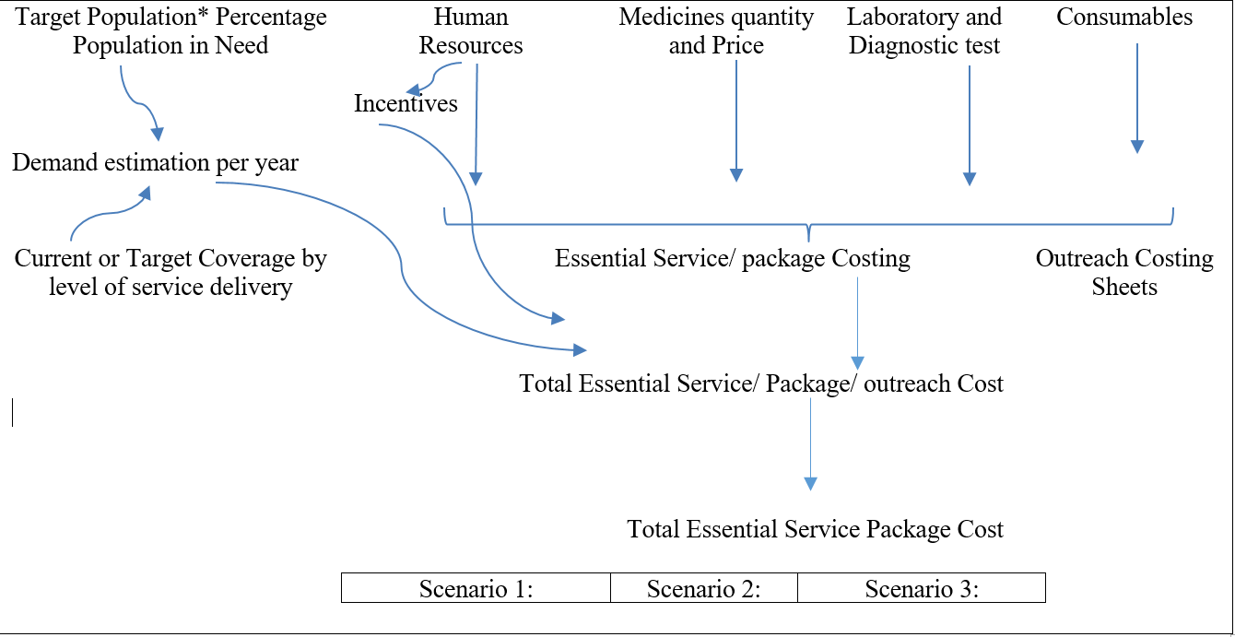
General Framework of Annual Cost Estimation
* Denotes Multiplication

Slide 15
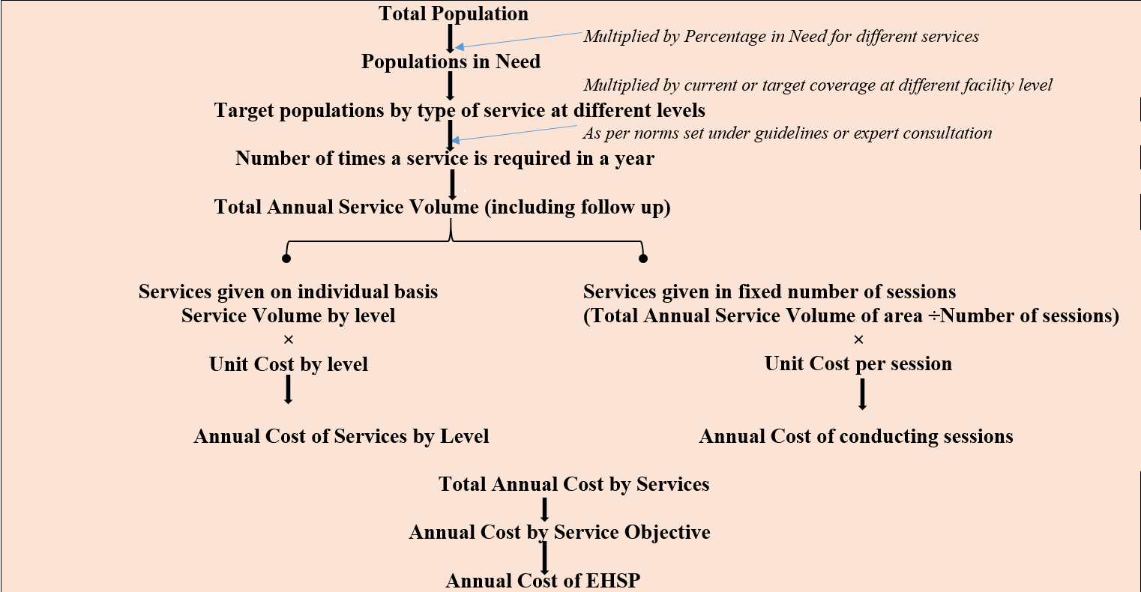
General Framework of Annual Cost Estimation

Slide 16
Analysis at Glance
What we included for all services?
- Human resource
- Drugs
- Consumables
- Diagnostics
What was included additionally?
- Cost of program administration and governance
What it does not include?
- Cost of augmentation of capital resources required for implementing EHSP
-Value of existing capital resources

Slide 17
Key Results

Slide 18
Total Cost* of EHSP (In billion Laos kip)
*Estimates of cost are representative of value of recurrent resources that would be required.
# Scale up is done for Program management, Governance and Administration expenses.

Slide 19
Key Financial Indicators
Indicators | 2019 |  | 2025
 | Without Scale up | With Scale up | Without Scale up | With Scale up
Health expenditure as % of GDP# | 2.40% | 2.40% | - | -
Total cost EHSP (In billion Laos kip) | 707 | 1,276 | 2,029 | 3,662
Per capita EHSP cost (In thousand Laos kip) | 99 | 178 | 258 | 511
Per capita EHSP cost (USD) | 12.1 | 21.8 | 31.6 | 62.6
EHSP Cost as % of Current Government Health Expenditure | 37.8% | 67.9% | 98.5% | 195%
Total cost of EHSP as percentage of GDP | 0.48% | 0.86% | 1.37% | 2.47%
*Estimates of cost are representative of value of recurrent resources that would be required.
# Scale up is done for Program management, Governance and Administration expenses.

Slide 20
Costs* (In Billion Laos kip), by Type of Services
 | 2019 |  | 2025 |  | % Change
 | Without Scale up* | With Scale up# | Without Scale up* | With Scale up#
Family Planning | 2 | 4 | 6 | 11 | 180
Immunization | 16 | 29 | 83 | 150 | 425
Tuberculosis | 29 | 53 | 187 | 337 | 535
Non-communicable diseases | 75 | 135 | 301 | 543 | 302
Malaria | 24 | 44 | 82 | 148 | 239
HIV | 77 | 138 | 150 | 271 | 96
Antenatal care services | 52 | 93 | 170 | 306 | 228
Abortion, intranatal and postnatal services | 45 | 82 | 98 | 177 | 116
DCDC | 250 | 452 | 517 | 933 | 106
Newborn care services | 15 | 27 | 31 | 56 | 104
Neonatal & Child health services | 60 | 108 | 311 | 562 | 422
Reproductive & adolescent care services | 61 | 111 | 93 | 168 | 51
Total | 707 | 1,276 | 2,029 | 3,662 | 187
*Estimates of cost are representative of value of recurrent resources that would be required.
# Scale up is done for Program management, Governance and Administration expenses.

Slide 21
Annual EHSP Cost by Service Domain

Slide 22
Annual ESP Cost by Nature of Service

Slide 23
Annual ESP Cost, by place of service delivery
 | 2019 |  | 2025 |  | % Change
 | Without Scale up | With Scale up | Without Scale up | With Scale up | % Change
Non – Facility# | 167 | 302 | 333 | 601 | 99
Facility | 540 | 974 | 1696 | 3061 | 214
Total | 707 | 1276 | 2029 | 3662 | 187
*Estimates of cost are representative of value of recurrent resources that would be required.
# Scale up is done for Program management, Governance and Administration expenses.
# Includes mobile and outreach services

Slide 24
Annual ESP Cost by place of service delivery

Slide 25
Annual ESP Cost by Place of Service Delivery
*Estimates of cost are representative of value of recurrent resources that would be required.
Notes:
Highest increase in Health Centre level costs

Slide 26
Annual EHSP cost by Input Resources

Slide 27
Service Specific Key Results

Slide 28
Annual Cost* of RMNCH by Service Objective
 | Annual Cost, Billion Laos kip (USD) |  |  |  | Change (%)
 | 2019 |  | 2025
 | Without Scale up | With Scale up | Without Scale up | With Scale up
SO1 | 2 (0.00) | 4 (0.00) | 6 (0.00) | 11 (0.00) | 180
SO2 | 52 (0.01) | 93 (0.01) | 170 (0.02) | 306 (0.03) | 228
SO3 | 45 (0.01) | 82 (0.01) | 98 (0.01) | 177 (0.02) | 116
SO4 | 15 (0.00) | 27 (0.00) | 31 (0.00) | 56 (0.01) | 104
SO5 | 60 (0.01) | 108 (0.01) | 311 (0.04) | 562 (0.06) | 422
SO7 | 61 (0.01) | 111 (0.01) | 93 (0.01) | 168 (0.02) | 51
*Estimates of cost are representative of value of recurrent resources that would be required.
# Scale up is done for Program management, Governance and Administration expenses.

Slide 29
Distribution of RMNCH Cost by Service Objective

Slide 30
Annual Cost of Routine Immunization: Scenario Analysis
*Estimates of cost are representative of value of recurrent resources that would be required.

Slide 31
Annual Cost of Routine Immunisation, 2019-2025
*Estimates of cost are representative of value of recurrent resources that would be required.
# Scale up is done for Program management, Governance and Administration expenses.

Slide 32
Input-wise distribution of cost of Immunization, 2019-2025
*Estimates of cost are representative of value of recurrent resources that would be required.

Slide 33
Annual Cost of Routine Immunization: Scenario Analysis
*Estimates of cost are representative of value of recurrent resources that would be required.
# Scale up is done for Program management, Governance and Administration expenses.

Slide 34
Total Cost of Routine Immunization, 2019-2025
*Estimates of cost are representative of value of recurrent resources that would be required.

Slide 35
Total Cost of Routine Immunization by Level, 2019 – 2025
*Estimates of cost are representative of value of recurrent resources that would be required.

Slide 36
Annual Cost of HIV services, 2019- 2025
*Estimates of cost are representative of value of recurrent resources that would be required.
# Scale up is done for Program management, Governance and Administration expenses.

Slide 37
Annual Cost of HIV services, by level
*Estimates of cost are representative of value of recurrent resources that would be required.

Slide 38
Annual HIV Cost by Input resources
Notes:
Prices for drugs have not been provided. So drug cost is 0. Share of HIV services in total cost will increase once drug prices are provided.

Slide 39
Distribution of Cost by Type of HIV Services

Slide 40
Annual Cost of NCD Services, by Level, 2019-2025
*Estimates of cost are representative of value of recurrent resources that would be required.
# Scale up is done for Program management, Governance and Administration expenses.

Slide 41
Annual Cost of NCD Services, by Level, 2019-2025
*Estimates of cost are representative of value of recurrent resources that would be required.

Slide 42
Proportional Distribution of NCD Service Cost, 2019 - 2025
Notes:
Grey: Treatment interventions (61% of all services).

Slide 43
Annual Cost of NCD Services, by Type of Service, 2019-2025
*Estimates of cost are representative of value of recurrent resources that would be required.

Slide 44
Annual Cost of Tuberculosis Service Delivery, 2019-25
*Estimates of cost are representative of value of recurrent resources that would be required.
# Scale up is done for Program management, Governance and Administration expenses.

Slide 45
Annual Cost of Tuberculosis Service Delivery, by Level
*Estimates of cost are representative of value of recurrent resources that would be required.

Slide 46
Annual Cost of Malaria Service Delivery, 2019-25
*Estimates of cost are representative of value of recurrent resources that would be required.
# Scale up is done for Program management, Governance and Administration expenses.

Slide 47
Annual Cost of Malaria Service Delivery, by Level
*Estimates of cost are representative of value of recurrent resources that would be required.
Notes:
Cost increases abruptly from 2020 onwards as government has committed to achieve high coverage targets 2020 onwards in national strategic document. Few examples: RDT for malaria cases will be three times 2021 onwards and microscopic confirmation will be for 10% of total cases instead of current (3.5%).

Slide 48
Limitations – Data Availability
Resource Use
  Intervention implementation details (Example: Surgical and Dental)
  Resource use (Drugs for Cancer treatment, procedure for dental ailments)
  Price information of drugs/ consumables/ tests
Hospital Information System
  Disease wise details of service utilization (consultations, admissions, procedures, tests) by level of facility was not available.
Eliciting the data from the TWG was challenging.
Indirect Costs such as administrative, program management
Standard Treatment Guidelines

Slide 49
Recommendations & Way Forward
Increase the public spending on health
ESP Costing Analysis could be used for developing Sector-wise Plans
Establish MIS system which enables updating of cost analysis in future.
Prioritize ESP package by identifying scale-up of cost-effective interventions

Slide 50
Thanks

