Slide 1
Presentation of MOH SWAp Coordination Mechanisms
Mr. Henry Kansembe, MOH Deputy Director Planning

Slide 2
Objective of Presentation
To stimulate dialogue on the MOH coordination structures that underpin the principles of collaboration for effective implementation of national health priorities and strategies
Review the existing coordination mechanism and structures
Discuss NHSP priorities related to strengthen partner coordination in the health sector
Agree on actions to strengthen partner coordination

Slide 3

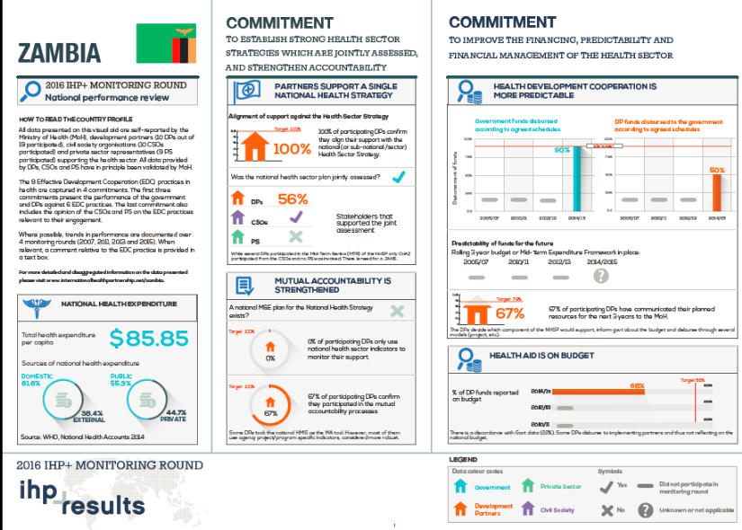

Recent Background
Notes:
The general principles for collaboration and coordination between MOH, cooperating partners, CSOs, NGOs and the private sector are stated in the Memorandum of Understanding between these bodies. While not binding the document provides an outline for the collective commitments of the signatories as a framework for effective implementation of national health priorities, improvement in harmonisation and coordination in the health sector, sustainable improvements in aid effectiveness, transparency and governance and predictability of support to the sector.
To compliment the MOU, Zambia is a partner country in the IHP+ initiative, the international health partnership, to promote dialogue between all partners under the leadership of the MOH on effective development cooperation practices. Zambia participated in the 5th monitoring round for this initiative which produced a scorecard of our progress toward effective cooperation in health.
The importance of these commitments is that we actively work to ensure effective implementation of national health priorities, harmonisation and coordination in the health sector, sustainable improvements in aid effectiveness, transparency and governance and predictability of support to the sector.
A core element to continuously promote and enhance cooperation is the MOH SWAp coordination mechanism that includes structures by which to facilitate these effective working relationships. As you know this Government-led mechanism facilitates the exchange of information and policy dialogue between the Cooperating Partners and the Government on all matters related to the health sector.
As addressed in our National Health Strategic Plan, 2017 - 2021 an important objective is to strengthen this partnership – specifically related to upholding and strengthening the SWAp structure mechanisms and to develop a formal agreement that binds partners to the IHP+ effective development cooperation principles – now referred to as the UHC 2030.
To appreciate the current state of the mechanisms, the following presentation will walk through each of these structures to discuss the purpose, participation, and terms of reference.

Slide 4
SWAp Coordination Mechanism
Policy Meeting
TWG
TWG
TWG
Sector Advisory Group Meeting
Annual Consultative Meeting
TWG
TWG
TWG
MOH-Troika/Leadership Team meeting
Health CP Group Meetings
Notes:
The SWAp provides a framework of collaboration among the stakeholders, Government ministries, civil society, the private sector, and CPs. It coordinates financing, planning, and monitoring mechanisms.
The aim is to achieve maximum results and in the process reduce transaction costs. The participants under SWAp are bound by a Code of Conduct, which is aimed at increasing transparency and improving predictability for allocation of resources. The SWAp is administered through TWGs, policy meetings, sector advisory group meetings, and the annual consultative meetings. There is also one annual planning meeting and one Joint annual review. Half way in the implementation of the Strategic Plan, a midterm review is conducted in which all stakeholders are involved.

Slide 5
Sector Coordination Meeting
There are four key sector coordination meeting namely, the annual consultative meeting, Sector advisory group meetings, policy meetings and TWG meetings
The Questions to ask about each of these are:
  Is the timing for the meeting appropriate in relation to MOH planning?
  Does this meeting accomplish what it sets out to do? Why or why not?
  What are areas can we address make the meeting more productive

Slide 6
Annual Consultative Meeting
Present achievements, challenges, the proposed AAP/ABB and confirm financial commitments
Chaired by the Honorable Minister of Health
Review annual report for the Health Sector from the year proceeding
Review trends and possibility to reach results of approved performance framework
Endorse action plans and budgets
Review pledges from Co-operating Partners
Consider amendments to NHSP based on policy changes and on experiences from reviews
Annual Consultative Meeting
Ministerial representation, ambassadors and high commissioners; heads of bilateral/multilateral development agencies, UN agencies and other organizations
Notes:
The overall purpose of the Annual Consultative Meeting is to present approved action plans; endorse progress reports within the framework of the National Health Strategic Plan, the MoU and other government documents and mobilize resources in relation to priorities
Typically during he Annual Consultative Meeting the agenda is to:
Review and discuss trends and the potential to reach results within the approved performance framework. Specific major challenges hampering the achievements of results need to be addressed in this forum and discussions around revision of indicators.
Endorse action plans, and budgets for the following year submitted by Ministry of Health including tentative financial commitments from all Co-operating Partners.
Review the annual report for the Health Sector from the year proceeding and to assess overall sector performance in relation to the approved results framework and work programme.
Review pledges from Co-operating Partners towards the annual action plans/MTEF and decide the global budget allocations to different programme areas.
Consider any changes to the multi-year NHSP based on policy changes and on experiences from reviews.
The meeting is chaired by the Minister of Health and consists of policy makers, three Troika members, GRZ, CPs, CSOs/NGOs (FBOs, NFBOs, PHPs) Ambassadors/High Commissioners, Heads of bilateral development cooperation, UN system , multilaterals, line ministries ( MoF, and Cabinet Office).
The Annual Consultative Meeting is held during the last week of November or first week of December of each year.
Questions:
Is the timing for this meeting appropriate in relation to MOH planning?
Does this meeting typically accomplish what it sets out to do? Why or why not?
What are areas that we can address make the meeting more productive?

Slide 7
Joint Stakeholder Meeting
Discuss and review sector progress in implementation of programmes biannually to inform CPs related to their disbursements and commitments
Chaired by the Permanent Secretary
Review implementation progress of approved work programme for previous quarters
Discuss analysis of causes and possible solutions, linked to policy meeting and technical working group outputs
Review preliminary findings from Joint Annual Review
Discuss GRZ and CPs’ funds in relation to budget for previous quarters and future quarters
Discuss interventions to maintain or improve results or address issues that impede achievement of goals
Sector Advisory Group Meeting
MOH, line Ministries and representatives from bi-lateral/multi-lateral agencies, private sector, civil society, NGOs, FBOs
Notes:
The Sector Advisory Group conducts a Joint Stakeholder Meeting twice a year to provide an opportunity for stakeholders to review progress in implementation of the approved programmes and manage information from the review for results.
Review progress in relation to the approved results framework and work programme of the previous quarters.
Review the preliminary findings from the Joint Annual Review
Where progress has not been as expected, an analysis of the causes and possible solutions is presented, linked to policy meeting and technical working group outputs.
Monitor GRZ and CPs’ funds in relation to the approved global budget made available to the sector for the previous two quarters;
Discuss interventions to maintain or improve results or address issues that impede achievement of goals.
Towards the end of the year (during the third quarter), the following issues will be addressed, partly to prepare for the coming year:
Endorse the annual action plan for the coming year and the planned contributions from all stakeholders,
Review progress for quarter one and two for the current year;
Monitor progress in relation to the approved results framework for the Strategic Plan for quarter one and two for the current year;
Where progress has not been as expected, present an analysis of the causes and possible solutions, linked to policy meeting and technical working group outputs.
Discuss and conclude on the finding coming out from the follow up of the activity report, JAR, HMIS and other systems feeding into the annual action plan.
Monitor GRZ and CPs’ funds in relation to the approved overall budget made available to the sector for quarter one and two for the current year.
Membership
The joint stakeholders meeting are open to all signatories GRZ, CPs, CSOs/NGOs (FBOs, NFBOs, PHPs) of the MAF, by themselves or through approved coordination structures
Questions:
Is the timing for this meeting and the number of times the meeting is held appropriate?
Does this meeting typically accomplish what it sets out to do? Why or why not?
What are areas that we can address make the meeting more productive?

Slide 8
Policy Meetings
Monthly meetings to review and take action on core programme issues identified by technical working groups, MOH-Troika/Leadership Team meeting
Discuss implementation updates from technical working groups
Review of action taken and progress in implementing areas of priority and concern raised at the Annual Consultative Meeting
Identify areas of concern that impede implementation of health services or require policy interventions
Decide on a course of action to be carried out to resolve identified problems
Approve an 'annual action plan’ that define actions to address policy implementation
Policy Meetings
MoH Senior Management Team, Heads of Agencies supporting the health sector, CSOs/NGOs (FBOs, NFBOs, PHPs) and relevant Government line ministries
Notes:
Monthly meetings to review and take action on core programme issues identified by technical working groups, MOH-Troika/Leadership Team meeting
Monitor the achievement of results: issue of strategic character that might have positive or negative impact on the achievement of the results are discussed and managed.
Review of action taken and progress in implementing areas of concern and priority and as identified and decided during the Annual Consultative Meeting;
Identify areas of concern that impede implementation of health services or require policy interventions of both MoH and CPs during the course of implementing action plans, using information from all the technical working groups; and
Decide on a course of action to be carried out to resolve identified problems.
Discuss implementation updates from technical working groups.
Approve an 'annual action plan’ that defines for each subsequent year the actions that will be taken to progress on implementing key policies. The action plan will define the headlines of relevant activity groups and (process) indicators, which allow measuring on an annual basis the progress made in the selected priority areas. The action plan is to be endorsed by the SAG and the ACM.
Membership
Participants in the meetings are members of the MoH Senior Management Team; First and Second Secretaries responsible for health, Heads of Agencies supporting the health sector, CSOs/NGOs (FBOs, NFBOs, PHPs) and relevant Government line ministries.
Meetings
Policy meetings are held every last Thursday of the month (except for July and December) and are chaired by the Permanent Secretary, MOH who is deputized by their Directors of Planning and Development.
Questions:
Is the timing for this meeting and the number of times the meeting is held appropriate?
Does this meeting typically accomplish what it sets out to do? Why or why not?
What are areas that we can address make the meeting more productive?

Slide 9
Troika Meeting
Platform for GRZ, MOH and CP Leadership to coordinate efforts to develop the health sector in the country, monthly
Review of endorsements and action points of the Minutes from previous Policy Meetings
Updates on priority actions, processes and developments within the health sector in Zambia
Coordinate interventions in the health sector
Review/endorsement of agendas for the SAG and policy meetings
Troika Meeting
PS Health and CP Leadership Team
Notes:
Health Sector partners are organized in the Health Cooperating Partners Group - a platform for dialogue and collaboration among cooperating partners working in Zambia through the health sector-wide approach (SWAp). The Cooperating Partners meet to share information, experiences and facilitate dialogue, with the aim of strengthening their cooperation and support, both as a group and with the Government of Zambia.
The Cooperating Partners Group annually selects one CP to act as a focal point in coordinating CPs in the sector. The Cooperating Partners Group meets monthly meet to share information, experiences and facilitate dialogue, with the aim to reach consensus on how to proceed in supporting the Government to address health sector priorities, in order to attain the goals in the NHSP and other strategic development frameworks. The chairperson represents the Cooperating Partners with a common voice in their dialogue with the Government and in the Troika. The Troika meets monthly, before the policy meeting

Slide 10
Technical Working Groups
Advisory support to the MOH to monitor performance of the technical areas against targets included in sector strategies, policies and the GOZ national development plan and coordinate stakeholders, donors and Implementing Partners
Monitor and manage results in implementing NHSP and annual Action Plans
Propose priorities in the annual action plans and provide updates
Advocate for and coordinate inputs from stakeholders
Advise on development of technical guidelines
Forward critical policy related issues to the Policy Meeting
Technical Working Groups
GRZ, MoH, and other line ministries; representation of organizations engaged in the technical area with relevant expertise
Notes:
The role of the TWGs is to monitor progress towards the objectives and targets set in the NHSP and the annual action plans. In order to address this broad mandate TWGs are an important means of consulting on policies, priorities, strategies and problems as well as coordinate partner contributions.
Monitor and manage results in implementing the relevant sections of the NHSP and annual Action Plans developed for its implementation.
Develop a set of targets/tasks for the technical working group to achieve on an annual basis.
Based on the priorities set in the NHSP and other relevant sub- plans propose priorities in the annual action plans. Coordinate inputs from all stakeholders in developing the annual action plans.
Advise on the development of area specific guidelines for planning at lower levels.
Approve Quarterly Progress Reports for sub-sector one month after the end of the quarter under review.
Discuss and propose how to resolve issues that provide impediments for implementation and achievement of results
Through the SWAp Secretariat/DCU forward critical policy related issues to the Policy Meeting for information-sharing, guidance and support.
This is to show that the TWGs are an integral part of the overall coordination mechanism and the work they do feeds into the MOH policy meetings to elevate critical policy related issues for further consideration.
Technical working groups are chaired by the relevant MOH directorate and are open to stakeholders that technically contribute to achieving the Terms of Reference. These are important fora for the MOH to coordinate technical input and resources from all stakeholders.
Membership
Participants in the meetings are members of the MoH Senior Management Team; First and Second Secretaries responsible for health, Heads of Agencies supporting the health sector, CSOs/NGOs (FBOs, NFBOs, PHPs) and relevant Government line ministries.

Slide 11
Technical Working Groups
Planning has been working on a few tasks as ground work to focus on efforts to rejuvenate TWGs as an integral structure that advises MOH on technical areas.
The Standard Operational Guide for TWGs provides a common set of procedures for all TWGs.
The Template for TWG TOR is a guide to develop the technical TOR including the writing of the scope of work, establishment of sub-TWGs and the organizational structure.

Slide 12


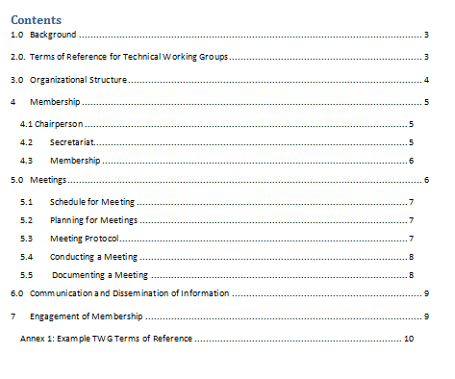
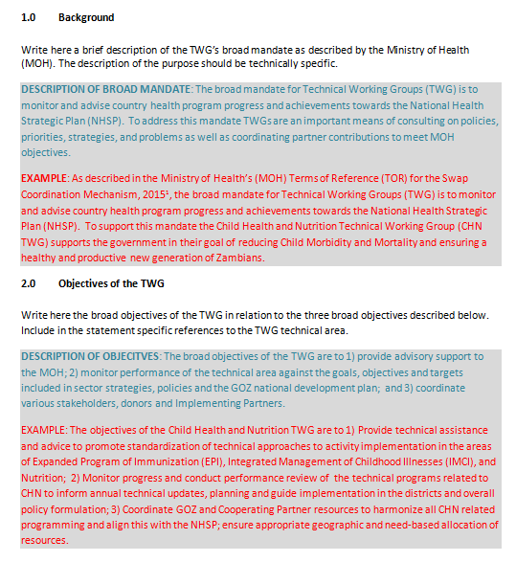
Technical Working Groups
Notes:
Planning has been working on a few tasks as ground work to focus on efforts to rejuvenate TWGs as an integral structure that advises MOH on technical areas and as a structure that provides information to the SWAp mechanism.
The Standard Operational Guide for TWGs provides a common set of procedures for all TWGs that establish standards of operations.
The Template for TWG TOR is a guide to develop the technical TOR including the writing of the scope of work, establishment of sub-TWGs and the organizational structure.

Slide 13
Streamline TWGs
Current / Recent TWGs
Adolescent Reproductive Health
Child Health
Nutrition
Emergency Obstetric and Newborn Care
Family Planning
Safe Motherhood
Indoor Residual Spraying
Malaria Case Management
Insecticide Resistance Management
M&E of the National Malaria Control Program
Malaria IEC/BCC
National Health Promotion
HIV/AIDS IEC/BCC
Quality Improvement / Quality Assurance
Operational Research
Procurement, Medical Products, Vaccines, Infrastructure, Equipment and Transport
Health Financing
Human Resources for Health
Monitoring and Evaluation
Suggested Streamlined TWGs
Human Resources
Health Care Financing
Supply Chain and Procurement
Surveillance and Communicable Diseases
Non-Communicable Diseases
RMNCAH-N
Malaria
Insecticide Resistance Management
M&E
Health Infrastructure, Medical Equipment and Transport

Slide 14
Joint Annual Review
MOH and stakeholders to conduct on-the-ground review and validation of select programme areas
Select programme areas to conduct programme area review and progress in relation to the results framework and work programme
Conduct visits to PHO, DHO, health centres/posts, hospitals and training institutions depending on select programme area
Discuss initiatives and challenges for the period
Recommend actions for following planning exercise
Joint Annual Review
Government, CSOs, the private Sector and Cooperating Partners
Notes:
The JAR is a review of sector progress in relation to the approved results framework and work programme.
The exercise provides an opportunity for stakeholders to participate in an on-the-ground review of initiatives and challenges at the subnational level. Recommendations from the JAR are inputted in planning for the following years.
Membership
The Joint Annual Reviews involves representatives from the Government, CSOs, the private Sector and Cooperating Partners.

Slide 15
Recommendations
Facilitate and work with MOH leadership to develop a formal agreement that binds partners to UHC 2030 principles for effective development coordination
Review and update Terms of Reference for SWAp mechanism; adjust Policy and Troika/Leadership meetings to quarterly
Streamline and reorganize TWGs; adopt standardized TWG TORs and operational approach; strengthen Directorate of Planning to proactively coordinate TWGs

