Slide 1
How Burkina Faso integrated vulnerable population in its UHC policies and what are the challenges ?
Implication and Role of CSOs
Dr S Pierre YAMEOGO, MD, MPH
Technical Secretary for the UHC in Burkina Faso
Mob. phone : 00226 70 26 67 39
yampite@gmail.com

Slide 2
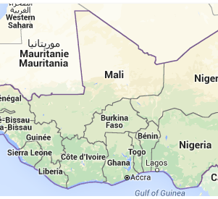
Some data of the country
Population 2017 : over 19 millions (274 400 km2)
Country with low ressources :
Mortality rates are higth

Slide 3
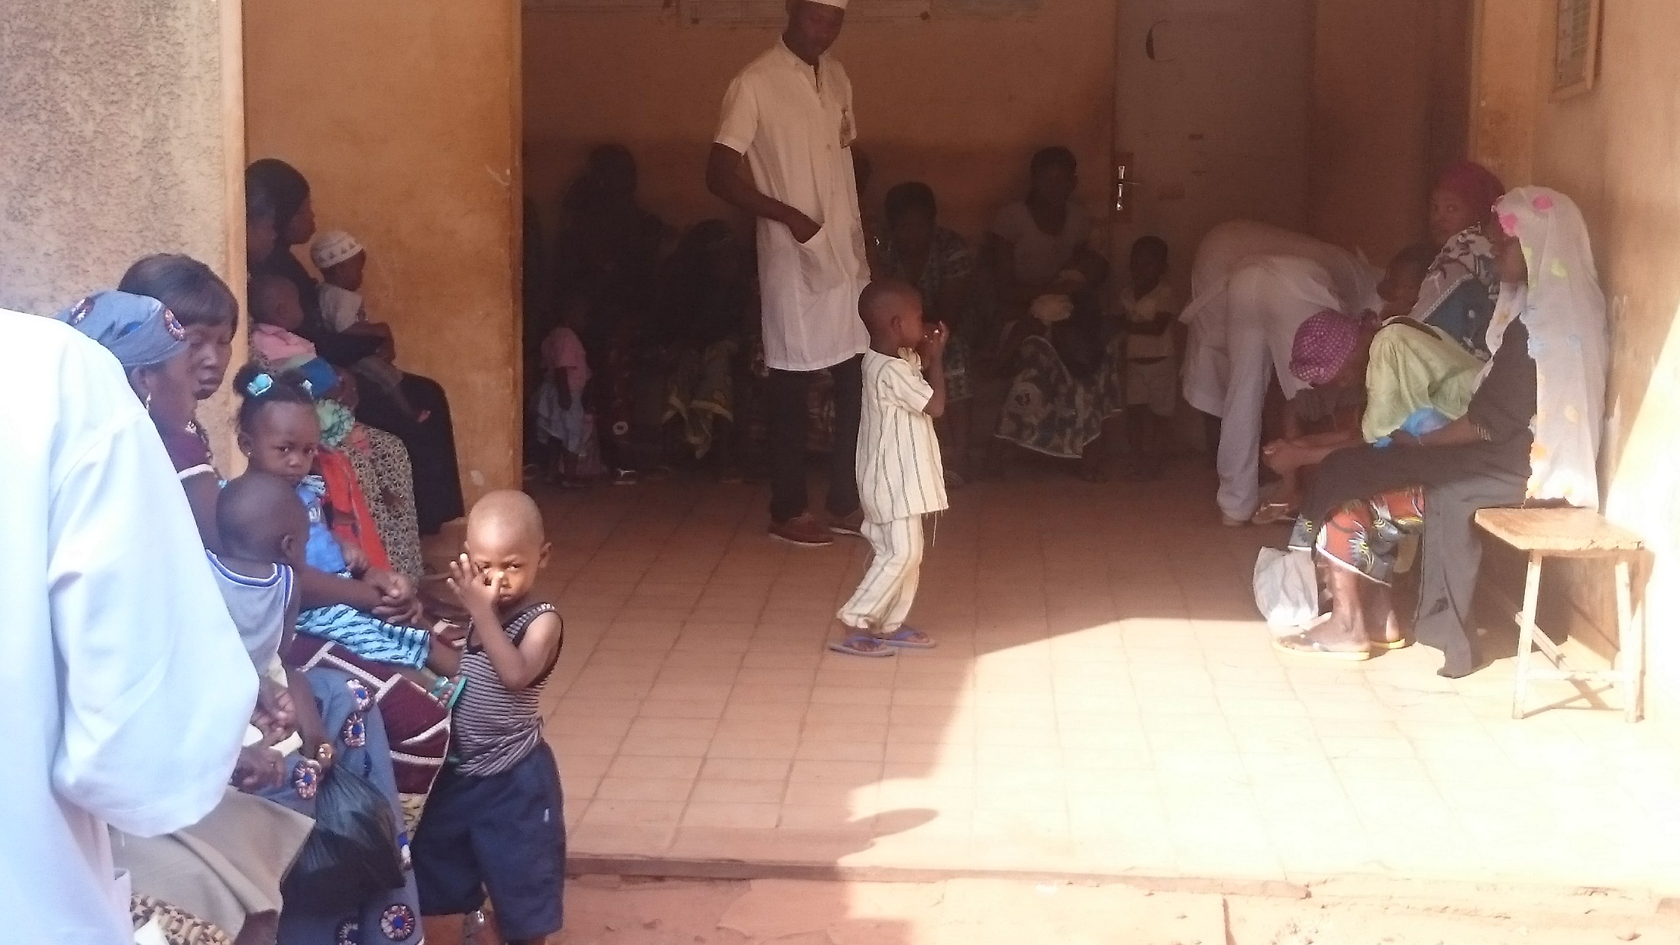
Today, in Burkina Faso under 5 children and women have access free package care in
health centers (25% population covered)

Slide 4
Message 1: Strong advocacy by NGOs to policy makers and technicians
1st step:2008 pilot phase of free care
2nd step: starting advocacy since 2009, researcher
Step 3 : Development of a national strategy of free healthcare : 2013
4th step: influence of the presidential campaign in 2015
National Policie of free care for vulnerable population since April 2, 2016

Slide 5
Free health care package : principle of progressivity
Children under 5 years
Women (pregnancy, delivery, obstetric fistula, Screening and treat precancerous lesions of the cervix)
All services (drugs, consultations, evacuations, hostelries, tests)
Health centers of all levels, private taken into account
Essential care for both vulnerable groups
Population covered: about 25% of the total population

Slide 6
Message 2: Simple model design and implication of the CSOs
Implementation approach: "learning by doing" during 20 months before drafting final application texts
Principle of separation of certain functions:
The effectiveness control function is carried out by the civil society (4 NGOs TDH, Help, ACF, SCI)

Slide 7
Build effective separation of functions
Government and PTF : financing and regulation
Public and private Health workers : Provide free health care
CSOs : control, alerts, checking
Free care for vulnerable

Slide 8
Role and functions of the CSOs
In the health centers
In the household
Check the level of effectiveness of free care
Check the concordances of financial data and quantity of service
Calculate indicators of rational use of medicines
Measure customer satisfaction: racket alerts, payments wrong.
Collect denunciations and good practices
Check the existence of patients
Collect patient opinion
Calculate the level of effectiveness of free care
Collect denunciations and good practices

Slide 9
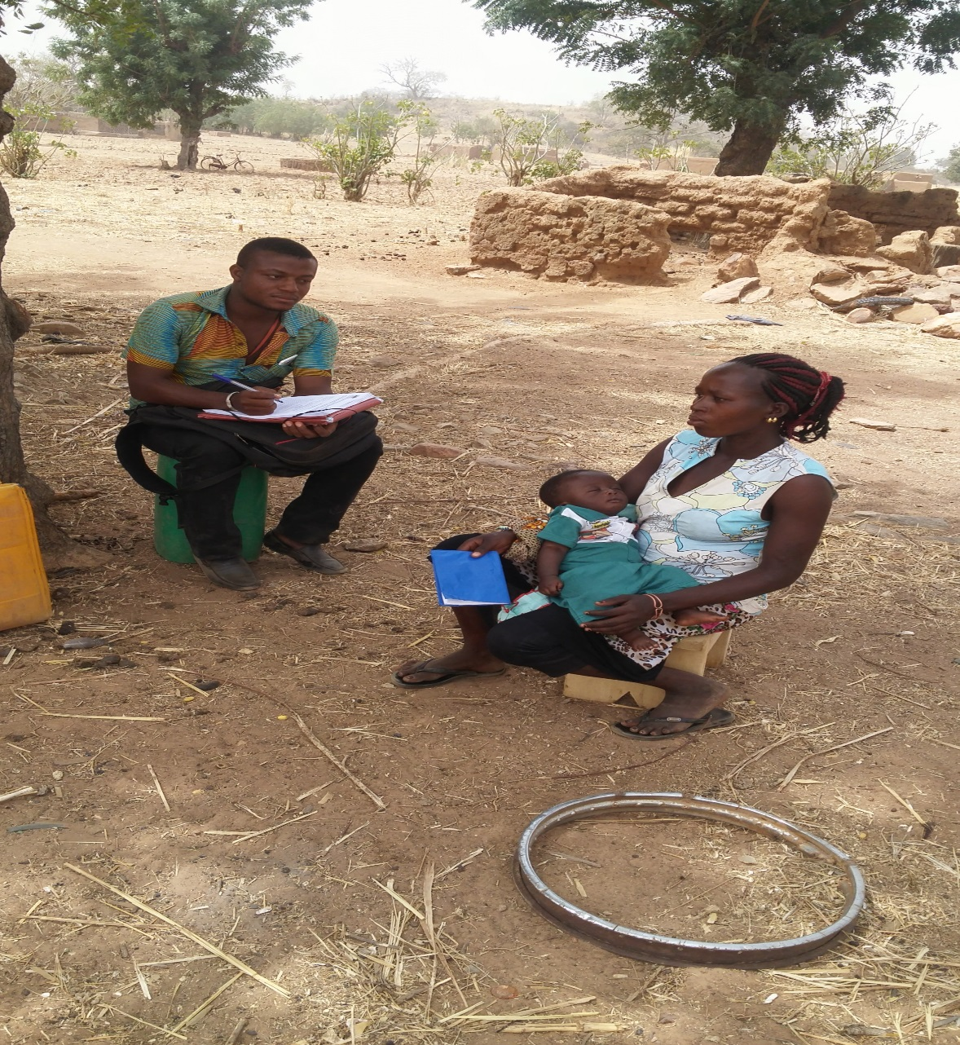
Household survey by CSO
NGO : Help monitor

Slide 10
Example of results
  Typologie des dysfonctionnements (Évolution de la typologie des cas) 1/2
Quelle place pour le médicament?

Slide 11
Quantité de césariennes transmise et contrôlée au CHU-YO

Slide 12
Success and achievements
Effectiveness of free healthcare: millions of beneficiaries
Regular disbursements of funds for the purchase of free healthcare: an average of CFAF 30 billion per year (US $ 53,177,866 per year), about 21% of total annual household expenditures
Strong involvement of the civil society in the follow-up: alerts of frauds, ruptures, dysfunctions ...
Strong political commitment: Presidency, Prime Minister, National Assembly take part in the biannual follow-up meetings

Slide 13
Key Lessons Learned
The learning by doing approach has firmly established the strategy of free care
The flexibility of the financial management procedures is the key to success: real involvement and support of financial actors
The principle of progressivity in the inclusion of free benefits has made it possible to financially support the social measure
Delegating monitoring to civil society has had two major effects: raising people's awareness of their rights and supporting decision-makers in solving problems

Slide 14
Message 3: challenges
Permanent availability of drugs, additional tests in health facilities: many drugs shortage
The eradication of irregularities : fraud, fictitious patients, discrepancies in invoicing
Some health workers do not accept the principle of control by NGOs
Always responding to alerts of the CSOs

Slide 15
Message 3: challenges
Financial sustainability: inclusion of other benefits in the free care package (Family Planning, elderly)
Extension of free services at Community level from 2018
Implementation of a strategic care purchase model: establish packages for GHS, purchase care based on health facility performance level that will be audited and ranked between one and five stars.

