Slide 1


Global Network for Health Financing and Social Protection
P4H countries’ experiences
Phnom Penh, Cambodia, 6th February 2018

Slide 2
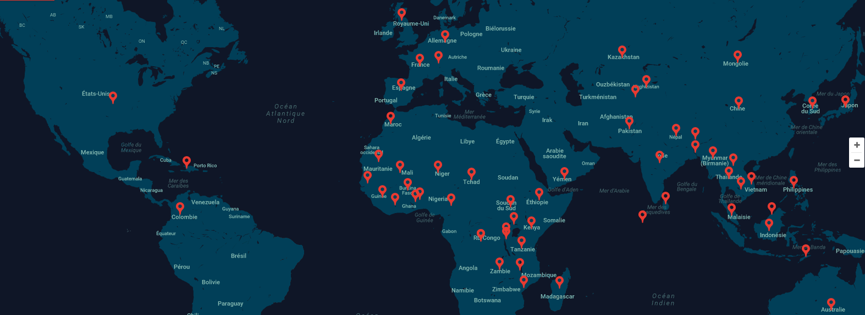

P4H focal point
P4H country focal point

Slide 3










































Partners in: Benin, Burkina Faso, Cambodia, Cameroon, Chad, Haiti, Mauritania, Mali, Malawi, Mozambic, Tanzania, Zambia

Slide 4
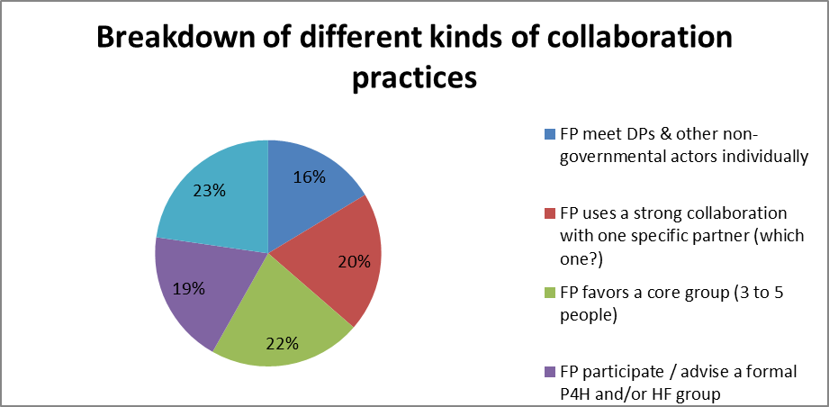
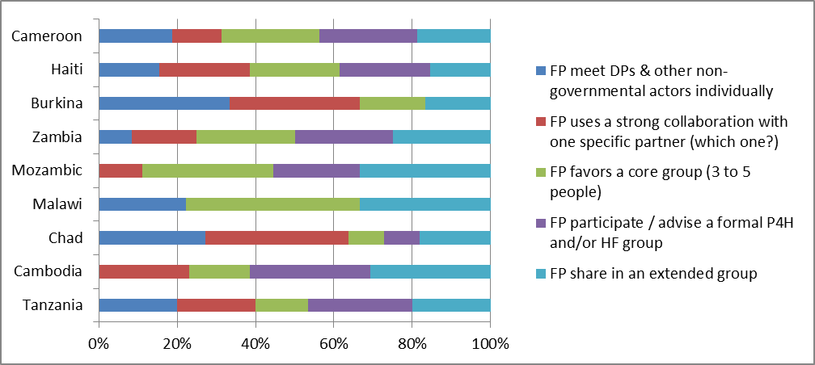
Collaborative set ups & practice
Same weight on average
Different practice in countries

Slide 5

Main work areas at country level
Quality
SP
User fees / fee exemption / vouchers / HEF / SHI
Health economics
Focus: inclusion
HFS
GFM focus GFF
Political economy
Budget advocacy
Fiscal space analysis
L4UHC
Legal provision

Slide 6
Outcome
Malawi
Zambia

Slide 7
Challenges…
…that give P4H all reasons to be
Maintaining the agenda
Making partners work together
The environment (State)
Suboptimal intersectoral dialogue
Time needed for processes
… that question P4H position
UHC much broader than Health Financing
Political economy more important than technical issue
… to our set up
Dependance on the Focal Point person
Visibility / P4H label in activities
P4H weight in Focal Point position (ToR, agenda, evaluation)

Slide 8





Some specificities
Support to NHI through a broader and integrated Social protection perspective
Critical environment (extreme situation re- many partners & week State)
At regional level linking PBF and Vouchers via the RFHP (Regional Funds for Health Promotion = Public Interest Groups with tripartite governance = State, Communities and Development partners)
Look into GBD risk factors (Malnutrition, WASH, Environment) & their intersectoral approach as per UHC
  Collaboration model (consensus building, individual lobbying, relation building)

Slide 9
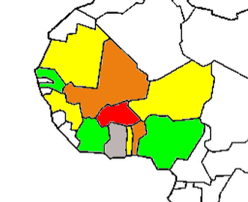
Regional level of P4H: WA insight
P4H tentative work
1 + 2 + 4
State of State building
Niger, Mali vs Ghana
Togo, Guinea Bissau
Ebola affected countries
Discontinuity
Benin
P4H focal point needed
to build: Senegal, Ivory Coast, Nigeria(+)
for damage control Guinea, Niger
Experience in terms of regional network:
an adapted support with specific set up

Slide 10
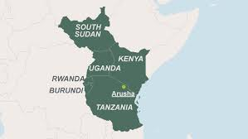
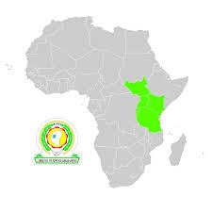

Regional level of P4H: EAC
Currently MOU of collaboration being established between P4H and the EAC with focus to:
Strengthen SHP and HF for UHC,
Strengthen leadership, governance, coordination and harmonization in the EAC Partner States and at regional level
Establishment of an EAC sub-regional network on SHP/ HF for UHC (continental & global linkages)
Develop capacity of the EAC secretariat and individual PSs according to needs
Support the SHP portability roadmap
Once MOU signed it is foreseen to have a Regional Focal Person placed at the EAC Health Department to coordinate activities and partners under above objectives

Slide 11

Connect with us: www. p4H.world

