Slide 1

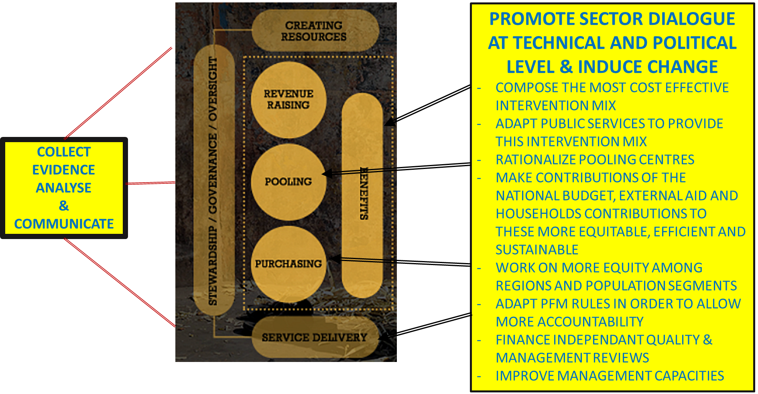
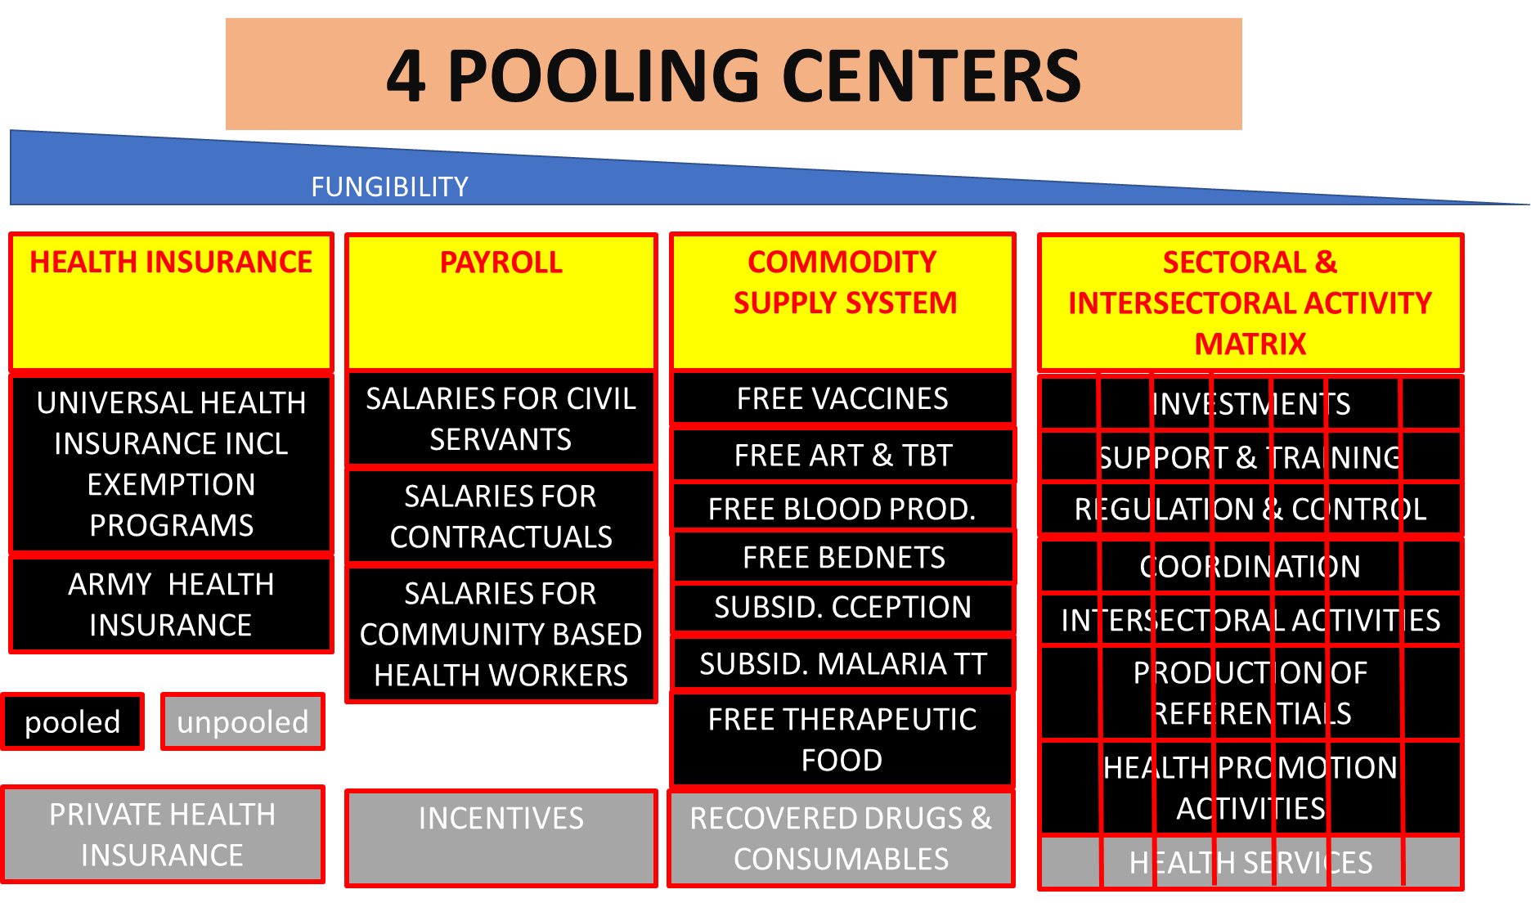
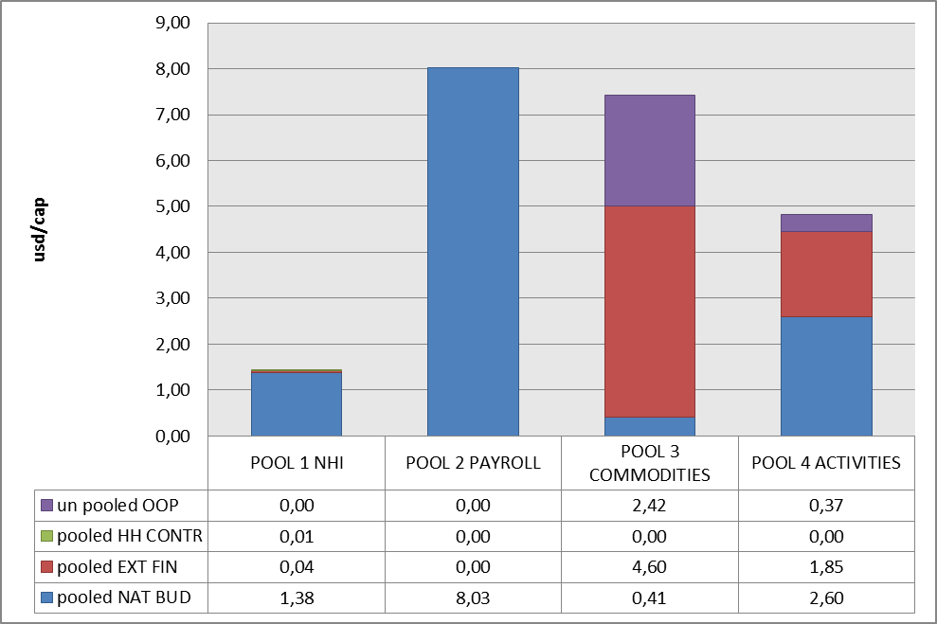
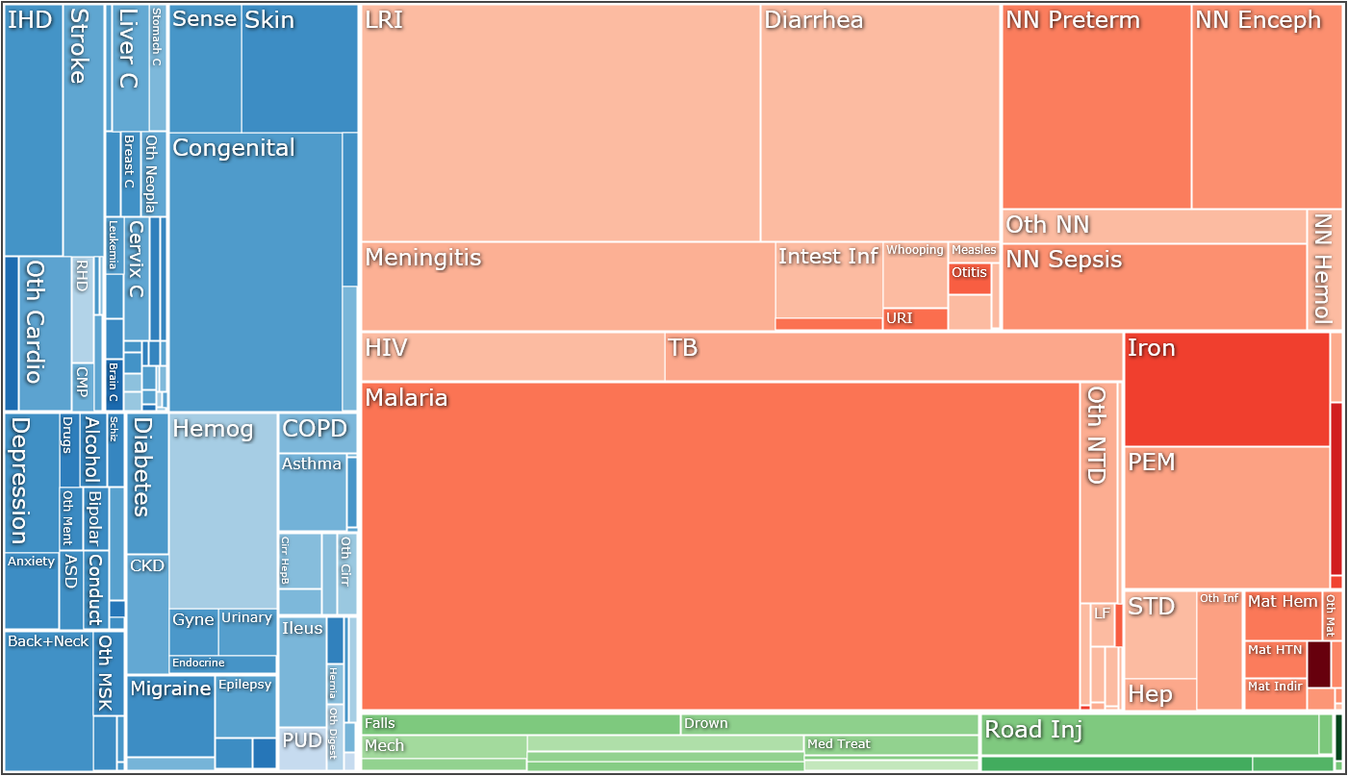
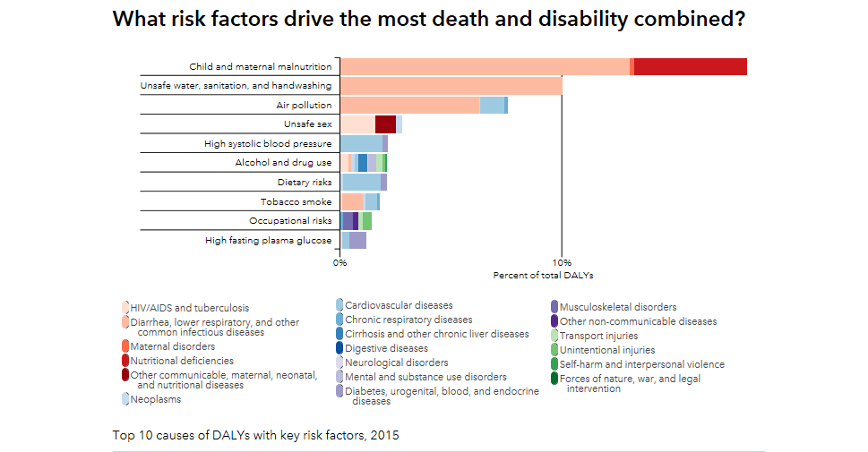
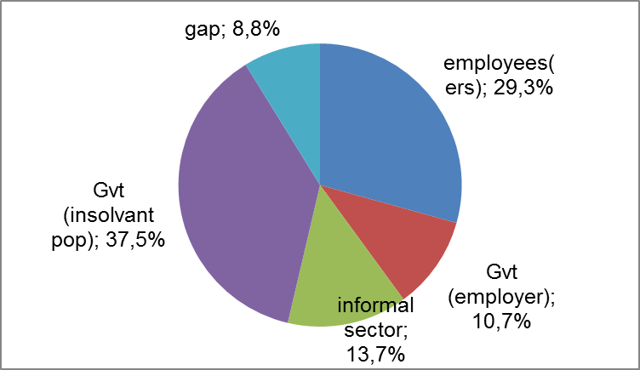
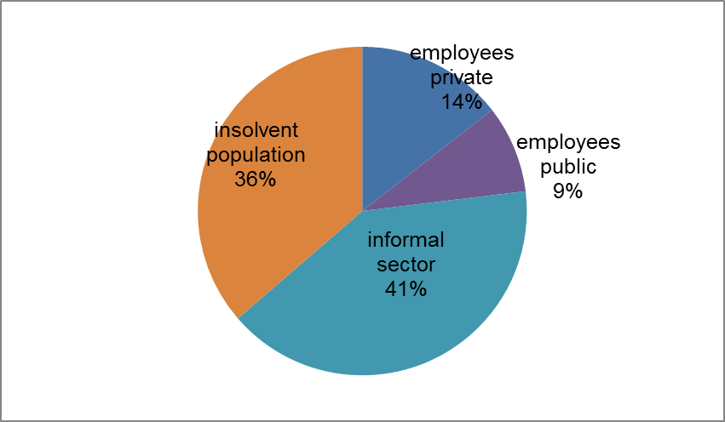

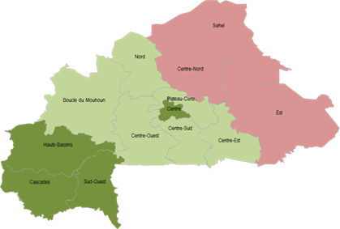
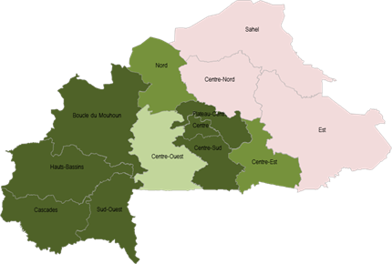
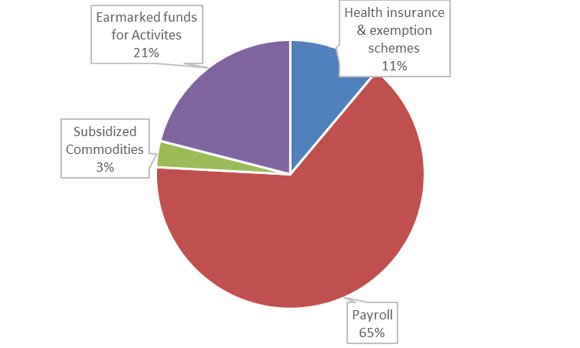
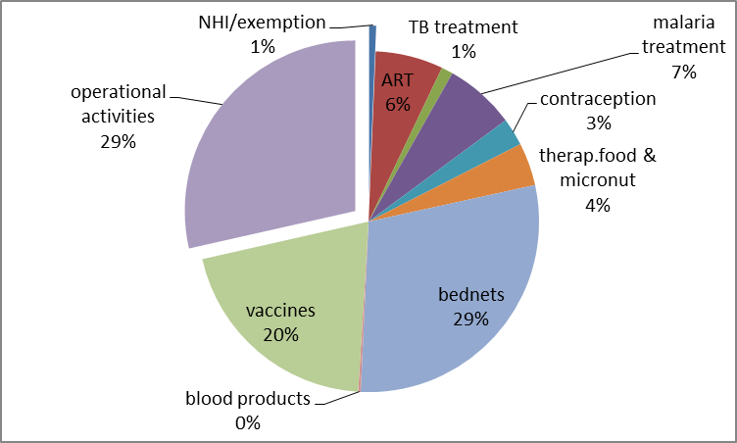
Effective pooling and strategic purchasing in Burkina Faso.
Some How tos
The Burkina Faso setting :
BF has maintained a stable allocation for health of 12% of the national budget but relies mainly on historic budget lines of input financing
In 2016 a 2 $/cap benefit package for pregnant women and Under Fives has been started. External aid contributes to this benefit package is only 3% (2016)
Universal health insurance is in its starting blocks with a perspective of 79% coverage by 2027 at a cost of 1,6 % of the BNP for a benefit package of 18 $/cap but regional insecurity represents an important threat for this scenario.
Transversal delivery teams has been set up to steward progress in access, quality, service development, strategic interventions and strategic purchasing of health services. However, these teams lack analytic tools that allow a bird view perspective.
The salary bill represents 65% of the national budget for health and the steady increase of this proportion consumes fiscal space for strategic purchasing.
69% of external aid is spent on subsidizing specific commodities and 31% is spent on an array of extremely fragmented and un standardized activities (2016)
Distribution of health services and qualified staff is largely inequal among regions and a significant relation has been demonstrated with performance indicators. Quality of public and private health services is also very inequal and relies largely on internal management capacities.
Non communicable diseases represent nearly 1/3 of the burden of disease. Malnutrition, unsafe water, insufficient sanitation and air pollution are risk factors that account for more than 1/3 of the burden of disease but these factors heavily rely on the local context. Health promotion activities are still centrally managed or rely on incoordinated community health workers
Some how to questions for analysis and action
Which interventions and technologies should be financed in priority ? How to raise prevention in public service delivery ?
How should we pool efficiently the available financing for these interventions and the facilities that deliver these interventions ? To which pooling centers and geographic areas should we orient public, household and external financing ?
How can we improve the use of available financing at provider level in order to ensure universal access and high quality services ?
Choose a cost effective mix of interventions and technologies for health priorities and their risk factors
Rationalize pooling centers and collect evidence on the sustainability, efficiency and equity in each pooling centre
For each domain of strategic planning, identify the main risk factors.
Evaluate effectiveness and operational costs of the interventions and technologies that address these risk factors and go as much as possible for preventive action
Compose the most cost-effective mix of interventions according to an optimistic, medium and pessimistic financing prognosis
Evaluate the impact of this mix on the functions and resources of public and private service providers
Update strategic plans to show how public services and private contractors will ensure support, supply and service delivery in order to implement the optimal intervention mix
Allocation to the 4 pooling centers in 2016 in $/cap
Monitor contribution and benefits of the health insurance system and preserve equity
Repartition of expected contribution in 2027 Expected benefitting population in 2027
Work on efficiency and access at provider level
Map availability of facilities, staff and services and work on equal distribution
regional resources score nurse/population rate
Organize independent certification of health facilities linked to a P4P system
Organize and finance prevention and community health action at decentralized level
Train health facility managers on financial and logistic management tools
Organize and finance service quality review by CSOs
Adapt PFM rules for more flexibility
Check prescription behaviour and normalize
Identify frauds and moral hazard and define penalities
Identify barriers on the use of services
Preserve the revolving fund for medecines and consumables
Improve data quality and real time availability of data
Monitor expenses for health and get more eficiency, sustainaibility and equity
allocation of national budget for health in 2016 allocation of pooled external aid in 2016
Notes:
This is a sample poster in powerpoint (pptx is more stable than ppt) from last year’s seminar, to offer format and layout guidance. Keeping to this format will enable you to prepare a 65X80 cm poster (standard conference format, that you also saw in the previous Seminars). Powerpoint offers the easiest and most user friendly text editor to that end; you can play with the place of boxes, graphs, etc. and insert all illustrations you find relevant. Please do not use a font below size 24 for the text you type in. Prefer to long stories some short synthetic statements (bullet points, arrows…), with illustration of the evidence that supports your statements. Keep in mind that you might have to present orally your poster. If solicited by the faculty, it will be easier to extract few messages in classic powerpoint format to be discussed in plenary. Posters will also remain displayed throughout the Seminar, so that you can personally engage with whom you seem best suited to get feedback, responses, etc. on a 1-to-1 basis. As for the QR code, leave that to us; once we have all the posters, we will post them on C4D, and you’ll be able to download them by scanning them from a mobile device connected to the local wifi.
Indicative content may include:
0. Key Messages / Questions you want to share
1. Context and justification of the intervention / Action,
2. Outline of the intervention (methods, including when appropriate, evaluation),
3. Key results:
a. in terms of process of the country policy dialogue, with particular relevance to health financing
b. in terms of improvements in quality, equity, availability of services, etc. (see the framework WHO shared in Jan’s email), and sustainability of systems,
c. other, including what did not work (the “department of error”, as The Lancet calls it ;) )
4. Discussion including but not limited to:
a. lessons for country policy,
b. lessons for country EU programme,
c. messages for other EUDs (caveats, do’s & don’ts, Auntie B’s pearls of wisdom, etc.),
d. any other discussion you may want to develop

