Slide 1
ACT-A Budget Dialogue
Discussion with MOHSS

Slide 2
Objectives
To raise awareness on the ACT-A Health Systems Connector.
To explore potential benefits of the initiative.

Slide 3
Background
The fiscal impacts of COVID-19 will impose additional strain on the budgetary space for health spending.
The need to sustain high public expenditures will not decline proportionally to the decline in C-19 incidence.
COVID-19 has also laid bare gaps in national preparedness and risk management arrangements.

Slide 4
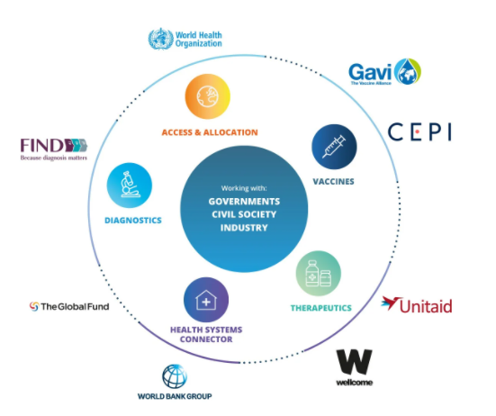
About ACT-A
The Access to COVID-19 Tools (ACT) Accelerator, is a global collaboration to accelerate development, production, and equitable access to COVID-19 tests, treatments, and vaccines.
It brings together governments, scientists, businesses, civil society, and philanthropists and global health organizations.
The ACT-Accelerator is organized into four pillars of work: diagnostics, treatment, vaccines and health system strengthening.

Slide 5
ACT-A process guide for national budgetary dialogue
To build on the momentum of the covid-19 pandemic and strengthen the budget dialogue process and address structural PFM and health financing issues.
Provides key stakeholders in the budgeting process (Cabinet, Finance, Health, CSO, Parliament) with operational guidance to address financing and PFM issues.
Analytical framework structured around the following four questions:
  What needs to be financed both in the immediate- and medium-terms to respond to the COVID-19?
  Whom to finance, identifying the responsible budgetary units/fund holders?
  How to Finance; including the role of fiscal instruments and budget prioritization, which shape budgetary space as well as the role of PFM systems?
  How to monitor the use and performance of funds to ensure transparency and accountability?

Slide 6
Aims
To support countries:
to reorient budgetary arrangements as required to facilitate the ability to deliver vaccines, therapeutics and diagnostics to their populations to respond to the COVID-19 pandemic.
to sustain the capacity to prevent, mitigate and respond to health threats in the short, medium and longer term, while concurrently delivering other essential health services.

Slide 7
Why focus on budget dialogue?
Recognition that the budget preparation processes are the platforms through which specific plans are transformed into actual resource allocation decisions.
Facilitate informed decisions by key stakeholders involved in the budgeting process.

Slide 8
What, who and how to finance?
WHAT?
Function: Supplies, vaccines, surveillance, policies
Type of budgeting input: Recurrent vs. Capital budget.
WHOM?
Fund holder: Ministries, agencies, central and sub-national governments
HOW?
Costing: Resource need estimates
Fiscal adjustments and scenarios: Scenarios and sources for public revenue for current and longer-term outlook
Adjustments in PFM systems: Budget formulation, PFM bottlenecks, central/subnational alignment, reporting
Time Horizon: Immediate term (6 – 12 months) vs. longer-term (1 – 6 year)

Slide 9
Illustrative what/when issues for vaccination
Function | Short term (0-12 months) |  | Medium term (12-36 months)
 | Budget input | Required health system improvement | Budget input | Required health system improvement
Vaccine and cold chain logistics | Vaccine, Syringes | Supply chain management | Vaccine | Supply chain management
 | Refrigerators/cold chain | Improved procurement | Refrigerators | Maintenance management
Service delivery | Training modules HRH reallocation Waste management | Pre- and in-service training | Training | Supervision, quality assurance, in-service training
 | PPE | Improved procurement | PPE | Supply chain management
 | Health workers | Deployment Surge capacity | Health workers | Scope of practice reform Strategies for recruitment
Demand generation | Community engagement |  | Community engagement | Civil society engagement
 | Risk communications |  | Social media
Epidemiological surveillance of vaccination coverage and diseases | Track and trace | Improvements to contact identification | Vaccine adverse event reporting system | Improvements to HMIS
 | Vaccination coverage system | Improvements to HMIS

Slide 10
Tracking and accountability
Without accountability mechanisms, flexibility invites abuse
Health spending patterns, before and during COVID-19, provide strategic information for investing in sustainable and resilient health systems and informing policy decisions.
Opportunity for collaborative efforts in tracking resources

Slide 11
Analytics
What activities must be financed and who are the budget holders?
  Baseline assessment, mapping, cross-programmatic efficiency analysis
Cost, macro-fiscal and health spending analyses
  Costing studies and generation of fiscal scenarios
Public financial management analyses
  Budget formulation assessment and PFM bottleneck assessment
Resource tracking and mapping
  Tracking needs assessment and development of data tools

Slide 12
Potential benefits
Help synthesize prior analyses.
Undertake studies on priority C-19 and broader HF issues.
Generate and share lessons learned and challenges; supporting knowledge exchange.

Slide 13
What have other countries done
Ghana
Support to operationalize recommendations of a PBB study.
Refreshing of strategies and development of information systems.
Private sector and delivery of C-19 services.
Cross-Programmatic Efficiency Analysis.

Slide 14
What have other countries done
Papua New Guinea
Analytic work on the drivers of PNG’s high staffing costs.
A scoping study into the possible role of taxes on the consumption of items harmful to health.
A review of the budget execution system of warrants in the health sector.
Resource tracking data tool for C-19 expenditures.

Slide 15
Discussion
Potential benefits / value-add with this work?
Potential areas of focus?
What are potential modalities and possible timeframes to ensure alignment with other initiatives?

