Slide 1
Debriefing to Ministry of Health Kuwait
HEF Mission (Dec. 11-16, 2021)
Faraz Khalid, Henrik Axelson, Batoul Dawi
December 16, 2021

Slide 2


Slide 3
Outline
ToRs of the Technical Support
Starting point: A standardized country assessment supporting progress towards UHC
Beginning of the journey: Progress in this week
Next steps: Points of inquiry, Approach & Activities

Slide 4
TORs of the Technical Support
Health Financing Review
Establishment of Health Economics & Financing Unit
Capacity Building of MOH & related institutions in HEF in Kuwait

Slide 5
Outline
ToRs of the Technical Support
Starting point: A standardized country assessment supporting progress towards UHC
Beginning of the journey: Progress in this week
Next steps: Points of inquiry, Approach & Activities

Slide 6

HEALTH FINANCING PROGRESS MATRIX
A standardized country assessment
SUPPORting progress towards UHC & Health Security

Slide 7
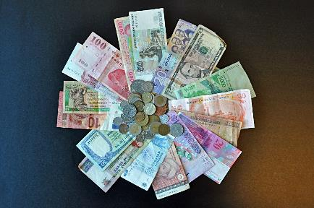
WHY use THE HEALTH FINANCING PROGRESS MATRIX?
The first standardized qualitative assessment of country health financing systems in support of UHC
Complements quantitative data which lags behind decision-making (by at least two years)
Provides regular, timely and clear recommendations for policy makers, to drive progress to UHC
Pulls diverse policy documents & analytical work into a single framework allowing monitoring over time

Slide 8



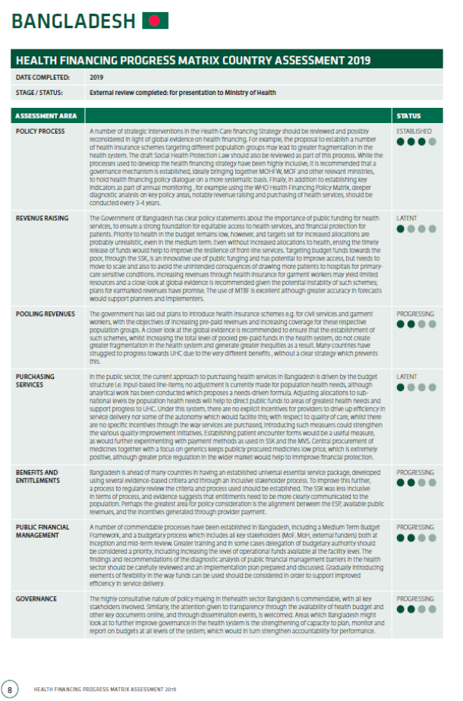
WHAT do PROGRESS matrix assessments deliver?
33 ASSESSMENT QUESTIONS
CONCISE FORWARD-LOOKING ASSESSMENT
ACROSS SEVEN ASSESSMENT AREAS:
1) HF POLICY, PROCESS & GOVERNANCE
2) REVENUE RAISING 3) POOLING REVENUES
4) PURCHASING & PROVIDER PAYMENT
5) BENEFITS & CONDITIONS OF ACCESS
6) PUBLIC FINANCIAL MANAGEMENT
7) PUBLIC HEALTH FUNCTIONS & PROGRAMMES
EACH QUESTIONIS ASSESSED AGAINST A 4-LEVEL BENCHMARK BASED ON GLOBAL EVIDENCE.
A CONCISE SUMMARY OF COUNTRY PERFORMING RELATIVE TO BENCHMARKS IS PROVIDED, TOGETHER WITH CLEAR DIRECTIONS FOR IMPROVEMENT.

Slide 9

WHO GLOBAL KNOWLEDGE DATABASE
OF COUNTRY ASSESSMENTS ALLOWING BENCHMARKING WITH OTHER COUNTRIES ON CHALLENGING ISSUES, AND CROSS-LEARNING ON PRACTICAL INTERVENTIONS ADOPTED ELSEWHERE.
PASSWORD-PROTECTED: ALL COMPLETED & REVIEWED ASSESSMENTS ARE UPLOADED

Slide 10
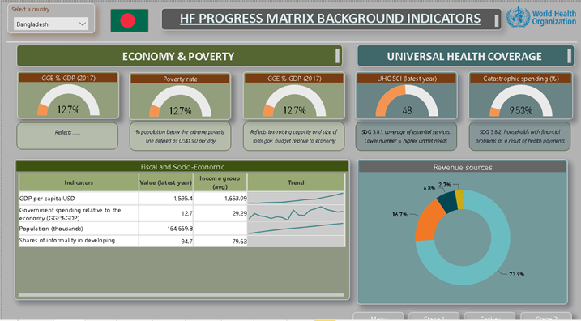
WHO GLOBAL KNOWLEDGE DATABASE
OF COUNTRY ASSESSMENTS ALLOWING BENCHMARKING WITH OTHER COUNTRIES ON CHALLENGING ISSUES, AND CROSS-LEARNING ON PRACTICAL INTERVENTIONS ADOPTED ELSEWHERE.
PASSWORD-PROTECTED: ALL COMPLETED & REVIEWED ASSESSMENTS ARE UPLOADED

Slide 11
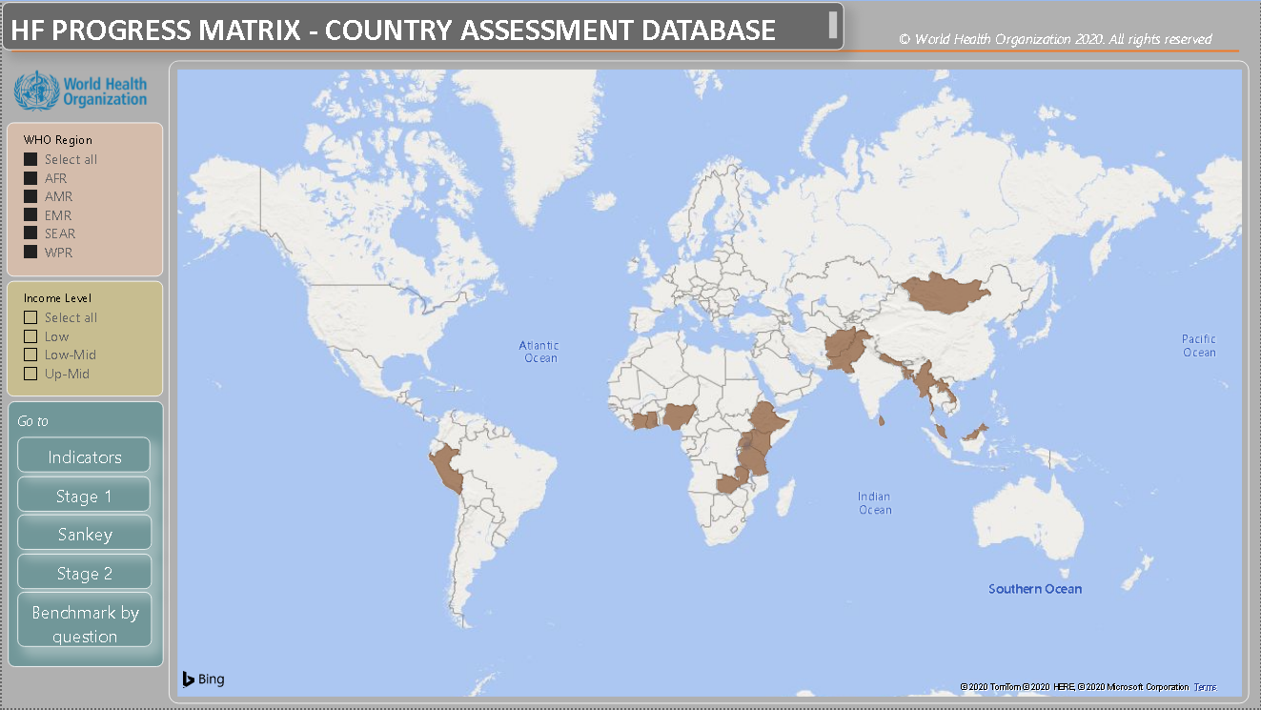
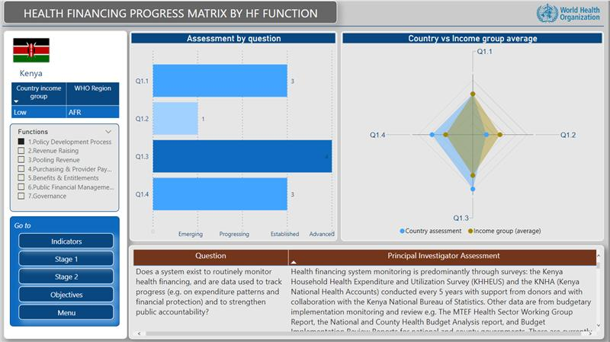
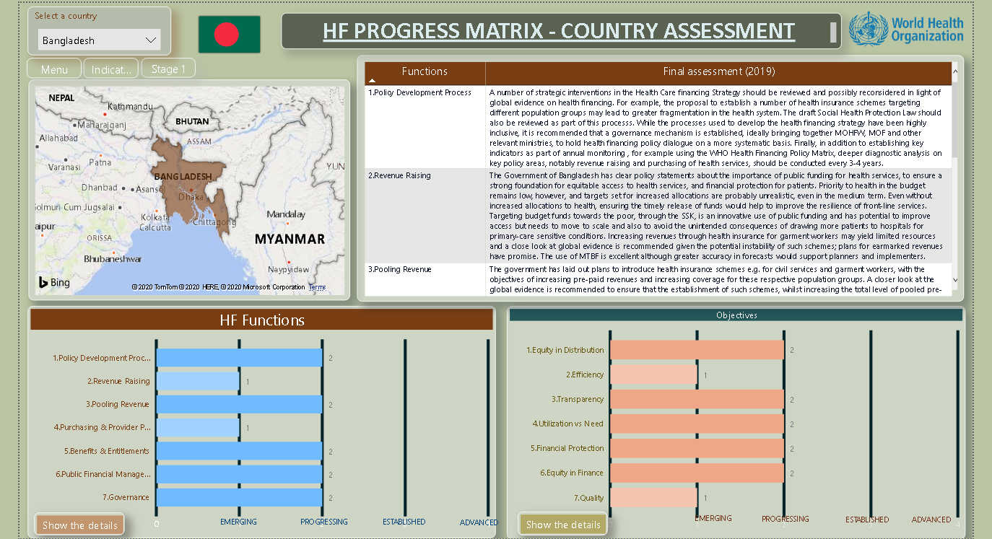
BENCHMARKING AND KNOWLEDGE SHARING

Slide 12
Outline
ToRs of the Technical Support
Starting point: A standardized country assessment supporting progress towards UHC & Health Security
Beginning of the journey: Progress in this week
Further points of inquiry
Approach for the next steps

Slide 13
Documents consulted
GoK & UN Strategic Cooperation Framework 2020 – 2025
Kuwait National Development Plan 2020 - 2025
Kuwait National Vision 2035
White Paper on Health
UN 2021 Kuwait Common Country Analysis (Internal Draft Nov. 2021)
Kuwait Voluntary National Review 2019
LSE Kuwait Health System Review 2018
Kuwait Annual Health Report 2015 – 2019
2021 Global Monitoring Report on Universal Health Coverage
Global Health Expenditure Database 2000 – 2019
Evolving register: https://docs.google.com/spreadsheets/d/1JlyU6osJB8i_RbvMmabRfvS6LSCKGWLFygGOiSrToG8/edit?usp=sharing

Slide 14
Stakeholders met
Ministry of Health
International Health Relations Directorate
Planning Directorate
Finance and Budgeting Directorate
Primary Care Directorate (Dr. Dina Dhubaib, Dr. Muneera, Dr. Jenan)
Others
Global Insurance Group
Health Information Centre (Dr. Ahmad Okashah)
UNDP
IOM
Kuwait University Faculty of Public Health
Dhaman (Thursday)
Evolving register: https://docs.google.com/spreadsheets/d/1iOfsCZc9EO3-4HsVdKbFSQD1A5wEqlNLuX2TI4wBZaQ/edit?usp=sharing

Slide 15
Initiation of STAGE 1: a summary overview of health coverage schemes in Kuwait
Identified schemes:
National health system
Afya health insurance for retirees (citizens)
Dhaman health insurance for expats
Armed forces health care
Private insurance for oil companies
Design features:
Focus of the scheme
Target population
Population covered
Basis for entitlement/enrolment
Benefit package
Co-payments
Conditions of access
Revenue sources
Pooling
Governance
Provider payment
Service delivery and contracting

Slide 16
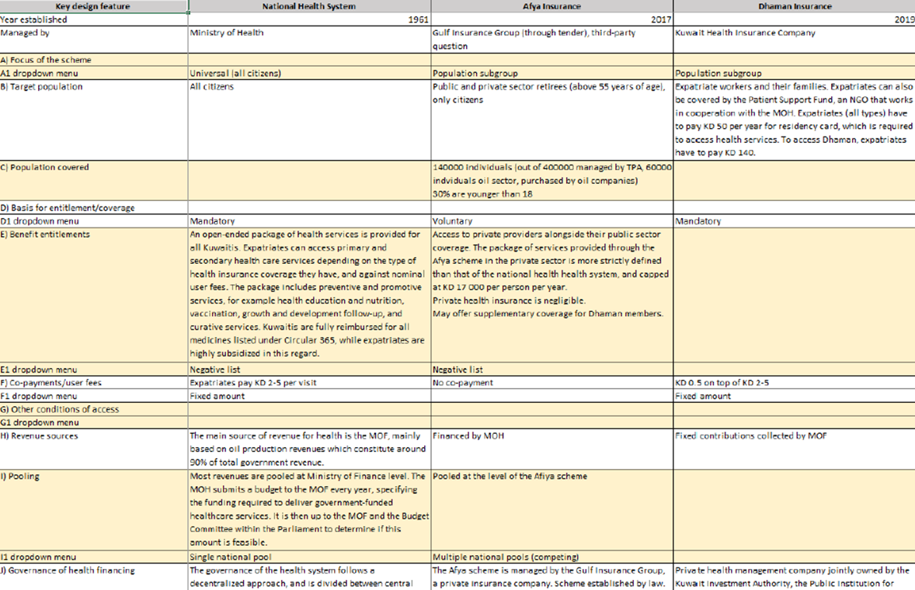
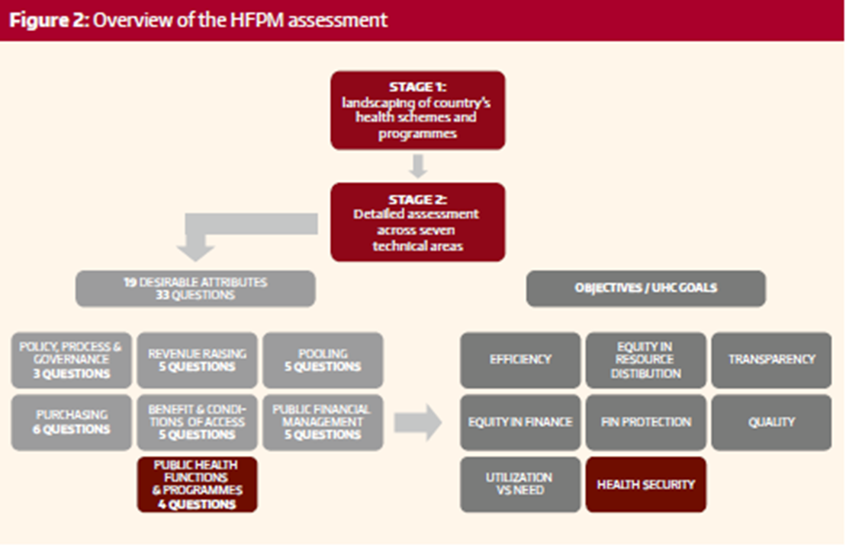

Slide 17
Understanding the needs & vision for a Health Economics & Financing Unit (HEFU)
Clear commitment from MOH to establish an HEFU
Vision and expected role of HEFU
Determine location of HEFU within the MOH organigram
Leverage existing capacities among MOH staff
Consider opportunities for collaboration with other MOH departments and units
Initial interest in collaboration from other government institutions
Consider role for HEFU in the establishment and implementation of a Health Technology Assessment (HTA) system

Slide 18
Mapping capacities in HEF
Some capacity in HEF exists in MOH, build on this and identify staff that may be interested in playing a role in the HEFU
Map capacities to strategic objectives and role of the HEFU to determine needs and gaps
WHO EMRO HEF team can carry out in-person and remote capacity building in health financing policy and specific functions
Opportunities for WHO online courses on health economic and financing
Consider additional mapping of opportunities for collaboration with other institutions that can provide capacity building support

Slide 19
Outline
ToRs of the Technical Support
Starting point: A standardized country assessment supporting progress towards UHC & Health Security
Beginning of the journey: Progress in this week
Next steps: Points of inquiry, Approach & Activities

Slide 20
Points of Inquiry: Health Financing review
- Completion of a national picture of health financing by assessing different elements of health financing system
- Specific points of inquiry will be around:
Health Financing Policy, Process and Governance
Revenue Raising
Pooling Resources
Purchasing and Provider Payment
Benefits and Conditions of Access
Public Financial Management
Public Health Functions and Programmes

Slide 21
Approach & Next steps
Health Financing Review
  Assignment of focal point/s by MOH for coordinating meetings with stakeholders and soliciting relevant data
  Synthesis of findings by the WHO consultant, with the support of WHO EMRO & HQ
  Joint review of findings of the review with MoH and development partners
Establishment of Health Economics & Financing Unit (HEFU)
  WHO consultant and MoH focal point/s to jointly draft:
    MOH’s vision & strategic objectives of establishing the HEFU
    Key functions and options for institutional arrangements of HEFU
    Required staff positions for the HEFU and job descriptions

Slide 22
Approach & Next steps
Capacity Building of MoH & related institutions in HEF in Kuwait
  MoH to nominate the existing staff to be engaged
  WHO to discuss with P4H and other development partners potential joint capacity building opportunities
  WHO consultant and MoH staff to map the current institutional arrangement for knowledge management and to develop options for its improvement

Slide 23
Thank you

