Slide 1
P4H Extraordinary Technical Coordination Group Meeting
Reflections on content and relevance of the Leadership for UHC Programme
Michael Adelhardt
Claude Meyer
P4H Coordination Desk
Bangkok, 2 February 2015
Notes:
LDP reflections: what’s good and why is it important for P4H? what should be changed? which parts should come out stronger? what’s missing.

Slide 2
Summary of most relevant highlights and issues of the LDP
  General observations
  Highlights
    Personal connection; sensing / listening; system thinking; technical versus adaptive challenges; stakeholder analysis / sculpting; HF Strategy Master Class; Collective Action Initatives
  Critical issues and what we need to work on
Notes:
Provide examples to each point...

Slide 3
General observations
  Overall impression: ‘missing link in path to UHC and P4H support’
  In general:
    Peer-to-peer learning approach; countries in forefront;
    Experts only provide frame, platform, principles, exercises and questions
    ++ U-Theory: idea of a journey (‘path to UHC’)
    LDP complements the ‘what’ with ‘how to’ – and the role we play ourselves

Slide 4

U-Process: 1 Process, 5 Movements
Advocating for UHC
Implementing change
1. Co-initiating:
uncover common intent
stop and listen to others and to what life calls you to do
5. Co-evolving:
institutionalize the new in practices
by linking micro, meso, macro change
Multi-sectoral approach
Dialogue and building consensus
2. Co-sensing:
observe, observe, observe
with MULTI-STAKEHOLDERS (Diversity) go to places of most potential for sensing the system from the whole
4. Co-creating:
Collective Action Initiatives - living examples to explore the future by doing
Analysing, reflecting and developing options
3. Co-inspiring:
connect to the source of inspiration and will
go to the place of silence and allow the inner knowing to emerge
Notes:
Idea of JOURNEY - perfect fit with common P4H approach and agenda....and what we (P4H members) want to jointly achieve in partner countries.
Advocating (initiating a process) for UHC; involving multi-stakeholders (LDP: are we really listining?); developing options

Slide 5
Highlights
Personal connection to UHC:
  useful to reflect on type and depth of own connection to the topic of UHC; why are we engaged in this? what makes us passionate about UHC? ...
  Foundation for becoming a change agent
Sensing / listening
  ++ ...suspending own pattern of thinking, perceptions about other stakeholders;
  asking questions and trying to see things from others’ perspectives
  Opening up for joint reflection and solutions

Slide 6
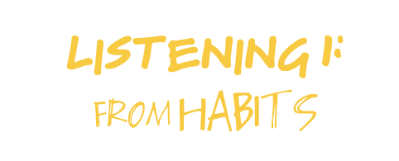















Levels of Listening
Notes:
Getting a deeper understanding about listening and developing some skills....sensing exercise.

Slide 7
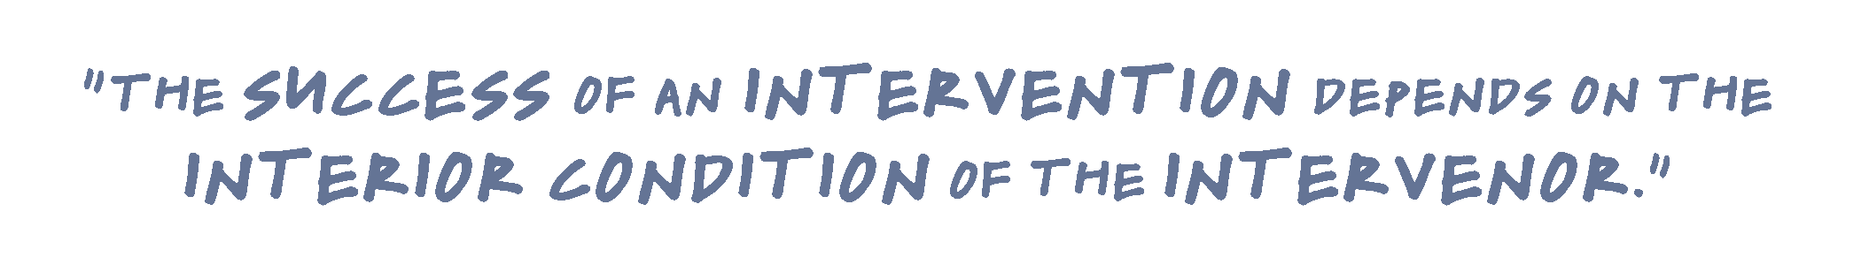
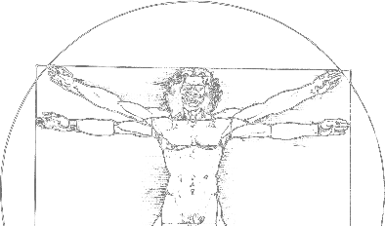














William O’Brien,
former CEO of the Hanover Insurance Company
e.g. MoH – MoF or DP relationships
Notes:
Give examples where this is relevant:
Interaction between MoH – MOF, or DPs with different approaches... (suspend patterns of thinking); let new culture of collaboration evolve.
Avoid getting stuck with preconceived ideas....

Slide 8
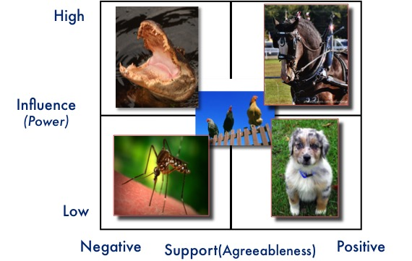
Highlights
Technical versus adaptive challenges:
  In line with key message that UHC requires technical and political solutions
  LDP makes participants think about technical vs adaptive UHC challenges; importance that they require different skills and approaches
Stakeholder analysis / sculpting
  many of us know the typical force field analysis;
  LDP goes a step further using ‘SCULPTING’ combining kognitive, intuitive and creative elements

Slide 9
System Sculpting: Steps
SEEK with YOUR HANDS
Vision / Presence
In this model, what is the old that should end?
What is the new, wanting to be born, to emerge?
START HERE!
Appreciation / Feeling
What do you appreciate in this model?
What gives you frustration (what causes energy to b e lost)?
Perspective / Insight
What are the systemic barriers that lock us into the current way of operating?
Truth / Practicality
What are the hard truths we need to face, even if we want to change the system we work in?
Life is full of opportunity to be narrow and small. We invite you to be BIG and BOLD!
Adapted from Cliff Barry and Tom Daly
9
Notes:
Examples of incisive questions
How did this happen?
What else happened?
What do you think?
What else? Tell me more.
What would success look like?
When will you know that you have succeed?
How would you act if you had no limitations?
What questions do you hold?
Why do you think this matters?
Are you ready for success?
What assumptions do you hold?
What would you do if you had all the powers in the world?
Where might you go to learn about this challenge?
What do you think you will know in future?
What do you notice?
And then?
Who else matters in this issue?
What are you afraid of?

Slide 10
Highlights
HF Strategy Master Class
  Linking LDP content with HFS process: joint reflections on meaning of strategy and multi-sectoral approach in context of newly aquired skills
  Country level HFS process:
    what is the personal connection?
    What would you do different in terms of stakeholder involvement and “listening”?
    What are the technical and what are adaptive issues?
    What are the main strategic options that require stakeholder analysis and consensus building?
    What would you need to let go and what needs to come?
    ...

Slide 11
Highlights
Collective Action Initiatives
  Learning at its peak when right away applied!
  Building teams and creating additional energy
  CAIs are concrete entry points to positively influence (HFS) processes; not meant to ‘take over agendas’ or ‘plan outside the country’
  LDP makes participants think about technical vs adaptive UHC challenges; importance that they require different skills and approaches

Slide 12
Technical Problems vs. Adaptive Challenges
Technical Problems | Adaptive Challenges
1. Easy to identify | 1. Difficult to identify (easy to deny)
2. Often lend themselves to quick and easy (cut-and-dried) solutions | 2. Require changes in values, beliefs, roles, relationships, & approaches to work. Implies learning.
3. Often can be solved by an authority or expert | 3. People with the problem do the work of solving it
4. Require change in just one or a few places; often contained within organizational boundaries | 4. Require change in numerous places; usually cross organizational boundaries
5. People are generally receptive to technical solutions | 5. People often resist even acknowledging adaptive challenges
6. Solutions can often be implemented quickly – even by edict | 6. “Solutions” require experiments and new discoveries; they can take a long time to implement and cannot be implemented by edict
Source: Adapted from Groupsmith
Notes:
The contrast between technical problems and adaptive challenges is well illustrated in the table under six main dimensions: problem identification, easiness of resolution, use of authority, nature and magnitude of the change, and people’s willingness to address the challenges and change values and beliefs. In sum, adaptive challenges demand shifts in mind sets, for the people facing the challenge to recognize they are part of the problem and to “own” it. It’s a process that requires learning.
“The most common cause of failure in leadership is produced by treating adaptive challenges as if they were technical problems.”
Technical problems
May be very difficult and critically important;
Often have a known solution that can be implemented with current know-how.
They can be resolved through application of expertise and through organization’s current structures, procedures, and ways of doing things.
Adaptive challenges
No adequate response has yet been developed.
They require learning to overcome the conflicts in values, or reduce the gap between the espoused values and reality.
They require changes in values, attitudes or habits of behavior.

Slide 13
Critical issues
Participant mix:
  Critical mass of high level and balanced representation across key sectors / stakeholders for effective change
  Role of P4H members in the selection of participants and follow-up
Effective link to ongoing (P4H supported) country processes
  CAI can add value to HFS process;
  Role of P4H members to foster synergies
Notes:
CAI examples: UGA – multi-stakeholder dialogue; Zambia : communication of SHI approach

