Slide 1

How is equity accounted for in
ILO’s approaches towards UHC?
Dr Xenia Scheil-Adlung
Health Policy Coordinator
International Labour Organization
Geneva
P4H Meeting, 3-4 Februrary 2015, Bangkok, Thailand

Slide 2
Overview
What are the issues behind inequities?
Addressing inequities through national social protection floor policies
Equity and universality
P4H Meeting, 3-4 Februrary 2015, Bangkok, Thailand

Slide 3
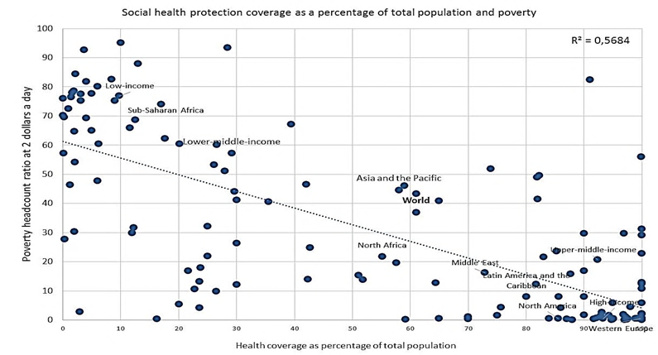
Equity requires rights resulting in affiliation to a scheme or system
:
Legal coverage by poverty rate
ILO, 2014
P4H Meeting, 3-4 Februrary 2015, Bangkok, Thailand

Slide 4
Equity requires a sufficient number of skilled health workers ensuring quality
(ILO threshold 41.1 health workers per 10,000 population in 2014)
Deficit Africa:
2.8 million
Deficit Asia:
7.1 million
Deficit Latin America:
391 thousand
Deficit Europe:
4.3 thousand
Deficit Oceania:
27 thousand
Global deficit:
10.3 million health sector jobs
P4H Meeting, 3-4 Februrary 2015, Bangkok, Thailand

Slide 5
Adequate benefits must be available in all urban and rural areas
Geographical inequities in legal coverage
between rural and urban areas (ILO 2015)
Differences in rural/urban distribution of health workers and resulting population coverage gaps towards UHC
Top 10 countries with lowest rural/urban SAD (excluding countries with zero deficit) | Top 10 countries with lowest rural/urban differences in SAD (excluding countries with zero deficit) | Bottom 10 countries with highest SAD | Bottom 10 countries with highest rural/urban differences in SAD
Guatemala | China | Somalia | Timor-Leste
Turkey | Costa Rica | Guinea | Nigeria
Dom. Republic | Thailand | Niger | Bolivia
China | Dominican Rep. | Chad | Lao’s
Namibia | Jamaica | Ethiopia | Peru
Belize | Guyana | Liberia | Morocco
Vietnam | Belize | Haiti | Yemen
Colombia | Vietnam | Burundi | Turkey
Costa Rica | Nicaragua | Cen. Af. Rep. | Zambia
Thailand | Colombia | Tanzania | Kenya
  Staff access deficit (SAD): Per cent of the population without access to health care due to the absence of the health workforce (Threshold: 41.1 health workers per 10,000 population)
P4H Meeting, 3-4 Februrary 2015, Bangkok, Thailand

Slide 6
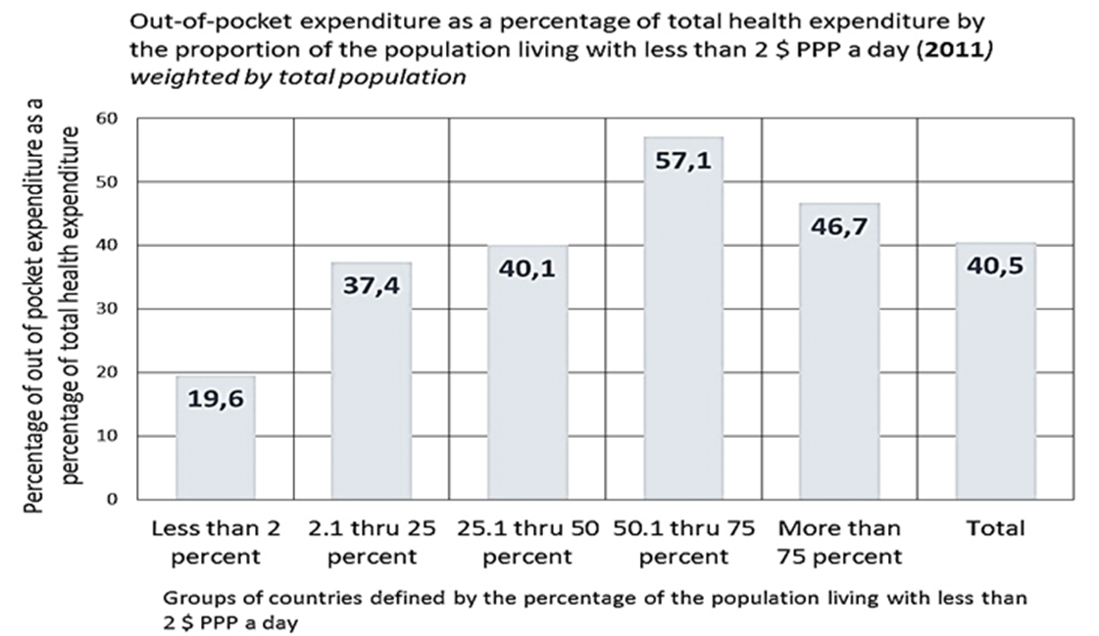
Equity requires affordability and financial protection…
Out-of-pocket payments by country level of poverty
Latest available year
ILO, 2014
P4H Meeting, 3-4 Februrary 2015, Bangkok, Thailand

Slide 7
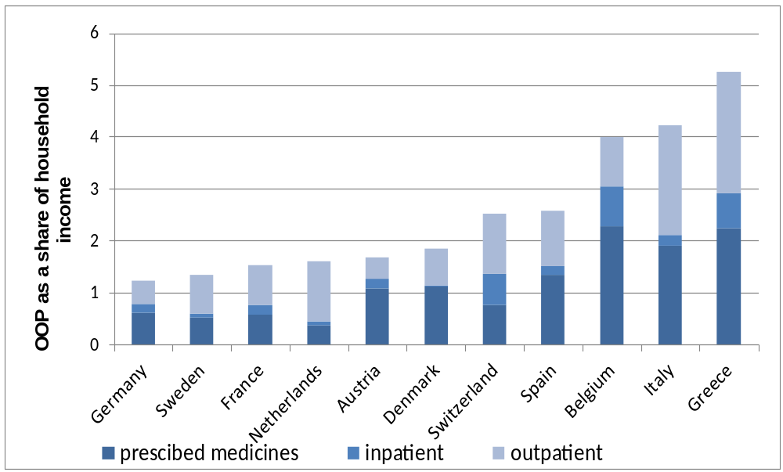
… for everybody and everywhere
Age-related inequities
Income effects of OOP among the 50+
(ILO 2006)
P4H Meeting, 3-4 Februrary 2015, Bangkok, Thailand

Slide 8
Equity requires a sufficient scope of benefits
                Percentage of elderly households paying more than 100 % of income on health expenditure,
                in selected European countries with universal coverage, 2004
                ILO 2013
P4H Meeting, 3-4 Februrary 2015, Bangkok, Thailand

Slide 9
Where are we with equity at global level?
Rights / Legislation
Quality
Availability
Financial
Protection
Affordability
Source: Universal Health Protection: Progress to date and the way forward. International Labour Office, Social Protection Department. Geneva: ILO, 2014.
P4H Meeting, 3-4 Februrary 2015, Bangkok, Thailand

Slide 10
What are the issues behind inequities?
Addressing inequities through national social protection floor policies
Equity and universality
P4H Meeting, 3-4 Februrary 2015, Bangkok, Thailand

Slide 11
Systemic issues resulting in inequities in access to health care
Affordability
of care
Gaps in financial protection e.g. OOP, transport costs
Availability
of services and benefits
Gaps in benefit packages
Lack of health infrastructure and health workers
Financing and resource generation
Under-funding
Gaps in burden sharing and risk pooling
Policy coordination
Absence of coordinated policy approaches for health and other social and economic sectors e.g. labour market and social security
Socio-economic factors
Deficits in poverty alleviation and income support
Labour market policies facilitating job creation and transition from informal to formal labour markets
Inequities due to gender, age, migration, ethnics
Issues within the health sector Issues beyond the health sector
P4H Meeting, 3-4 Februrary 2015, Bangkok, Thailand

Slide 12
Global impacts on equity in access to health care
Global and national policies used to address the past financial and economic crises
Current financial policies, exchange rate developments, threats of depts in EU countries including Grexit and petrol prices impacting on global and national economic growth (EU, China, LA, USA)
Geopolitical crises
result in inequities due to
Household level
Changes in employment status and informalization of work
National level
Budget cuts on social (health) protection programs, e.g. reductions in benefit packages, increased co-payments, wage bill cuts of health workers
Income reductions
Budget cuts on social protection programs e.g. for the chronically poor
Increased expenditure (food, housing, health care)
Increase in overall poverty and unemployment
P4H Meeting, 3-4 Februrary 2015, Bangkok, Thailand

Slide 13
What are the issues behind inequities?
Addressing inequities through national social protection floor policies
Equity and universality
P4H Meeting, 3-4 Februrary 2015, Bangkok, Thailand

Slide 14
Achieving equity through national social protection floors
ILO Recommendation 202:
Proving for basic guarantees to prevent and alleviate ill health, poverty, unemployment and other vulnerabilities through health and income support
Ensuring coverage in Addressing gaps in coverage and access to
health protection income support
Universal access to preventive and curative health care
Income security at poverty level for all children to access education, health, housing
Social assistance for the poor and unemployed in working age groups
Income security at poverty level for those in old age, invalidity and survivors securing access to needed services
Everyone should have
  - The right to be affiliated to a health scheme or system
  - Guaranteed access to at least essential quality health care that is available, affordable and financially protected
P4H Meeting, 3-4 Februrary 2015, Bangkok, Thailand

Slide 15
Components, principles and criteria of equitable access to health care in the context of national social protection floors
ILO Recommendation 202 on National Social Protection Floors)
Health protection
Universal access to nationally defined, at least essential benefits including preventive and maternal care for all citizens and children;
Consist of an in-kind and in-cash component
Are based on key principles …
Rights-based;
Universal;
Equitable;
Solidarity in financing;
… and criteria
Affordable;
Available;
Of sufficient quality;
Financially protected
P4H Meeting, 3-4 Februrary 2015, Bangkok, Thailand

Slide 16
ILO’s comprehensive approach to address access inequities within National Social Protection Floor Policies
1. Ensuring coverage and access to health protection
Inclusive legislation
Health protection
Fair financing
Universal social protection
Labour market policies
Other policies
Extending coverage through inclusive rights-based approaches, non-discrimination and equity re informal economy workers, rural areas, ethnicities, etc.
Financial protection of at least essential quality benefits that are available and affordable for all
Fair burden sharing and solidarity in financing using taxes, contributions and minimizing OOP
Focus on income support, poverty prevention and alleviation
Ensuring income generation from formal work enabling tax/contribution payments for health
Ensuring policy coordination and coherence of developmental, economic, social and health polices to achieve poverty alleviation and UHC
Support disadvantaged groups and people with special needs
Setting priorities on national consultation
2. Addressing poverty and ensuring access to income
P4H Meeting, 3-4 Februrary 2015, Bangkok, Thailand

Slide 17
Summary
1. Root causes of inequities relate to
  Gaps in legislation, design and financing of health protection
  Social and economic policies and status of the vulnerable
2. Addressing these issues in the context of social protection floor policies can be achieved by:
Reducing poverty and social exclusion
Increasing legal coverage through coordinated social protection schemes, extending risk pooling and ensuring equitable access
Extending coverage and effective access in social health protection
Increasing (formal) labour market participation of the vulnerable
Providing an essential level of cash and in kind benefits
Making prevention and curative care affordable and available
Addressing social and economic determinants of inequities in access:
Increasing policy coherence
Developing coherent social, economic and labour market policies
P4H Meeting, 3-4 Februrary 2015, Bangkok, Thailand
Notes:
17

Slide 18
Thank you !
scheil@ilo.org
P4H Meeting, 3-4 Februrary 2015, Bangkok, Thailand

