Slide 1


Equity in German Development
Cooperation (BMZ/giz/KfW)
Health/Social Protection Programmes

Slide 2
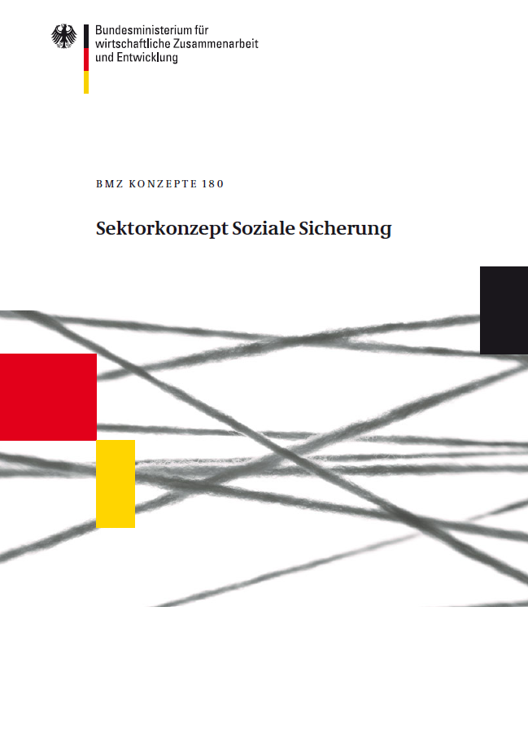
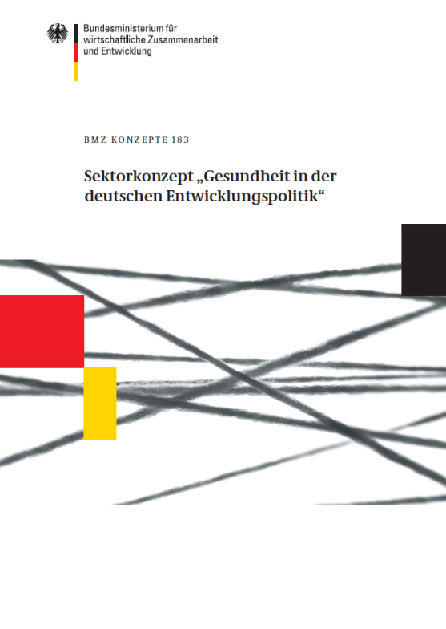
Conceptional foundations
Notes:
Of course our point of departure is the right to social security as enshrined in the universal declaration of human rights and several other international treaties.

Slide 3
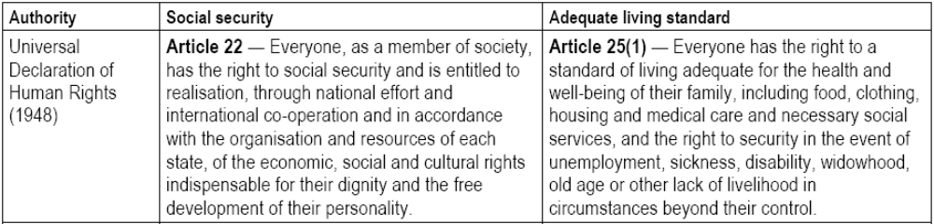
Conceptional foundations…
Universal Declaration of Human rights
Article 12 of ICESCR
Available, accessible, acceptable and of quality
Notes:
Of course our point of departure is the right to social security as enshrined in the universal declaration of human rights and several other international treaties.

Slide 4
Principles and values of GIZ advisory services
Germany the country with the first statutory Social Security system
No ‘blueprints’, context adapted advisory services
Principles
Social Market Economy Systemische Herangehensweise
Objective: comprehensive and inclusive social protection system reaching out the very poor and vulnerable
Values shaping the system: Universal Access, Solidarity, Fair Financing, Subsidiarity, Autonomy

Slide 5



