Slide 1
Equity in Development Partners’ support on health financing in Lao PDR
P4H Meeting
Content:
Background
DPs on health financing
Equity in DPs’ support for health financing
Discussion

Slide 2
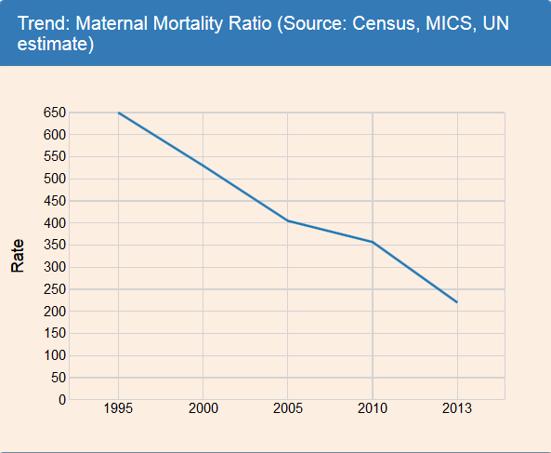
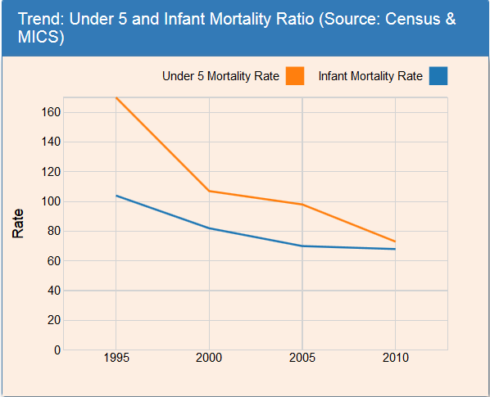
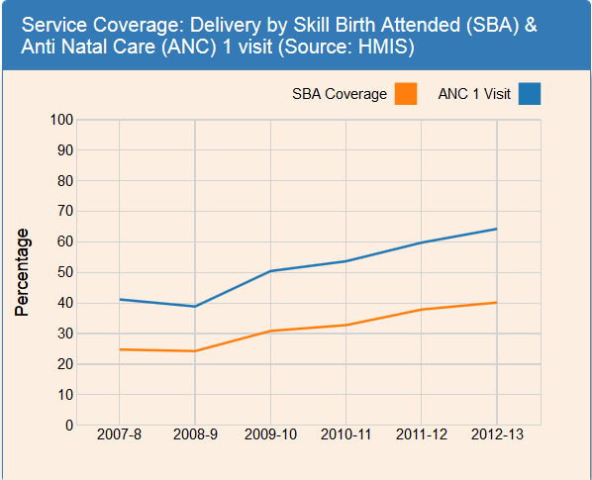
Health indicators
1. Background
Poor health indicators
…. with constant improvement

Slide 3
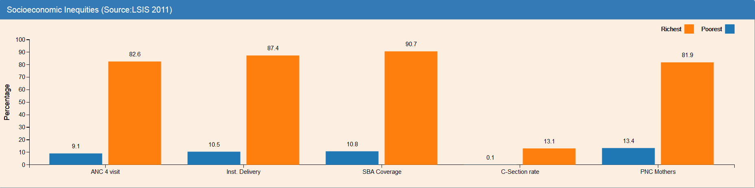
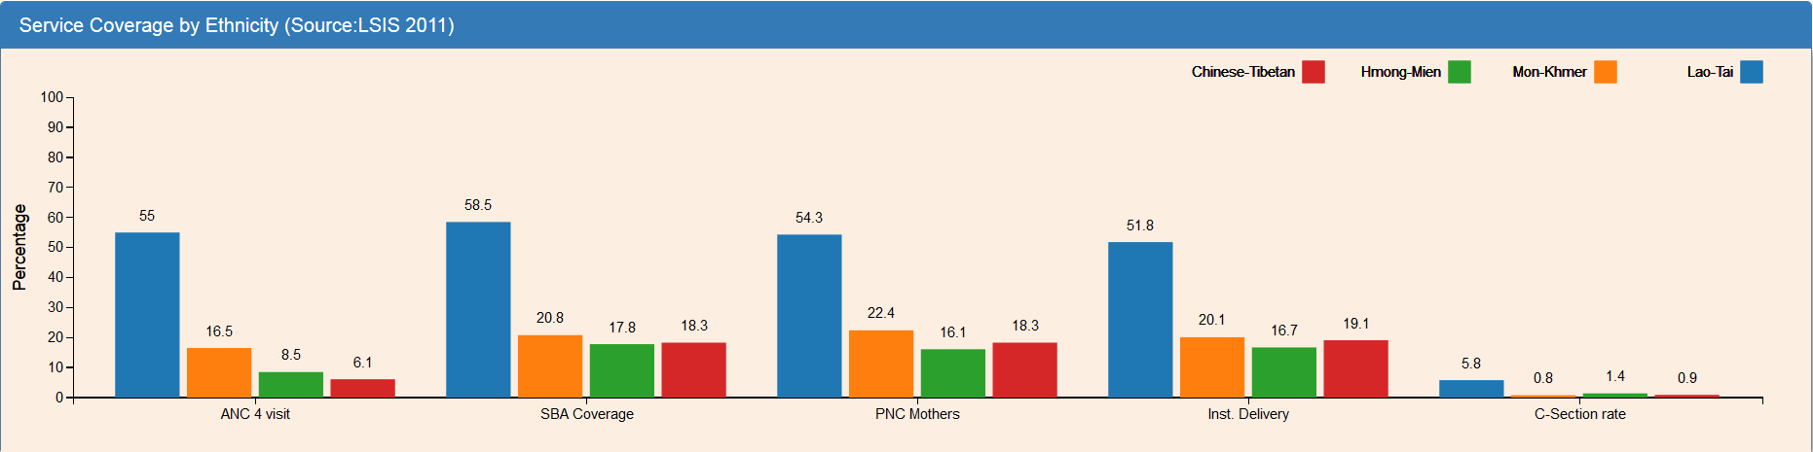
Inequity
1. Background
By socio-economic status
By ethnic group

Slide 4
Health Financing in Lao PDR
1. Background
~30$/cap – 50% in OOP
Very low domestic funding but high increase in past 2years (0.5%=>1% GDP; 3%=>6-9% Domestic GGE) *
High External support for public health: 25-35%
Low social health protection coverage (24%*) with challenges to cover the informal sector and even to enforce enrolment for private employees
Context:
  Decentralization; Financial crisis since 2013,
  Increasing inequities and corruption
  Limited service delivery/performance/quality of public health system

Slide 5
Health Sector Reform
1. Background
HF Policy in Lao PDR
Health Financing Strategy
Phase 1(2013- 2015):
To achieve MDG targets
Phase 2 (2016-2020):
To improve access to basic health care and financial protection
Phase 3 (2021 – 2025):
To reach UHC
Increase investment in public health, esp. from domestic source
Increase allocation to PHC at district level, focus on the poor
Increase Social Health Protection
Strengthen capacity in health financing
Mainly pushed by Government and DPs agenda (Dvpt Correct / Not exclusive)

Slide 6
DPs on health financing
2. DPs in HF
Many DPs (multilateral, bilateral, INGOs)
Specific focus: comprehensive PHC support, sub-sector support, Socio-health protection, NHA/Costing..
Various coverage: national, province-wide, districts
Various schemes: supply funding, free national programs, SHI, HEF, Free MNCH, RBF for Quality–Preventive, CCT
Various modalities: Budget support (EC-WB), Program (ADB), MOH projects (WB, WHO, Unicef), TA (WHO, ILO), Provincial support (Luxemburg), Projects (NGOs)
Concentrated technical support mainly at central level
No match between HF DP support and the very limited technicians on HF/SHP (~50% in training/meetings)

Slide 7
2. DPs in HF
Health Financing specific
 | What * |  |  |  |  |  |  |  |  |  |  | Where | How
Focus | Supply |  | Selective focus |  |  |  | Social Health Protect. |  |  |  | Policy
 | PHC subs | Nat. Prog | FreeMAT | FreeCU5 | PFP | PFQ | Poor HEF | Infor CBHI | Infor CHE | Formal SHI | TA
MOH | X | X | X | X | X |  | X | X | x | X |  | Country | Program
ADB | X |  |  |  |  |  | X |  |  |  | X | North=> all? | Program
WB | x |  | X |  | X | X |  |  |  |  |  | South=> all? | Project/Progr
Luxemburg | X | X | X |  | x |  | x |  |  |  |  | Provinces | Province
ILO/WHO |  |  |  |  |  |  |  | X |  | X | X | District | TA+ Project
KOFIH/WHO |  |  | X |  |  |  |  |  |  |  |  | Province | TA+ Project
EC/WHO |  |  |  |  |  |  | x |  |  | x | X | District | BS+ Project
JICA |  |  |  |  |  |  |  |  |  |  | X | Province | TA + Project
Un fpa/icef | X | X |  |  |  |  |  |  |  |  |  | Country/Pro | Nat. Progr
GF, USAID.. |  | X |  |  |  |  |  |  |  |  |  | Country | Nat. Progr.
GAVI |  | X | x | x |  |  |  |  |  |  |  | Districts | Project
SCI/CARE.. | X |  |  |  |  |  |  |  |  |  |  | Province | Projects
SRC | X |  | x | x |  |  | X |  | x |  | X | Province | Projects TA

Slide 8
DPs collaboration
2. DPs in HF
Improving collaboration / coordination mechanisms among Gov’t-DPs and within DPs
  Official Sector Wide Coordination (Working Groups, Technical WG, Task Forces) led by Gov’t/WHO/JICA;
  New DPs group
  INGO network
  (CCM GF)
  Joint projects: ILO/WHO, EC/WHO, UN/Luxbg
  Sub-contracts: MOH/WB-SRC…
  Regular unofficial collaboration
  Joint monitoring – programs (?): ADB-WB
  No P4H

Slide 9
Equity in DPs support (health financing)
3. Equity DPs support
Various results (no robust assessment):
  Supply: Continuous support to ensure PHC/MNCH service delivery at district level strongly increases MNCH indicators, health systems performance/ownership (SCI); ensure first funding of routine immunization, nutrients is fundamental (Unicef)
  HEF: When managed/monitored proactively with clear targeting (HH poor card or village targeting), HEF for poor can increase access to curative services for the poor (2-3x increase, poor use more than non-poor, distance barrier reduced*) but less for delivery, not for preventive services, nor guaranty of quality; Village targeting increases very significantly the utilization of curative services (but also unnecessary utilization) and requires control of overuse for OPD/observations prone to cheating (MOH/SRC-WB)
  HEF in a passive government led setting under govt list of HH targeting without card can be expanded fast, well integrated in government system and be a cheap pro-poor subsidy to local facilities. But it may not be enough to really prevent catastrophic health expenditure (MOH/ADB, MOH/Govt)

Slide 10
Equity in DPs support (health financing)
3. Equity DPs support
Various results (no robust assessment):
  Free Maternity : slower uptake than for curative services; money is not the main barrier for delivery; supply factors more important (presence of midwife, trust, perceived quality, language, traditions); unequal results poor (20%) vs non-poor (40%) capture of funds by the non-poor; bypassing of lower level (MOH-WB, MOH-WHO) *
  => From universalism to targeting? (free for all only at district level +
  referrals; in towns free only for poor; Food/Transport only for poor)
  Free CU5: seem to boost consultations for non-poor and poor; slow increase of admissions/surgeries (MOH-SRC/WB)
  CBHI: failure or stagnation (collection issue, small pools, adverse selection, risk on provider, underservicing, vicious circle) ; 50% subsidies about to be tested by MOH-ILO/WHO in one pilot district
  Formal SHI: fast extension to civil servants, low enrolment of private companies (poor enforcement), big push/rationale for merging but risk of unintended consequences (merged reserve, pension), providers and insured not fully on board

Slide 11
What HF interventions?
4. Discussion
1. In context of Laos, to improve equity in health, what is the right mix & acceptable trade-off in terms of focus on:
Improve the health service delivery supply at local level (functioning PHC)
Improve access to the poor (HEF)
Also subsidize for non-poor/catastrophic expenditure
Improve access to specific priorities (Free MNCH, pay for preventive services, etc)
Improve the quality of services (PBF-Pay for Quality)
2. No agreement on Universalism at local level or Targeting
3. Sum of parallel strategies can be detrimental (absorption, HR, perverse effects, competition, complexification…).
4. Too advanced HF strategies for the level of service delivery?

Slide 12
How?
4. Discussion
The “how” to provide support may have as much importance as the “what”?
Institutionalization: Budget support vs Program vs Project
Predictability, timeliness, flexibility, simplicity and accountability of funding
Cost of change in approaches
Subsidy + proximity technical/management support

Slide 13
DP Collaboration
4. Discussion
Optimal DP Collaboration?
Real move by DPs towards real joint collaboration in health funded interventions (e.g. WB-ADB, DPs informal meetings..)
Still key differences on philosophic, process, technical/internal DP constraints
Time consuming collaboration/info sharing with still limited operational synergies
Competing for limited HR, time and government funds
~ DPs agreement on “what” but not yet on the priority entry points, the steps and “how”. No clear messages to MOH & MOF (Policy = sum of DPs priorities and Government agenda)

Slide 14
Support slides

Slide 15
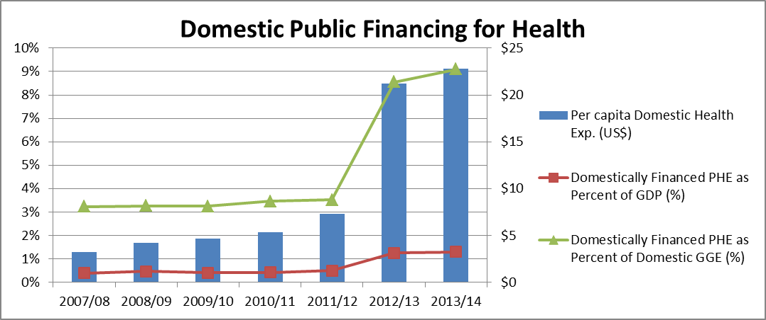
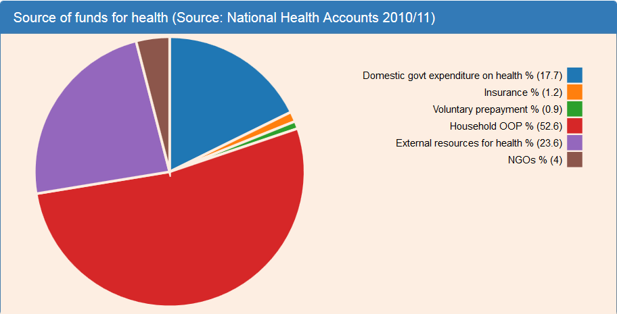
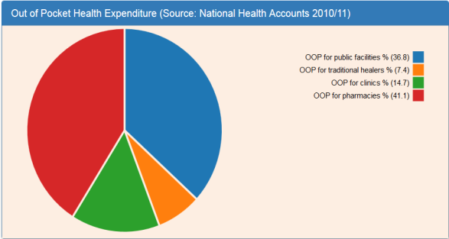
Health Financing *
Decentralization
Financial crisis since 2013

Slide 16
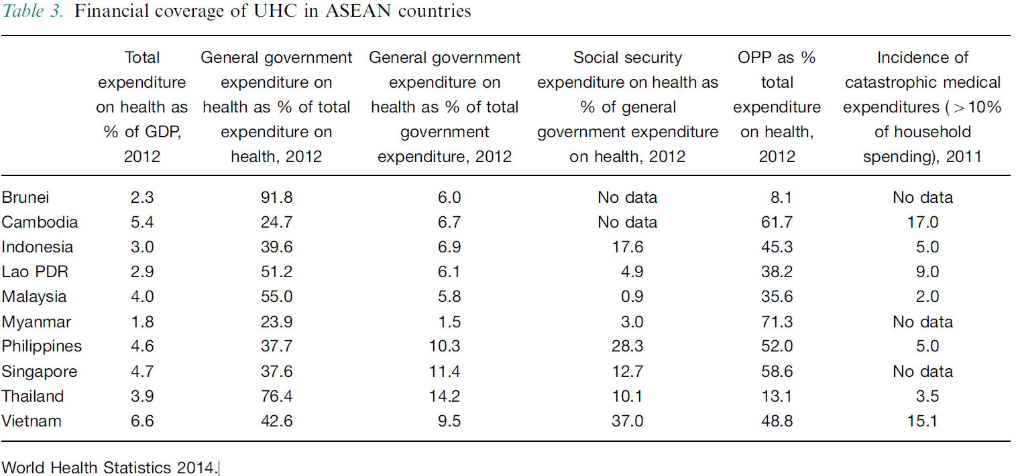
Health Financing *

Slide 17
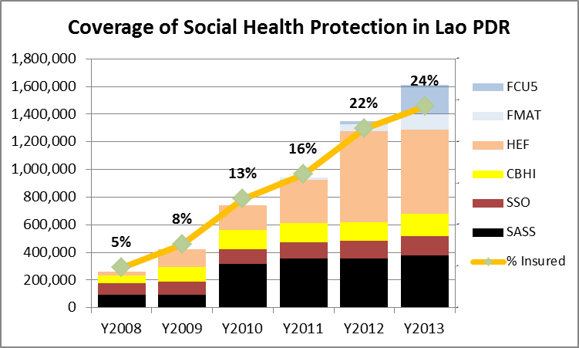
Social Health Protection Coverage *
Excluding Police/military

Slide 18
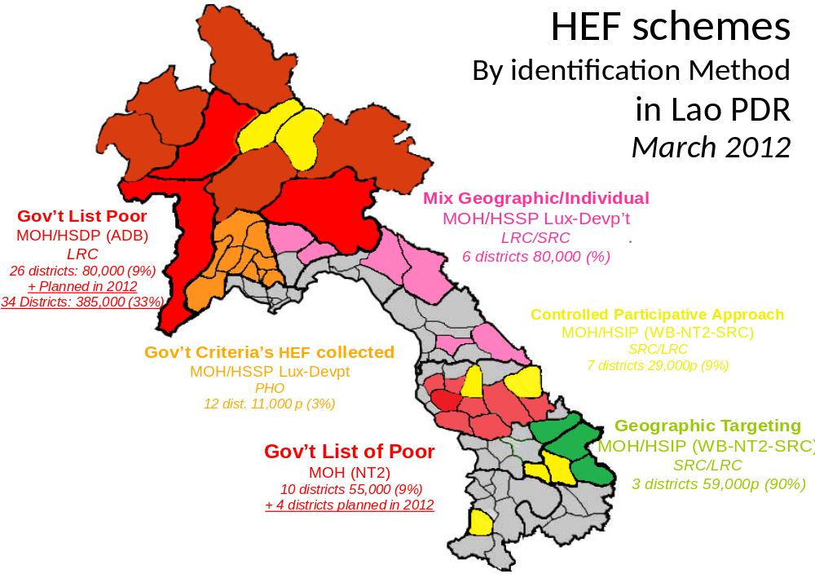
HEF *

Slide 19
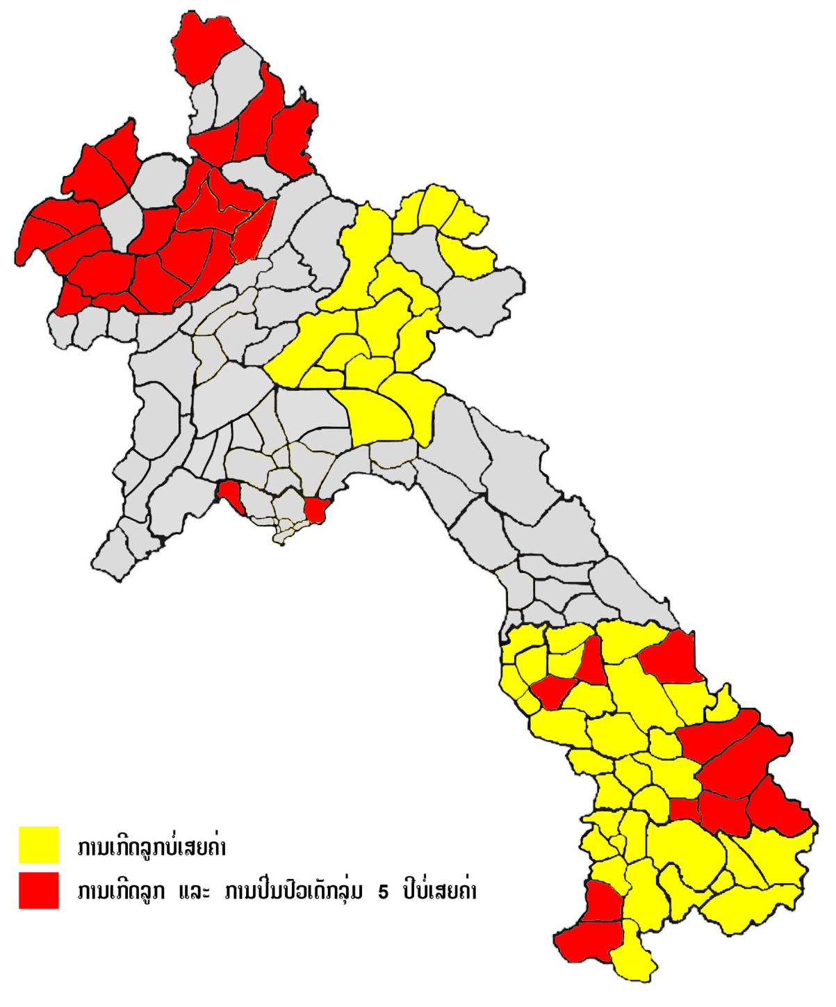
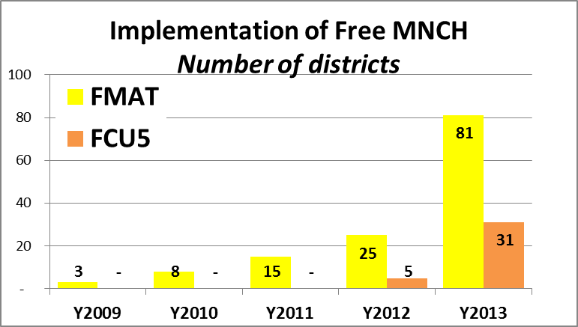
Free MNCH Implementation by end 2013 *
FMAT: 81 districts (110,290 PW = 59%)
FCU5: 31 districts (167,612 CU5 = 20%)
FMAT only
FMAT + FCU5

Slide 20
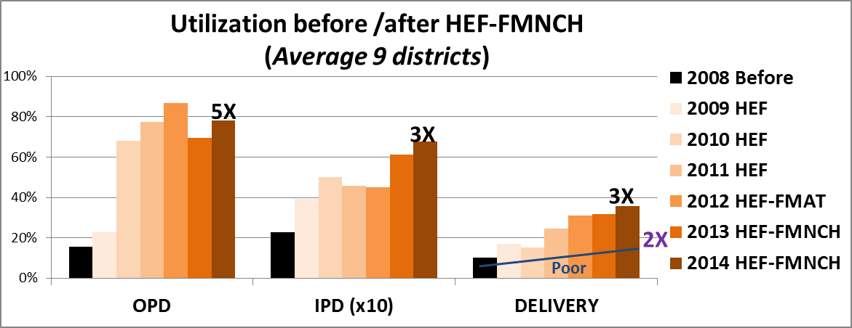
HEF implementation in 9 districts 2009-14 *
Notes:
What are the results?
Implementation is still recent starting mainly 2-3 years ago.
By providing free services, one can observe an increase of delivery in facility from 10 to 30%
However, the increase is much less automatic than for the curative services. Indeed, the graph showed that by providing free curative services (OPD, IPD, Surgery for the poor), utilization directly increased sharply.
For delivery, money is not the main barrier. Supply factors are more important (presence of midwife, trust, ethnics,..)
SRC/LRC had to focus on the promotion, the proximity contact with women to see utilization increase (as shown on the first graph)
Free Maternity for all is not always the panacea and shows unequal results between the rich and the poor. Here you see that the non-poor deliver 4x more in facilities than the poor.

Slide 21
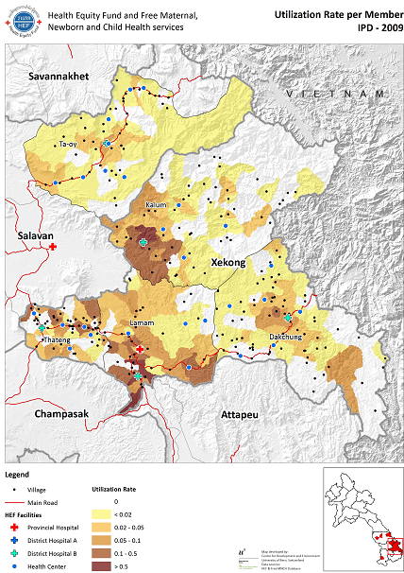
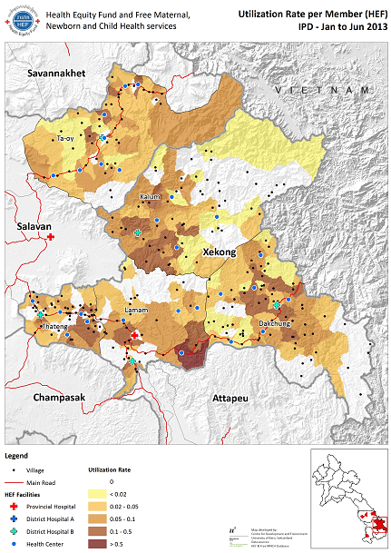
HEF *
IPD 2009 IPD 2013
Country avg excluding Vientiane whole pop.: 0.06 (incl HC Observ)

Slide 22
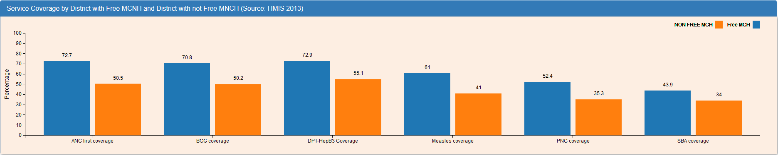
Free MNCH *
FMNCH seems to improve MNCH coverage
Continuous strong PHC/MNCH support without FMNCH seems to have an even greater “impact”: key MNCH indicators ~3 times better than the national average (SCI) but requires more time, more structural & integrated approach, less a “quick fix”

Slide 23
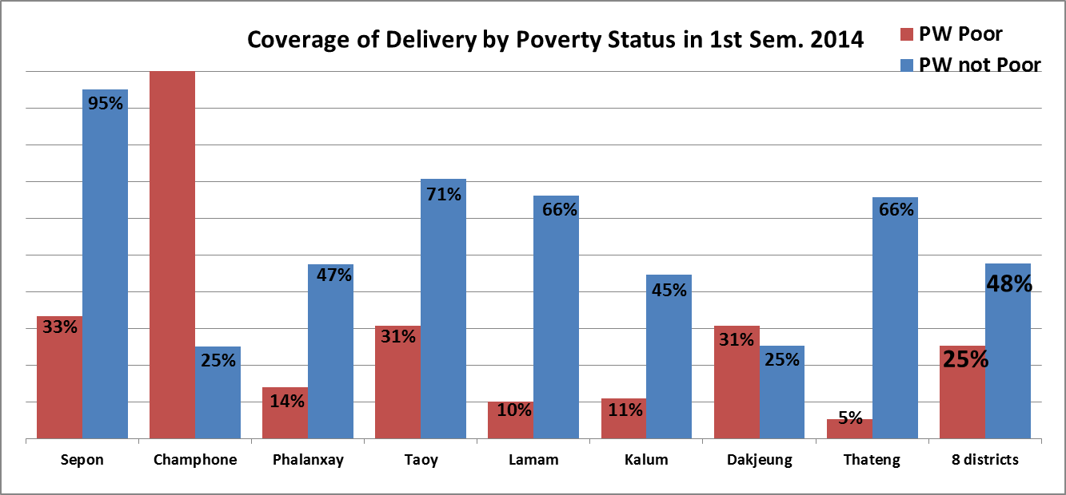
Free Maternity *
Unequal results between Poor and Non-Poor.
Non-Poor deliver ~2x more than Poor at public facilities (39% vs. 22%)
“Free Delivery for all” logically profits more the Non-Poor
Notes:
What are the results?
Implementation is still recent starting mainly 2-3 years ago.
By providing free services, one can observe an increase of delivery in facility from 10 to 30%
However, the increase is much less automatic than for the curative services. Indeed, the graph showed that by providing free curative services (OPD, IPD, Surgery for the poor), utilization directly increased sharply.
For delivery, money is not the main barrier. Supply factors are more important (presence of midwife, trust, ethnics,..)
SRC/LRC had to focus on the promotion, the proximity contact with women to see utilization increase (as shown on the first graph)
Free Maternity for all is not always the panacea and shows unequal results between the rich and the poor. Here you see that the non-poor deliver 4x more in facilities than the poor.

