Slide 1
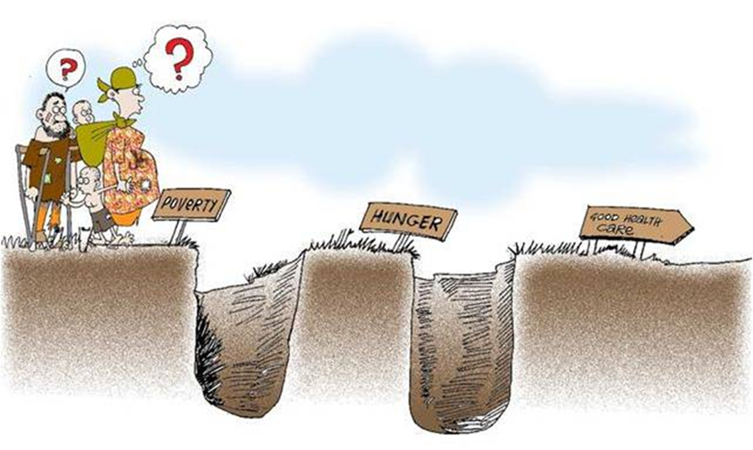

SDC experience in working with the private sector in Chad

Slide 2
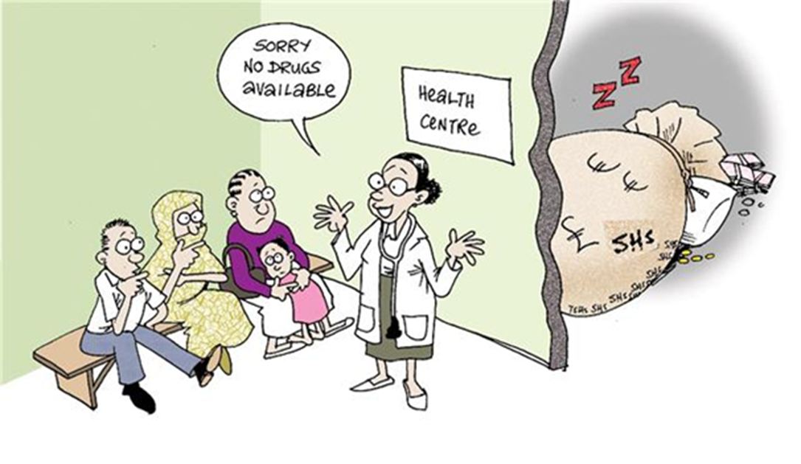
What Private Sector?
Private FBO (& few public) health facilities
NGO for implementation of mutuelles
Vision of a community based network

Slide 3
«Mutuelles de santé»
1st Phase 2011-13
Aim
Increased access to quality service
Objective
Promote organisations
  with participatory governance,
  supported by professional management,
  and set up in a network.
  13 Mutuelles in 5 southern districts

Slide 4
End of Phase External Review
Achievments
  Structure & systems developed
  Awareness among population increased
  Individual capacities developed
Challenges
  Limited coverage (~7% in responsibility zone)
  Limited re-enrollment (~49%)
  Limited enrollment of the poor
  Quality of services (public/private)
  Limited interest of District Health Authorities
  Limited ownership by BELACD
  Free emergency care (2007) + RBF

Slide 5
Phase 2: 2014-16
5 southern districts
Coordination with district HS strengthening programme => Engage with district health authorities
Clarify legal framework
Method for inclusion of poor
Include free service and RBF experiences
Feed into the definition of the national UHC strategy => with P4H support

Slide 6
Conclusions & Open Questions
The objectives of Govt & NGO are unrealistic.
UHC can’t be achieved through a voluntary community based scheme.
What can the Govt & Partners learn from this experience, and how?
How to build on what is existing (free service, RBF, Mutuelles)?
How to overcome the suspicion of the Govt towards the private sector?
Where to concentrate our efforts?

Slide 7

Thank you for your attention!

