Slide 1
New approaches to advocate for domestic financing for health in Tanzania
Draft for consultation
HP+ Tanzania
October 2016

Slide 2

Objectives
Draft for consultation
Explore the context of international spending targets
Reflect on the impact they’ve had in Tanzania
Understand why increasing public spending is important
Propose potential new approaches specific to the Tanzanian context that could be more effective
2
Notes:
First bullet is reflected in slide 4
Second bullet is slide 5
Third bullet is slide 6 & 7
Fourth bullet is new approaches

Slide 3
Background

Slide 4
Draft for consultation
Several international spending targets have been proposed
2001
2009
2014
Abuja Declaration
Chatham House
Source
WHO
“We pledge to set a target of allocating at least 15% of our annual budget to the improvement of the health sector”
Amount of public spending on health as a % of GDP - captures both the priority given to health in budget allocations, and the fiscal context
5% of GDP may be insufficient for many LICs to fund universal PHC services, which is estimated to require at least $86 per capita (in 2012 USD)
Description
GGHE = $86 per capita, or GGHE = 5% of GDP (whichever is greater)
Measure
GGHE = 15% of GGE
GGHE = 5% of GDP
GGHE: General government health expenditure
GGE: General government expenditure
GDP: Gross domestic product
LICs: low income countries
PHC: Primary health care
4
Notes:
The Abuja Declaration of 2001 recommended that governments allocate 15% of their budgets to the health sector, although the basis for this figure is not clear, with no explicit connection to achieving a certain level of health system performance. - Source: Jowett et. al., Spending targets for health: no magic number, WHO, 2016.
WHO target is quoted in 2010 World Health Report

Slide 5

Draft for consultation
Spending targets appear to have limited impact on health budgets
Domestic health budget as a % of total govt. budget¹ and as a % of GDP²
Abuja target = 15%
GDP target = 5%
¹ Ministry of Finance and Planning, Tanzania. 2007/08-2016/17 Budget Volumes (as passed by National Assembly).
² International Monetary Fund, World Economic Outlook Database, April 2016 and HP+ analysis
CFS - Consolidated funds services, GGHE – General government health expenditure, GGE – General government expenditure
5

Slide 6
Draft for consultation
Resource gap is only projected to increase under HSSP IV
HSSP IV resource gap range, 2016-2020
Tanzania may face challenges in scaling up health programs and strengthening its health system given these funding gaps – advocating for greater public spending on health will become increasingly critical
¹ Barker, C., Dutta, A., Sustainability Implications for Tanzania’s Fourth Health Sector Strategic Plan, 2015/16–2019/20, Health Policy Project, Sept 2015
6
Notes:
Figure shows the potential range in the HSSP IV funding gap each year by comparing the HSSP IV costs to the three fiscal space scenarios (most optimistic scenario: SNHI implemented and innovative financing sources such as a proportion of alcohol and tobacco taxes allocated to health; middle scenario: no SNHI but with innovative sources, base scenario: no SNHI, no innovative sources). The estimated funding gap in 2015/16 is $660 million across all scenarios. Under the most ambitious fiscal space scenario, the funding gap will increase from $259 million in 2016/17 to $737 million in 2019/20. Without innovative financing sources or SNHI, the funding gap could be as large as $680 million in 2016/17 and grow to $1,172 million by 2019/20.

Slide 7
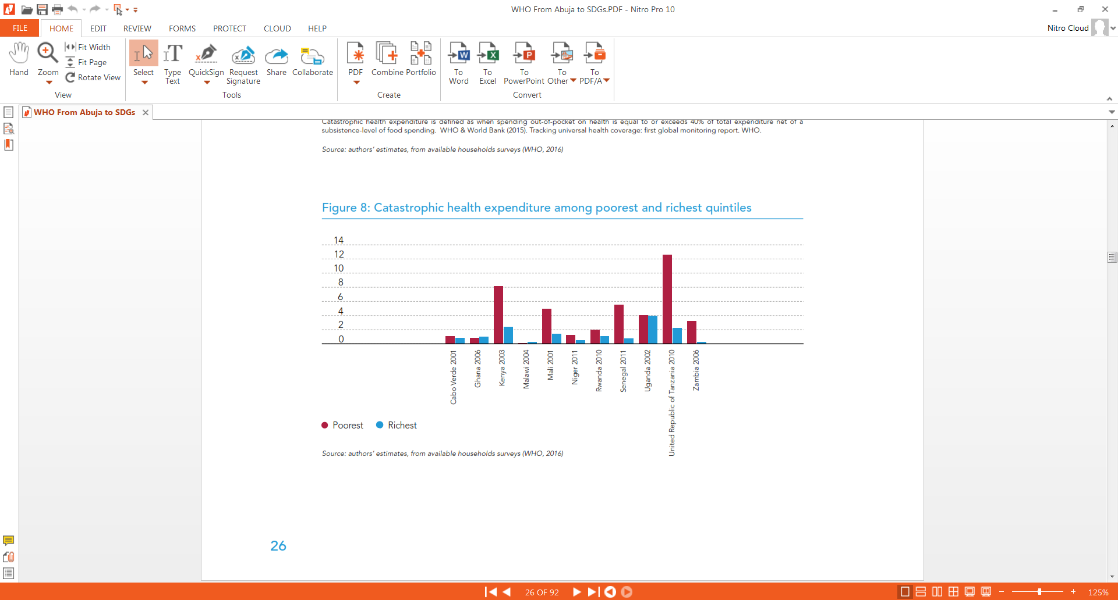
Draft for consultation
Increased public spending leads to improved financial protection
Catastrophic health expenditure among poorest and richest quintiles¹
14
12
10
8
6
4
2
0
% of quintile facing catastrophic
health expenditure
Ghana 2006
Kenya 2003
Malawi 2004
Mali 2001
Niger 2011
Rwanda 2010
Senegal 2011
Uganda 2002
Zambia 2006
Cabo Verde 2001
Tanzania 2010
Poorest 20%
Richest 20%
Cross-country evidence suggests that as public spending increases, there is convergence in UHC performance – initially service coverage improves and eventually so does financial coverage²
¹ Public Financing for Health in Africa: from Abuja to the SDGs, WHO, 2016
²Jowett et. al., Spending targets for health: no magic number, WHO, 2016
7
Notes:
Jowett paper found that service coverage improves first ($40-60 per capita), followed by financial coverage (>$200 per capita)

Slide 8
New approaches
Draft for consultation

Slide 9
Draft for consultation
Two main periods to advocate for greater public spending on health
Reporting and stakeholder consultations
Planning and budget formulation
Budget submission and review
Parliamentary debate and approval
MOF consultative meetings with revenue generating MDAs and Agencies, and key strategic Ministries
Submission of budget performance reports by MDAs, RSs, LGAs
Submission of plan and budget proposals to MOF
Parliamentary sub-committee review MTEF; Budget entry into IFMIS
National Budget Speech presented and debated; Budget voted into Law
July - August
September - October
November - January
February
March - April
May
June
Annual sector consultative reviews
Preparation of plans and budgets by MDAs, RSs, LGAs
Joint review of plans and budgets by MOF, PO-PC, MDAs, RSs, LGAs
Submission of final budget estimates to Cabinet; Production of Budget Book
Key advocacy window
Key advocacy window
Execution of Plan and Budget / Ongoing Monitoring and Evaluation
9

Slide 10
Draft for consultation
New approaches and suggested criteria for assessment
Four approaches
1
2
Prioritization of annual needs
(based on the current approach)
Focus on health sector targets
3
4
Meeting middle income commitments
Health as an investment
Criteria for assessment
Potential gain
Is the absolute and relative value of funding unlocked by this approach potentially significant?
Timeline / effort
Does the approach require customization each year, or consistent multi-year advocacy?
How complex is the approach and how much coordination is needed?
Appeal to MOFP
Does the approach communicate in terms that resonate with MOFP?
Does the approach link health spending to development more broadly?
10
Notes:
Are there other alternatives we should consider?

Slide 11
Draft for consultation
1
Prioritization of annual needs
Key characteristics
Input based
Operational
Short term focus
Assessment against criteria
Potential gain
Limited to specific asks that represent immediate needs, line item based and not linked to strategic goals
Timeline / Effort
Annual process, requires extensive donor/MOHCGDEC coordination and sustained effort
Appeal to MOFP
Limited, doesn’t highlight efficiencies, health outcomes or links to broader development goals
Methods
Pros and Cons
Development partners and civil society;
  individually prioritize their key budget concerns for the coming budget cycle
  meet to discuss their budget concerns and prioritize 2-4 ‘budget asks’
Analyses and advocacy briefs prepared to support budget asks.
Focused advocacy to GOT conducted for the priority ‘budget asks’
✓
Allows for customized approach each year
Opportunistic
Promotes communication between partners
Most aligned with MOH current methods and budgeting cycle
Wins are likely to be incremental rather than systematic
Not rooted in any specific framework
Line item based; not linked to outcomes
✓
✓
✓
✗
✗
✗
11

Slide 12
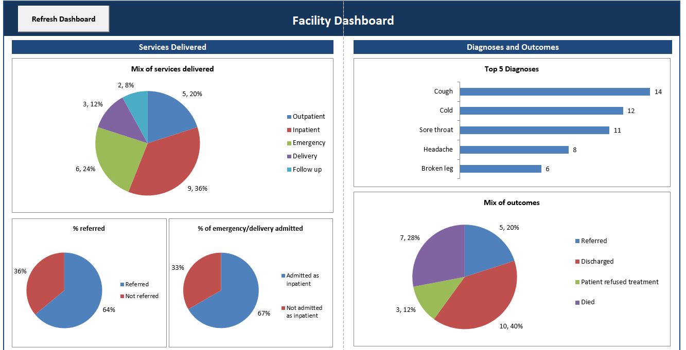
Draft for consultation
1
Prioritization of annual needs
Illustration of Impact
Improvements to this approach
For FY 16/17, new allocation of TZS 251.5 billion in the MOHCDGEC development vote, and a substantial portion was used to pay down MSD debt
However while the total health budget increased nominally it actually decreased proportionally relative to the prior year
Further disaggregation of MOH budget lines (e.g. salaries) may reveal arguments for investment due to shortages in specific cadres or regions
Further disaggregation of development budget can be used to increase budgets based on relative productivity and need;
  LGA level dashboards can be developed to illustrate this
New
LGA Dashboard
SAMPLE
Source: Lee, B., Dutta, A., et. al., Budget Analysis of the Government of Tanzania’s Ministry of Health, Community Development, Gender, Elderly and Children Fiscal Year 2016/17
12

Slide 13
Draft for consultation
2
Focus on health sector targets
Key characteristics
Outcome based
Strategic
Long term focus
Assessment against criteria
Potential gain
Significant, both for specific health areas (e.g. MCH) and for health systems goals (e.g. HRH and infrastructure investment)
Timeline / Effort
Significant upfront effort to prioritize intermediate outcomes and monitoring system, then an annual progress check and update
Appeal to MOFP
Limited, focused on national and international health targets and outcomes without linking to MOFP priorities
Methods
Pros and Cons
Link international health targets to national commitments (e.g. SDGs to Vision 2025)
Isolate intermediate outcomes that lead to topline indicators (e.g. 4+ ANC visits and SBA for MMR)
Develop dashboards to track progress against intermediate and final outcomes
Prioritize outcomes with lagging progress for budget advocacy work with GoT
✓
Tangible progress can be measured against well established targets
Promotes MOHCGDEC accountability for health outcomes
Allows for consistent multi-year advocacy
Relevant to the international community and external funding
Targets may not be fully owned by all stakeholders
Time lag in data collection, processing and availability
✓
✓
✓
✗
✗
13

Slide 14
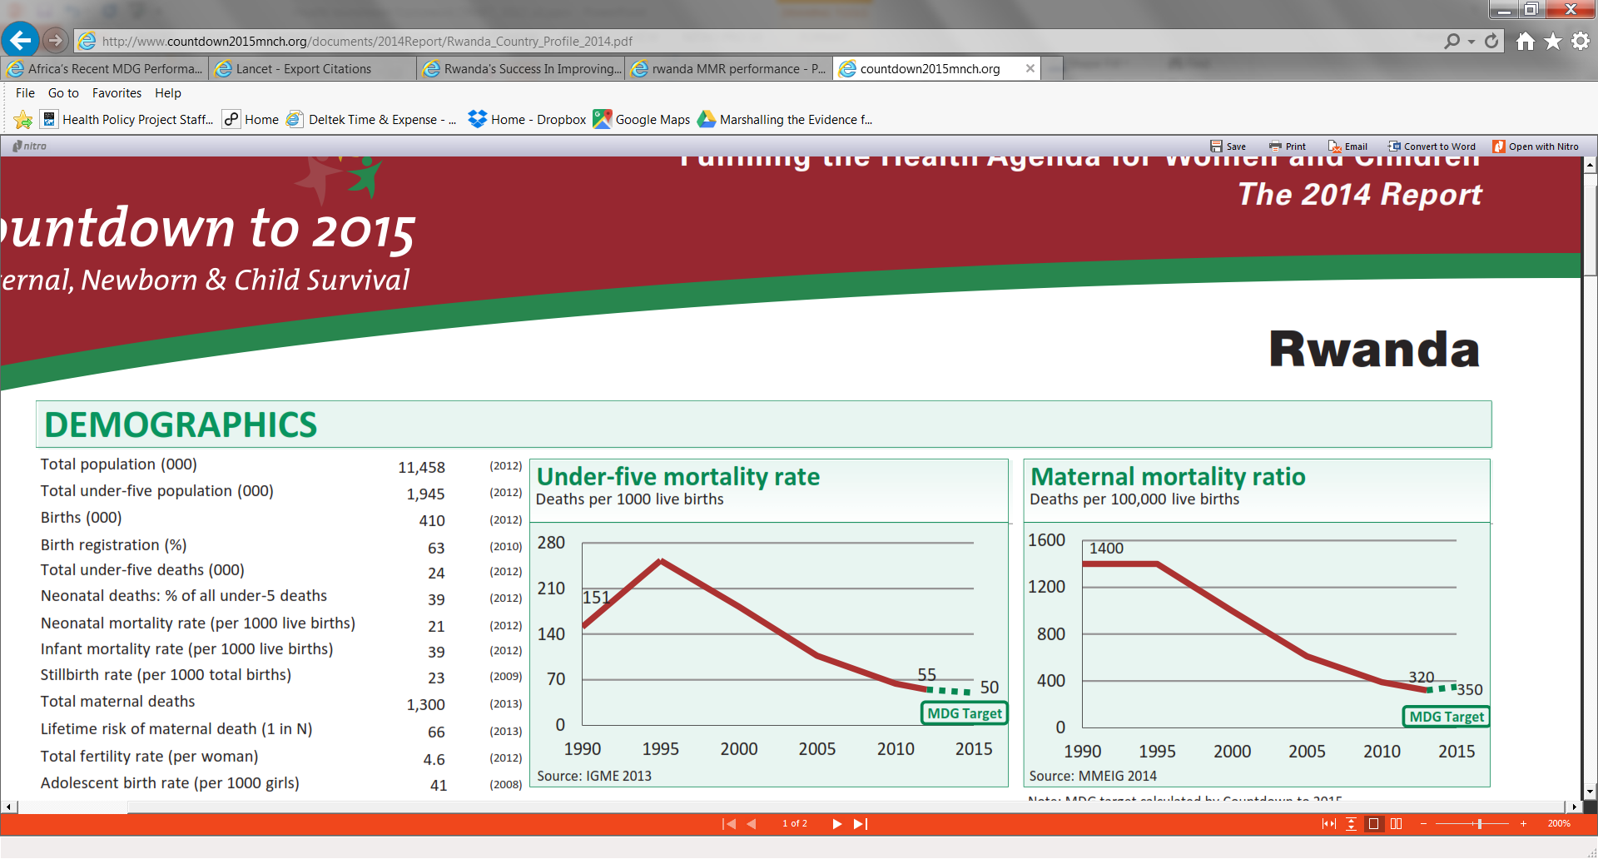
Draft for consultation
2
Focus on health sector targets
Illustration of Impact
Implementing this approach
An evaluation of the pay for performance (P4P) scheme in Rwanda revealed the greatest effect on those services that had the highest payment rates and needed the least effort from the service provider.¹
  P4P incentives can improve both the use and quality of MCH services, and could serve to accelerate progress towards achievement of MCH targets.
Advocate for program based budgeting implementation to allow for greater visibility on spending and stronger links to impact and health outcomes
Workshops to determine key intermediate actions/outputs necessary to improve high level outcomes (e.g., BRN Workshop identified key initiatives and enablers to improve RMNCH)
Tracking annual progress facilitated through dashboards for consistency and ease
Prioritized advocacy to GOT to fund key intermediate actions that will facilities progress against stated health sector targets
U5 mortality²
Maternal mortality²
¹Effect on maternal and child health services in Rwanda of payment to primary health-care providers for performance: an impact evaluation, Basinga, Paulin et al. The Lancet , Volume 377 , Issue 9775 , 1421 - 1428
²Countdown to 2015 – Fulfilling the Health Agenda for Women and Children – The 2014 Report
14

Slide 15
Draft for consultation
3
Meeting middle income commitments
Key characteristics
Statutory
Externally driven
Phased
Assessment against criteria
Potential gain
Significant; public funding must be mobilized to meet higher co-financing needs (though there could be limited impact on the total health budget given potential displacement effect)
Timeline / Effort
Multi year transition process, requires sustained effort
Appeal to MOFP
Significant; Linked to broader economic progress and national developmental vision as well as statutory requirements
Methods
Pros and Cons
Work with MOFP on macro-fiscal projections of TZ’s transition to lower middle income status and beyond
Model the funding implications of this change including transition timelines and projected changes in funding need
Prioritize budget advocacy to GoT on the basis of these expected transitions and projected funding shortfalls for specific health interventions
✓
Needs can be well defined and time bound according to a transition strategy
Promotes consistent multi-year advocacy
Driven by multiple donors (GFATM, PEPFAR, GAVI etc.) and is a mandatory requirement of continued funding
Linked to a positive achievement (i.e. reaching a higher income status)
Does not necessarily mobilize any new money
Focused mostly on vertical programming (e.g. would not benefit SNHI pooling and sustainability)
May not be priorities for all stakeholders
Not linked to structural reforms
✓
✓
✓
✗
✗
✗
✗
15

Slide 16
Draft for consultation
3
Meeting middle income commitments
Implementing this approach
Examine scenarios of how and when Tanzania reaches middle income status - development of a phased implementation plan to achieve various policy, budgetary and operational targets will be required
Explore intermediate financing mechanisms (including loans and guarantees) to bridge the funding gap in the short term; develop longer term financing strategies to increase the sustainable domestic funding of the health sector
Transition Assessment
Transition Plans
Implemen-tation of Plans
Monitoring Framework
Multi-partner external assessments
Areas:
  Program performance
  Institutional capacity
  Financial sustainability
  Alignment with HSS priorities
Actions with assigned responsible parties and timelines
Costed activities, and technical assistance needs identified
Holistic plan that takes into account all external funding support
Recurrent report of plan implementation
Joint appraisal of strategies and their implementation
Post-transition appraisal of transition process and future needs
Support to be provided through:
Technical Assistance
Implementing partners
Comprehensive engagement approach to transition¹
¹Graphic adapted from GAVI WHO Consultation Orientation, Slide 25, June 2016
16

Slide 17
Draft for consultation
4
Health as an investment
Key characteristics
Economic
Multi-sectoral
Relative performance
Assessment against criteria
Potential gain
Significant; health is currently underfunded relative to other social sectors and the empirical evidence that health is an investment is compelling
Timeline / Effort
Annual process due to fluctuations in state of the economy (and consequently government revenues) and competing MOFP priorities
Appeal to MOFP
Significant; Prioritizes demonstrating impact on other sectors and the economy
Methods
Pros and Cons
Build investment cases for health interventions showing multi-sectoral benefits, for example, link;
  Improved nutrition/child health to better education attainment
  HRH investments to economic growth
  Improved access to increased labor productivity
Highlight where health sector budget execution and service delivery capabilities outperform relative to other sectors
Prioritize budget advocacy to GoT on the basis of economic returns and multi-sectoral benefits
✓
Highlights health’s relative contribution to GDP and other sectors – reframes as an investment not an expense
Links specific interventions or health areas to broader developmental outcomes
Conveys advocacy in MOFP language (e.g. impact on GDP per capita, return on investment)
Provides a new rationale for increasing investment on highly effective health interventions
Theoretical and limited evidence base (beyond concepts)
Could be politically sensitive if it portrays other sectors negatively
Requires significant analytical capacity and financial fluency among stakeholders and the MOH
✓
✓
✓
✗
✗
✗
17

Slide 18
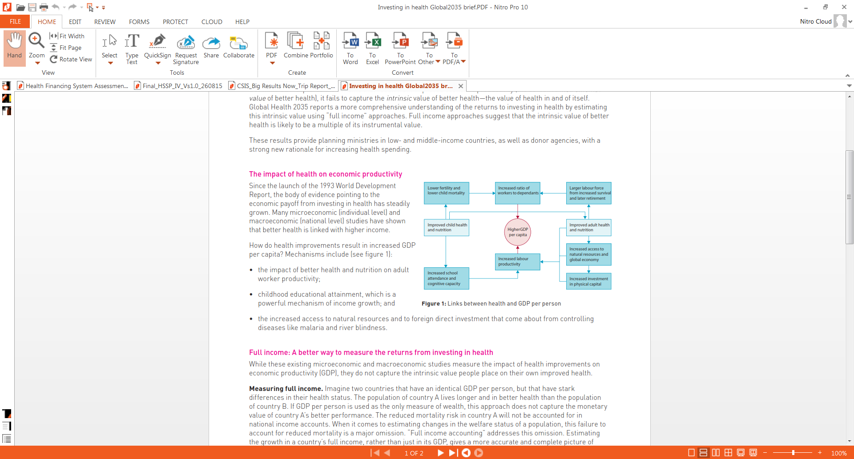
Draft for consultation
4
Health as an investment
Implementing this approach
Develop investment cases modeled on examples from other countries (e.g. RMNCH investment case)
Summarize findings from the literature on returns on investments in health and tailor to local context
Present the Tanzania specific analyses developed to the MOFP illustrating how MOHCGDEC has capacity to achieve them
How better health contributes to higher GDP per capital¹
²¹The Lancet, Global Health 2035, Policy Brief #2, The returns to investing in health, December 2013
18

Slide 19
Draft for consultation
Summary of approaches
Potential gain
Timeline/ Effort
Appeal to MOFP
Priority
Prioritization of annual needs
Annual, continuous
Limited
Limited
TBD
Focus on health sector targets
Research questions
Significant
Multi-year, front loaded effort
Limited
TBD
Meeting middle income commitments
Multi-year, continuous
Significant
Significant
TBD
Health as an investment
Annual, continuous
Significant
Significant
TBD
19

Slide 20
Draft for consultation
Next steps
Discuss potential new approaches during round table discussion
Summarize initial reactions, questions and feedback from discussions
Determine which approach(es) should be;
  Tweaked
  Eliminated
  Prioritized
  Added
  Refine analysis on subset of approaches
20

Slide 21
Thank You

