Slide 1
P4H in a Nutshell
Bayarsaikhan Durjsuren
Senior Health Systems Advisor
P4H Coordination Desk
Department of Health Financing and Economics
World Health Organization
Salma El-Gamal,
Health Financing and Social Health Protection Technical Officer,
P4H Coordination Desk,
International Labour Organization
19 March 2024
Notes:
Name in 14 point
Title and remaining information in 12 point

Slide 2

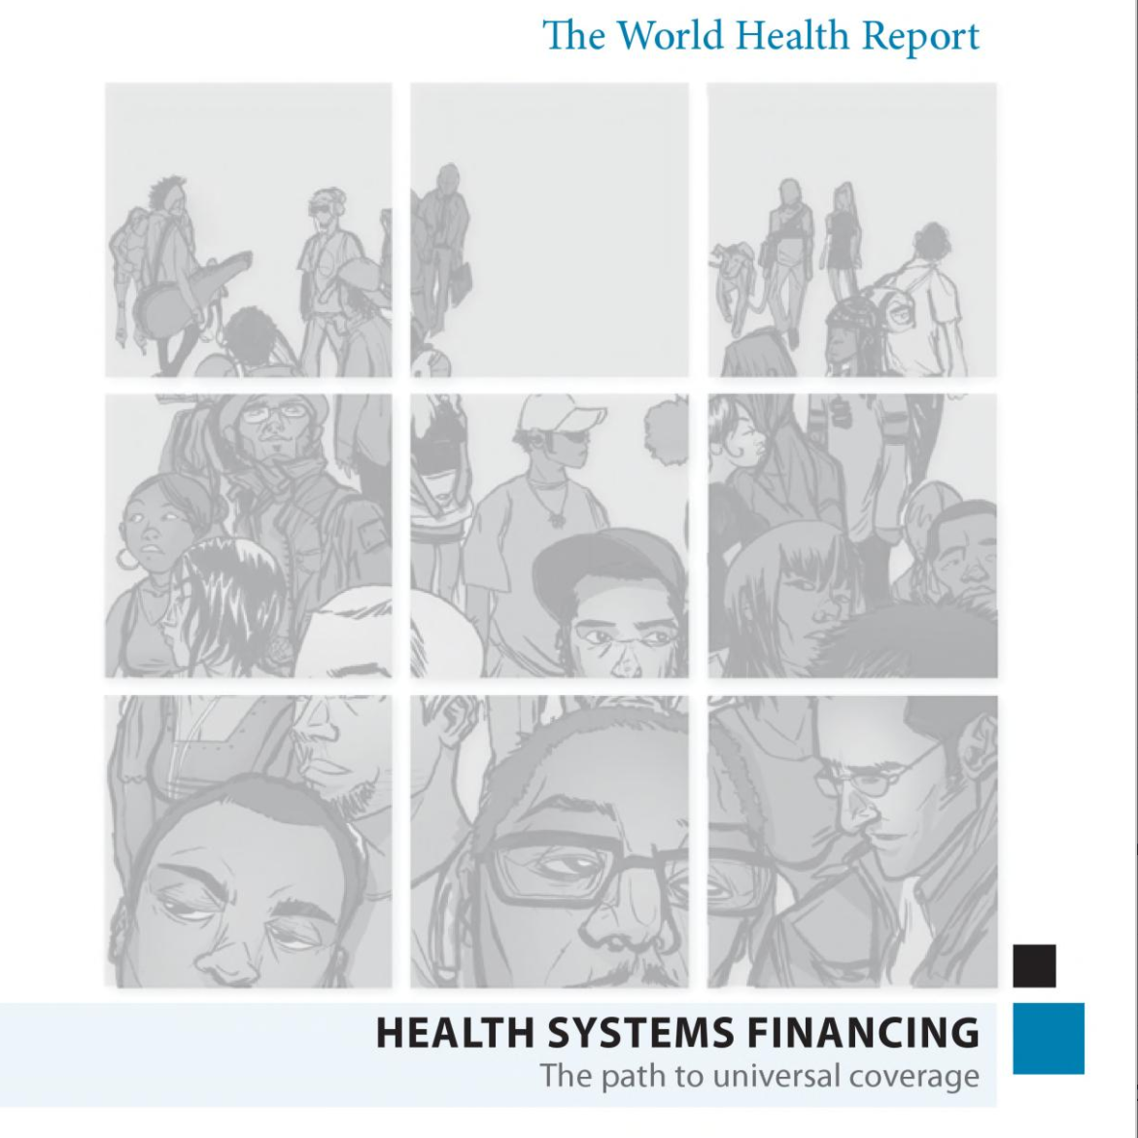


P4H Pioneers in Social Health Protection and Health Financing
G8 Summit
at Heiligendamm
World Health Report: Health Systems Financing
International Labour Organization: Social Protection Floors Recommendation
United Nations: Sustainable Development Goals
2007
2010
2012
2015
Launches Providing for Health (P4H) with twin goals:
Equitable social health protection
Sustainable and efficient health financing systems
First time WHO synthesizes actions countries can adapt to modify their financing systems for UHC
Reaffirms social protection
as a human right
Calls its 186 members to set and monitor national floors
193 countries commit to working together towards the common UHC target (health financing outlined in Indicator 3.8.2)

Slide 3




Our Mission
Accelerate progress towards UHC
VISION
Act as an honest broker and build frameworks for country, regional and global action
ROLE
MISSION
Promote, develop and strengthen exchange and collaboration for social health protection and health financing
Support the development of sustainable and equitable health financing systems
GOAL

Slide 4

Minds Meet: Health, Social and Finance Sectors
Say something here about where Health/social/financial meet.
Focusing on a common goal
Collaborating to solve problems
Partnering to find intersecting solutions

Slide 5



P4H Network’s Key Principles
Social Health Protection
Complex systems thinking, contexts and interactions matter
Health Financing
Social health protection and health financing are transdisciplinary
Joint assessment and activities can improve efficiency

Slide 6
Results Framework
OUTPUTS
1. High level multisectoral commitment
2. Collaborative networks
3. Coherent frameworks
4. Link with broader health systems issues
5. Innovations for social health protection and health financing
INTERMEDIATE
OUTCOMES
Selected social health protection and health financing reforms
Using the WHO Health Financing Progress Matrix (HFPM)
HIGH LEVEL
OUTCOMES
Improved social health protection and health financing systems
More sustainable, equitable and efficient
IMPACT
SDG Indicator 3.8.2
Financial protection

Slide 7
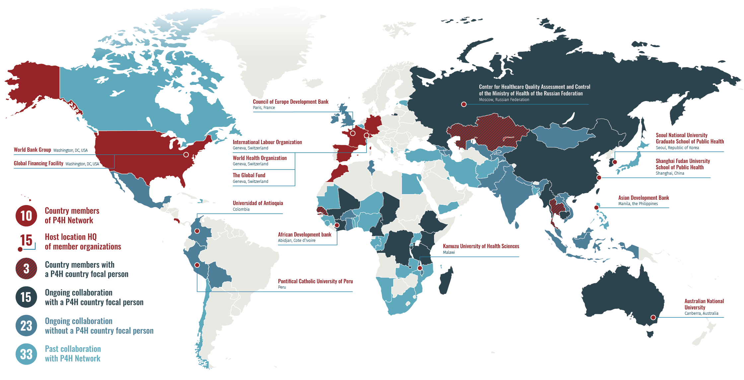
P4H Across the World

Slide 8



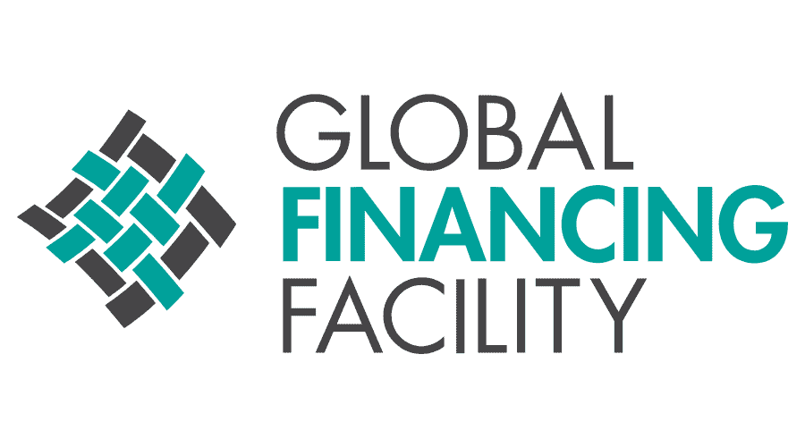





















Institutional Diversity
Australia
China
Colombia
Costa Rica
France
Germany
Kazakhstan
Republic of Korea
Malawi
Morocco
Peru
Russian Federation​
Senegal
Spain
Switzerland
Thailand
United States of America

Slide 9







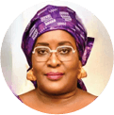

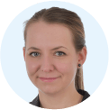
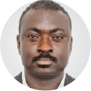
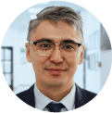





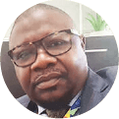
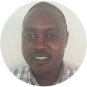














P4H Country and Regional Focal Persons
FUNDING
CONTRACTING
Serge Mayaka
CÔTE D'IVOIRE
Adja Thiané Guéye Diaw
SENEGAL
Virginie Longang
BURUNDI
Shana Hoehler
KENYA
Kingsley Addai Frimpong
ETHOPIA
Damir Kobzhasarov
KAZAKHSTAN
Lu Yi-han
CHINA
Juhyeon Moon
REPUBLIC OF KOREA
Nelly Gilyazetdinova
RUSSIAN
FEDERATION
What do these persons do?
Form collaborations among experts, who share knowledge and lead action
Facilitate evidence-based policy dialogue specific to individual countries
Document reform processes, boosting knowledge base
Their unity is their strength.
One cross-functional team from various member institutions of the P4H Network
One common workplan
One shared reporting framework
CAMEROON
Aminata Tou
DEMOCRATIC REPUBLIC
OF THE CONGO
Jean-Lambert
Mandjo Aholoma
TANZANIA
Kuki Tarimo
MADAGASCAR
Virgile Pace
MYANMAR
Htet Nay Lin Oo
THAILAND
Somtanuek Chotchoungchatchai
CAMBODIA
Niccolò
Rotigliano
CHAD
Saibou Seynou
AUSTRALIA
Esabelle
Yam Yo Lan
ASIA
Marielle
Phe Goursat
CONTRACTING
FUNDING
9

Slide 10
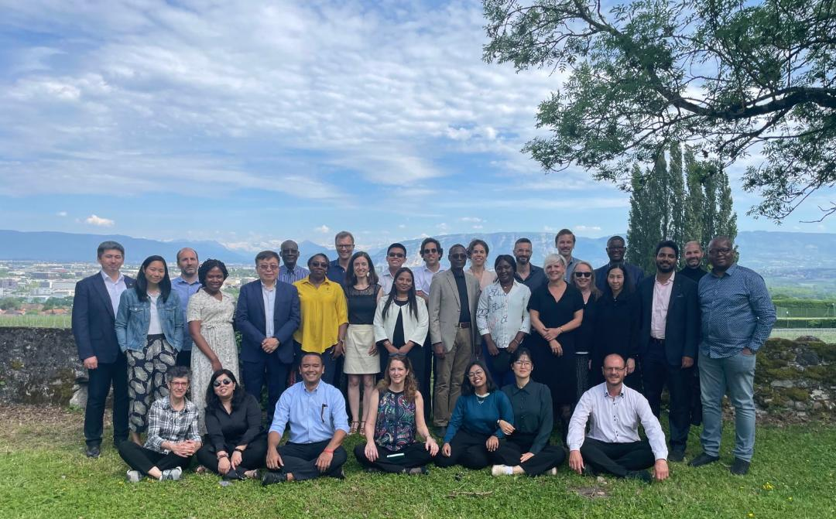
Effecting Change: Supporting P4H Country Focal Persons
10th P4H Coordination
Team Meeting
SATIGNY

Slide 11











P4H Coordination Team: What the Team Members Know
6
10
18
Web Management
Anthropology, Sociology, and Demography
24
5
Social Health Protection
Law
Business Development
and Private Sector
6
28
24
1
Communications
12
Engineering
6
Health Economics/Financing
Data and Research
Medicine
Political Economy

Slide 12
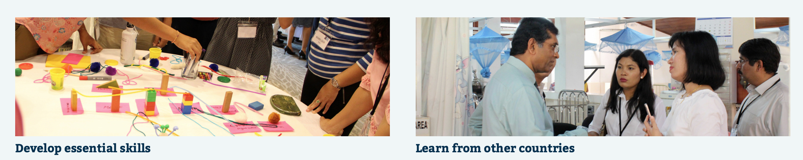
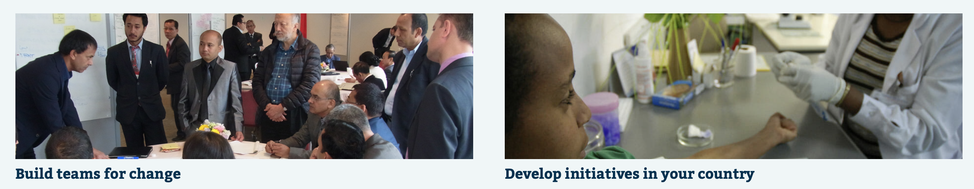

Effecting Change: Leadership for UHC Programme
Road maps and advocacy are one thing,…
leadership another.
L4UHC helps senior decision makers
Boost leadership skills
Foster high levels of trust
Build networks
Notes:
February 2024 update
—screenshot replaced with current screenshots of 5 benefits
—shorter text previously revised and approved by Claude Meyer

Slide 13





Functional health financing & social health protection networks
a) Enhanced regional HF & SHP exchanges:
Africa, Asia, Eastern Europe and Central Asia, and Latin America and the Caribbean focused community networking for knowledge sharing, (connecting, incentivizing and facilitating).
Developing and implementing joint products and services.
b) Collaboration with regional networks:
Link with broader health systems and social health protection initiatives
Innovations for social health protection and health financing by promoting evidence, accountability and country ownership.
Notes:
You indicate products, but the first bullet point is for people. Consider rephrasing to something like P4H Personnel and Products.

Slide 14

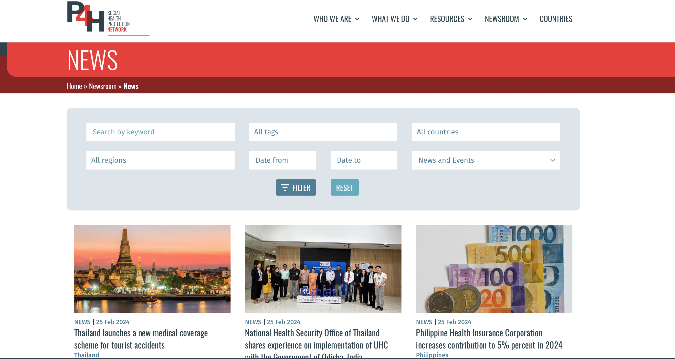
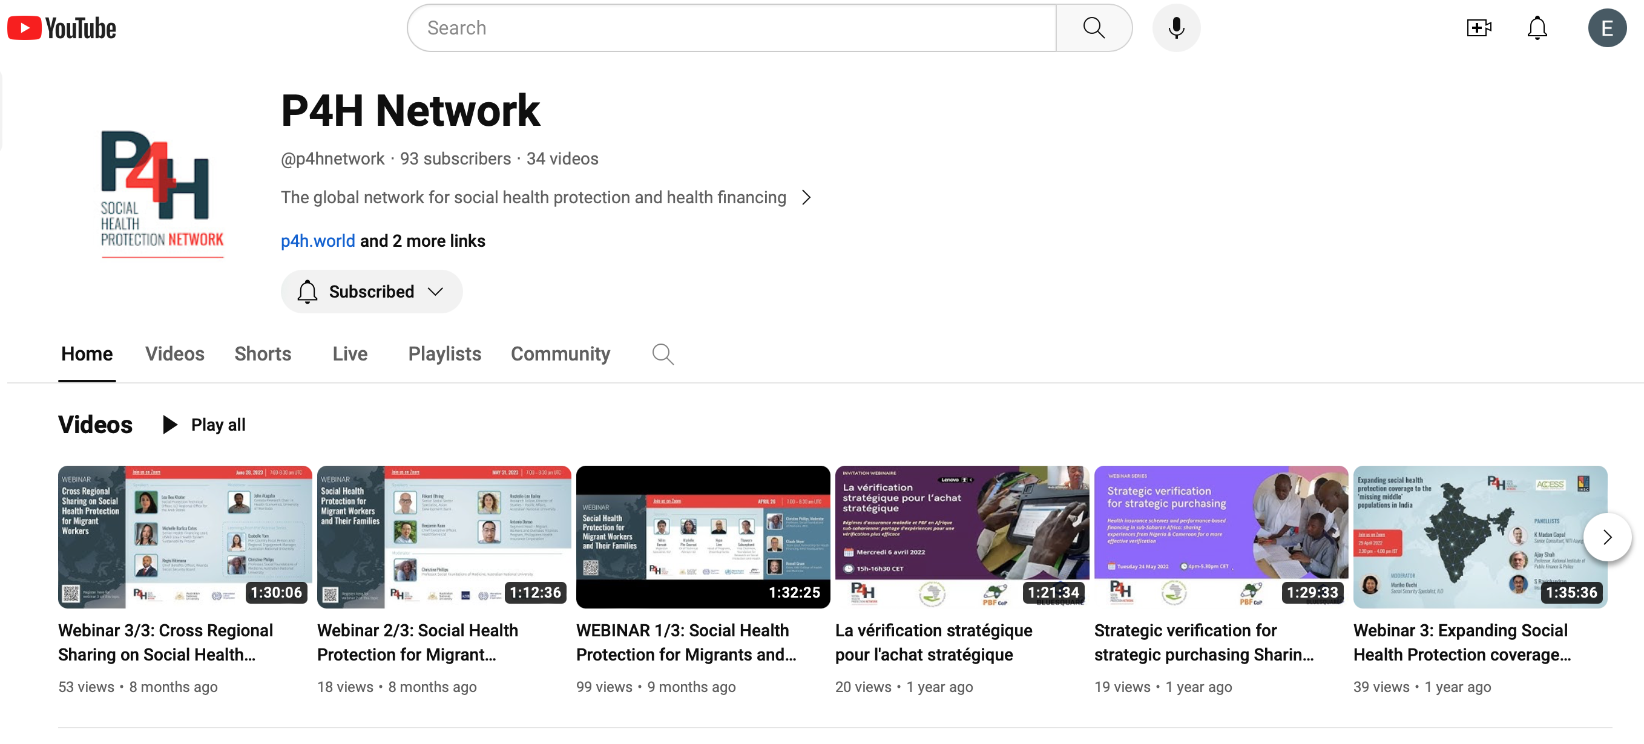


P4H Network’s Digital Ecosystem
Notes:
February 2024 update
—screenshot replaced with current screenshots of digital platform news page, YouTube page, Twitter (X) page

Slide 15


The role of collaboration to support the efforts in the field of Health Financing & Social Health Protection in Cameroon
Aminata TOU NANA
Senior Health Advisor/
Public Financial Management specialist
P4H Country Focal Person in Cameroon
19 March 2024

Slide 16









Main development partners involved in Universal Health Coverage (UHC) in Cameroon

Slide 17

Added value of the P4H Country Focal Person (P4H-CFP)
1. Improve communication between development partners and the national authorities
  Establishment of a health financing technical working group and UHC, facilitated by the P4H-CFP
  Monthly meetings with recommendations channelled to the national authoritiesby the P4H-CFP
  Discussions between development partners for a joint support on national requests in SHP/HF
2. Support a synergy of actions between development partners and the national authorities
  Common advocacy on the disbursment of resources through the establishment of a mutltisectoral committee
  Co-financing of UHC related activities
  Joint support for training on UHC and health financing
  3. In collaboration with all development partners, techincal support in:
  Public financial management
  Gender-sensitive budgeting
  Health Financing

Slide 18
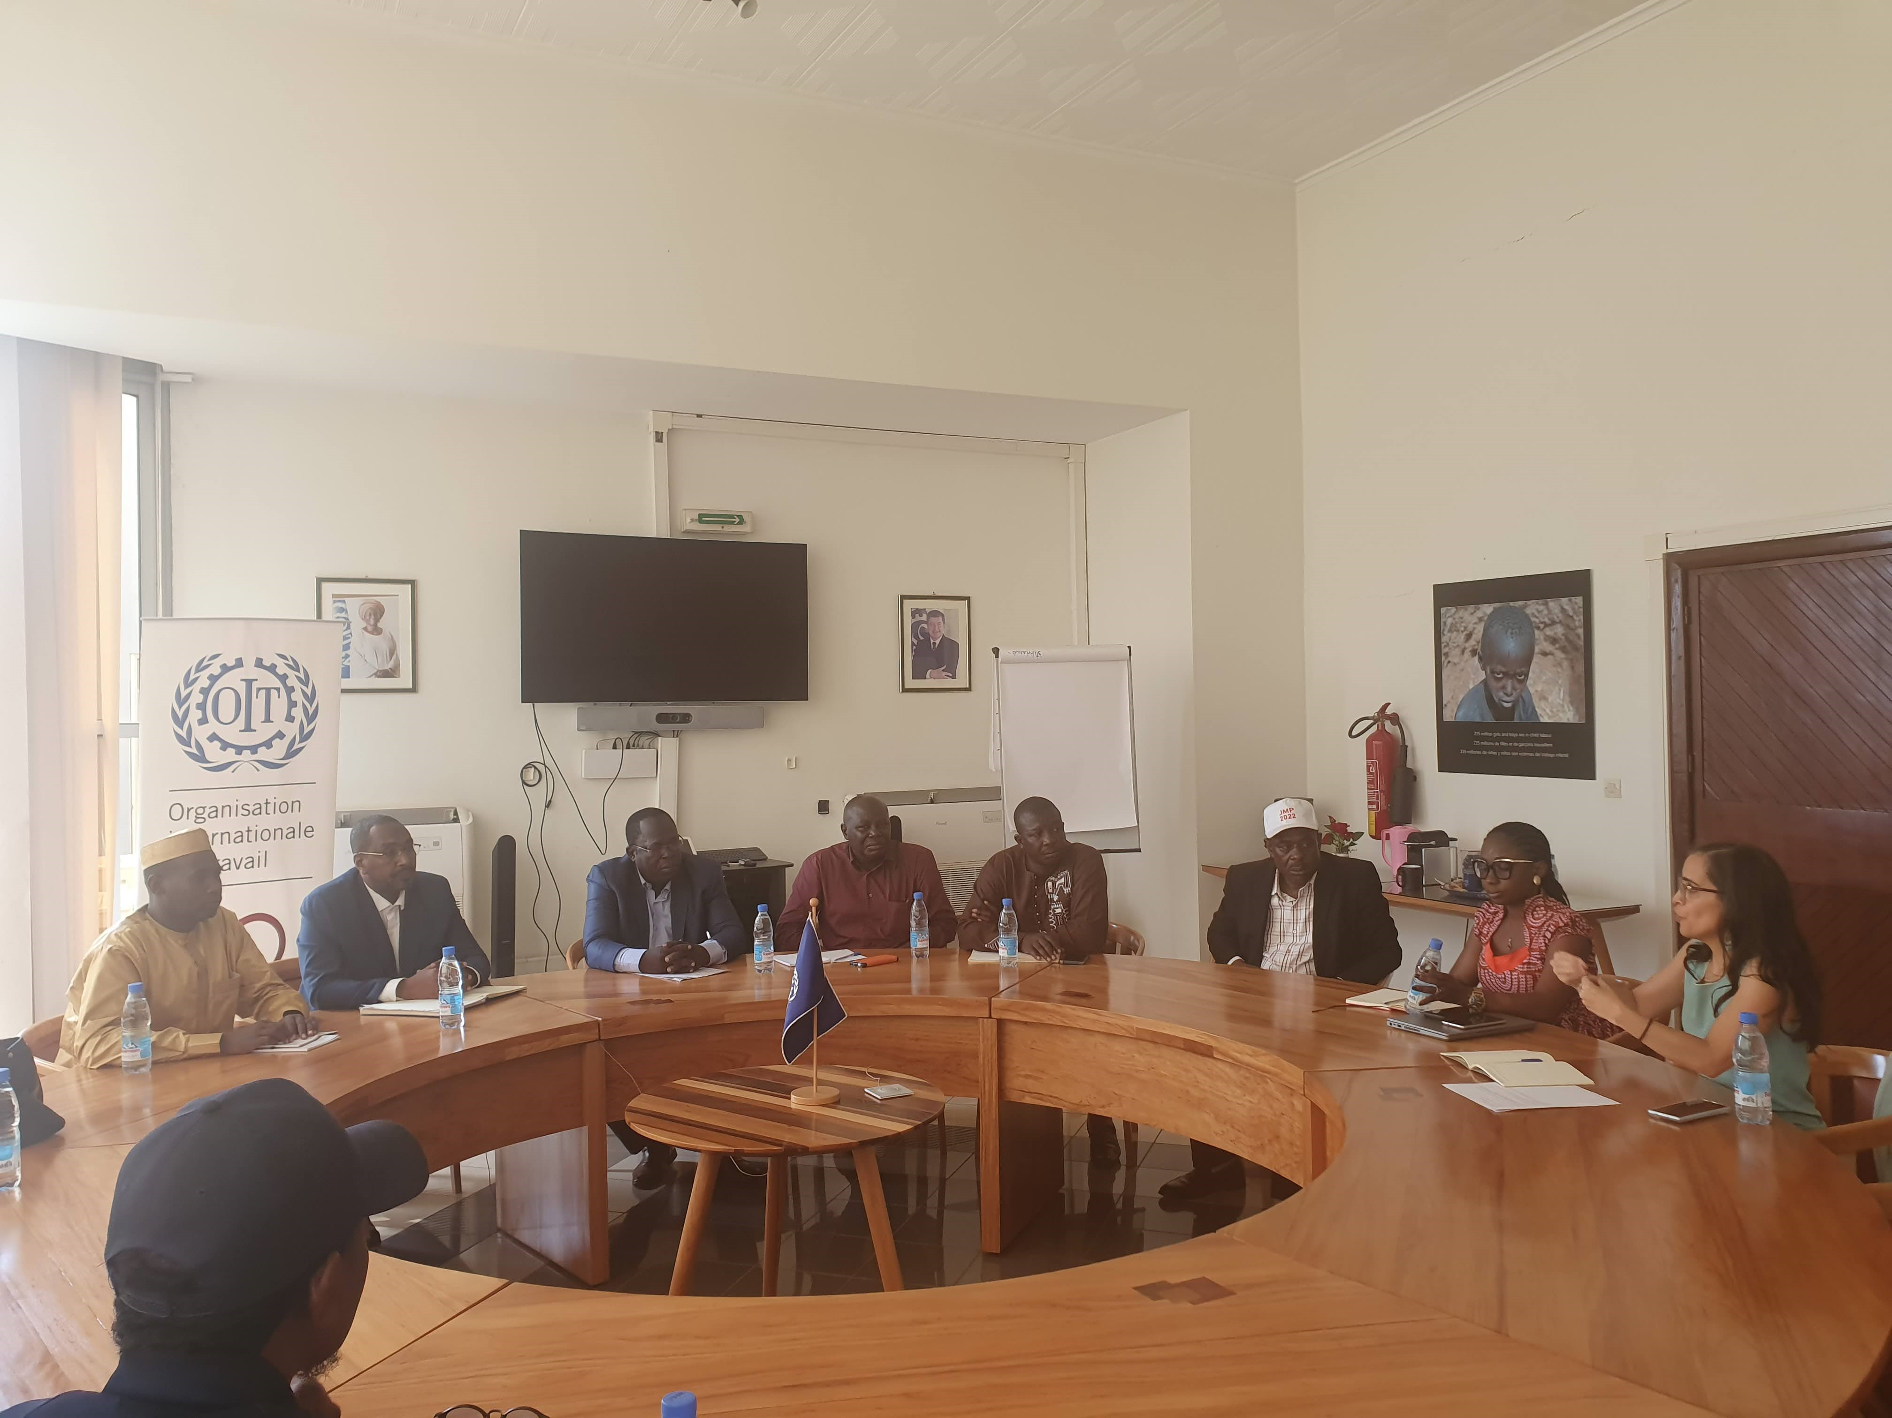
Example of a collaboration facilitated by the P4H-CFP: experience sharing between Chad & Cameroon
P4H members involved: WHO, WBG, ILO, AFD, GIZ
National authorities involved: sectorial ministries of Chad & Cameroon
UHC related topics discussed:
  Development partners’ alignment
  Implementation issues
  Resource mobilization
WHO & ILO offices provided support during the 10 days’ mission
Chad delegation has visited a region in Cameroon where a specific health financing mechanism is implemented: “le chèque santé”

Slide 19
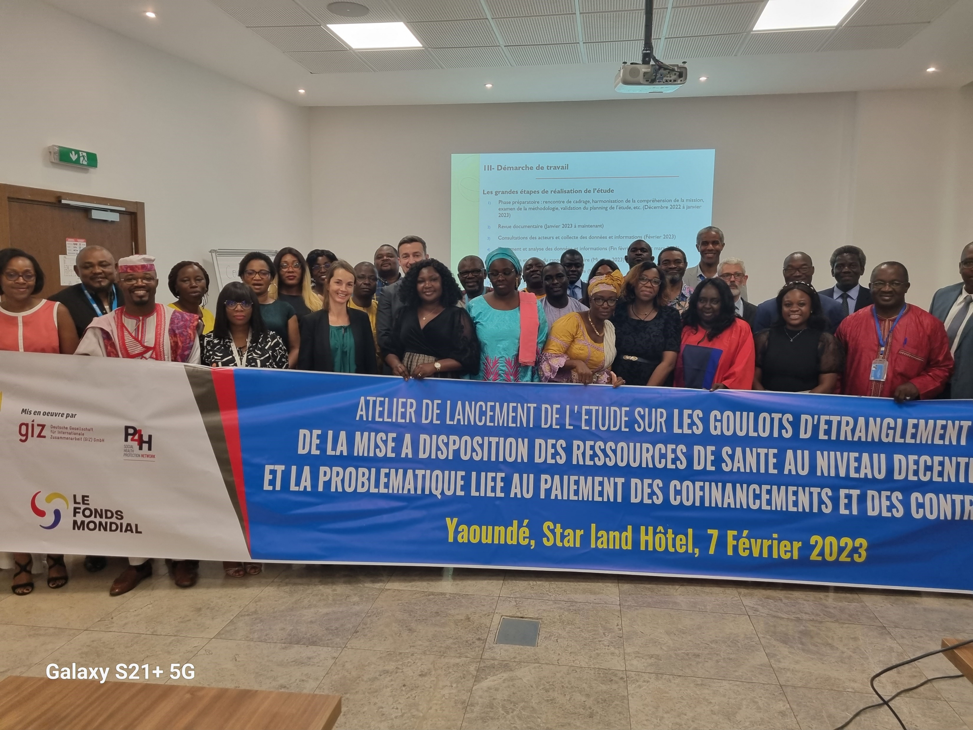
The development partners entrust the P4H-CFP to coordinate the implementation of joint activities
Study on Health Financing bottlenecks
Terms of reference drafted by the P4H-CFP
Study co-financed by the Global Fund and GIZ
In-site supervision facilitated by the P4H-CFP
All development partners and the national authorities have participated in the launch and end-presentation of the study

Slide 20






THANK YOU
CONNECT WITH US

