Slide 1
Climate change, public health
and health financing
How to integrate climate change in health financing work at country level?

Slide 2
Effects of climate change on health financing
Brief estimation of main effects
Health impacts of climate change
Infections, under-nutrition, morbidity and mortality related to heat and cold waves, trauma, displacement, mental health disorders
A broader vision: Health impacts of ecosystemic crisis:
Air, soil, acoustic and chemical pollution, plastification, incl. food, food scarcity (pollinators, dead seas, drought)
(morbidity impacts at all levels, CVD, mental, NCDs, mortality)
UHC Objectives
Health financing functions
Increased demand of health services
Challenges to meet universal coverage based on need, quality and equity objectives
Breadth of benefit packages, rationing
A turn to prevention?
Increased cost of an expanded service provision

Slide 3
Effects of climate change on health financing
Brief estimation of main effects
UHC Objectives
Health financing functions
Reduced availability of raw materials, water, and energy sources
(including those needed for the energetic transition and for transport)
Forced de-growth, consumption reduction and re-localization
Decreased availability of essential supplies, infrastructure and equipment for health systems, incl. medicines
Challenges to meet coverage, quality and equity objectives
Reduced benefit packages, rationing, user fees?
Reduced tax collection
Revenue raising function compromised

Slide 4
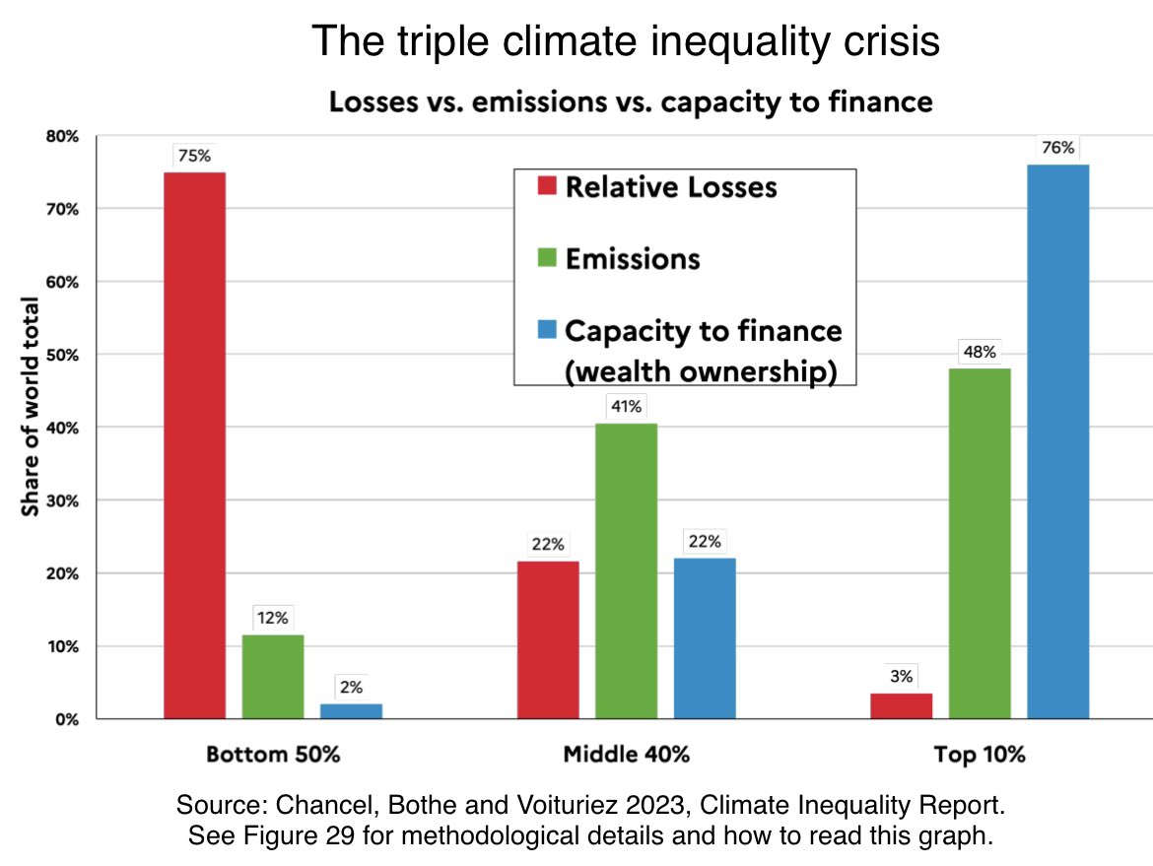
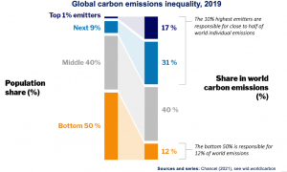
A distributional approach - Carbon emissions + overconsumption, waste, and air, noise, water and chemical pollution
High-income earners are the most pollutant citizens. Can taxes alone revert this situation?

Slide 5
The experience in Mozambique
1. Strategies and long term perspective
Difficult fit of environmental health narratives at MoH Environmental Health/ NCD Dept.
        Focused on malaria vectors, water quality (water-related diseases), communicable diseases
        Political limitations (MoH no to invade others’ competences – City councils)
        Environmental determinants of health do not appear in the NCD strategy (2021) –
In spite of evidence (CVD, obesity, birth outcomes, mental health) – 13M deaths/year (WHO)
Resilient health infrastructure: Construction guidelines to resist extreme climate events. Poor health facilities’situation (SARA diagnostic: only 5% of health facilities have all supplies and staff)
Environmental taxation –
        Reduced taxation on bicycles (Dec.2022)
        Increased taxation on most expensive (and polluting) cars, but...reduced taxation on the smallest cars – Creating constituencies in favour of private vehicles... And trucks (industrialization )
Urban planning for health and climate resilience is not a not key priority in the City Council’s agenda: Urbanism for the car in cities (10% own a car) / Poor public transport, but improving / Limited active mobility policies - walkability / No control of air and noise pollution / No greening policies

Slide 6
The experience in Mozambique
2. Responding to climate-related crisis
Extreme climate events
        Need to constantly operate responses to health emergencies (floods, hurricanes), which add to the already existing ones (cholera, polio, terrorism)
        Strain on budgets: Extra-budget needs – Progressive introduction as part of MoH operations – PFM adaptation – Budgets to be prepared in advance – not only in-year reallocations

Slide 7
...and a glimpse on political economy
Industrialization is at the center of development policies, this sides environmental concerns, including its health effects
        Promotion of exports (carbon footprint, including internal commerce by airplane)
        Agriculture productivity – Big push from partners to subsidize pesticides. Impacts on food soverignty /tech packages – depending on buying new seeds – RSA – Soil, air, water and food pollution. Monoc.
        Fish and logging agreements with China: Depletion of marine and forest resources and biodiversity, coastal and forest communities no more able to manage resources sustainably.
        Gas industry – Reserves at Quirimbas National Park – Environmental impact and transport worldwide
        Foreign investments – i.e. Supermarkets chains – Nutritional transition towards ultra-processed food – higher carbon and waste footprint – Food environments – Urban space design... More markets?
        The lack of a strong industrial sector could be an opportunity to shape it according to planetary boundaries

Slide 8
...and a glimpse on political economy (cont.)
Rapidly widening inequalities are not the best context to transit towards more sustainable production and consumption patterns
Distributional approach:
        Elites – Accelerated and intense process of asset accumulation, property concentration (+ rents) and State patrimonalization – Overconsumption as a social class marker. Environmental concerns are far.
        Middle-clases – Reaching some level of confort and westernization, not allies in restricting consumption, after long restriction periods (wars 1974-94). Aspirational consumption.
        The role of foreign economic models and development policies
        Development policies based on increased productivity, intense use (and depletion) of natural resources, waste and pollution, incl. Car culture.

Slide 9
What can we do as health financing specialists?
Support MoHs to include environmental determinants of health in policy design and to align service delivery with broad prevention, adaptation and mitigation policies
Support MoH to promote active policy reform in key areas outside their mandate (Environmental Health, School health, City Councils, NCD prevention, Industry and Commerce) – Making the case for public health impacts of improvements and to reflect on health impact of policies out of MoH. Government-wide policies.
Cross-sectorial coordination.
Investment cases on Environment and Health – Understand the costs and savings of (non) intervening, to foster policy change. Economic gaze is limited, but useful.
Environmental taxation – Imperfect measure (richest can pollute indefinitely)
  Phase out fuel and pesticide/agrotoxic products subsidies
  Heavily tax cars
  Introduce taxation of air and water pollution (mining sector)
Fossil fuels 6 trillion
Not lack of money
Uncompensated effects
There is no economic argument to subsidize

Slide 10
Annexes

Slide 11
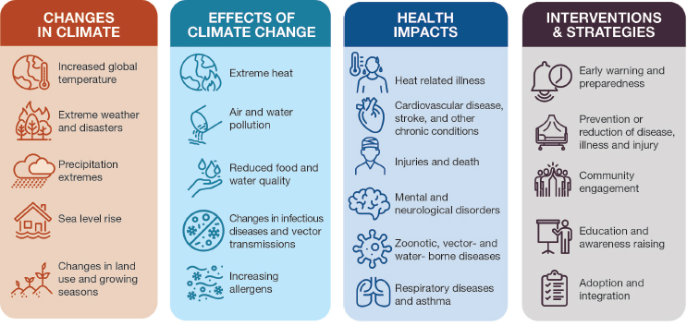
Intro: It is not only climate change

Slide 12
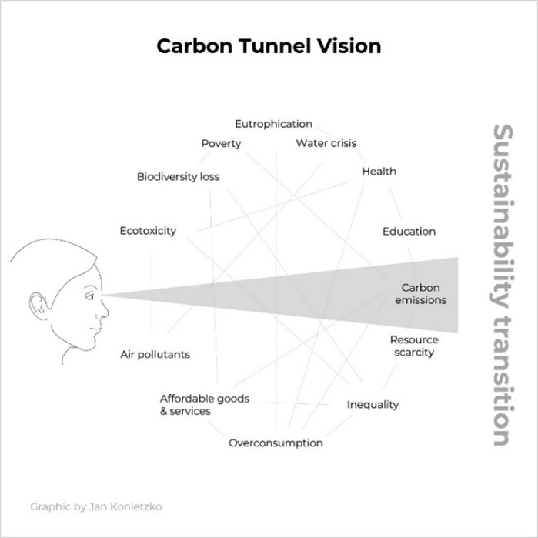
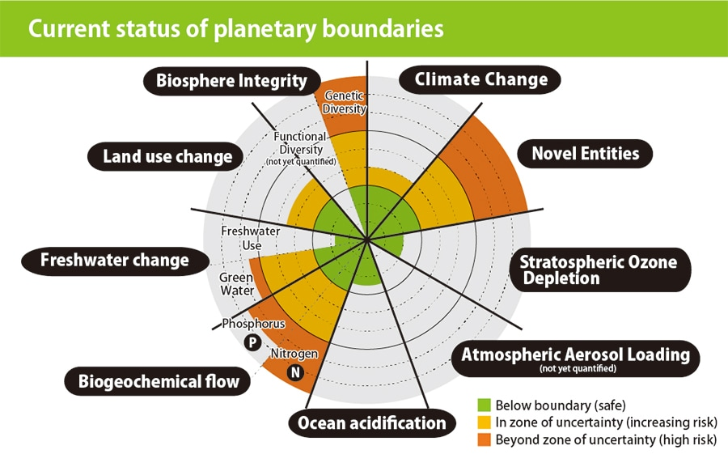
Ecosystemic and public health crisis beyond climate and CO2

Slide 13
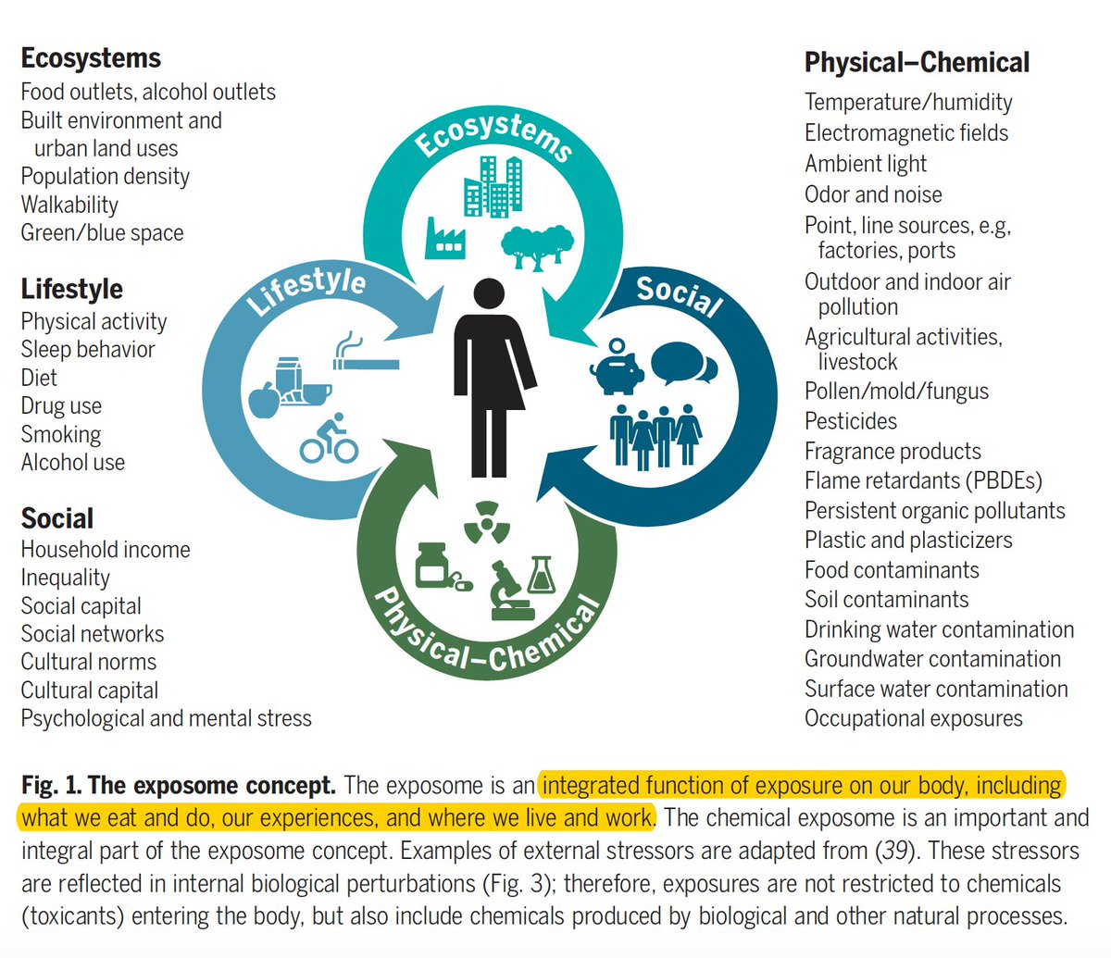
The concept of exposome in public health
Health outcomes
Health provision
Health costs and financing

Slide 14
A broader vision: How the ecosystemic crisis affects health now
Environmental determinants of health
Air pollution: Related to +9 million annual deaths (WHO), cancer (esp. Leukaemia), neurodevelopmental alterations, autism, adverse birth outcomes, etc.
Noise pollution: stress, immunodepression, CVD. 4% of hospitalizations in Madrid (Ruiz-Páez et al, 2023).
UNEP dedicates 2022 Report to noise pollution: 4/5 areas of intervention are greening.
Urban design as a determinant of health: Air and noise pollution, lack of spaces for physical activity, socialization, also in childhood. Active and non-polluting mobility, clean air, sociability spaces, physical activity, sedentarism, obesity
Lack of green areas as a cause of amenable morbility and mortality: 43.000 preventable deaths in Europe (Barboza, 2021), 13% less consumption of anti-depressants in Barcelona (Triguero-Mas, 2023)

Slide 15
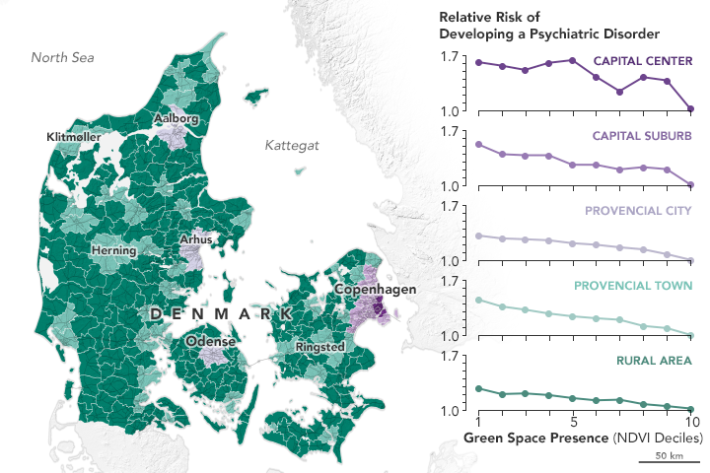
Green space is good for mental health
NASA / American Academy of Sciences, 2019 – Medição de Normalized Difference Vegetation Index (NDVI)
The risk of developing a psychiatric disorder reaches zero as green areas increase in Denmark

Slide 16
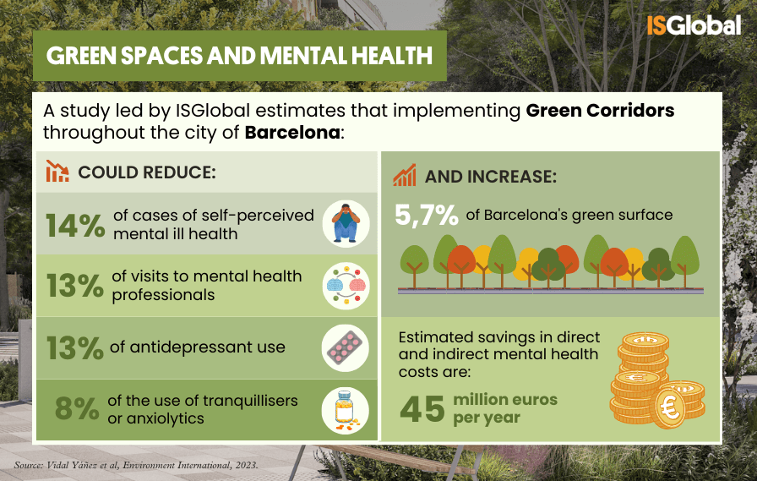

Slide 17
