Slide 1


IMPACT OF HEALTH FINANCING ON HEALTH OUTCOMES
IN MADAGASCAR
PACE VIRGILE, DR YE MAURICE, DIANA RATSIAMBAKAINA, CHRYSTELLE TEMAH TSAFACK,
DR VATSIHARIZANDRY MANDROSOVOLOLONA, PROF. MUSANGO L.
Mars 2025

Slide 2
1. INTRODUCTION (1)
Understanding the Health Financing Landscape in Madagascar
The Health Financing Landscape :
Madagascar’s health financing system is facing huge challenges.
5.3% of Madagascar national budget is allocated to health.
Domestic General Government Health Expenditure (GGHE-D) is 29% of Current Health Expenditure (CHE).
External funding accounts for 30.4% of total health expenditures.
Out-of-pocket payments account for 38.3% of total health spending.
Preventive care receives 31.4% of health expenditure.
3.7% of allocated health budgets are effectively executed.
Domestic General Government Health Expenditure (GGHE-D) as % of Current Health Expenditure (CHE)

Slide 3
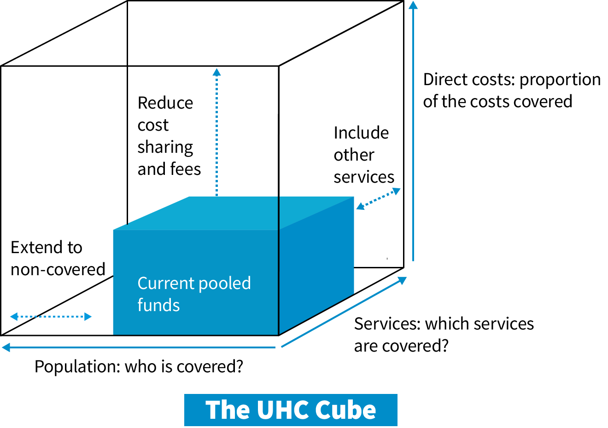
2. INTRODUCTION (2)
Objective of the Study
Key Objectives :
Analyse the relationship between health financing and health outcomes in Madagascar (maternal and neonatal morbidity).
Identify key challenges in the current health financing system in light of the UHC Cube.
Explore potential strategies for health financing reform to improve health outcomes.
Highlight transferable best practices from comparable countries
WHO’s Cube

Slide 4
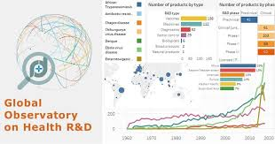
3. METHODOLOGY
Research Approach and Analytical Framework
Research Approach and Limitation :
Mixed-methods approach integrating qualitative and quantitative data.
Data sources: WHO Global Health Observatory, Madagascar's 2022 National Health Accounts, National Health Surveys.
Analytical framework: WHO Health Financing Cube (population coverage, service coverage, financial protection).
Comparative analysis with three African countries to highlight best practices.
Absence of real-time and disaggregated data by geographic, demographic, and income strata constrains the precision of equity analyses and limits a full understanding of disparities in service access and financial protection.
WHO’s Global Observatory on Health

Slide 5
4. RESULTS and DISCUSSION (1)
Structural Challenges and Financial Gaps in Madagascar
Structural Challenges :
Domestic resources mobilization remains constrained: “Crowding out” discourages national efforts to mobilize more domestic resources; Heavy reliance on external funding makes the system vulnerable to donor priorities.
Domestic General Government Health Expenditure (GGHE-D) per Capita is 5 US$.
Resource pooling is yet to be fully optimized : Institutional frameworks for pooling of resources are weak.
The implementation of strategic purchasing is still in progress: Pilot projects are currently being implemented.
Public Financial Management (PFM) is facing challenges in its functionality: Budget execution is extremely low; The CSB (Basic Health Center) allocation, newly introduced, was only executed at 1% in 2024.
Domestic General Government Health Expenditure (GGHE-D) per Capita in US$

Slide 6
5. RESULTS and DISCUSSION (2)
Consequences of Financial Gaps on Public Health
Impact on Health Outcomes :
Government-funded health expenditures (2000-2021) accounted for 1.7% of GDP.
$12.2 per capita is allocated to primary healthcare: On average, $26.2 per capita is allocated to primary healthcare in Low-Income Countries.
Out-of-pocket costs (32% of CHE) push vulnerable households into poverty.
Limited pharmaceutical spending results in frequent shortages of essential drugs.
Mutuelles de santé (Community-Based Health Insurance schemes) and Equity funds cover less than 2% of the population in 2021, leaving the informal sector (80% of the workforce) without financial protection mechanisms.
Out-of-pocket (OOPS) as % of Current Health Expenditure (CHE)

Slide 7
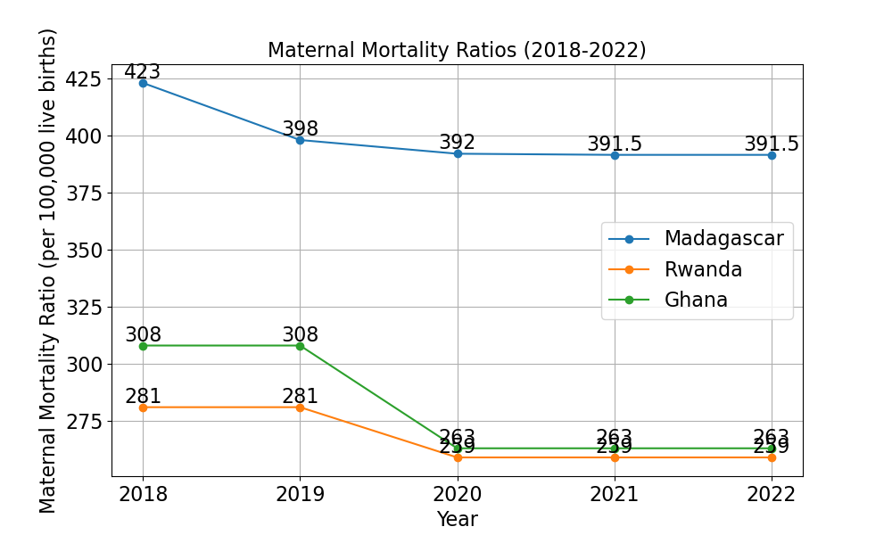
6. RESULTS and DISCUSSION (3)
Successful Health Financing Models in Others African Countries / UHC Cube (a)
Rwanda: Community-Based Health Insurance (CBHI) Success
• Population Coverage: 92% of the population covered by health insurance as of 2011.
• Service Coverage: CBHI ensures access to essential health services, including maternal and child health, infectious disease control, and non-communicable disease management.
• Financial Protection: The Rwandan government heavily subsidizes CBHI, ensuring even the poorest have access to healthcare without financial burden.
Comparative Maternal Mortality Ratio 2018-2022

Slide 8
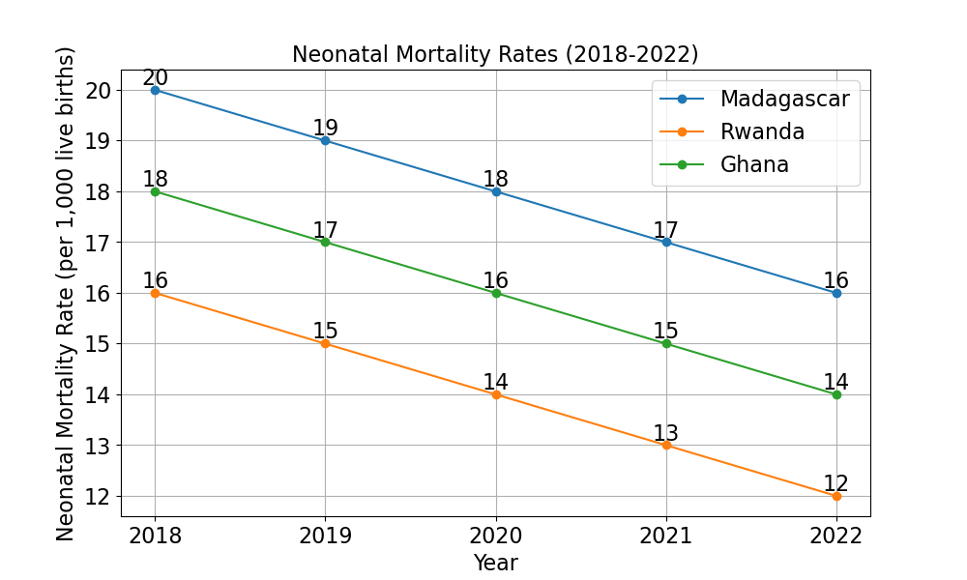
7. RESULTS and DISCUSSION (4)
Successful Health Financing Models in Others African Countries / UHC Cube (b)
Ghana: National Health Insurance Scheme (NHIS) Achievement
• Population Coverage: 67.5% enrolled by 2009, ensuring access for vulnerable populations.
• Service Coverage: NHIS covers a broad package of services, including maternal health, family planning, and chronic disease management.
• Financial Protection: The scheme reduces out-of-pocket expenses, ensuring financial barriers do not limit access to healthcare.
Comparative Neonatal Mortality Rates 2018-2022

Slide 9
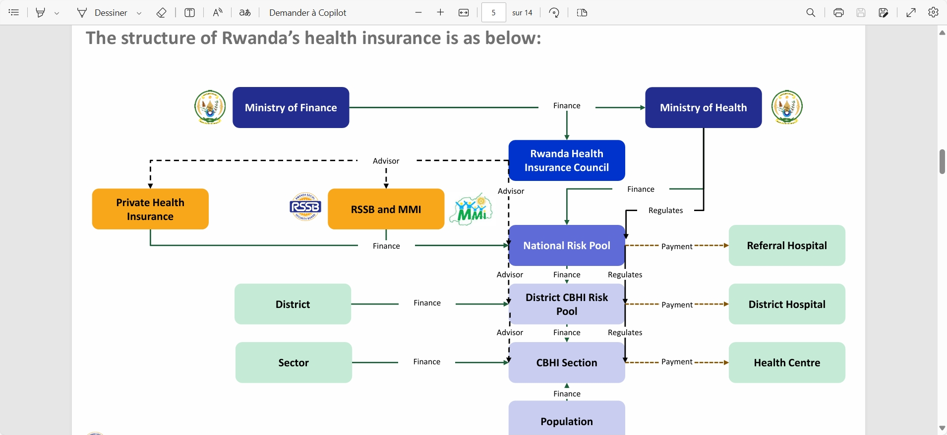
8. RESULTS and DISCUSSION / RECOMMENDATIONS (1)
Strategies/Core Reforms for Madagascar
Expanding Population Coverage :
• Reform health financing to guarantee adequate funding for Primary Health Care (PHC) and expand equitable access.
• Strengthen Community-Based Health Insurance (CBHI) by adopting key components of Rwanda’s success model, when feasible: Mandatory or near-universal enrolment for risk pooling; State subsidies for vulnerable populations; Nationwide integration of healthcare and administrative structures.
• Reduce household financial burden, aiming for 20% out-of-pocket expenditure, protecting families from catastrophic health costs.
Structure of Rwanda’s Health Insurance – Source: RSSB, 2023

Slide 10
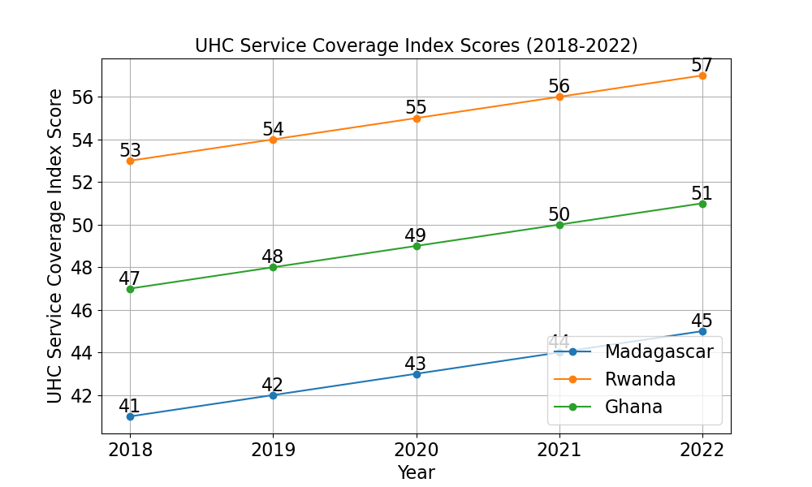
9. RESULTS and DISCUSSION / RECOMMENDATIONS (2)
Strategies/Core Reforms for Madagascar
Expanding Service Coverage :
• Equip the healthcare system with sustainable resources to address stagnation in reproductive health and vaccination indicators.
• Adopt a "Health in All Policies" approach to address the social determinants of health: Collaborating with sectors such as education, housing, and employment is critical.
• Engage stakeholders (government, donors, private sector) in health system reforms to ensure sustainable service delivery.
Enhancing Financial Protection :
• Increase domestic revenue generation by: Introducing health-specific taxes (financial transactions, polluting vehicles);
• Establish a special Treasury allocation account (Compte d’affectation spécial du Trésor) for PHC ensuring equitable resource distribution;
• Optimize resource use through performance-based financing and strategic purchasing; Improving budget execution efficiency and accountability.
UHC Service Coverage Index (2018-2022)

Slide 11
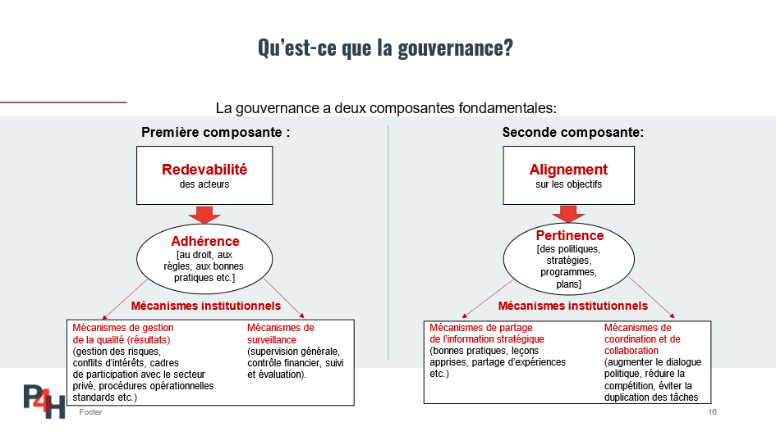
10. CONCLUSION AND WAY FORWARD
The Future of Health Financing in Madagascar
Improve Governance and Financial Transparency by :
• Strengthening accountability in health financing through clear regulations.
• Establishing a monitoring and evaluation (M&E) framework for transparency and impact tracking.
• Building political commitment to drive UHC reforms, ensuring sustained health financing.
• Establishing a PHC Steering Committee (Comité de pilotage) to ensure intersectoral coordination, participation, and community ownership of reforms. tracking.
• Learning from African successes: Adopting best practices from countries with comparative socio-economic contexts, when possible.
What is Governance for Health Financing?

Slide 12
MANY THANKS

