Slide 1
Benefit Package
Working Group 4
Juliet Bataringaya
Health Financing Reforms Consultative Workshop
4th July 2013

Slide 2
What benefits are currently included in the package delivered by the govt?
HSSIP outlines the services SUPPOSED to be delivered by level of care from community to national referral level.
However:
  Uncertainty regarding what is supposed to be delivered and received (for providers and recipients)
  Unfunded mandates undermine the trust in the system and in the government overall
  Mismatch between available resources and expectation of the population and providers
  Weak systems and poor quality undermine effective utilization

Slide 3
What do you think should be included in the package?
Impossible to provide all services for all people at all times – need to make tough choices
Should govt provide core/essential services for all people?
Should govt provide expanded package for selected groups?
What happens when people need services outside the package?

Slide 4
What do you think should be included in the package?
Design
  Essential Package of services for individual health and the level of care at which to access the services
  Essential Package of services for population health (preventive, promotive, addressing social determinants – IRS, Deworming, etc) and propose multi-sectoral approach for their delivery – Consider village as beneficiary unit

Slide 5
What do we mean by benefit/entitlement design?
Entitlements and obligations for the population
  Entitlements: services available to covered population or defined individuals or groups
  Obligations: responsibilities to be met by the covered persons in order to obtain the benefits (e.g. cost sharing, referral, other rules governing rationing of use of health services)
Notes:
When you hear “benefit package”, what do you think of?

Slide 6
Key objectives for policy on benefit design
Allocative efficiency (prioritizing a cost-effective mix of services)
Financial protection (prioritizing mix of service and cost coverage that is likely to protect people against catastrophic risk)
[note: these two objectives can be in conflict]
Other efficiency dimensions – promoting efficient use of the health system

Slide 7
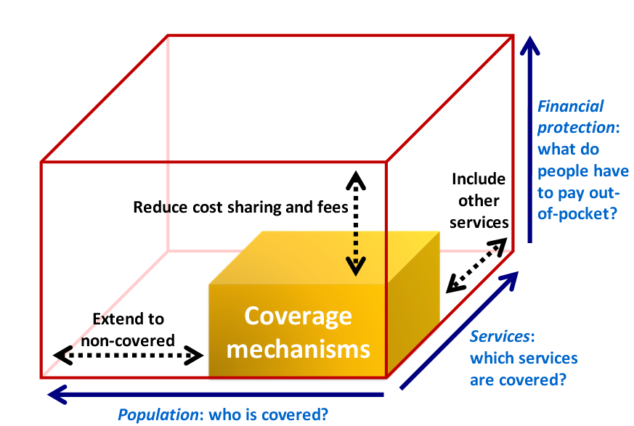
Basics: three dimensions of coverage
Who is covered?
For what services are these people covered?
How much (costs) is spent on the covered services?

Slide 8
The critical link to Purchasing
Purchasing is key policy instrument to manage costs and focus resources on priority services and/or populations
With weak purchasing (e.g. line budget purchasing), even a well-designed benefit package can become unaffordable or unrealized
Incentives to providers and to potential service users are important to steer utilization in desired direction

Slide 9
No Easy Road
Benefit package design is not easy
Need to manage pressures – social, economic and political
Establish a process, monitor extent of imbalances, and adapt over time

Slide 10
Are you aware of the benefits you are entitled to?
NO!
Assumption is that the population is entitled to health services as needed and free at the point of utilization – subject to availability
Government taking ‘all measures possible’ to provide health services – this is vague and unquantifiable

Slide 11
What can be done to improve transparency and awareness of the pop. to improve utilization of the benefits?
Through empowering people with information to know all about the packages (including appropriate incentives/disincentives).
Print flyer, posters, display package in OPD and other departments
Improving the functioning of the Hospital Board and Health Unit Management Committees.
Through public campaigns.

Slide 12
In what ways can we improve individual and community responsibility towards improvement of their own health?
Empower (authority and resources) the appropriate structures (e.g. VHTs, etc) to inspect, build capacity and enforce the by-laws.
  The team should enforce vital statistics registration, personal hygiene, immunization, one health approach (animal and human health - not staying with animals in houses).
  To leverage the actions of other sectors like agriculture to promote food security
Strengthen the community information system so that the data can be used for planning, decision making and encouraging improvements.

Slide 13
In what ways can we improve individual and community responsibility towards improvement of their own health?
Specific collective action can be encouraged in form of Community days (monthly or weekly) to improve environmental health e.g. cleaning the water sources, clearing roads, etc.
Reward and sanction measures at the home and village levels - recognize and reward good performers (clean homes, villages with good indicators, etc).

Slide 14
Thank You

