Slide 1

Universal Health Insurance Scheme for Nepal
Institutional setup and business processes
MoHP-November 25, 2013
Dr. Jiří Němec
(jirneme@volny.cz)

Slide 2
Agenda
  Phases of introduction of the universal health insurance scheme in Nepal (UHIS)
  Institutional setup for the UHIS
  Business processes for the UHIS
  Actions to be taken for the implementation of the UHIS
  Information system for the UHIS

Slide 3
Phases of introduction of the UHIS
Design phase (definition of insurance product)
  What health care is covered?
  What is cost sharing?
  What are other conditions (enrollment periods, waiting periods etc.)?
  What are contributions?
  What health care providers can be accessed?
Implementation phase
  Build insurance agency and recruit workers
  Acquire operational information system
  Identify, contract and train sales network
  Identify, contract and train health care providers
Routine phase
  Running of standardized business proccesses

Slide 4
Breakdown of the problem
remuneration and prices
What else care covered ?
(drugs, in-patient/out-patient?
benefit package
What unit of health care is remunerated?
Who pays contributions?
Are they mean s tested?
funding and contributions rates
Institutional setup and operating procedures

Slide 5
What affects the institutional setup/ business processes the most?
Enrolment/funding
Implicit enrolment
/taxed based funding
Implicit enrolment
/individual contributions
Explicit enrolment
/individual contributions
Remuneration/invoicing
No purchaser - provider split
/no invoicing
Purchaser - provider split
/aggregate invoicing
Purchaser - provider split
/individual invoicing

Slide 6





Institutional setup
Ministry of Finance
Ministry of Home Affairs
Ministry of Women,
Children and Social Welfare
Ministry of Health
and Population
others
Control Board
National Health Insurance Agency (NHIA)

Slide 7
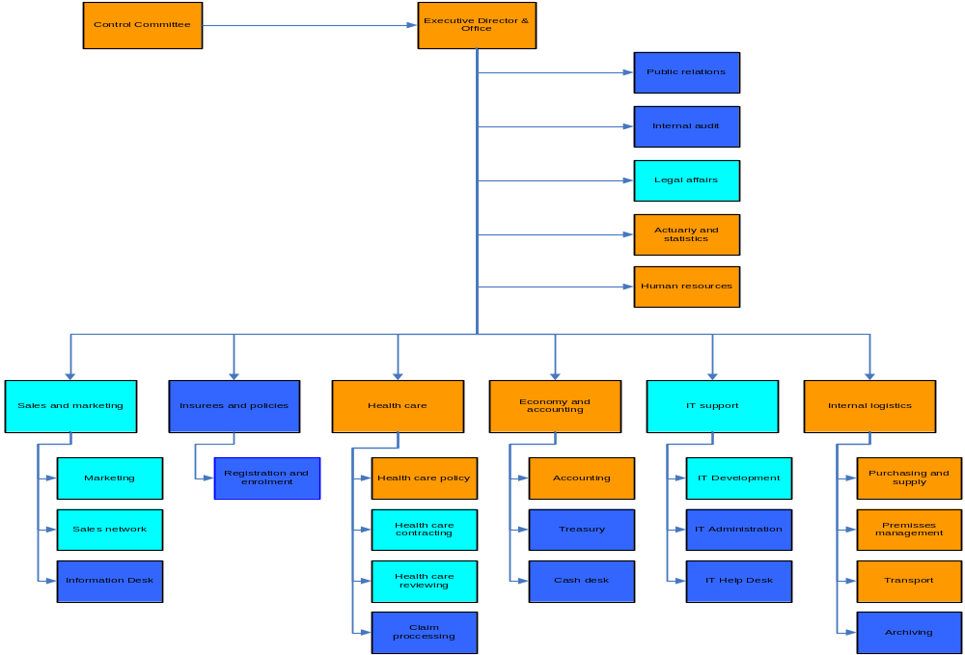
Organizational structure of the NHIA
design phase
implementation phase
routine phase

Slide 8
Description of tasks and staffing (1)
Section Actuary and Statistics
Staff: 2-3 actuaries/statisticians and 1 administrative officer
Responsibility:
gathering statistics on utilization of health care
assessment of expected impact of cost-sharing schemes
proposing of a setup of parameters of cost-sharing schemes to be used
calculation of contribution rates
elaboration of actuarial/statistical reports

Slide 9
Description of tasks and staffing (2)
Section Claims Processing
Staff: 1 + (3 per 100 000 insurees) administrative officers
Responsibility:
taking over claims from representatives of health care providers
entering claims into the information system
checking correctness of claims (usually it is done automatically by the information system)
selecting of claims for a medical review
communicating with health care providers on problems encountered
valuating of claims according to predefined rules (usually it is done automatically by the information system
handing over settled claims to the archive

Slide 10
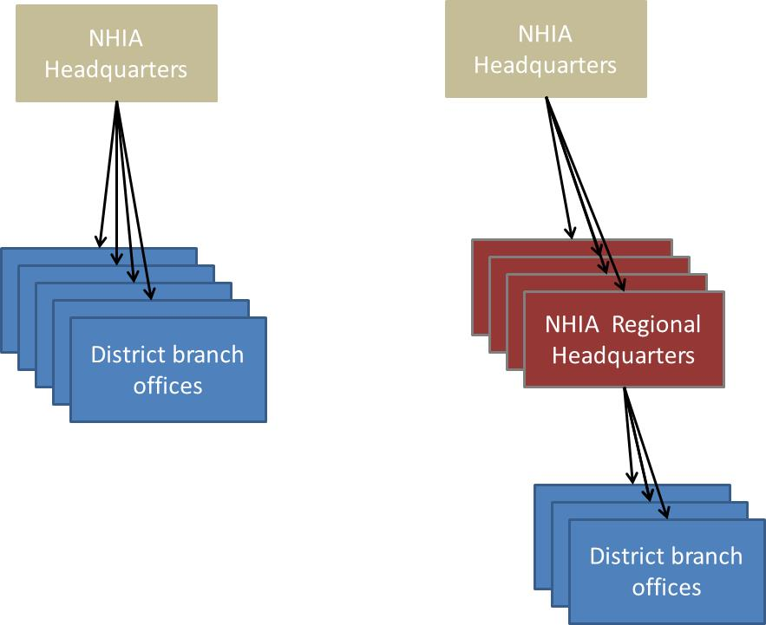
Decentralization of the NHIA (1)
-decentralization of operations of the NHIA
-decentralization of the scheme (probably not on the agenda)
two tiers organization three tiers organization

Slide 11
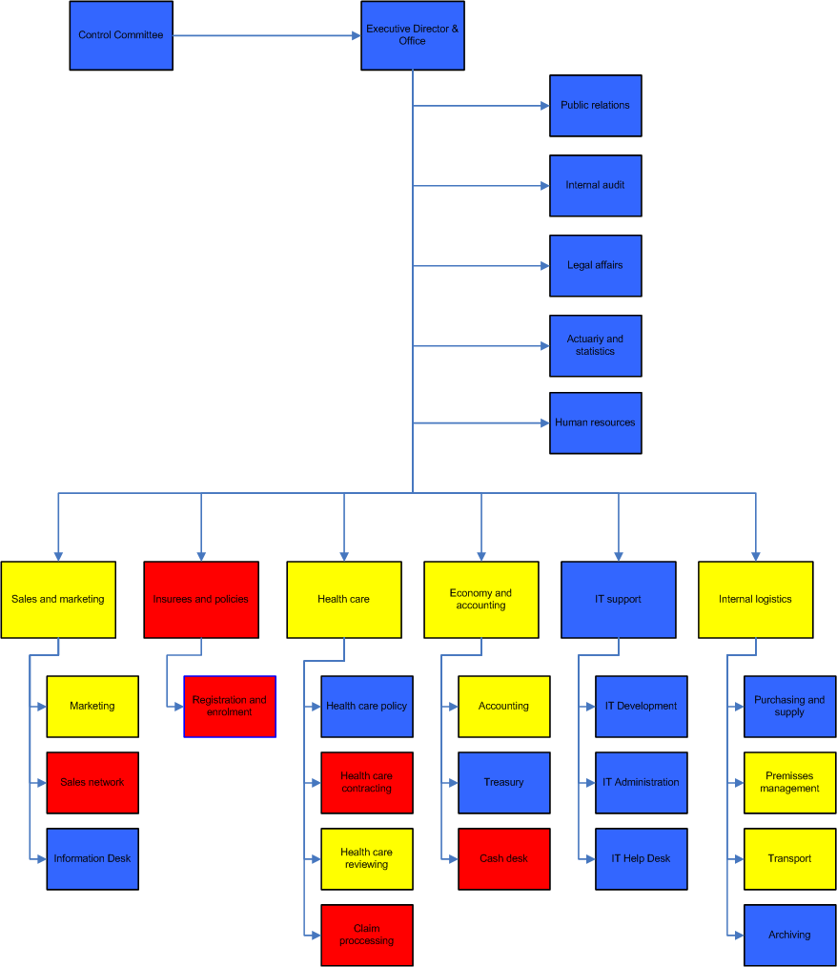
Decentralization of the NHIA (1)
only central level
both central and district
only district level

Slide 12
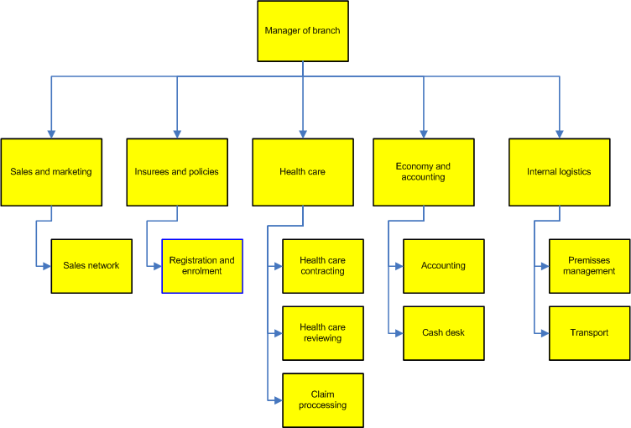
Organizational structure of a branch office

Slide 13
Structure and number of staff
 | 10,000,000 | 25,000,000
Director | 77 | 77
Public relation | 1 | 1
Internal audit | 6 | 6
Legal affairs | 7.5 | 12.5
Actuary and statistics | 4 | 4
Marketing | 4 | 4
Sales/distribution | 225 | 225
Information desk | 4 | 6
Registration and enrolment | 275 | 475
Health policy | 6 | 6
Contracting | 77 | 77
Medical reviewing | 23 | 48
Claim processing | 400 | 800
Accounting | 94 | 111
Treasury | 3 | 3
Cash desk | 75 | 75
IT development | 3 | 3
IT administration | 3 | 3
Purchasing | 3 | 3
Mangement premises | 76 | 76
Transport | 76 | 76
Archive | 3 | 5
Human resources | 12 | 18
Help desk | 3 | 4
Total | 1,461 | 2,119

Slide 14
Administration costs(1)
Assumptions made:
Average salary per a specialist 40,000 NPR monthly
Average salary per an administrative worker 20,000 NPR monthly
Average contribution rate per a household 1,500 NPR annually
Average number of members per household 5
Number of district branches 75

Slide 15
Administration costs(2)
Number of insured persons | 1,000,000 | 5,000,000 | 10,000,000 | 20,000,000 | 25,000,000
Expected revenue (NPR) | 300,000,000 | 1,500,000,000 | 3,000,000,000 | 6,000,000,000 | 7,500,000,000
Number of specialists | 117 | 126.5 | 137 | 158.5 | 171
Salaries of specialists (NPR) | 56,160,000 | 60,720,000 | 65,760,000 | 76,080,000 | 82,080,000
Number of administrative staff | 763.5 | 1012 | 1323.5 | 1947.5 | 2260.5
Salaries of admin. staff (NPR) | 183,240,000 | 242,880,000 | 317,640,000 | 467,400,000 | 542,520,000
Overhead costs (% of personnel costs) | 20.0% | 19.5% | 18.9% | 17.6% | 17.0%
Depreciated capital costs (NPR) | 6,163,500 | 7,969,500 | 10,223,500 | 14,742,000 | 17,020,500
Distribution costs (% of revenue) | 4.0% | 3.6% | 3.2% | 2.4% | 2.0%
Administration costs (% of revenue) | 101.8% | 28.4% | 18.8% | 13.3% | 12.0%

Slide 16
Administration costs(3)
number of insurees

Slide 17
Subsidization of administration costs
number of insurees

Slide 18
How to alleviate the problem with administration costs? (1)
Make the system mandatory ?
  high number of insured households guaranteed
  merging income from contributions with the contemporary public funding ensures the higher level of revenue
But
  Is there any governmental institution capable to collect money from the whole population?
  Is there any rather complete register of population?

Slide 19
How to alleviate the problem with administration costs? (2)
Don’t use individualized claiming?
but
  Individual ceilings for coverage within the health insurance scheme hardly can be used.
  There is not effective check of a correspondence between provided and invoiced health care.

Slide 20
How to alleviate the problem with administration costs? (3)
Centralize operations whenever possible
number of branches

Slide 21
How to alleviate the problem with administration costs? (4)
Streamline routine operations
  e.g. submission of claims electronically by health facilities
Use existing (and already paid) staff
  central level
  district level
Use contracted workers when it make sense

Slide 22
Business processes
Core business processes
  Enrolment and collection of contributions
  Claim processing
  Renewal of policies
  Modification of policies
Control business processes
Support business processes

Slide 23
Decisions influencing business processes
Fixed or floating period of enrolment
Grace periods
Contributions in instalments
Waiting periods
Ceilings for expenditures
Ceilings for utilization
Construction of contribution and new members of households during insurance period

Slide 24
Decisions influencing business processes
Fixed or floating period of enrolment
Grace periods
Contributions in instalments
Waiting periods
Ceilings for expenditures
Ceilings for utilization
Construction of contribution and new members of households during insurance period

Slide 25
Issue: Acquiring of insuree’s identification and coverage
Two approaches:
centralized
  ID card of an insuree contains only his/her ID number (and name, date of birth etc.)
  all info on coverage even including photo is acquired from a central information system
decentralized
  all information is at an insuree (chip card, insuree’s booklet)

Slide 26
Issue: Acquiring of insuree’s identification and coverage
Two approaches:
centralized
  ID card of an insuree contains only his/her ID number (and name, date of birth etc.)
  all info on coverage even including photo is acquired from a central information system
decentralized
  all information is at an insuree (chip card, insuree’s booklet)

Slide 27










Centralized approach
Enrolment
Central server
Data entry at the NHIA
Visit to a health facility

Slide 28


Decentralized approach
Enrolment
central server
Data entry
and personalization
of the card at the NHIA
Visit to a health facility
local computer

Slide 29
Issue: Identification number
Each insuree should have an unique identification number
  use national identification number (Nepal ?)
  use specific identification number for health insurance
    assigned by a branch office (e.g. xxxxyyyyyyy where xxxx is a code of district, yyyyyyy is an order number)
    pre-printed on an enrolment form and insurance card

Slide 30


Example: Preprinted ID on an insurance card (Tanzania)

Slide 31
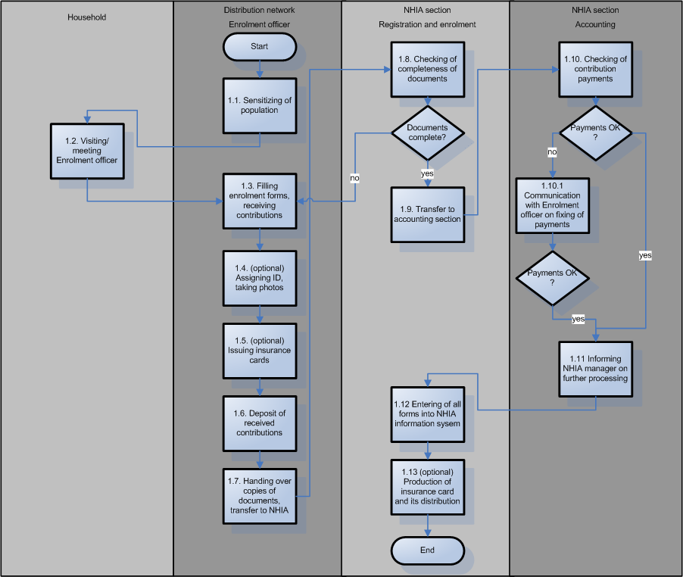
Description of business processes (enrolment)

Slide 32
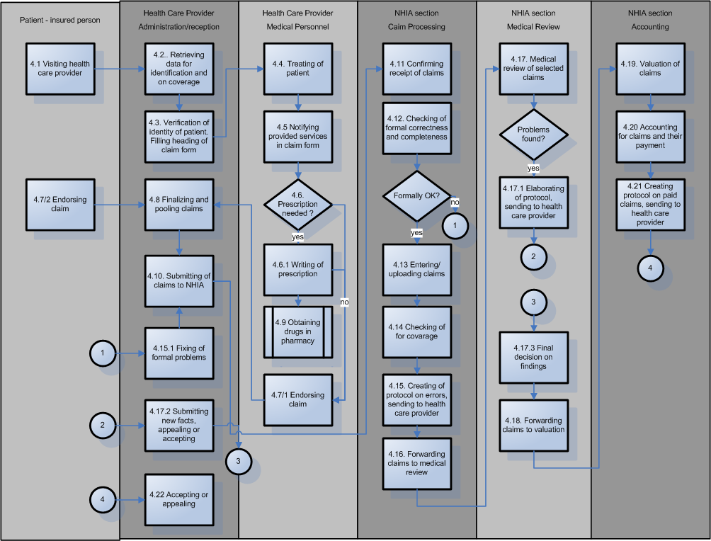
Description of business processes (claim processing)

Slide 33
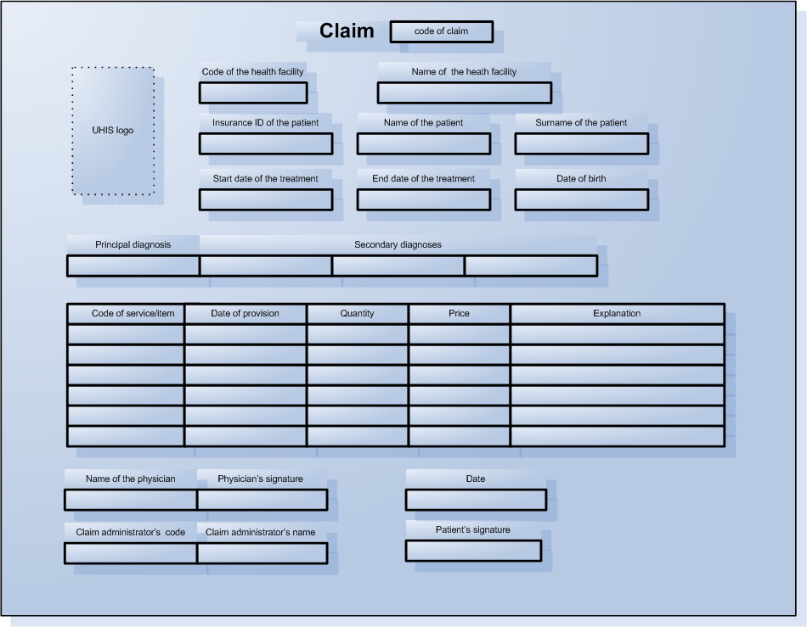
Issue: Design of claim forms
-aggregated claim forms
-individual claim forms
  -collective
  -separated

Slide 34
Actions to be taken for the implementation of the UHIS
Design of the scheme
Design of the scope of the benefit package
Design of cost-sharing scheme and
Elaboration of classifications for covered health care
Design of remuneration mechanisms and elaboration of pricelists
Calculation of contributions
Design of measures preventing adverse selection
Implementation of the scheme
Design of all forms and finalizing of operating procedures
Acquiring of an information system
Selection, contracting and training of distribution channels
Elaboration of guidelines for contracting of health care providers
Selection, contracting and training of health care providers
Purchasing and distribution of all equipment for external partners
Set-up of the full organizational structure of the NHIA
Preparation and launching of a marketing campaign

Slide 35
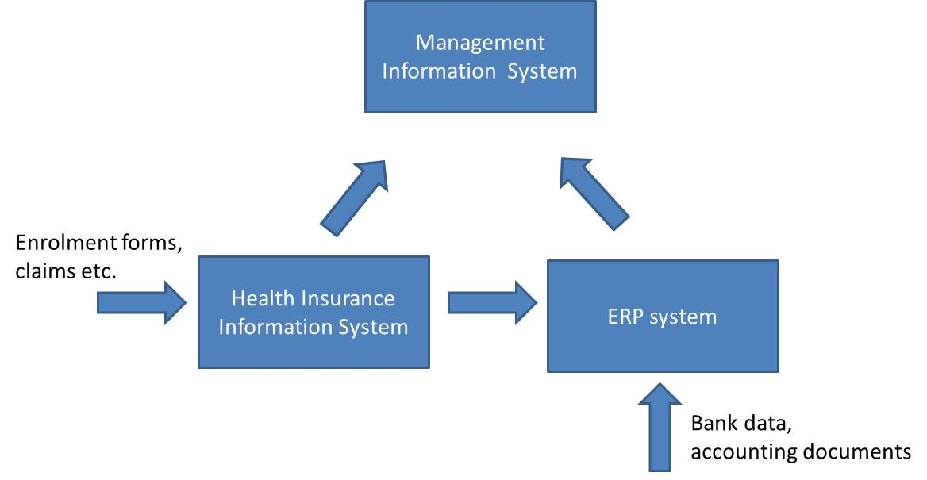
Issue: Insurance information system
Typical structure:
Health Insurance Information System can be
  developed as tailored made information system (around 500 men days)
  acquired as open source system (e.g. from Swiss Development Agency)
  Purchased ?

Slide 36
Thanks for attention

