Slide 1
Financial Risk Protection for Universal Health Coverage
- Indicators and measurements
Jahangir A. M. Khan _{PhD}
Health Economics and Financing Research Group
CEHS, icddr,b

Slide 2
Financial risk protection
No one should die and suffer because they cannot afford health care, and no one should be made poorer because they get sick.

Slide 3
Current status in Bangladesh

Slide 4
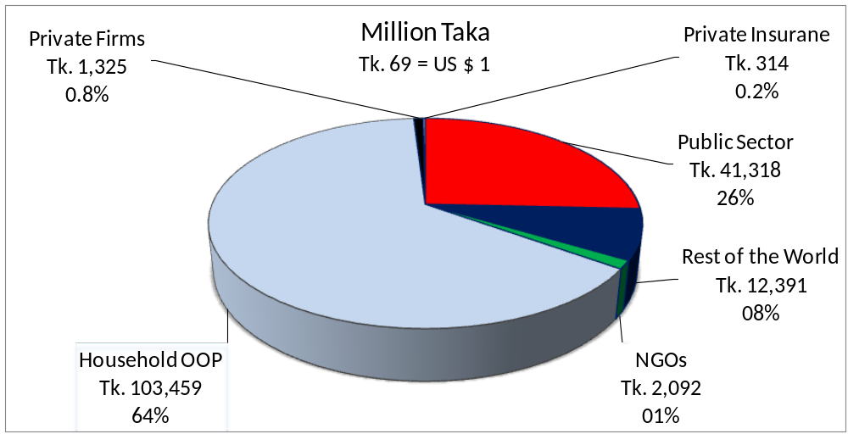
Health Financing in Bangladesh 2006 - 2007
Source: Bangladesh National Health Accounts, 2007

Slide 5
Trends in health expenditure in Bangladesh
Issues | National Reports |  |  |  |  | WHO Estimates
 | 1997 | 2000 | 2003 | 2005 | 2007 | 2008 | 2009 | 2010 | 2011
Total Health Expenditure in US$ per capita | 9.2 | 10.1 | 115 | 13.7 | 16.2 | 19.4 | 22.4 | 24.8 | 26.5
Total Health Expenditure as % of GDP | 2.7% | 2.8% | 3.0% | 3.2% | 3.4% | 3.5% | 3.7% | 3.7% | 3.7%
Mean annual growth rate in THE | - | 10% | 8% | 15% | 16% | - | - | - | -
Mean annual growth rate in GDP | - | 8% | 10% | 11% | 14% | - | - | - | -
Public expenditure on health as % of THE | 36% | 31% | 28% | 26% | 26% | 36% | 37% | 37% | 37%
Public expenditure on health as % of GDP | 1% | 1% | 1% | 1% | 1% | 1% | 1% | 1% | 1%
OOP as % of total health expenditure | 57% | 59% | 61% | 64% | 64% | 62% | 61% | 61% | 61%
NGO expenditure as % of THE | 1% | 2% | 2% | 2% | 1% | - | - | - | -
External assistance to NGOs as % of THE | 5% | 7% | 9% | 8% | 8% | - | - | - | -
Other private expenditure as % of THE | 1% | 1% | 1% | 1% | 1% | - | - | - | -

Slide 6
OOP payments for health care as a percentage of total household consumption expenditure across SES
SES |  | Bangladesh |  | India |  | Nepal |  | Sri Lanka
Poorest 20% |  | 2.94 |  | 3.30 |  | 2.44 |  | 1.64
2nd quintile |  | 3.17 |  | 4.41 |  | 2.71 |  | 1.82
3rd quintile |  | 4.55 |  | 5.23 |  | 2.90 |  | 2.00
4th quintile |  | 5.98 |  | 6.16 |  | 2.86 |  | 2.21
Richest 20% |  | 8.86 |  | 6.48 |  | 3.64 |  | 2.86
Source: Van Doorslaer et al. 2007

Slide 7
Source: Estimated

Slide 8
Coping mechanisms for healthcare expenditure, 2010
Preliminary results

Slide 9
Catastrophic health care spending and coping mechanisms in Bangladesh - An analysis of Household Income and Expenditure Survey, 2010

Slide 10
The incidence of household catastrophic expenditure¹⁾ in different socioeconomic groups of urban and rural areas
Socioeconomic Groups | Rural | Urban | Total
Poorest | 16.6% | 10.6% | 16.5%
2nd | 16.3% | 10.9% | 15.9%
3rd | 15.9% | 10.2% | 15.0%
4th | 15.8% | 10.7% | 13.8%
Richest | 16.6% | 6.8% | 9.2%
Total | 16.3% | 8.6% | 14.2%
¹⁾ OOPP share (at least 10%) of total household consumption expenditure

Slide 11
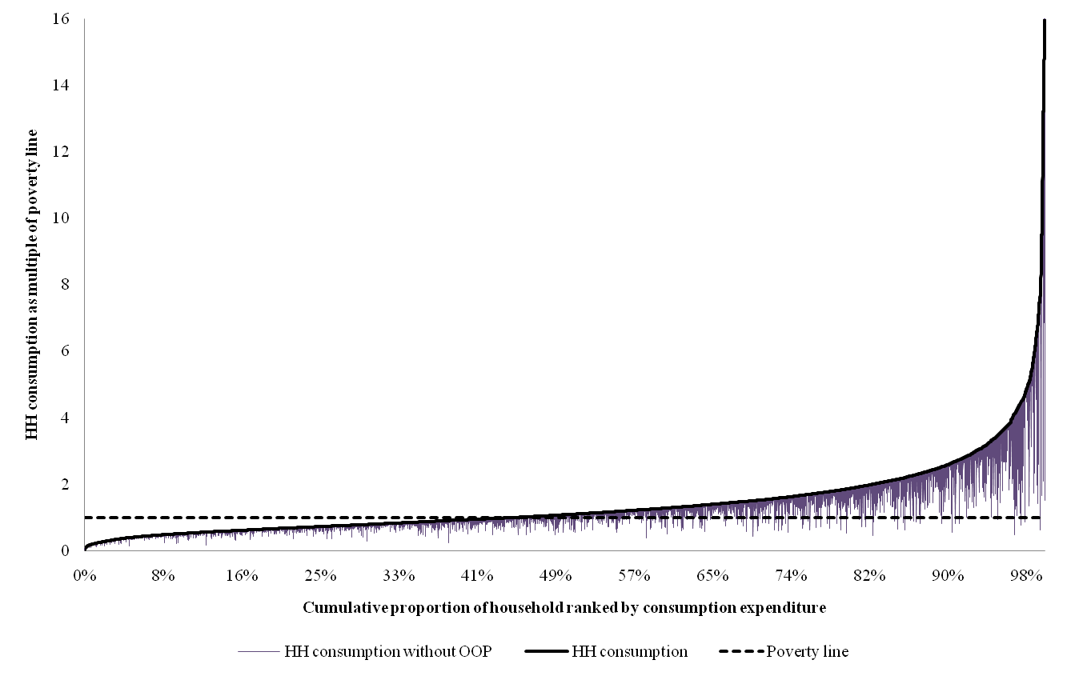
Pen’s Parade showing Impact of Healthcare Payments on Poverty

Slide 12
Remarks
Many households face catastrophic health expenditure due to OOP payments
OOP payments due to healthcare push people under poverty line
Magnitude of OOPP shows only a part of problem related to affordability and can be considered as an underestimation as
Those who did not receive any healthcare, though had illness, are not in the calculation of catastrophic payments. Thus, “No pocket” needs to be estimated based on “Unmet need of care”
Risk-pooling mechanisms should be utilized more for reducing OOPP and its consequences

Slide 13
Indicators of financial risk protection
Categories | Indicators at national level | Distributional dimensions*
Overall financing | Health expenditure per capita | Urban: Slums and non-slums AND rural reachable and hard-to-reach areas | Across socioeconomic groups
 | Health expenditure as % of GDP
Private | Private spending in health (per capita & as % of THE**)
 | OOPP for health (per capita & as % of THE)
 | OOPP for health in total household consumption expenditure
Risk pooling | Share of health spending in total government expenditure
 | Public spending in health (per capita & as % of THE)
 | Social HI contribution (per capita & as % of THE)
 | CBHI contribution (per capita & as % of THE)
 | Other health insurance (per capita & as % of THE)
Coping | Share of households (%) borrow for healthcare
 | Share of households (%) sell assets for healthcare
Economic impact | Share of households (%) facing catastrophic health spending
 | Share of population (%) fall into poverty due to OOPP
Inaccessibility | Share of population (%) lack adequate healthcare due to financial hardship
*Whenever applicable, **THE=Total health expenditure

Slide 14
Indicators of financial risk protection
Financing mechanisms and its ‘impacts‘
Indicators should include ‘level’ and ‘distributional dimensions’, like
- Level = National
- Distributional dimensions = Geographic areas, socioeconomic groups etc.
Multiple indicators required

Slide 15
THANKS

