Slide 1
Measuring and Monitoring UHC: Global framework and its application in Bangladesh
Tanvir Huda
International Centre for Diarrhoeal Disease Research, Bangladesh (ICDDR,B)
18 February, 2018

Slide 2
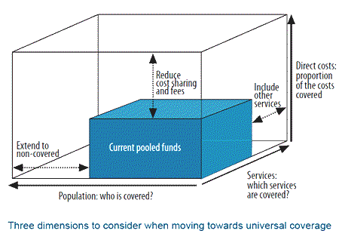
Universal Health Coverage
Financial Protection: Protect populations against impoverishment due to illnesses since most of health care is paid for out-of-pocket
Population Coverage: Expand coverage to allow equal access for all persons
Service Coverage: Define a set of essential health care services based on the priority health needs for each country
Notes:
UHC has been defined as a situation where all people who need health services (prevention, promotion, treatment, rehabilitation and palliative care) receive it, without incurring financial hardship (World Health Report 2010).

Slide 3
Guiding Principal for UHC M&E framework
Should measure essential health services coverage and financial protection coverage
Should encompass the full population inclusive of all ages and gender
Should capture all levels of the health system
Should be disaggregated by socioeconomic strata

Slide 4
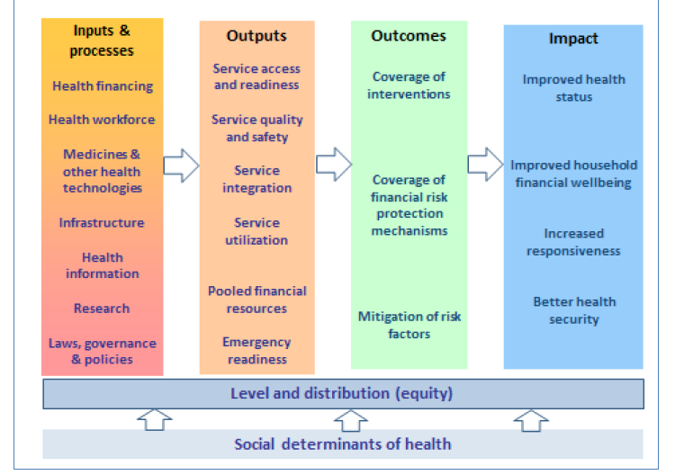
Result framework for UHC
Notes:
Using a results framework the progress monitoring of the service access component of UHC can be focused on health system inputs (such as financing or health workforce), outputs (such as service delivery and quality), outcomes (notably intervention coverage or effective coverage, as well as reductions in risk behaviours/factors), and impact on health

Slide 5
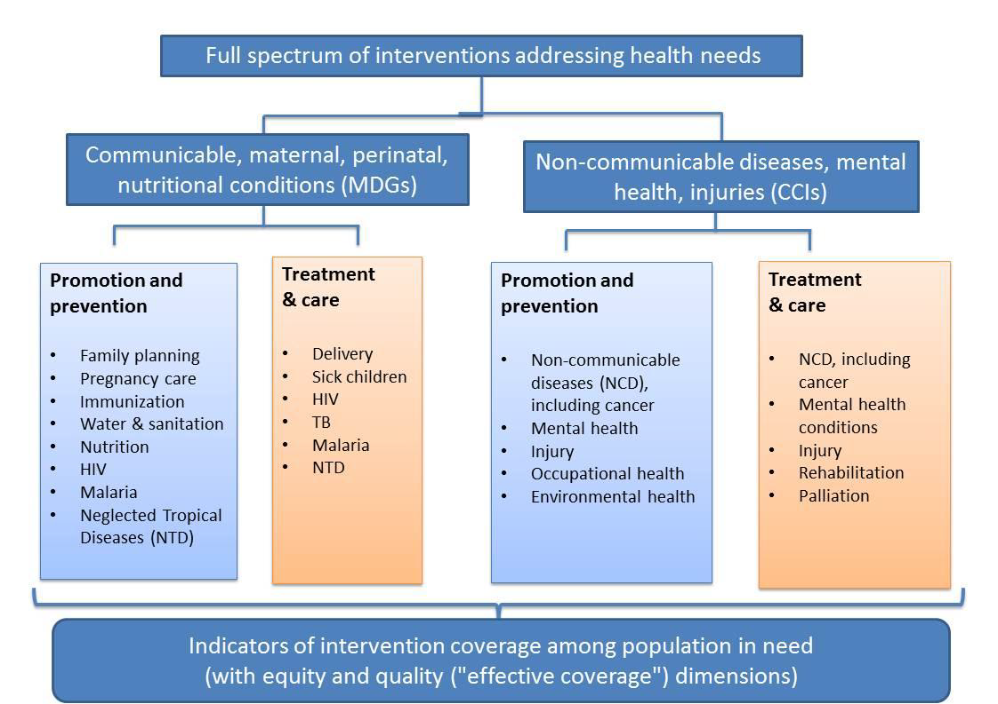
Coverage of what interventions for health needs

Slide 6
M&E framework and practices for current health sector program
Bangladesh is currently in its third sector-wide approach
  A Results Framework and 32 OP-level indicator lists are in place to monitor the implementation of the sector plan
  Program Management and Monitoring Unit along with Planning wing of MoHFW is responsible for measuring the progress of implementation of HPNSDP
Notes:
the current framework was developed through a vigorous national stakeholder consultation process and it focuses on delivering primary health care to all citizens. The current RF was also cited as one of the best examples for monitoring results. However the current RF does not address some of the key aspects

Slide 7
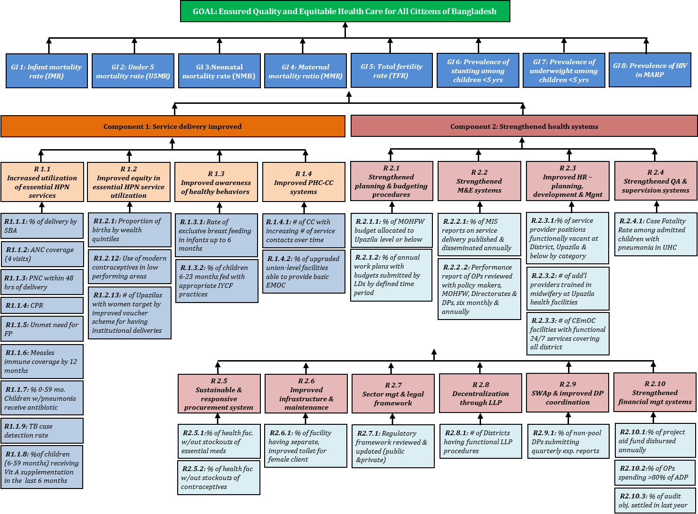
Result framework for HPNSDP

Slide 8
Result framework for HPNSDP (Output)
At the output level, current RF focuses mainly on service utilization provided at the primary level
  No indicators to measure service utilization and quality of service at other levels of care (Secondary and tertiary level)
  With introduction of prepayment schemes we expect service utilization to increase at all levels.
Notes:
At the output level there is quite a good mix of indicators on service access, quality and utilization. The Results Framework also has thirteen input or process indicators on health workforce, supply of medicines, health infrastructure, law-governance-policies and health financing.

Slide 9
Result framework for HPNSDP (Outcome)
At the outcome level HPNSDP RF suggest a strong preference for measuring primary care service coverage ( MNCH, Nutrition)
  No indicators to measure the coverage of secondary or tertiary level health care services, or services directed towards non-communicable diseases.
  No indicators to measure coverage of financial risk protection
Notes:
Thirteen indicators on maternal, child health and nutrition services.
At the outcome level the present set of indicators suggest a strong preference for measuring primary care service coverage, with thirteen indicators on maternal, child health and nutrition services (e.g. Skilled birth attendance, ANC, PNC, EBF, IYCF). Again, there are no indicators to measure the coverage of secondary or tertiary level health care services, or services directed towards non-communicable diseases. Indicators on coverage of financial risk protection are also absent.

Slide 10
Result framework for HPNSDP (Impact)
All impact level indicators are directed towards improved health status in maternal child health nutrition and family planning, except for one on HIV.
  No indicator on the health status of the adult population or financial wellbeing of the household
Notes:
The Results Framework for the current health sector programme has eight goal-level indicators or impact indicators. All of them relate to improved health status in maternal child health nutrition and family planning, except for one on HIV. No indicator on the health status of the adult population or financial wellbeing of the household is included.

Slide 11
Coverage Indicators (FP, Delivery, Maternal Health, Under-5 Illness, TB, HIV, Malaria, NTD)..current RF and OP indicators
 | Promotion /Prevention | Treatment | Equity
Family Planning | 6 | n/a | 1
Delivery and Maternal Health | 3 | 7 | 2
Under five illness | - | 6 | -
Immunization | 3 | n/a | -
Malaria | - | 1
Neglected Tropical Disease | - | 1 | -
HIV/TB | - | 1 | -
Notes:
From Result framework and OP indicators

Slide 12
Coverage Indicators (Chronic disease, disease requiring higher level intervention, Cancer, mental health, injury, occupational health, environmental health, injury, rehabilitation, palliation)
 | Promotion Prevention | Treatment | Equity
Chronic disease, disease requiring higher level intervention, Cancer | 2 | 1 | -
Mental health | - | - | -
Injury | 1 | - | -
Occupational Health | 1 | - | -
Environmental Health | - | - | -

Slide 13
Result framework for UHC
  Current RF is suitable for measuring the UHC provided few indicators are added on the missing domains
    Coverage of NCD, Injury, occupational, environment services
    Coverage of priority services provided at secondary and tertiary level,
    Overall Service quality
    Coverage of Financial protection

Slide 14
Additional Indicators for UHC..examples
At output level
  Service readiness
    Percent of facilities, by type, has facilities to screen a) hypertension and b) diabetes for adult clients
    Percent of facilities, by type, has facilities to screen cervical cancer / or undertake mamogram
  Service quality and safety
    % of deliveries in facilities ending in perinatal death
  Emergency readiness
    Percent of private hospitals/clinic having functional Emergency Ward

Slide 15
Additional Indicators examples..cont
Outcome level
  Coverage of Intervention targeting Injury
    Care within 30 mins. of traffic and non-traffic accident
  Coverage of Intervention targeting Chronic care
    Proportion of Hypertension and diabetic cases taking medication and disease under control
  Coverage of secondary and tertiary level Intervention
    % of cataract cases under gone surgery
    % of angina, arthritis, asthma,depression, diabetes, and mental illness receiving treatment
Notes:
Care within 30 mins. of traffic and non-traffic accident; Treatment of angina, arthritis, asthma, dental problems, depression, diabetes, and mental illness; Mammogram; Pap Smear; Cataract removal

Slide 16
Additional Indicators examples..cont
Impact level
  improved health status (adult population)
    Prevalence of uncontrolled Hypertension
    Prevalence of uncontrolled Diabetes
    Prevalence of Injury

Slide 17
Additional Indicators examples..cont
Equity dimension: For all service and financial coverage, it is essential to have measures disaggregated by
  income/wealth, sex, age, place of residence or any other important socioeconomic or demographic factors

Slide 18
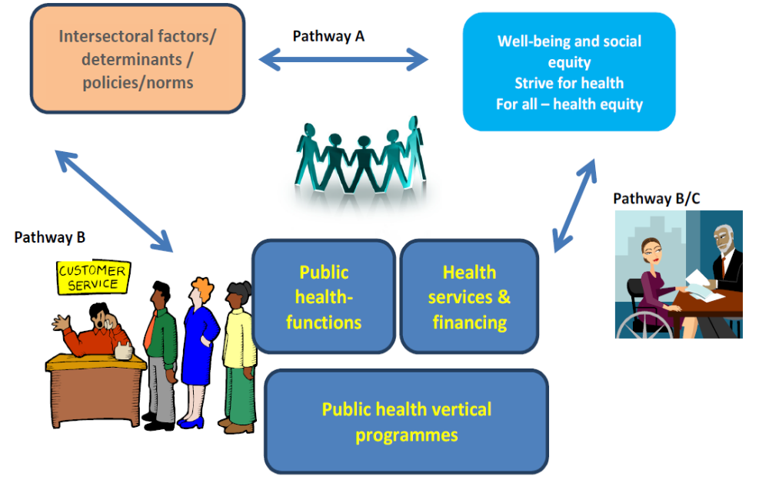
Shall we measure Factors enabling/preventing health equity

Slide 19
Can we measure UHC indicators?
Periodic household surveys in regular basis for measuring coverage of priority interventions
  Bangladesh Demographic and Health Survey (BDHS)
  Multiple Indicator Cluster Survey (MICS)
  Bangladesh Health Facility Survey (HFS)
  Bangladesh EPI Coverage Evaluation Survey (CES)
  Bangladesh maternal Mortality and Health Care Survey (BMMS)
  Utilization of Essential Service Delivery Survey (UESD)
  National Nutrition Survey
  Bangladesh Urban Health Survey (UHS)
  Non-Communicable Disease Risk Factor Survey Bangladesh
  Household Income and Expenditure Survey (HIES)
  National Health Accounts

Slide 20
Routine Information System
Increase focus and attention in recent times
Multiple initiatives are ongoing to strengthen the RHIS
  Electronic system at the sub district and district level in patient facilities
  Electronic recording of pregnancy surveillance data
  Streamlined MIS tools
Notes:
The newly designed forms and systems are currently being piloted at district, sub-district, and community levels in 3 selected sub-districts and the district hospital of Tangail.
Piloting in all sub-districts of Habiganj including the district hospital in collaboration with Save the Children (under USAID-supported District Health Systems Strengthening project) is scheduled to start on 15/09/13.

Slide 21
Conclusion and Recommendation
Current sources of information and the readiness of governmental and non-governmental institutions shows that Bangladesh is in a good position in monitoring the UHC;
However it would be necessary
  to better understand the concept of UHC
  to develop an M&E framework for UHC which should be embedded in the HPNSDP framework

Slide 22
Recommendation..contd
  A general consensus on essential packages of care (secondary and tertiary level) to be covered under UHC (based on country’s disease burden)
The service coverage indicators should be linked with the proposed service package

Slide 23
Recommendation..contd
Retain a breadth of indicators using the full range of indicators covering inputs, outputs, outcomes and impact
Must be comparable with other countries while being adapted to the Bangladesh context.

Slide 24
Recommendation..contd
Will be important to measure effective coverage (i.e., affordable good quality care) rather than nominal coverage
In terms of service coverage there must be adequate indicators both communicable and non communicable diseases as well as injuries
All coverage indicators should be disaggregated by socioeconomic and demographic stratifiers to measure equity dimensions.

Slide 25
Recommendation..contd
A balance between indicators that can be readily measured frequently using routine sources and those that can be measured from household surveys
Must capture different dimension of health financing, as progressing toward UHC will require major health financing reform

Slide 26
Recommendation..contd
The Ministry of Health through its HEU and Planning wing will immediately need to initiate and lead the process of developing UHC M&E framework
Incorporate the UHC framework in the HPNSDP result framework would be the critical success factor

Slide 27
Thank You

