Slide 1


Integrated Framework and Process Guide
A tool for examining alignment between health Financing and Public financial management systems
Dar es Salaam, Tanzania
2016

Slide 2
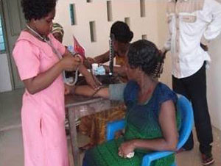
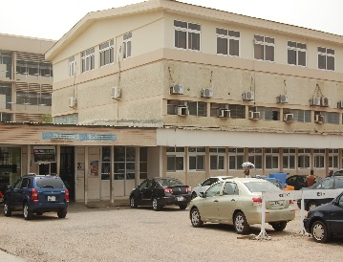
More money for health will not get a country closer to UHC if funds cannot be directed to priority populations, programs, and services
Health Spending in Ghana
44%
16%
40%
Total Health Expenditure:
National
Health
Insurance
Scheme
Ministry of Health Budget
Out-of-Pocket
Uninsured
Inputs
Other services and medicines
Services and medicines in the NHIS benefits package
Source: Schieber, Cashin and Saleh (2012).
Notes:
More funding for health and UHC alone will not achieve sector objectives. There is a need to be able to direct the money to priorities.
But more resources will not help achieve goals if they cannot be efficiently directed to priority populations, programs and services.
Purchasing misalignment example: because of the line item budget rigidities most funds in Ghana go to support infrastructure rather than directed at services
Main Message: Money has to be able to be pooled so can move money to where it is needed most and improve equity. It also means being able to get money to the front line providers in a way that can be used to deliver priority services and interventions in the most effective way and creates incentives for quality and efficiency.

Slide 3
Health Financing policy and PFM systems have the same ultimate goal
PFM System
Health Financing System
Budget Formulation
Generation of Health Revenue
Accountability
Efficiency
Equity
Budget Execution
Pooling of Health Funds
Service Delivery
Budget Monitoring and Reporting
Purchasing of Health Services
Improved Population Health
Notes:
This goal is to ensure that public funds are used efficiently and effectively to deliver public services and commodities to the population entitled to them. In health, this means that funds are spent efficiently and equitably, and ultimately used to purchase quality interventions that generate good health outcomes for populations.

Slide 4
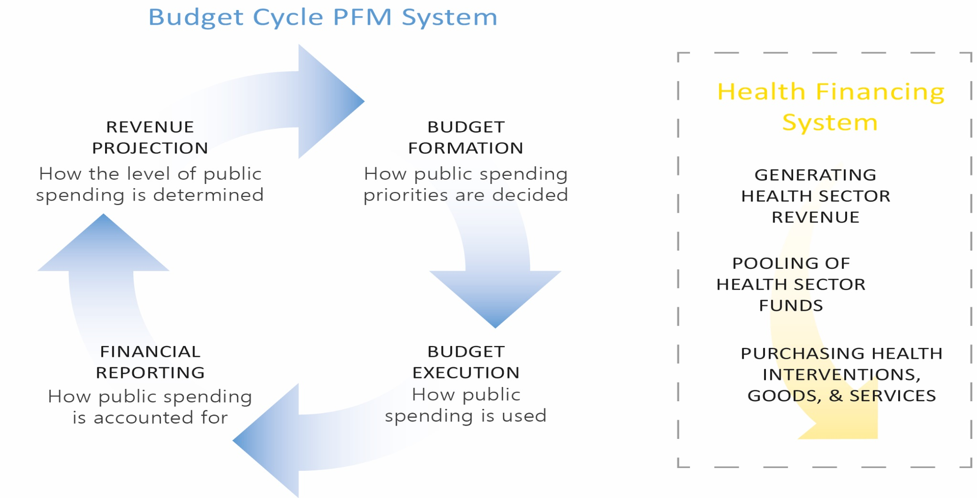
The rules and systems governing the management of public funds can often be at odds with how health financing systems function.
Notes:
While public financial management (PFM) systems provide a standard set of rules that must be broad enough to govern the entire public sector; the health sector has often evolved its own mechanisms to deal with fragmented and unpredictable funding sources, equity issues and unpredictable population needs, and historical line item budgets that limit incentives. The sector has its own planning cycles that may or may not align to budget requests, and requirements for flexible and predictable funding at the front line that can buy services instead of pay for buildings and staff.
As a result of lack of dialogue, the public finance system often lacks visibility into health needs and is thus not well equipped to deal with these unique issues. In turn, the health financing system may not be maximizing what flexibilities do exist as a result of a similar lack of understanding
For instance, in Mongolia a Provider payment assessment review revealed that while providers were still being paid based on line item budgets, that the new budget law theoretically allowed for using more flexible forms of provider payment, even though they were not yet being implemented.

Slide 5
Areas for improving alignment between health financing functions and PFM: REVENUE COLLECTION
Financing Function
Implementation Conditions
PFM Functions
PFM Challenges
Revenue collection
Sufficient and stable resources to meet stated objectives
Revenue forecasting
Budget formulation
Unpredictable resource envelopes
Budget classification by inputs rather than objectives, activities, and outputs
Budget allocations separate from objectives and planning

Slide 6
Areas for improving alignment between health financing functions and PFM: POOLING
Financing Function
Implementation Conditions
PFM Functions
PFM Challenges
Pooling
Mandate and mechanism to accumulate and redistribute funds
Budget formulation
Fiscal decentralization
Fragmented revenue streams, input budgets, donor funds
With no mandate or mechanism to accumulate and redistribute

Slide 7
Distribution of government health spending under fiscal decentralization in Tajikistan
Per capita government health spending across regions (2007)
Source: Langenbrunner, Cashin and O’Dougherty (2009).
Notes:
Distribution of government health spending under fiscal decentralization in Tajikistan
Pooling misalignment example: Tajikistan fiscal decentralization with no mandate or effective mechanism to reallocate health funds led to fragmented, highly inequitable pools across regions
Inequity in service utilization can stem in part from inequity in resource allocation—both financial and service supply (buildings and health workers), which are of course relate
When government revenue generation is decentralized, the distribution of resources is highly linked to the ability to raise revenue at the local level
In Tajikistan per capita spending in the highest spending region was almost 5 times the per capita spending in the lowest spending region. We do not have data on service need and utilization, but it is difficult to imagine that it could have been equitable

Slide 8
Areas for improving alignment between health financing functions and PFM: PURCHASING
Health Financing Function
Implementation Conditions
PFM Functions
PFM Challenges
Purchasing
Mandate to purchase services for the population (benefits package, essential services, etc.) rather than infrastructure
Budget classification
Budget formulation
Difficult to match health spending to needs and priorities
Different purchasing arrangements and accounting for different revenue streams
Challenges to engagement with the private sector
Delays in the release of funds
Lack of provider autonomy
Poor information systems and monitoring capacity

Slide 9
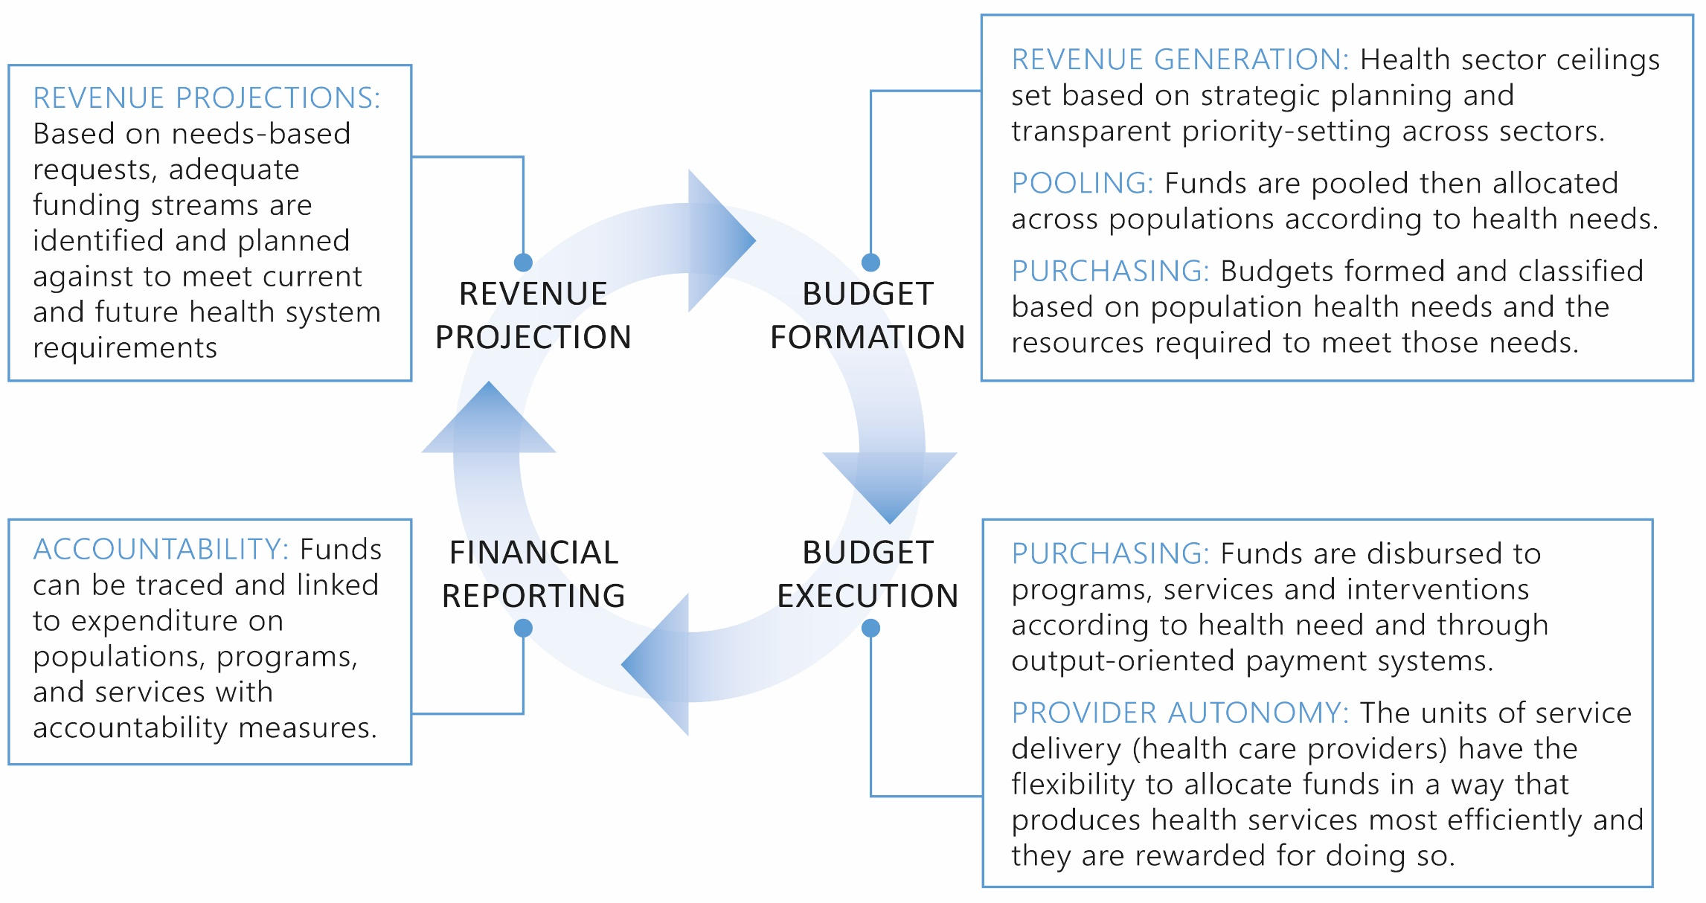
What is good alignment between the PFM system & health financing policy?
Notes:
When aligned, PFM rules can positively affect health financing in the level and allocation of public funding (budget preparation), the effectiveness of spending (budget execution) and the flexibility in which funds can be used (pooling, sub-national PFM arrangements, and purchasing).
Rules and regulations can be effectively leveraged for health outcomes, and so that resources, incentives, pooling functions, and systems are aligned to get the most flexible funding to providers, so that they can provide services to populations that are in line with UHC and population health objectives

Slide 10
MOH and MOF Joint Process to Improve Communication
The over-arching questions to be answered through the Process Guide are:
Process Guide contains Package of resources
  Do budgeting processes and PFM systems make it possible to:
ENSURE SUSTAINABILITY - Allocate sufficient funds to the health sector to meet sector objectives and fulfill strategic plans given the macro-fiscal realities of the country
ENSURE EFFICIENCY - Direct funds to priority populations, programs, and services at every step of the budget cycle (through pooling and purchasing arrangements)
ENSURE ACCOUNTABILITY - Demonstrate that public spending on health reached priority populations, programs, and services and met stated objectives in the budget reporting and accountability systems
A FRAMEWORK
A SET OF BENCHMARKS for looking at alignment in different parts of the PFM system
SAMPLE QUESTIONS
Notes:
The guide can help to identify issues and create a space for dialogue to occur, so that PFM and health financing systems can work to achieve their mutual goals, and get the funds where they need to go!!

Slide 11
General purpose of this Process Guide
To help guide a systematic dialogue between health and finance actors (MOH and MOF) to do three things:
1
2
2
3
3
To EXAMINE areas of misalignment and their consequences and PRIORITIZE among them for action
To create a COLLABORATIVE ROADMAP for action that will allow countries to strengthen alignment
For countries to be able to MONITOR PROGRESS on improving alignment
Notes:
General purpose of this work is to help guide a constructive dialogue between health and finance actors to do three things: 1) gain a better understanding of the health and financing environment in a country and resulting bottlenecks, 2) to create a collaborative roadmap for action that will allow countries to strengthen alignment 3) to have a lasting and constructive impact on dialogue between health and finance officials
The guide can be an important entry point to demonstrate where underlying issues exist before implementing system changes that might impact the health financing or public financial management system and require them to work in tandem.
What we have found in all three countries where they have expressed interest in this diagnostic guide – is that they are articulating some health sector strategies or reform directions around universal health coverage and recognizing at a fairly early stage that there is a parallel process happening in Finance that may or may not be in alignment
For example, in Myanmar they want to get money to front line providers to deliver their essential benefits package but there are a lot of bottlenecks and the money is not getting to where it needs to go -- and they want to understand why

Slide 12
A closer Look: Descriptive Table - Allocation Within the Health Sector
Characteristic of the Budget Formulation Process | Current Situation | Key Bottlenecks
Basis of budgets within the health sector
Integration/fragmentation in the health budget
Allocation of health budgets across geographic, administrative and service delivery levels

Slide 13
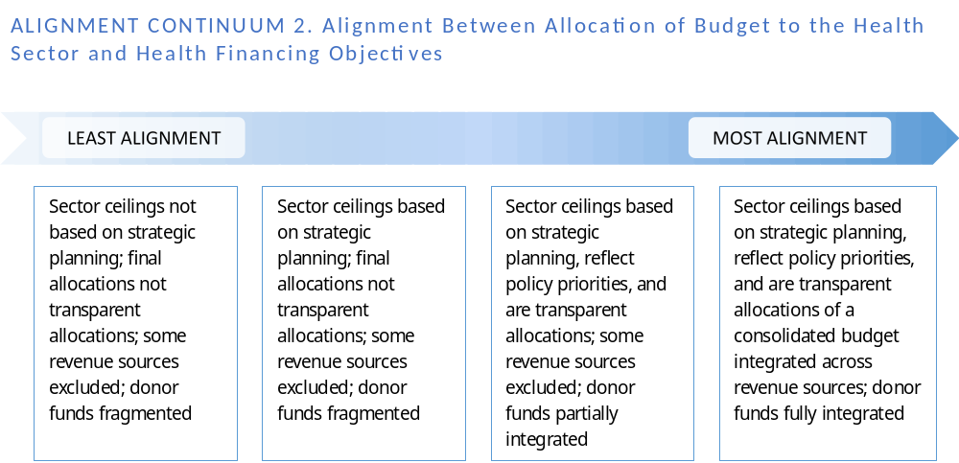
Assessment: Placing alignment along a continuum
Alignment Between Allocation of Budget to the Health Sector and Health Financing Objectives
Notes:
Another that allows you to place your country on a continuum of alignment

Slide 14
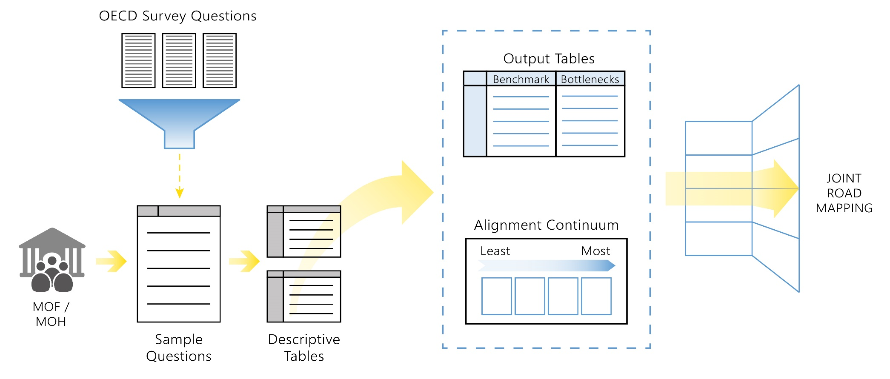
What we have learned through initiating the process in countries
      We have gotten to A HIGHER LEVEL OF UNDERSTANDING of what dialogue between health and finance means
      There is a demand for RESOURCES for MOH to become more prepared for the dialogue with finance
DIALOGUE
      There is a need for some sort of a FRAMING or FOCAL POINT for the dialogue itself, and something systematic you can do with the information to inform the way forward
Notes:
So we need to serve a couple of purposes with this process guide, we need to first get the dialogue going. we need to get the health sector informed on the issues they need to be looking at on the Finance and PFM side, and to actually address some of the bottlenecks, so we need to know what they are which ones are the most severe/highest priority
What we are also finding, is that we anticipated this would be a liner process where both sides comes to the table and discuss these issues and decide how they would want to use the guide in their particular context. And in fact, we are sensing that the health sector wants another step before that - to bring themselves up to speed in their understanding of these issues and knowledge and just vocabulary even, before they can feel comfortable entering into a dialogue with the MOF – This is an extra purpose this guide is serving.
We imagined this differently as we were pulling this together and as we have started working with the countries we realize this is not a linear process – We work through this whole guide following the steps in the budget cycle as it is conceptualized and it is there on paper in that way so it makes sense but the countries are picking and choosing and looking at it as a package of resources
Last point– we don’t have experience in that yet, we have not gotten that far in any of the countries, but our indication at least from Myanmar is having the benchmarks and placing countries in whatever process they are using ( right now it is in the internal phase of the health sector in Myanmar) putting themselves on the alignment continuum in these areas is helping them to prioritize where they really need to focus in making things better, where things are on the extreme of alignment, so it is helping to prioritize – just a way to guide people towards where they might have the biggest impact in making improvement
We have some indication already from what is coming out of Myanmar – that this could be helpful although it is to early in the process to say.
We have gotten to a newer level of understanding what dialogue between health and finance means – hearing that the Ministry of Health wants to be prepared for the dialogue and this process guide is helping them becoming informed on the issues and provides a framework for them to understand the issues – even before the dialogue can begin. Its way to build the confidence of the health sector to build the dialogue, where is it is lacking
Framework that links to the conceptual thinking on the topic but with very concrete issues to look at based on what we know are the common bottlenecks - leaving it open and adaptable for bottlenecks we can’t conceive of. A basked of resources for countries to gather around and dialogue on. And this idea of benchmarks and continuums to help prioritize issues that need to be at the heart of the dialogue to develop clear steps for improvement.
These are what have emerged from the little experience we have working with countries. Part of our hope for this meeting is to get more feedback on the approach, the benchmarks – especially from the countries who encounter this as a daily issue.
We are hitting on something we think is resonating, but it is to early to tell for sure – However, there certainly is a need for a framework and resources for MOH to become more educated for the dialogue, there is a need for some sort of a framing or focal point for the dialogue itself, and something systematic you can do with the information and what is happening in your country to inform the way forward – and that is what we are trying to provide

Slide 15
How can this align with existing processes in Tanzania?
Synergies to existing health financing activities around the Health Financing Strategy and Single National Health Insurance
  To help identify preliminary implementation steps/preconditions that have to do with PFM to enable moving towards Single national HI (i.e. purchasing)
  Building on results and recommendations of existing studies, such as funding flows study
Potential opportunity to integrate Process Guide to PFM working group that is forming, which could be a good entry point to eventually bringing the MOF and others to the table
  In the interim, this can continue to be housed with the HF TWG
Putting MOF/MOH in the position to co-drive the process and build a platform for ongoing collaboration

